Slide 1
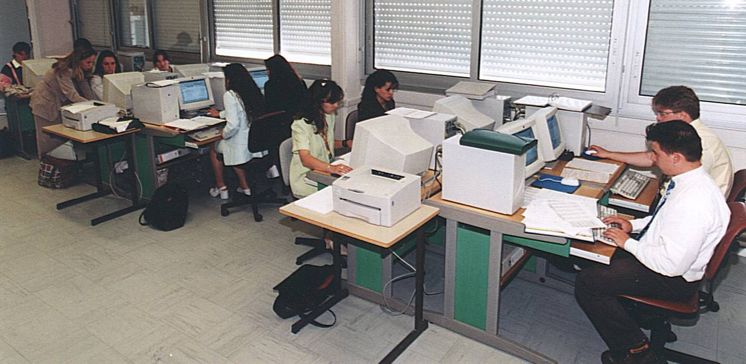
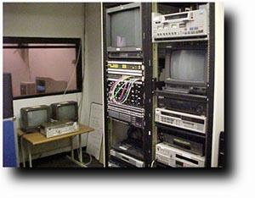
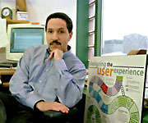
Human-Centered Software Engineering: DESIGNING FOR AND WITH HUMANS
Canadian Undergraduate Software Engineering Conference
March 7-9, 2002, Montreal, Canada
Ahmed Seffah
Department of Computer Science
seffah@cs.concordia.ca
http://hci.concordia.ca

Slide 2
Outlines
Designing for People and Usability
Is Usability a Good Business for Software Engineers?
How Usability can be Engineered?
Concordia Research Chair on Human-Centered Software Engineering
Conclusion

Slide 3
Designing for people!
Is the software system easy to use (usability) and easy to learn (learnability)?
Usability is the extent to which, a product can be used by a specified set of users to achieve specified goals with effectiveness, efficiency and satisfaction in a certain context of work [ISO 9241-11 standard]

Slide 4

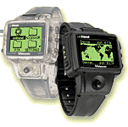
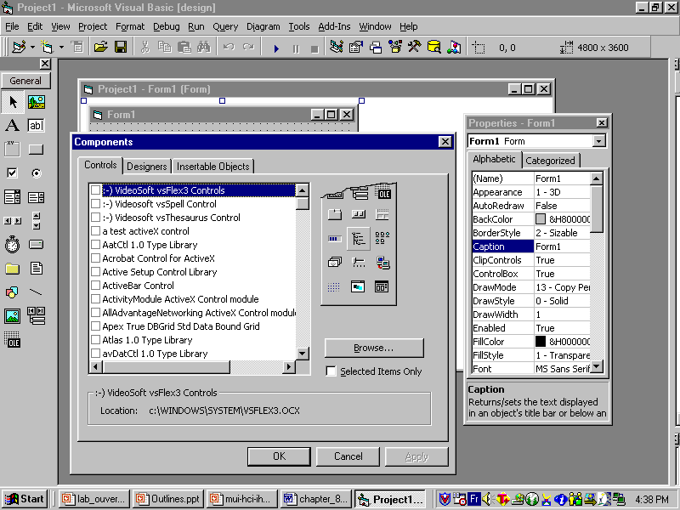
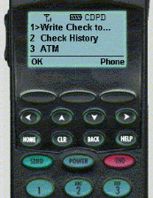
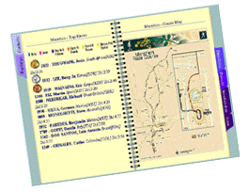

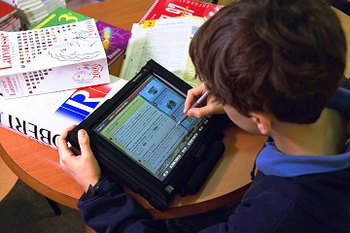
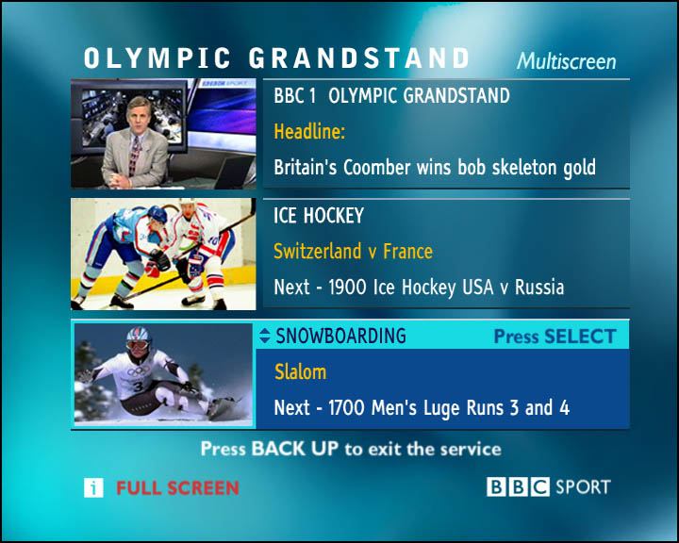
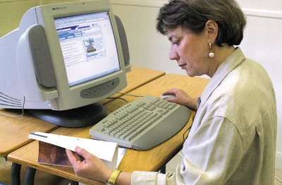
Usability of what?
Computing Variety
BlazerJet
CardPC, GPS, GSM 'phone, a novel Pinger receiver and both the audio interface and a Jornada 420 palmtop.
Wearable Computing
Multiple User Interface for Universal Accessibility
e.Book
Mobile Computing
Small Narrow UI
GUI
Web UI
Realthing UI
UI
Style
Handheld Computing
Stationary Office
Computers

Slide 5
Is usability a good business for software engineers?
User
  User satisfaction, productivity, performance, safety
Company
  Sales and competitiveness
  Development, maintenance and user support costs and time

Slide 6
Is usability a good business for software engineers?
American Express Customer Service
Integrating a task-oriented wizard in an existing system
Conclusions after usability tests
  Training period – 12h > 2h
  Productivity – 17 > 4 minutes/request
  Errors rate – 20 > 2%
AT&T saved $2,500,000 in training expenses as a result of usability improvement

Slide 7
The rule of thumb
For each dollar a company invests in developing the usability of a product, the company receives $10-$100 in benefits (Karat, 1995)

Slide 8
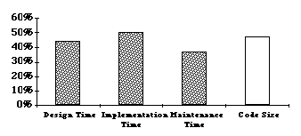
Is usability a good business for software engineers?
47-60% of the code is devoted to the user interface
50% of the development time is spent on the user interface [MacIntyre et al, 1990; Mayer, 1995]

Slide 9
Is usability a good business for software engineers?
Maintenance cost represents 80% of total software development costs
  80% related to problems of user with the system; not technical bugs (Boehm, 1991; Pressman, 1992; Martin, 1993)
    64% are related to usability problems (Laundauer, 1995)

Slide 10
What is wrong in software engineering?
Project Success Factors % of Responses
1. User Involvement 15.9%
2. Executive Management Support 13.9%
3. Clear Statement of Requirements 13.0%
4. Proper Planning 9.6%
5. Realistic Expectations 8.2%
6. Smaller Project Milestones 7.7%
7. Competent Staff 7.2%
8. Ownership 5.3%
9. Clear Vision & Objectives 2.9%
10. Hard-Working, Focused Staff 2.4%
Other 13.9%

Slide 11
What is wrong in software engineering?
Project Challenged Factors % of Responses
1. Lack of User Input 12.8%
2. Incomplete Requirements 12.3%
3. Changing Requirements & Specifications 11.8%
4. Lack of Executive Support 7.5%
5. Technology Incompetence 7.0%
6. Lack of Resources 6.4%
7. Unrealistic Expectations 5.9%
8. Unclear Objectives 5.3%
9. Unrealistic Time Frames 4.3%
10. New Technology 3.7%
Other 23.0%

Slide 12
What is wrong In software engineering?
Project Fail Factors % of Responses
1. Incomplete Requirements 13.1%
2. Lack of User Involvement 12.4%
3. Lack of Resources 10.6%
4. Unrealistic Expectations 9.9%
5. Lack of Executive Support 9.3%
6. Changing Requirements 8.7%
7. Lack of Planning 8.1%
8. Didn't Need It Any Longer 7.5%
9. Lack of IT Management 6.2%
10. Technology Illiteracy 4.3%
Other 9.9%

Slide 13
Involving user is key issue
Ensures that the product is being designed so that users will be satisfied
  User involvement is one of 12 best influences on software engineering [IEEE Software, January 2000]

Slide 14
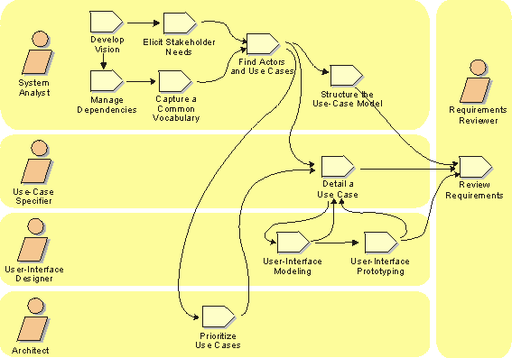
User in software development lifecycle

Slide 15

How usability can be engineered?
Peanut Butter Theory of Usability
Product Orientation
UI Metaphors
User Documentation
Adaptable and adaptive UI
[Seffah-97, 98]
Training Resources [Seffah-93]
Context-Sensitive User Interface
Help and Performance Support Systems [Seffah-90]
Process Orientation
Guidelines and Patterns [Seffah-01]
User-Centered Design [Norman-86]
Task Model-Oriented Development [Forbrig, 01; Seffah, 02]

Slide 16
Moving to Human-Centered Software Development
Traditional software development
Technology/developer-driven
Component focus
Individual contribution
Focus on internal architecture
Quality measured by product defects and performance (system quality)
Implementation prior to human validation
Solutions are directed by functional requirements
Versus
Human-centered development
User-driven
Solution focus
Multidisciplinary teamwork including users, customers, human factors experts
Focus on external attributes (look and fell, interaction)
Quality defined by user satisfaction and performance (quality in use)
Implementation of user-validated solution only
Understanding the context of use (user, task, work environment)

Slide 17
How usability can be engineered?
All the aspects that affect software usability should evolve in parallel
  user interface
  help system
  training plan and resources
  user documentation
  technical support
  installation and configuration procedures
They should be under one management process

Slide 18
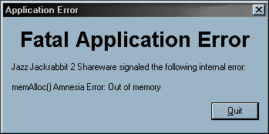
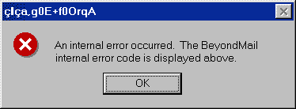
A fallacious Dichotomy
Intimate cause/effect relationship between the internal software attributes and usability
E.g. If a system must provide continuous feedback, the developer should consider this when designing time-consuming system functionalities

Slide 19
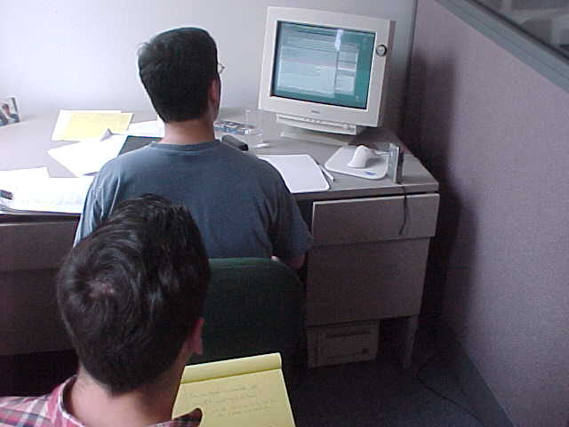
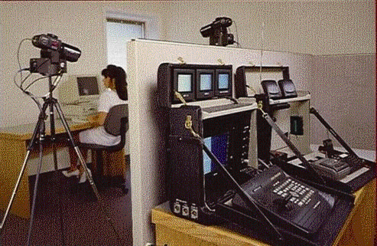
How Usability can be Engineered?
Observing and quantifying the user behavior and feedback

Slide 20
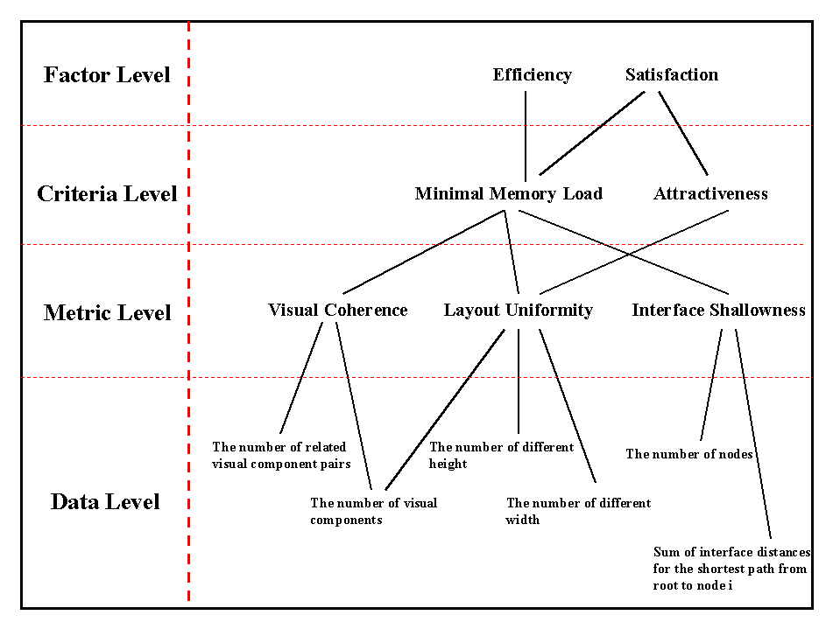
Measurable attributes

Slide 21
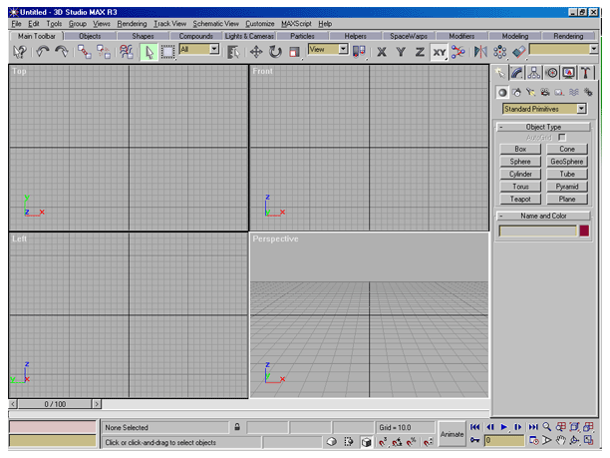
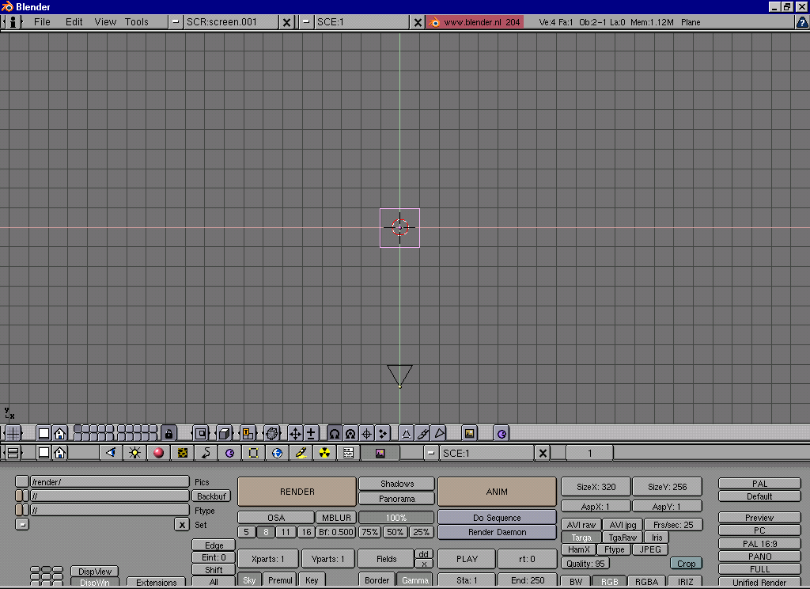
Layout uniformity or how well visual components are arranged
Blender
LU = 81%
3DStudioMax
LU = 63%

Slide 22
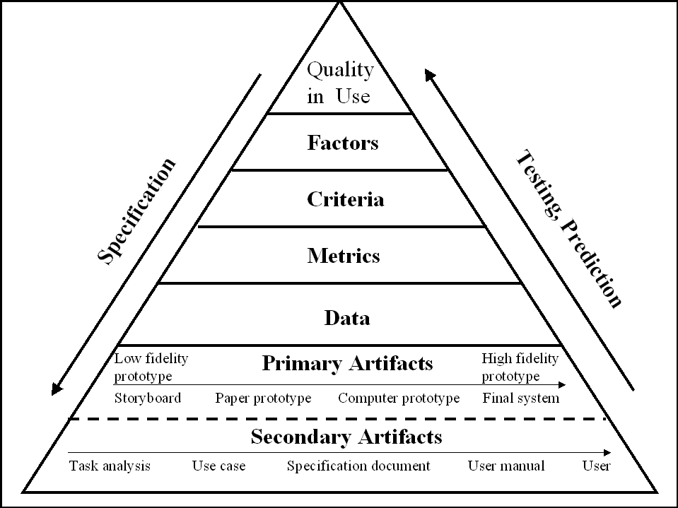
QUIM project: integrated map for usability measurement
Methods and Process

Slide 23
How usability can be engineered?
Gathering and disseminating user experiences and best design practices
  Design guidelines and heuristics
  Usability patterns
    UPADE Project
    MOUDIL

Slide 24
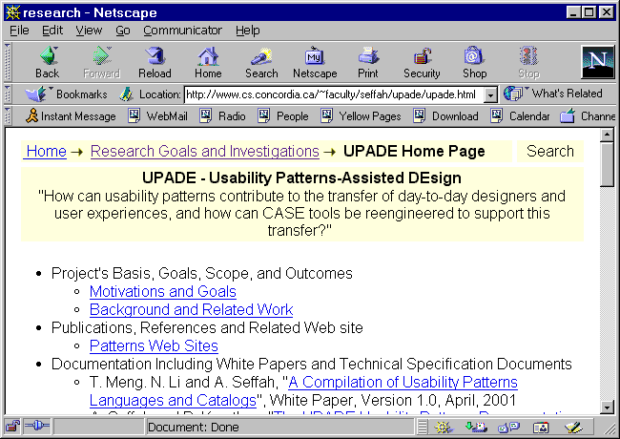
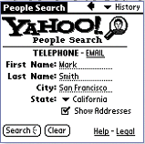
Convenient Toolbar Pattern

Slide 25
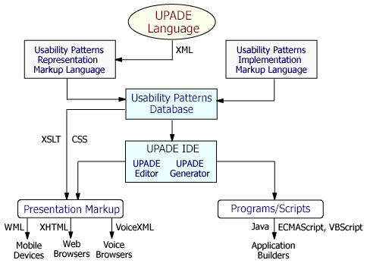
UPADE project: usability patterns-oriented designs
MOUDIL – Online Digital Library for Gathering and Disseminating Word Wide

Slide 26
How usability can be engineered?
The most fundamental principle: Early involvement of users and a strong commitment to usability and user requirements
  Who are the future users?
  What kind of tasks they need to accomplish?
  In which environment the software will be used?

Slide 27
More Investigations
User experience (Usability, User, Usage) is just one point!!!
CASE tools are hard to master and learn
  Initial training (Seffah, 99), transition to new features and versions (Seffah, 98),
Programmer experience (Programmer, Implementation, Learnability)
  Human-centric CASE tools (Rilling and Seffah, 02)
Maintainer experience (Programmer, Maintenance, Understandability)

Slide 28
Merci ! Thank you!
Ahmed Seffah
Yes, usability (sorry, quality in use, human experiences) is an excellent business for software engineers
Yes, human experiences can be engineered
How, it takes a multidisciplinary team for observing human, analyzing their experiences and based on these experiences we - software engineers – can build more human-centered software technology
Visit our Website to know more hci.cs.concordia.ca

