Slide 1

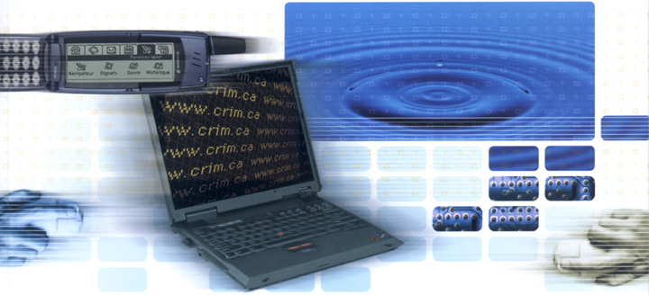
Inspections :
A Flexible Method to Increase Software Quality
By Sylvie Trudel
CRIM
sylvie.trudel@crim.ca
CUSEC, Concordia University
March 2002

Slide 2
Presentation Objectives
Provide a level of awareness on inspection practices in the software industry
Demonstrate flexibilty in a formal technical review method

Slide 3
Agenda
History
Why Inspect ?
Inspection Objectives
Inspection Method
Quality Assurance And Managers Role
Return On Investment
Leverage and Barriers

Slide 4
History
Created in the late 60’s (IBM)
Published by Fagan in the 70’s
Many methods developed over the last 10 years :
  We will show an adaptation of Tom Gilb and Dorothy Graham’s work
  Deployed and optimized over 2000 software inspections

Slide 5
Why Inspect ?
Quality : Find and correct defects
Productivity : reduce time-to-market
Efficiency : Correct defects at their point of origin
Cost :
  up to 1,000 times cheaper to correct an error during analysis than during test
  up to 40,000 times if the defect is correct before deployment!

Slide 6
Inspection Objectives
Find and fix defects
Help the developer
Reduce time-to-market
Alleviate the « downstream » effect of defects
Train team members (knowledge transfer)
Process improvement
And many more!

Slide 7
Inspection Is Not...
Design Optimization
Quality of design approval
Level of ambition approval
A discussion forum
A bureaucratic routine!
IT IS:
  Inner consistency checking of all related documents, by peers
  Verifying against defined best practices (rules, checklists)
  Only done if measurably profitable

Slide 8
Inspection Context
Entry/Exit
Criteria
Roles
Rules
Checklists
Author
Inspection
Form
Product
considered
ready to inspect
Inspection Process (documented)
1. Plan
2. Open
3. Inspect
4. Explain
5. Edit
6. Verify
7. Close
Inspection
Database
Sources
(Physical,
electronic,
or references)
Process
Improvement
Suggestions
Re-inspection required
Defects
Noted
Inspection Leader
Trained Inspectors

Slide 9
Inspection Process : Detailed View
Sources
Entry/Exit
Criteria
Product
considered ready
to inspect
Author
1. Plan the Inspection
Inspection
Form
Not Ready
Ready
Roles
2. Open the inspection
Rules
3. Inspect the product
Product
(Defects noted)
Checklists
Process
Improvement
Suggestions
4. Explain issues found
Corrections not accepted
5. Edit the product
Product
(Updated)
6. Verify corrections
Corrections accepted
Inspection
Database
7. Close the inspection

Slide 10
Inspecting: The Key Points
2 to 5 inspectors :
  at least 2 different roles
  the author cannot be the inspection leader
  the author can be an inspector with at least 2 other inspectors
Inspect slowly to find more important defects :
  3 to 5 pages/hour for most documents
  up to 20 pages/hour for code (~1,000 LOC)
Attitude, attitude, attitude!
  Respect, professionalism, minded to help the author, aim for excellence, give/share/receive

Slide 11
Inspection Rules : Some Examples
Generic
  Complete
  Clear
  Consistent
  Correct
  Brief
  Relevant
Design
  Loose coupling
  High cohesion
Requirements
  Testable
  High-level
  Elementary
Code
  Confined
  Complexity
  Style

Slide 12
Most Common Inspector Roles
Logic
Requirements
User interface
  Usability
  Consistency
Standards
Quality
Design
  Coupling
  Cohesion
Rules
Algorithm
Graphics
Financial

Slide 13
Quality Assurance Role
Audit inspection process usage
Inspect with a role such as « standard » or « quality »
Show « due diligence »
  Have its own documents inspected

Slide 14
Manager Role
Support inspection process usage
Provide resources
NEVER ask for individual inspection results
Show « due diligence »
  Have its own documents inspected
Show enthusiasm on positive results
Sanction the “outlaws”
Do not inspect subordonate’s work
  unless they insist

Slide 15
Return On Investistment
Ratio of rework saved by inspection hour :
  According to Gilb ⇒ 9.3 : 1
  According to an IBM study ⇒ 18 : 1
Account for :
  Cost of quality (inspection effort)
  Cost of non-quality
  Corollaries (hard to put numbers on)
    More performant software development teams (better productivity through enhanced communication)
    Organization’s reputation

Slide 16
Leverage
Positive attitude towards quality
Willingness to improve at all levels
Customer or contractual requirements
Working climate that promotes :
  respect
  excellence
  innovation

Slide 17
Barriers
Lack of resources
Previous bad experience
A blame culture
Big egos, prima donna behaviours
Opinion leaders who reject any process

Slide 18
You certainly have questions ?
Lets inspect!

Slide 19
References
Tom Gilb and Dorothy Graham, Software inspections, Addison-Wesley, 1993
Tom Gilb, Document Inspection Team Leader Course material, version 8.21, 1996
Roger S. Pressman, Software Engineering: A practitioner’s Approach, 5th édition, McGraw-Hill, 2001
Partick D’Astous, Les aspects de l’échange d’information dans un processus de génie logiciel, École Polytechnique de Montréal, 1996
Karl E. Wiegers, Software Requirements, Microsoft Press, 2000

Slide 20
Contact
Sylvie Trudel
Software Engineering Specialist
sylvie.trudel@crim.ca
(514) 840-1235 ext. 4562
CRIM Software Test Center
www.crim.ca

