Slide 1
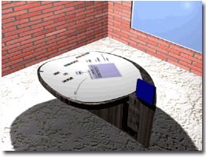
P-Tab
A Multidisciplinary Participatory Design Environment
Jonathan Benn
B.Eng. Software Engineering
M.Sc. Computer Science (in progress)
benn@cs.concordia.ca
Human-Centered Software Engineering Group
Concordia University
http://hci.cs.concordia.ca/www/hcse/
Notes:
Hi, my name is Jonathan Benn. I was among the first people to graduate from an accredited Software Engineering program in Quebec, at Concordia University in Montreal. I decided to continue my education by starting a Master’s degree in Computer Science (thesis option), with a specialty in Human Computer Interaction.
My Master’s thesis involves helping to develop the Participatory Tangible Board (P-Tab), and seeing how it can be applied to software engineering. Today, I will present to you the P-Tab, and the various research issues that surround it.
At several points during the presentation, I will pause and ask if there are any questions. I would appreciate it if any members of the audience would please hold their questions until then.

Slide 2
Outline
Introduction to Design
Introduction to HCD
Introduction to P-Tab
P-Tab and the Design Process
  Brainstorming
  Design Patterns
  Interactivity
  Metaphors
Conclusion
Notes:
I will begin this presentation by introducing three key concepts: software design, human-centered design (or HCD), and the Participatory Tangible Board (or P-Tab). Afterward, I will discuss how P-Tab could be integrated into the software design process, and then I will conclude the presentation.

Slide 3
Introduction to Design
What is software design?
  Tradeoffs, constraints and stakeholders
  Describes how “software is decomposed and organized into components.”
  Describes the “interfaces between those components… at a level of detail that [enables] their construction.”
Source: Software Engineering Body of Knowledge (SWEBOK). http://www.swebok.org/
Notes:
Once you know a project’s requirements, it’s usually necessary to figure out how to meet those requirements before you can start implementing them. This act of creating a plan is software design.
Software design involves many tradeoffs, as requirements are balanced against each other, not every requirement can necessarily be met equally well. Sometimes meeting one requirement may cancel out another. For example, obtaining better security may negatively impact performance.
Usually, constraints will impact a design. Perhaps current computing power is insufficient for some requested features. Maybe there’s limited space available on the target platform, like with mobile devices. Maybe the final product needs to be better than a competitor’s product. That’s a constraint too.
Software design involves many stakeholders, people that have a stake in the outcome of the project. For any project of significant size, software architects, managers, financial backers, user-interface specialists, and so on are going to be involved in the design.
The end product of design, which may include a software architecture, detailed design, and so on, describes the parts of a future program, and how they will interact.

Slide 4
Importance of S/W Design
Work distribution
Maintenance
All domains and disciplines
Notes:
For really small projects, software design is not a big deal. However, for significant projects, those that require a lot of time, resources and people to develop them, it’s a whole other story. Software design becomes essential.
For one thing, it allows tasks to be effectively distributed among a large team of developers. If you don’t know what needs to be done, you can’t possibly assign a task. What’s more, developers working independently can only be expected to work well as a whole if they have some idea of what the other developer’s are doing. For example, their module interfaces need to match. This requires a plan.
Over time, we’ve discovered that for successful products, software maintenance makes up the majority of the cost, time and effort of producing that product. Whether it’s bug fixes, feature enhancements, ports to new platforms, or whatever, maintenance is really important. Unfortunately, software that lacks a coherent design is very difficult to maintain. On the other hand, we can design for change, by predicting what sorts of changes will probably be required in the future and implementing accordingly. Hence, software design is a critical part of producing any software product with a chance at long-term success.
Finally, software design is important because software touches all domains and all disciplines. Whether software is flying planes or helping you to write documents, it’s always there affecting almost every part of your life. We can only hope that the software we depend on every day is of high quality. Software design is the cornerstone of ensuring that quality.

Slide 5
The Design Process
External requirements
3
Postulate a
white box
design
solution
1
Clarify
nature of
requirements
2
Analyze needs
and build black
box model of
problem
5
Implementation
of the design plan
using a suitable
form of
software
4
Validate solution
(including use
of prototypes)
Source: D. Budgen. Software Design. 2nd Ed. Addison-Wesley, 2003.
Notes:
Let’s take a look at the design process. Before I begin explaining the steps, remember that this process is iterative, which means that it’s not strictly a forward process that we go through only once. We can take steps back if it’s necessary, and we can also refine a design over several stages by going through the process multiple times.
First, we obtain a set of requirements, which tell us what the end product should be. Once we understand the requirements, we proceed to step 2, where we create a model of the requirements in order to gain a better understanding of what needs to be done. For example, this could be a flowchart of some of the expected states of the final product. At this stage, we may discover that some requirements are missing, or incomplete, in which case we have to return to step 1 and re-clarify.
Once a good understanding of the problem has been obtained, we can finally create a design. This part is tricky, because we have to create an abstract plan that gives enough information to allow people to implement the product, without actually implementing it. We will also want to validate a design before implementing it. In step 4, a design can be shown to peers for comments, and small prototypes can be written to see if some of the riskier aspects are feasible. If yes, then we proceed to implementation. If not, then it’s back to the drawing board.
It should come as no surprise that the design process is very difficult. But why?

Slide 6
Why is Design Difficult?
“The fundamental problem is that designers are obliged to use current information to predict a future state that will not come about unless their predictions are correct.”
--J. Christopher Jones
Source: J.C. Jones. Design Methods: Seeds of Human Futures. 1970.
Notes:
(read the quote)
“The designers have to work backwards in time from an assumed effect upon the world to the beginning of a chain of events that will bring the effect about.”
In other words, designing means predicting the future, and predicting the future is hard.

Slide 7
Outline
Introduction to Design
Introduction to HCD
Introduction to P-Tab
P-Tab and the Design Process
  Brainstorming
  Design Patterns
  Interactivity
  Metaphors
Conclusion
Notes:
Thus far I’ve explained what design is, why it’s important, how the design process works, and what makes design difficult. Next, I will introduce Human Centered Design (HCD).
Are there any questions?

Slide 8
Introduction to HCD
Human Centered Design
  User focus
  Multi-disciplinary
  Iterative development
Notes:
HCD comes from the world of Human-Computer Interaction, where the user is paramount.
A very important rule to keep in mind when writing a presentation is to “know your audience”. In this case I know that my audience is mostly young software engineers, and I’ve structured my presentation accordingly. HCD works along the same principal, except that it’s applied to software design instead of speech writing.
HCD is composed of three main elements…
The user focus is there to ensure
The multi-disciplinary and iterative aspects of HCD serve to mitigate the difficulty of predicting the future. By leveraging the knowledge and experience of a variety of people from a variety of fields, we increase the odds of obtaining a successful design.

Slide 9
Peanut Butter Theory
Peanut Butter Theory Approach
  UI is a thin spread
  User is an afterthought
  Focus is on system functionalities
Human-Centered Approach
  UI has a major focus
  User is a primary stakeholder
  Focus is on user tasks
Notes:
One good way to understand what something is, is to understand what it is not. This brings up the so-called peanut butter theory of design.
The peanut butter theory goes something like this: the underlying software system is the real system, and the User Interface (UI) is a thin layer that sits on top of it. If we imagine the underlying system as a piece of bread, then the UI can be seen as a thin layer of peanut butter smeared on top of the bread. The peanut butter is there to make the bread taste good. If the bread still doesn’t taste good (in other words, if the software is still unusable) then make the layer thicker by making the UI more “user-friendly”. If that’s not enough, then add a user manual on top of that. If that’s still not enough, then add training on top of that…
Needless to say, I believe that this is the wrong approach to design and to usability.
In HCD, the user interface is a fundamental part of system design, and the user is considered (and consulted) throughout all parts of the software engineering process. The system is seen less in terms of functionalities, and more in terms of the tasks that users need to perform.
This sort of approach impacts more than just usability. It impacts the overall quality of the software as seen by the end user, and hence improves end user satisfaction.

Slide 10
The Problem
HCD is a good thing, but…
Challenges
  User communication
  Team communication
  Supportive environment
A solution
Notes:
I’ve (hopefully) established that Human-Centered Design is a good thing to implement in the software engineering process. The question is, how do you implement HCD in an organization? There are many challenges standing in the way of this goal.

Slide 11
Outline
Introduction to Design
Introduction to HCD
Introduction to P-Tab
P-Tab and the Design Process
  Brainstorming
  Design Patterns
  Interactivity
  Metaphors
Conclusion
Notes:
Are there any questions?

Slide 12
Introduction to P-Tab
Participatory Tangible Board
  Concordia University
  HCSE group & OBX lab
What is it?
The P-Tab Group
  Dr. Ahmed Seffah
  Antoine Morris
  James Maciukenas
  Prof. Jason Lewis
  Jonathan Benn
  Rozita Naghshin
Notes:
P-Tab stands for the Participatory Tangible Board.
P-Tab is a research project in the early stages of development. It is being developed at Concordia University by the Human Computer Software Engineering group in conjunction with the laboratory for experimental media. These organizations are led by professors Ahmed Seffah and Jason Lewis, respectively. Four students, myself included, round out the rest of the current P-Tab development team.
Physically, the P-Tab is a smart board (a giant, flat computer screen) that takes the form of a table that people can sit around. P-Tab was conceived to enable Participatory Design, which is another name for multi-disciplinary design, the cornerstone of Human Centered Design. Its goals are to stimulate creativity and improve team communication.

Slide 13
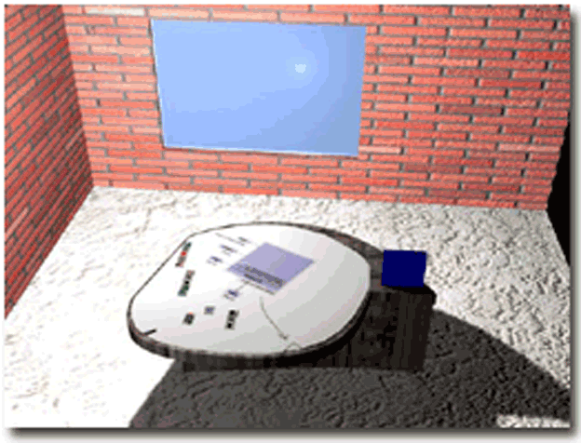
Artist’s Conception
Notes:
This is an artist’s conception of what the P-Tab might end up looking like, although I can’t guarantee that the first prototype will look this good.
Notice how the table itself is used to display information. Users sitting around the table will benefit from two-way interaction. Not only will P-Tab be able to record brainstorming and design ideas, but it will also be able to provide feedback, and produce working prototypes. P-Tab will be better than pen and paper because of easy drag-and-drop, painless erasure, and the potential to zoom in and out from a design in order to show the desired level of detail. Basically, P-Tab will offer all of the capabilities of a desktop computer, but it will also offer an environment that fosters teamwork.
The P-Tab will have an operator, who will use a traditional computer (you can see its LCD screen on the right side of the P-Tab) to control the device. The operator will be able to decide what programs to run, and if multiple programs are running at the same time, he or she will be able to partition the P-Tab’s display accordingly.

Slide 14
P-Tab Characteristics
Two distinct user groups
  Software engineers
  Digital media artists and designers
Additional features/constraints
  Network access
  Interoperability
Notes:
We are aiming P-Tab toward two distinct groups: software engineers (which I will be focusing on), and also digital media artists and designers.
An additional feature that P-Tab should have will be the ability to connect to a corporate intranet, in order to allow its users to tap into personal and company files and the Internet. This way, designers would have all of the necessary resources at their fingertips.
One constraint to the P-Tab’s design is that we will need to carefully integrate all of the tools that make it up so that it offers its users a complete package. Interoperability between the various pieces of software it uses is key to providing a good user experience.

Slide 15
Challenges
P-Tab
  Research, not engineering
How to enable participatory design
  Brainstorming
  Design Patterns
  Interactivity
  Metaphors
Studies
Notes:
It’s important at this point to re-emphasize that P-Tab is a research project, not an engineering project. This means that our goal is not necessarily to produce a product, but rather to discover everything there is to learn about this kind of product while attempting to produce one. We know that we want P-Tab to enable participatory design, but at this point the question of “How?” is up in the air.
How do we support the brainstorming process and stimulate a design team’s creativity? Are design patterns effective design tools, and are they useful for multi-disciplinary communication? How do we use interactivity to support the design process? Computers are capable of many things, but what will come in handy, and what will get in the way? What sort of design metaphors could we use to tie together P-Tab’s capabilities? A good metaphor could make using P-Tab more intuitive.
While we can certainly think about these questions and come up with possible answers on our own, Human-Centered Design philosophy tells us that the only way to know the real answers is to find out from the users themselves. We are currently planning user studies, in the hope that they will shed light on how designers think and work, so that we can better design P-Tab to support them. Already, some designers and design professors are expressing interest in participating in our studies.
These studies will help us understand how designers work, create and collaborate, and help us model their behaviors. It will also serve as potential validation for our ideas.

Slide 16
Outline
Introduction to Design
Introduction to HCD
Introduction to P-Tab
P-Tab and the Design Process
  Brainstorming
  Design Patterns
  Interactivity
  Metaphors
Conclusion
Notes:
Are there any questions?

Slide 17
Back to the Design Process
External requirements
3
Postulate a
white box
design
solution
1
Clarify
nature of
requirements
2
Analyze needs
and build black
box model of
problem
5
Implementation
of the design plan
using a suitable
form of
software
4
Validate solution
(including use
of prototypes)
Notes:
P-Tab will only be useful to designers if it supports the whole design process. We know that these three highlighted steps are the main parts of the design process, but exactly what sort of tools are needed at each step is in question.

Slide 18
Back to the Design Process
External requirements
3
Postulate a
white box
design
solution
Design Patterns
Brainstorming
1
Clarify
nature of
requirements
2
Analyze needs
and build black
box model of
problem
5
Implementation
of the design plan
using a suitable
form of
software
Interactivity + Metaphors
4
Validate solution
(including use
of prototypes)
Interactivity
Notes:
Previously, I mentioned some avenues for research, and here is where they might be applied.
In steps 2 and 3, freeform brainstorming tools could help designers develop models, which could then be translated into more formal diagrams and documentation using more traditional tools.
Design patterns could be used not only to express a design solution (step 3), but they could also be useful for overall communication among multi-disciplinary design team, and for helping implementers create the product in step 5.
In step 4, interactive elements like software agents and rapid prototyping tools could help validate and improve design solutions.
Overall, interactive capabilities such as audio/visual annotation, design visualization and access to digital libraries could help the whole design process. In addition, using effective metaphors and tangible objects could help improve the design process.
We hope that the studies we will conduct will shed light on these issues, and let us know if we’re on the right track.
I will now go over each of these future research possibilities in greater detail.

Slide 19
Brainstorming
Supporting brainstorming
  Freeform tools
  Flexible visualization tools
Annotation
  Audio/visual
Notes:
P-Tab could be used to help multi-disciplinary teams brainstorm ideas for user-interface and software designs. In order to accomplish this, we will need to consider how people brainstorm, and provide software tools that help with, rather than interfere with, the process.
What I know of any creative endeavor is that getting effective results means starting with a brainstorming session. This session has no rules or criticism, only ideas thrown out and merged with other ideas. It’s only after all of the creative ideas have been exhausted that one should start criticizing, correcting, and removing inappropriate ideas.
We can hypothesize that software engineering tools that are too strict will prevent effective brainstorming. Hence, we want to look into what sorts of tools might help brainstorming, and see how they relate to our study findings.
What’s more, some sort of automated note-taking will be required to help people remember what was brainstormed after they go off into their little corners to work alone or in smaller groups.

Slide 20
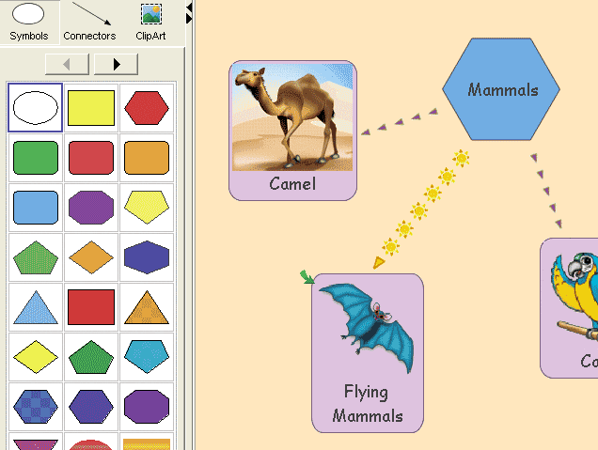
Freeform Tools
Source: Smart Technologies. Smart Ideas Concept-Mapping Software. http://www2.smarttech.com/st/en-US/Products/SMART+Ideas/Features.htm
Notes:
Here is a diagrammatic brainstorming tool called Smart Ideas. This software allows its users to select arbitrary shapes and connectors, and easily put them together in any way. It also supports embedding clipart, multiple zoom levels and hyperlinks.
Tools developed specifically for software engineering could offer the same sort of functionality, but be tailored for the domain of software design. For one thing, included clipart would probably not include flying mammals.

Slide 21
Design Patterns
Reuse solutions
Common terminology
High-level perspective
Source: A. Shalloway and J. R. Trott. Design Patterns Explained: A New Perspective on Object-Oriented Design. Addison-Wesley, 2001.
Notes:
Since a multi-disciplinary team by definition contains people from many different fields, we will need to use or invent design notations that will be easily understandable to engineers and non-engineers alike. One idea for solving this problem is to use software engineering design patterns
Design patterns serve three main purposes. Typically, you will learn the first two listed here. The last reason, however, is possibly the least recognized but perhaps the most important.
Design patterns allow you to reuse tried-and-true solutions, thus helping you to avoid making costly mistakes, and save the time required to reinvent the wheel. Design patterns also help establish a common terminology, which is useful for any team. Finally, design patterns offer a high-level perspective that frees you from needing to consider details too early. This abstraction is good for design, but it is also good for allowing people from other disciplines to “break in” to software engineering. People will not necessarily need to learn the nitty gritty details of programming in order to understand how, when and why design patterns are useful.
Let’s go over an example to make this point more clear. I will draw from a much older discipline than computer science: carpentry.

Slide 22
Carpentry Example
Carpenter 1: “How do you think we should build these drawers?”
Carpenter 2: “Well, I think we should make the joint by cutting straight down into the wood, and then cut back up 45 degrees, and then going straight back down, and then back up the other way 45 degrees, and then going straight back down, and then…”
Source: A. Shalloway and J. R. Trott. Design Patterns Explained: A New Perspective on Object-Oriented Design. Addison-Wesley, 2001.
Notes:
Let’s say that two carpenters are building a chest of drawers. While they’re designing the drawers, it would be normal for one carpenter to turn to the other and ask, “How do you think we should build these drawers?”
Here, his partner’s response is purposefully confusing. Carpenter 2 is giving a precise answer, but we don’t get a sense of what he’s really talking about, or why he’s chosen to describe this technique and not a different one.
Carpenter 2’s speech has a lot of parallels with software engineering. It amounts to the same thing as talking about while loops, if statements and switches. There’s nothing wrong with talking about these while programming, but they don’t belong in design. They’re too low-level. During design, we need to consider the project’s requirements, constraints and trade-offs, not the precise details of how to implement them. At the same time, if software engineers want non-engineers to be able to make any sense out of what they’re saying, then they’ll need to use a more abstract language. That higher-level language is design patterns.

Slide 23
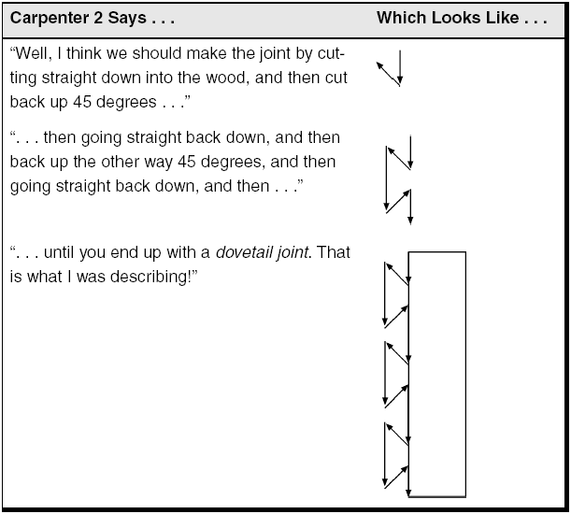
Source: A. Shalloway and J. R. Trott. Design Patterns Explained: A New Perspective on Object-Oriented Design. Addison-Wesley, 2001.
Notes:
If we take a look at this picture, we see that Carpenter 2 was really talking about a dovetail joint. This is a carpentry design pattern.

Slide 24
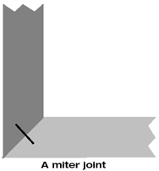
Patterns Are High-Level
Question: Should we use a dovetail joint or a miter joint?
Translation: Should we use an expensive and durable joint, or should we make a cheaper but less durable joint?
Source: A. Shalloway and J. R. Trott. Design Patterns Explained: A New Perspective on Object-Oriented Design. Addison-Wesley, 2001.
Notes:
Because carpentry has been around for long enough and carpenters have developed a language of design patterns, another question that a carpenter might ask would be, “Should we use a dovetail joint or a miter joint?” As you can see, there’s a lot of subtext to a question like this. The carpenter is really asking if the carpenters should do the job well, or quickly.
A design pattern represents design tradeoffs, exactly the sort of thing that design teams will need to discuss around a table. And without understanding anything about carpentry, I can understand that a dovetail joint is hard to make but durable, and that a miter joint is easier to build, but breaks more easily. I hope that in the same way this abstraction that patterns offer will make them a useful communication medium for a multidisciplinary team.

Slide 25
Interactivity
Audio/visual annotation
Software agents
Digital libraries
Prototypes
Design Visualization
  Zoom levels
  Fisheye views
  Customizable views
Notes:
P-Tab must support interactivity and knowledge transfer. Fundamentally, simply bringing a team into one room helps to transmit knowledge, but there’s more to it than that.
Automated audio/visual annotation could help people remember what was brainstormed days, months or years after the fact. It could also help record design decisions, and the circumstances under which decisions were made.
Software agents could be used to provide P-Tab users with feedback on the quality of their design, and on applicable design patterns.
Digital libraries could offer sound advice and information at the touch of a button.
Prototyping features could allow designers to quickly create throw-away or evolutionary prototypes, in order to clear up uncertainties and mitigate risks, or jump-start the project’s implementation.
P-Tab could be equipped to offer multiple zoom levels of designs, fish-eye views, and customizable views both on-screen and in print. This would allow designs to be better visualized and communicated.

Slide 26
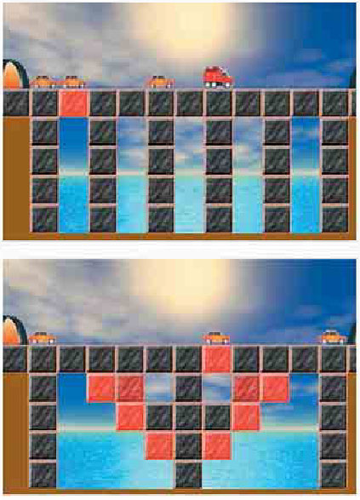
The Bridge Builder
Source: A. Repenning and A. Ioannidou. Agent-Based End-User Development. Communications of the ACM, September 2004.
Notes:
As an example of applying software agents to design, I’d like to use the simple example of the Bridge Builder. This is an educational bridge design environment. In this example, the software agents are the bricks that make up the bridge. Each brick calculates the stress it is undergoing, and changes color to indicate its stress level.
This sort of principle could potentially be applied to other domains, such as software engineering. Perhaps agents could be created to monitor design constraints to make sure that they are being respected. Or maybe agents could be used to monitor the design and suggest design patterns where appropriate.

Slide 27
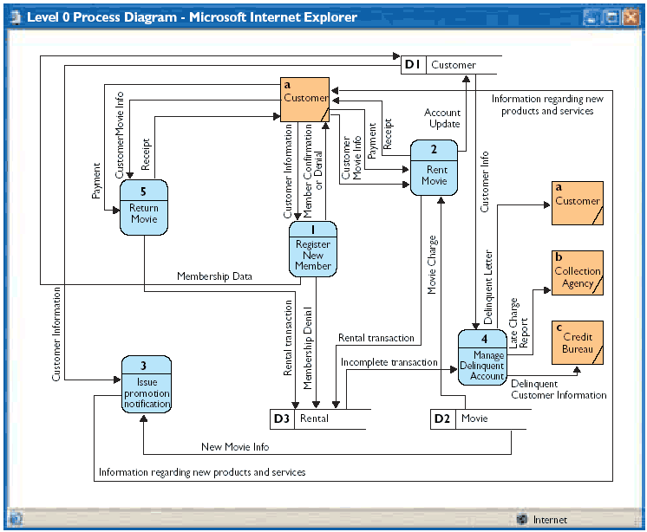
Source: O. Turetken, D. Schuff, R. Sharda, and T. T. Ow. Supporting systems analysis and design through fisheye views. Com. of the ACM, September 2004.
Notes:
I will now explain the concept of fish-eye views in a little more detail. Fish-eye views are a visualization technique that should help designers be better able to read and understand diagrams.
This picture is a Data Flow Diagram (DFD). DFDs are hierarchical diagrams, which means that each of these numbered items can be subdivided into sub-items. Let’s say we wanted to zoom in on the 1st item.

Slide 28
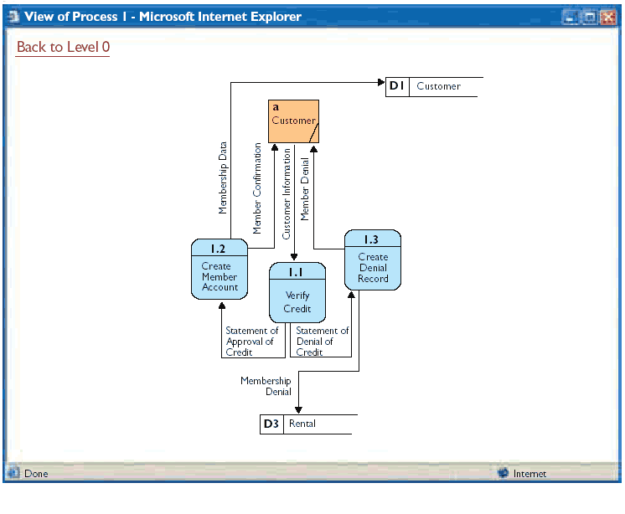
Source: O. Turetken, D. Schuff, R. Sharda, and T. T. Ow. Supporting systems analysis and design through fisheye views. Com. of the ACM, September 2004.
Notes:
Most visualization tools will give you a view like this. But this isn’t very good because now you’ve lost the context, and you’re forced to remember it.

Slide 29
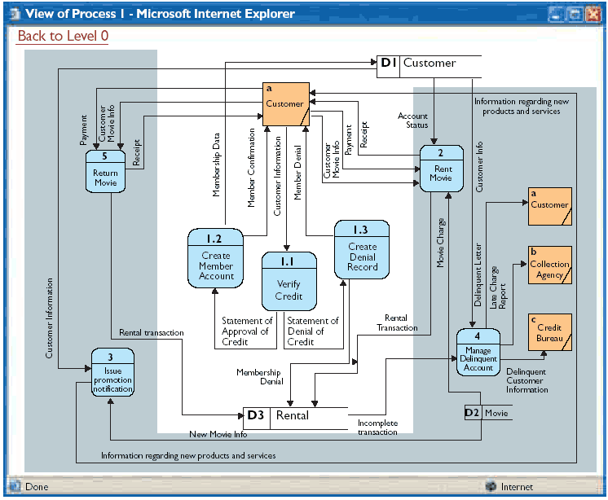
Source: O. Turetken, D. Schuff, R. Sharda, and T. T. Ow. Supporting systems analysis and design through fisheye views. Com. of the ACM, September 2004.
Notes:
On the other hand, a fish eye view allows you to retain the context, which makes comprehension easier. The main focus is the largest part of the diagram, and the context is smaller and on the outskirts, but still present.

Slide 30
UI Design Metaphor
Design metaphor
Tangible objects
Impacts
  Learnability
  Comprehension
  Satisfaction
Metaphors and P-Tab
Notes:
A user-interface design metaphor is a theme used to inspire a user interface. For example, an operating system desktop theme is a good example of a design metaphor. The user could choose a baseball desktop theme, or a jungle theme, and so on, and his or her interaction with the computer would be modified depending on the choice. Perhaps a given icon would appear as a baseball bat, or as a vampire bat, depending on the choice.
Tangible objects are a physical representation of an abstract concept. A good everyday example is a computer file. In reality this is just a string of 0s and 1s, but the operating system can abstract it into an icon that you see on your desktop and interact with.
If used correctly, user-interface design metaphors and tangible objects can help improve product learnability, and user comprehension and satisfaction. In short, they can make a user-interface more intuitive. If taken too far, like when a metaphor is stretched to fit an incompatible program functionality, then a metaphor can reduce a user-interface’s quality. So one has to be careful.
For P-Tab, we will potentially need to define and implement metaphors and tangible objects to represent, and interact with, design concepts and models. Determining what is required remains to be seen. Only studies will be able to correctly tell us what we need.

Slide 31
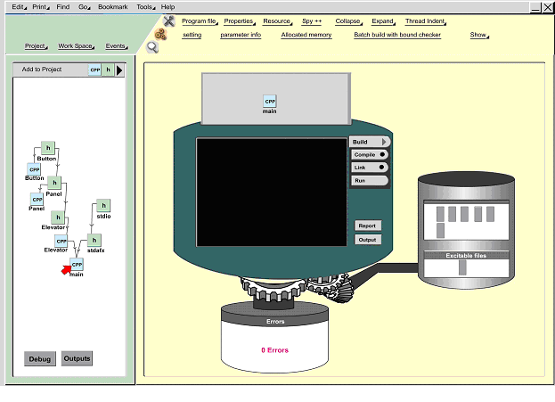
Notes:
In the meantime, we can look at metaphor examples such as this one. In this example, compiling a program is seen as something akin to grinding up sausage. The source files are put into a mill (equipped with a screen) and then ground up. The mill then spits out one of two things: either an executable file that goes to the right of the screen, or error messages that drop to the bottom.

Slide 32
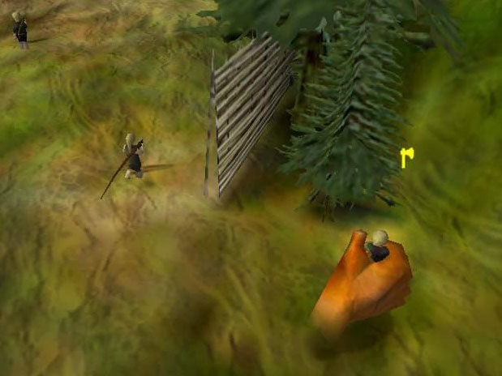
Source: Black & White game. Courtesy of Strategy Informer. http://www.strategyinformer.com/screenshots/blackwhite.shtml
Notes:
A good example of a metaphor taken to the extreme is the game Black & White. In this game, the player takes the role of a deity. The game’s developers made an effort to extend the illusion that the player really was a deity by forcing all of the player’s interaction to follow this metaphor—sometimes to the point of annoyance.
In this screenshot, we see that the player’s mouse pointer has been replaced by an enormous hand, in this case used to grasp an innocent bystander.

Slide 33
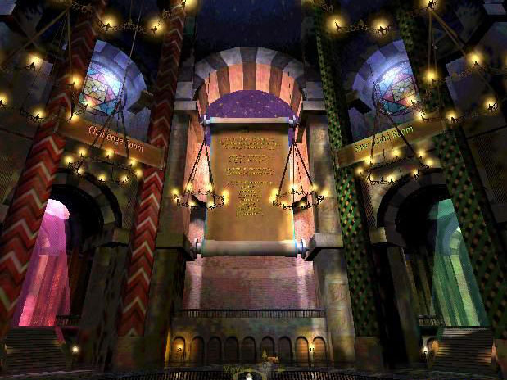
Source: Black & White game. Courtesy of Strategy Informer. http://www.strategyinformer.com/screenshots/blackwhite.shtml
Notes:
Black & White’s option screen works in much the same way. Instead of the traditional menu system, it uses a grand temple (presumably dedicated to the player). The rooms and walls of this temple represent the game’s various functionalities, such as saving and loading.

Slide 34
Outline
Introduction to Design
Introduction to HCD
Introduction to P-Tab
P-Tab and the Design Process
  Brainstorming
  Design Patterns
  Interactivity
  Metaphors
Conclusion
Notes:
Are there any questions?

Slide 35
P-Tab Applications
Software design
User-interface design
User-interface testing
PMix
Notes:
We envision several powerful ways in which P-Tab could be used.
As I’ve already said, P-Tab could become an indispensable tool for software design. Freeform design tools combined with more rigorous design tools. Design pattern digital libraries and pattern-knowledgeable software agents. Multiple views of emerging designs. (review and summarise what I’ve already said about P-Tab).
However, there’s more to P-Tab than just this. It has many other possible applications. P-Tab could be used for creating user interfaces. It would offer space and resources for brainstorming sessions, in order to come up with good user-interface designs. On-site users and interactive software agents could offer their input. Digital libraries could hold necessary information.
P-Tab could be used for performing tests on user interfaces. There are many usability tests, such as heuristic analysis, that require evaluators to conduct a test individually and then get together afterward to put together their test results. P-Tab could be the perfect environment for this brainstorming and summarizing session.
PMix is a P-Tab-based software environment for brainstorming and rapidly prototyping interactive multimedia documents. (write more)

Slide 36
Some Existing Research
P-Tab vs. other research
IBM’s Rational Rose
AIRE group and DRG at MIT
  http://www.ai.mit.edu/projects/aire/projects.shtml
  http://www.rationale.csail.mit.edu/projects.shtml
HCII at Carnegie Mellon
  http://www-2.cs.cmu.edu/~NatProg/
GUIR at Berkeley
  http://guir.berkeley.edu/projects/denim/
Notes:
Research never happens in a vacuum, and unsurprisingly there are projects and products out there that are similar to P-Tab. In general, I feel that the Participatory Tangible Board will be a complimentary element to many of these projects.
For example, it’s not necessarily a replacement for products like Rational Rose. In fact, a finished P-Tab might incorporate Rational Rose. Rational Rose now includes features such as support for design patterns, free-form diagramming and rapid prototyping. In a sense it already embodies some of the principles we’ve set out to accomplish with P-Tab.
The Agent-based Intelligent Reactive Environments (AIRE) research group, based at MIT, is working on some interesting projects, such as the intelligent room. This is an interactive room equipped with speakers, microphones, cameras, projectors. The AIRE group is also researching ways to automatically facilitate and record meetings, which is of great interest for P-Tab.
The Design Rationale (DR) group is developing a natural sketch recognition program for Unified Modeling Language (UML) diagrams. This sort of technology would also be very interesting.
At Carnegie Mellon, the Human Computer Interaction Institute (HCII) is researching natural programming techniques. The results of this kind of research might be applicable for P-Tab, especially in the case of creating rapid prototypes, or for making programming more accessible to non-programmers in a software development team.
Finally, the Group for User Interface Research at Berkeley developed a product called DENIM, for rapid sketch-based website prototyping. This product gave me a lot of ideas on what sorts of directions P-Tab could take.
Please note that the above-mentioned research is only a small sample of what’s out there.
Various organizations have already come up with interactive tables of their own. Here is a sampling of some of the most interesting that I was able to find.

Slide 37
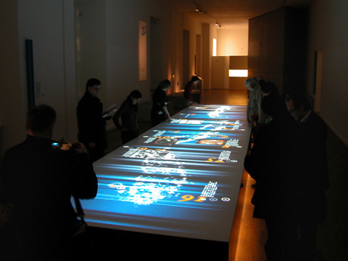
floating.numbers
Source: Jewish Museum, Berlin, Germany. http://www.artcom.de/
Notes:
This is a 9m x 2m interactive table that uses an overhead projector.

Slide 38
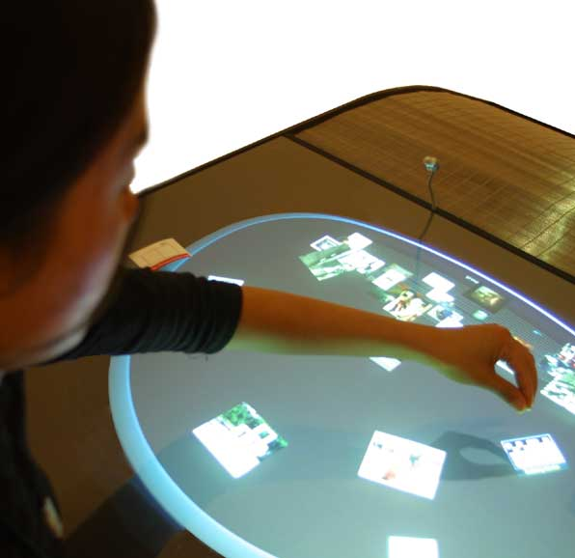
Dialog Table
Source: Walker Art Center, Minneapolis, USA. http://dialogtable.com/
Notes:
This is the Dialog Table is an interactive table that allows users to view pictures, narratives and movies.

Slide 39
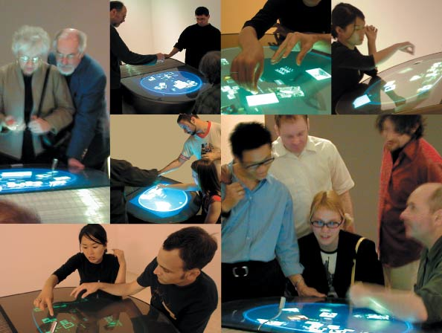
Hmm… Looks Like Fun
Source: Walker Art Center, Minneapolis, USA. http://dialogtable.com/
Notes:
Apparently up to eight hands can interact with the screen at the same time.

Slide 40
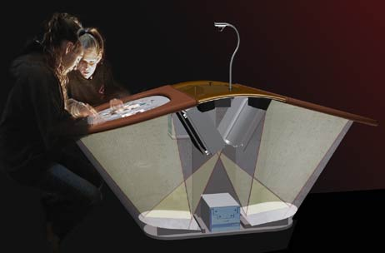
How It Works
Source: Walker Art Center, Minneapolis, USA. http://dialogtable.com/
Notes:
It works via rear-projection as you can see here. A camera on the ceiling analyzes hand motion.
This is different from our vision for the P-Tab, which we expect will use an interactive smart-board, which would be an LCD or plasma screen equipped with touch-screen capability.

Slide 41
Acknowledgements
Many images:
  Rozita Naghshin
Constructive criticism and ideas:
  Dr. Ahmed Seffah
  James Maciukenas
  Prof. Jason Lewis
  Rozita Naghshin
Notes:
I’d like to thank the following people for their contributions to this presentation.

Slide 42
Any Questions?
Jonathan Benn
B.Eng. Software Engineering
M.Sc. Computer Science (in progress)
benn@cs.concordia.ca
Human-Centered Software Engineering Group
Concordia University
http://hci.cs.concordia.ca/www/hcse/
http://www.cs.concordia.ca/~benn/publications/

