Slide 1
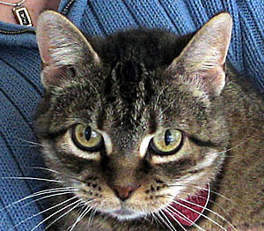
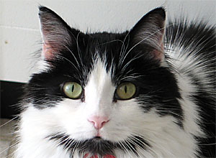
Engineering High Quality Software Applications
Alan Wassyng
Software Quality Research Laboratory
Department of Computing and Software
McMaster University
Presented at
CUSEC 2005
©Alan Wassyng 2005
Notes:
Thank the person who introduces me and the organizers
Mike - Chris - Karen

Slide 2
Where we are
Notes:
Switch on sound - use microphone
Well - he’s outside the cubicle

Slide 3
Where we are - really
Why was that funny?
Yes - software quality is not what it should be
BUT - we have already achieved outstanding successes. Software is pervasive and works remarkably well much of the time
We have seen humorous comparisons (usually with cars) that present both sides of software progress:
  cars could be faster than a jet plane, smaller than a bicycle and cost $2000 (new)
  changing the tires on a car would require removing the engine (temporarily) - occasionally after such a change, the car may refuse to turn right

Slide 4
Engineering safety-critical software
I’m going to tell you a story - not a fairy story
A true story - maybe a legend even
Embellished only slightly
And - it’s a story with a happy ending
Notes:
It’s also a long story, so I am going to have to condense it.

Slide 5
Shutdown System Context
Darlington Shutdown Systems
T/C = Trip Computer
D/T = Display/Test Computer
Mon. Comp = Monitor Computer
Notes:
SDS1 and SDS2 are independent
Show a “channel”

Slide 6
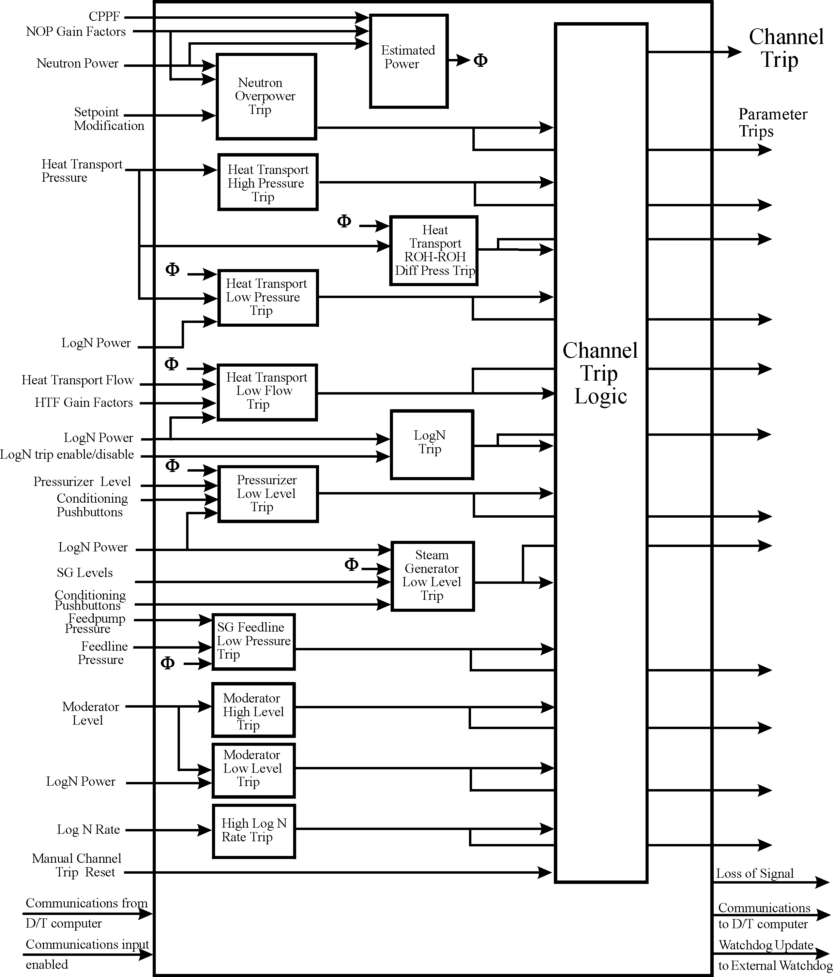
Software Size
Shutdown System One
A single trip computer
60 modules
280 access programs
40,000 lines of code
(including comments)
33,000 FORTRAN
7,000 assembler
84 monitored variables
27 controlled variables
Notes:
Make sure to talk about monitored and controlled variables
Highlight “parameter trips”

Slide 7
Notation
m_ name is a monitored variable, c_name is a controlled variable, k_name is a constant, e_name is an enumerated token in a type, etc.
m_name represents current value of the variable
m_name₋₁ represents “previous” value of m_name
Notes:
You can see the notation we use - we spent many hours deciding on notation
It is VERY important
understanding
word-processing technology etc
All members of the teams contributed

Slide 8
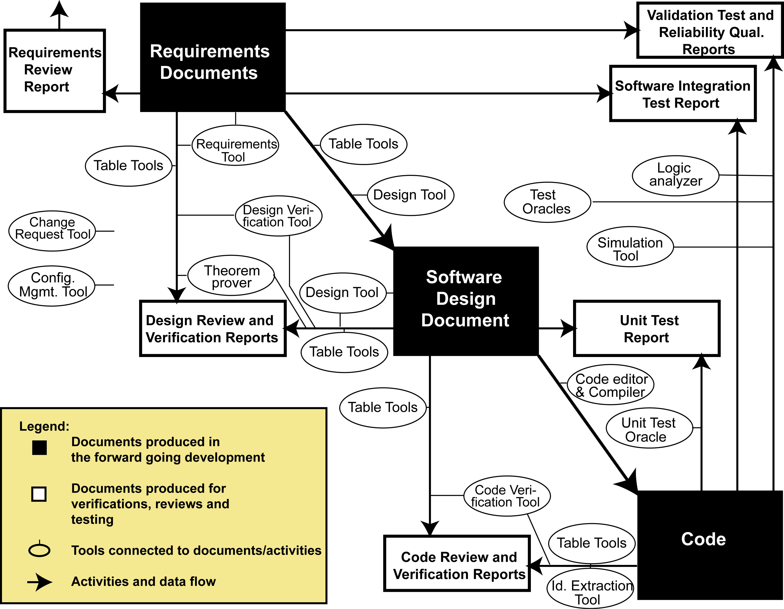
Software Development Lifecycle
Notes:
Our methods were designed to work together over the entire lifecycle
Three main development documents - all remain live documents
Verification & review between each stage
Testing
DISCUSS TEAMS TEAMS TEAMS

Slide 9
Requirements
Mathematically based
A priority was that domain experts would be able to read and understand all the details
Integrated:
  Requirements
  Software Design
  Design Verification
  Code
  Code Verification
As few software design artefacts as possible
Practical - must deal with real industrial applications
Tabular
Expressions
Notes:
Difficult to get agreement on using mathematics for the requirements
Tables are pervasive and they are the major reason we managed to convince industry professionals to use
these formal approaches - they glued the stages together

Slide 10
Tabular Expressions
 | Result
Condition | f_name
Condition 1 | res 1
Condition 2 | res 2
... ... ... | ...
Condition n | res n
If Condition 1 then f_name = res 1
Elseif Condition 2 then f_name = res 2
Elseif …
Elseif Condition n then f_name = res n
Condition i ∧ Condition j ⇔ FALSE ∀i,j = 1,..,n, i ≠ j
Condition 1 ∨ Condition 2 ∨ … ∨ Condition n ⇔ TRUE
and
Notes:
This is just one kind of function table - about 11 kinds have been identified
Completeness and disjointness are wonderful

Slide 11
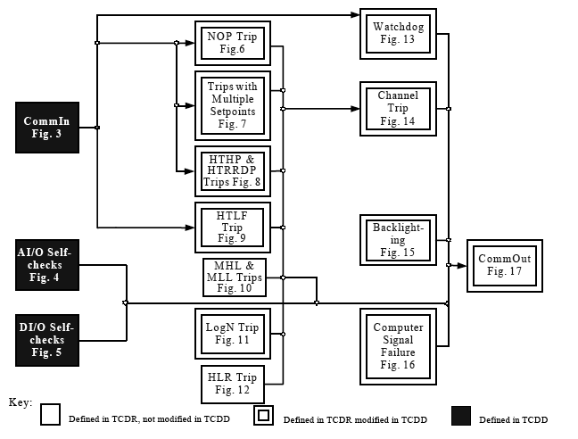
Requirements - SDS1

Slide 12
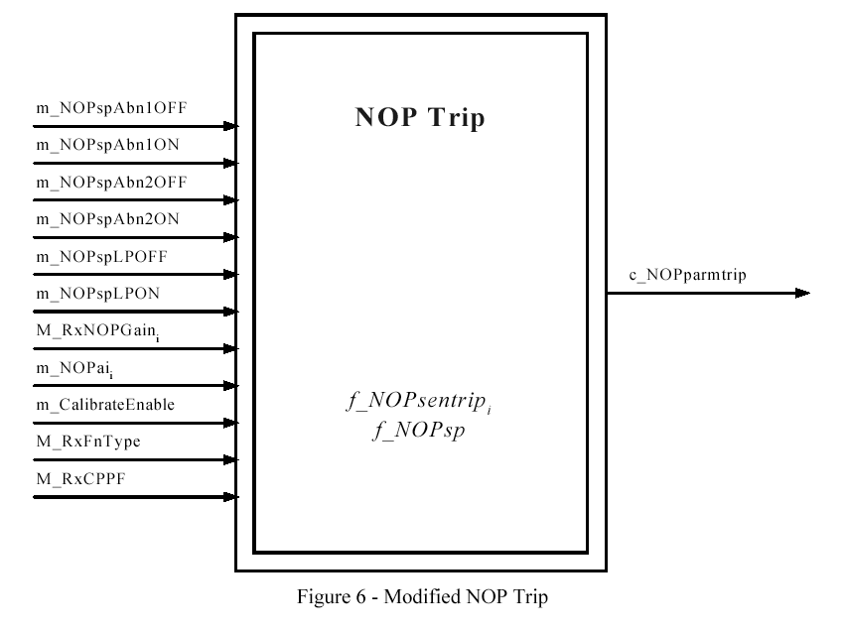
Requirements - NOP Trip 1
inputs
parameter trip
internal functions
outputs
18 sensor trips
18 signals (sensors)
Notes:
Explain (again) the idea of sensor trip and parameter trip

Slide 13
Requirements Model
Finite State Machine (FSM) Model
  C(t) - vector of values of controlled variables at time t
  M(t) - vector of values of monitored variables at time t
  S(t) - vector of values of state variables at time t
  t₀ - time of initialisation
  S(t₀) must be known
  C(t_{k}) = R(M(t_{k}), S(t_{k}))
  S(t_{k+1}) = NS(M(t_{k}), S(t_{k})), k=0,1,2,3,...
Notes:
Discrete time - arbitrarily small clock tick

Slide 14
Requirements - NOP Trip 2
Notes:
We decide to start with the controlled variable first

Slide 15
Requirements - NOP Trip 3

Slide 16
Requirements - NOP Trip 3
f_NOPsp
NON-TRIP REGION
Calibrated 4th
NOP signal
k_NOPhys
NON-TRIP REGION
TRIP REGION

Slide 17
Requirements - NOP Trip 4
and
Notes:
Example of a prioritised requirement

Slide 18
Requirements - NOP Trip 5
Notes:
Just 1 example

Slide 19
Tolerances
Tolerances & Timing Requirements
  Requirements model/document describes behaviour of an idealised system - impossible to meet
  Need tolerances in general
  Need timing tolerances in particular

Slide 20
Timing Resolution
An event that lasts for TR or longer must be detected
TR
TR
setpoint
m_signal
TR for time continuous monitored variables
time
Two events at least TR apart must both be detected
TR
TR
M_signal
M_signal
M_signal
M_signal
TRs for time discrete monitored variables
time
Notes:
Gloss over time-discrete case

Slide 21
Performance
Timing Requirements
  The PTR for a m-c pair specifies an allowable processing delay
  The PTR is measured from the time that the value of m crosses the system boundary until the time that the value of c crosses the system boundary
sampled here

Slide 22
Timing Issues
My main research interest is to cope with timing issues
  What if time constants have tolerances?
  How do performance timing issues and functional timing issues interact?
  Unfortunately, it appears that existing theory does not cope adequately with these problems!

Slide 23
Lesson 1
Precision of mathematical requirements acted as a catalyst for probing questions from domain experts at an early stage of development.
Notes:
Our lesson

Slide 24
Lesson 2
Mathematical precision builds a false sense of confidence.
  Differences in the interpretation of the model can lead different readers of the requirements to different interpretations of the requirements!
  The math may be precise, but readers may still read it incorrectly.

Slide 25
Software Design
The software design is decomposed for different reasons compared with the requirements
Decompose for maintainability as a primary concern - Information Hiding!
“secrets” are identified from changes that are predicted to be likely to occur. Each secret is hidden in a module, so the implementation of the module can be changed without affecting other modules
Parnas, D.: On the criteria to be used in decomposing systems into modules.
Communications of the ACM December (1972), 1053-1058
Notes:
Information hiding was what got management to give the go ahead on the project - when they understood what it could do

Slide 26
Modules
A module is a
conceptual design
unit in the
decomposition of
software functionality.
Modules can be
developed in a
hierarchical structure
where one module
can “contain” other
modules.
Leaf modules communicate through externally visible access programs.
code is in leaf
modules only
Top level
Notes:
Modules do not have to be separately compilable units

Slide 27
“Rational Design Process”
Parnas talked about a “rational design process” - we set out to implement such a process
Major components
  Module Guide
    For each module - secret, responsibility
  Module Interface Specification
    External description of module interface behaviour
  Module Internal Design
    Details of how each module implements its interface specification

Slide 28
Documentation of Modules
Module
Internal
Design
Module
Interface
Spec
Notes:
TEAMS TEAMS TEAMS

Slide 29
Module Interface Specification
Traditionally, researchers have looked for ways of making this specification as “black-box” as possible, and have approached the problem without thinking enough about the previous phase - the requirements
If we assume we have mathematical requirements, then those requirements should be useful for the MIS
Problems:
  Software variables are different from domain variables
  Software design decomposition is different from requirements decomposition
So - try and solve those problems and then we have a more integrated methodology!
Notes:
IMPORTANT - example of academic community not taking into account the practical ramifications

Slide 30
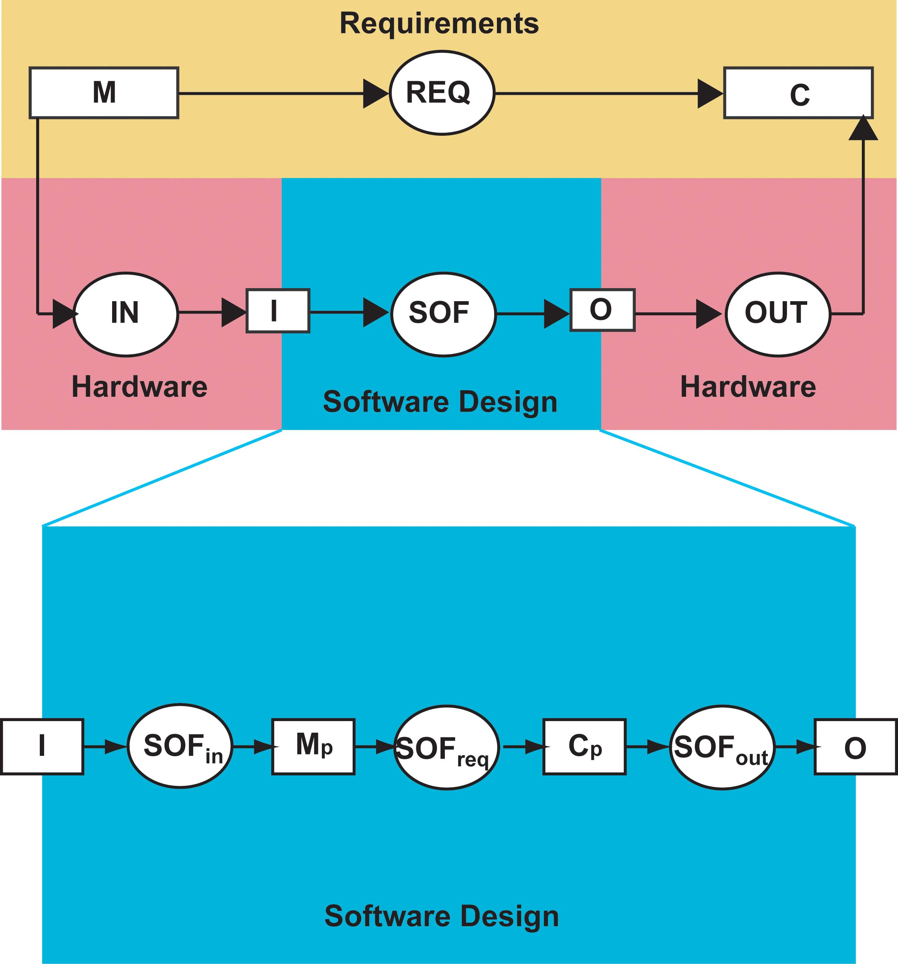
Modified 4 Variable Model
Are the software variables really different from the domain variables as far as the MIS is concerned?
variables
functions
Hardware
hiding
Hardware
hiding
Parnas, D.L., Madey, J.: Functional documents for computer systems. Science of Computer Programming, 25, (1995), 41-61
Notes:
[CLICK]

Slide 31
Modified 4 Variable Model
Are the software variables really different from the domain variables as far as the MIS is concerned?
Not if we look at the modified 4 variable model - which is what developers normally choose to implement anyway
variables
functions
Hardware
hiding
Hardware
hiding
Parnas, D.L., Madey, J.: Functional documents for computer systems. Science of Computer Programming, 25, (1995), 41-61
Notes:
[CLICK]

Slide 32
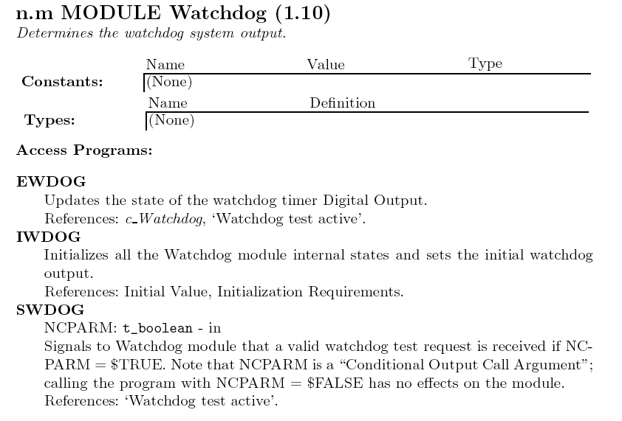
MIS Example
Provide spec for access program
*
*
Needs to be more specific

Slide 33
MIS Example - NOP
Module
“cover page”
(MIS)
shows
external
behaviour
only.

Slide 34
MID Example - NOP
safe state
if there is one
Notes:
Vertical tables seem to work better in design

Slide 35
Software Design Verification
Assumes we use “supplementary function tables” in the design documentation
  Verify software design against pseudo-requirements - have same data flow topology
  Verify pseudo-requirements against requirements - only need to verify those blocks that are different

Slide 36
Software Design Verification
Proof obligation (general form)
Path 1
Result via path 1 must equal result via path 2
pseudo-requirements
REQ_{p}(M) =
Abst_{c}⁻¹(SOF_{req}(Abst_{m}(M)))
software
design
and
Abst_{m}(M) = SOF_{in}(IN(M))
Path 2
C = OUT(SOF_{out}(Abst_{c}(C)))
Notes:
The proof obligation is tremendous if it is tackled directly from this formulation.
Note Mp and Cp etc

Slide 37
Verification Abstract Example
Choose an arbitrary example:
pseudo-requirements
software design
Notes:
Use SFTs to make the data flow topologies in the SDD and pseudo-TCDD equivalent

Slide 38
Example: Proof Obligation
The complete proof obligation for our example evaluates to:
f₄(f₂(f₁(m₁, m₂)), f₃(f₁(m₁, m₂), m₂)) =
Abst_{c 1}⁻¹(g₄(g₂(g₁(Abst_{m 1}(m₁), Abst_{m 2}(m₂))),
g₃(g₁(Abst_{m 1}(m₁), Abst_{m 2}(m₂)), Abst_{m 2}(m₂)))) ... (1)
f₃(f₁(m₁, m₂), m₂) = Abst_{c 2}⁻¹(g₃(g₁(Abst_{m 1}(m₁), Abst_{m 2}(m₂)), Abst_{m 2}(m₂))) ... (2)

Slide 39
Verification Piece-Wise
pseudo-requirements
Block 2
Block 3
Block 1
software design
Block 4 (everything else)
Notes:
We can show that if each block is verified, then the entire SDD is verified

Slide 40
Software Design Verification Process
So, our procedure is to divide the software design and the pseudo-requirements into blocks such that each block in the design has identical inputs and outputs to a corresponding block in the pseudo-requirements
Each block is verified individually, usually by manipulating function tables. We have also managed to implement more automated block verifications using PVS (so far, only relatively simple blocks)
Afterwards we deal with the pseudo-requirements to requirements verification, and the monitored/controlled variable abstractions
Notes:
But - [CLICK]

Slide 41
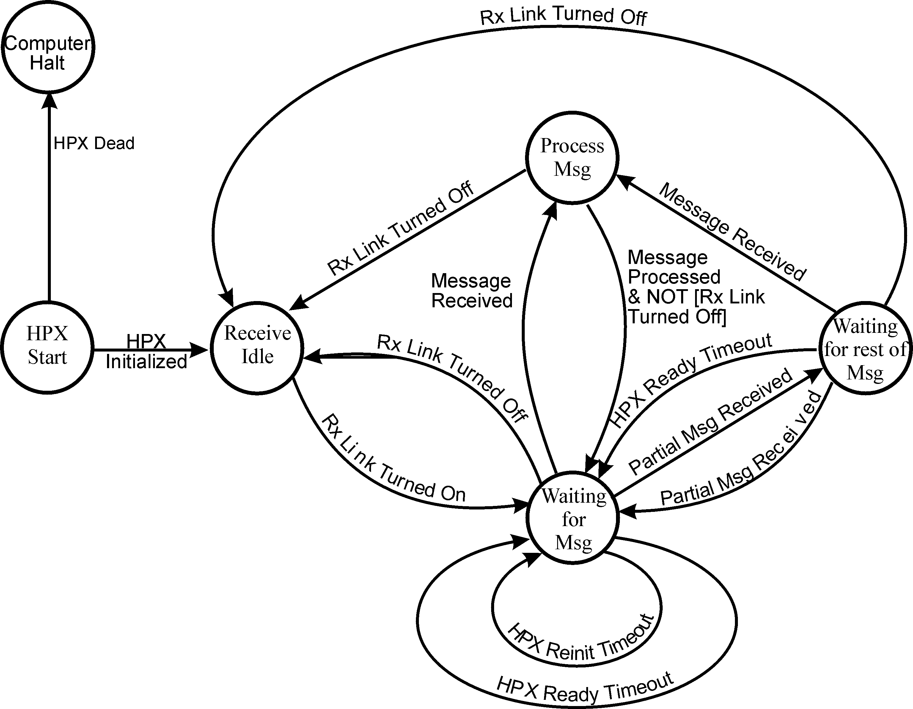
Software Design Verification - Still Tough!
software
design
requirements
Notes:
Note the extra functionality

Slide 42
Coding
Coding is pleasantly simple since each module internal design is very complete
Most designs are in the form of tabular expressions (some are psuedo-code), and coding guidelines are quite easy to create and very effective in helping to produce well structured code

Slide 43
MID Example - NOP
safe state
if there is one
Notes:
Refresh your memory

Slide 44
Coding Example - NOP
comments are used
to reference software
design
all function tables are
implemented in a consistent
column order etc

Slide 45
Coding Example - NOP cont.

Slide 46
Code / Code Verification Linkage
A couple of decisions were made in the coding procedure that make code verification much simpler
  Comments in the code act as references to the software design, so the verifier knows if the code was produced from a table or from pseudo-code (crucial)
  The coding procedure is very precise and quite prescriptive in how to produce code from tables and pseudo-code. This means the verifier has a good idea of how to produce a table or pseudo-code from the code so that it has a very similar format to the software design

Slide 47
Code Verification
Process is quite simple
  For each module, the verifier constructs documentation that is very similar to the software design, but does it by analysing the code without referring to the software design
  Then the verifier compares the resulting documentation with the software design
Coding verification was a pleasant surprise - much easier than anticipated

Slide 48
Testing
Our philosophy is that no one method will detect all faults - so, even though we do all the reviews and mathematical verifications, we also do: unit testing, software integration testing, validation testing, trajectory-based random testing
Function tables provide an excellent basis for test cases - they obviously describe boundaries very well

Slide 49
Lesson 3
Software tool support for these methods is mandatory. The tools should work seamlessly over all the processes in the software development lifecycle
Integrated tools will come from integrated methods - so first priority is to make the methods as integrated as possible
Often, mundane repetitive tasks can be automated with a lot less effort than the more theoretically interesting tasks
Notes:
CVR tool

Slide 50
Lesson 4
Mathematicians have been known to make mistakes. We should not rely on the formality of our approaches to the extent that we throw away years of experience and so forego normal “best practices”, such as accepted coding principles for the language in use, and (manual) inspections

Slide 51
End of story
This story is important because:
  It consumed 13 years of my life
  We learned many valuable lessons (I only highlighted a very few) - valuable to many software developers
  It is one of only a handful of successful safety-critical software developments in a real industrial setting

Slide 52
Why the world needs you
Contrary to current enrollment numbers, there is a shortage of qualified software professionals
You can help change the norm - less hacking more rigor and discipline. That does not (necessarily) discard agile methods
Don’t accept development cycles that skimp on requirements, rationale, design - take pride in your work and responsibility for your professional conduct

Slide 53
What we expect of you
As software ENGINEERS
  Competency in your activities related to software
  A disciplined, engineering approach to software development and maintenance
  Responsible
  Ethical
For your own sakes - go out and do something you enjoy! Have fun!
Notes:
This may be trite - but it’s still true and worth saying

Slide 54

Thanks

