Slide 1
A Real-World Development Lifecycle
Greg Wilson
gvwilson@cs.utoronto.ca

Slide 2
Context
A lot of noise about methodology these days
But:
  Very little hard data
  And most developers don’t work at the extreme ends of the spectrum
Here’s a process that delivered on time, on spec, on budget for five years running
  Worked at Nevex/Baltimore/HP
  Working right now for one-term student projects

Slide 3
Project Lifecycle (Industrial Version)
A&E
Design
Implement
Maintain
Test
Document
Deliver
A&E

Slide 4
Analysis & Estimation
A&E
Design
Implement
Maintain
Test
Document
Deliver
Everybody does analysis & estimation (A&E)
  The most important part of a successful project
  Capabilities ⇒ Features ⇒ Schedule
  More on this later

Slide 5
Design
A&E
Design
Implement
Maintain
Test
Document
Deliver
Have to know how in order to figure out what
  “…and then a miracle occurs”
  Build throwaway prototypes to check
No point creating write-only designs

Slide 6
Implementation
A&E
Design
Implement
Maintain
Test
Document
Deliver
Notice how short this segment is
  50% of overall time is typical
Keep schedule up-to-date
  The fine art of cutting corners

Slide 7
Maintenance
A&E
Design
Implement
Maintain
Test
Document
Deliver
Stop adding features weeks or months before release
  QA & docs need a stable target
That doesn’t mean you stop coding/testing

Slide 8
Testing
A&E
Design
Implement
Maintain
Test
Document
Deliver
Test-first coding only works for small things
QA must be involved in design
  Don’t build things that can’t be tested
Keep testing as long as there’s a customer

Slide 9
Documentation
A&E
Design
Implement
Maintain
Test
Document
Deliver
Get technical writers involved in design
  Often better at laying out GUIs than engineers
  If they can’t explain it, you don’t build it
Keep them involved (they hate surprises)

Slide 10
Delivery
A&E
Design
Implement
Maintain
Test
Document
Deliver
Writing an installer is a programming problem
  Often as hard as adding new features
Build and test installers well before shipping
  QA should only work with released installer

Slide 11
The Planning Game
Product manager lists desired capabilities
Developers analyze and estimate features
  Estimates include testing, documentation, deployment, etc.
  Total typically three or four times longer than time available in schedule
Product manager then chooses which features will actually be built
  Rank each low/med/hi on time and importance
  Is not allowed to shave developers' estimates

Slide 12
Afterward
Always do a post-mortem
  What went right, what went wrong
  Can't improve what you don't think about
Label and branch your code
  Fix on one branch, add to the other
  Often move code back and forth
Start the next round of A&E
  Often overlaps final stages of previous project

Slide 13
And Now, the Academic Version
Student projects are typically one term long
  13 weeks
  8-10 hours/week
  Lots of other demands on their time
Usually have little or no experience with the subject matter
How to tailor this lifecycle to those needs?

Slide 14
Thirteen Weeks
Warmup exercise (2 weeks, 10%, individual)
  Throwaway code that forces students to learn tools and technologies
Analysis & estimation (2 weeks, 10%, group)
  Result is a target and a schedule
Development (7 weeks, 30%, group)
  Everyone tests along the way!
  Cut corners early!
Final report (2 weeks, 50%, group)

Slide 15
Project Environment
IDE with symbolic debugger (Eclipse)
Version control (CVS, Subversion)
Build & test (Ant, JUnit, CruiseControl)
Issue tracker (CVSTrac)
Archived mailing list (Mailman)
Schedule (continuously updated)
See Trac (http://projects.edgewall.com/trac)

Slide 16
How Well Does It Work?
Pretty well, actually
  Employers and other profs like the results
  Time management
  It’s not done ’til it’s done
Most students schedule too optimistically
  But learn quickly
Now focusing on multi-term projects
  More emphasis on architecture docs
  More opportunity for students to lead teams

Slide 17
Things to Remember
Tools are signposts, not destinations
Collaboration skills are more important than coding skills
A week of hard work can sometimes save you an hour of thought
The deadline isn’t when you’re supposed to finish; the deadline is when it starts to be late
Code unto others as you would have others code unto you

Slide 18
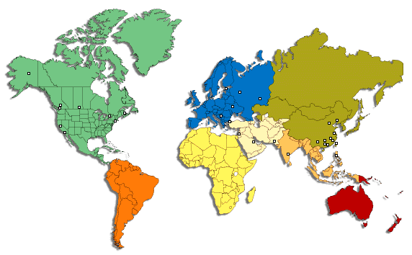
http://pyre.third-bit.com

