Slide 1

Software Engineering:
Develop Software Precisely and Efficiently
By Michel Daigle
Development Manager
Presented at CUSEC, March 8th, 2002
Forensic Technology Inc.
5757 Cavendish blvd
Cote St-Luc QC H4W 2W8
Notes:
TAILOR THE PRESENTATION TO YOUR AUDIENCE BY REMOVING OR ADDING ADDITIONAL SLIDES

Slide 2
Presentation Outline
Present our company and products
Our development structure history
Our software engineering process
Discuss the benefits
Questions & Answers

Slide 3
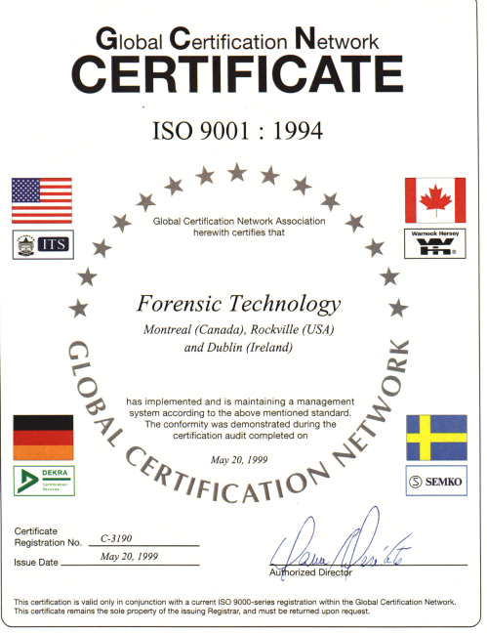

























Company Profile
Founded in 1992
Over 220 employees
International company: Offices in Canada, Ireland, South Africa , USA
Products installed in 26 Countries
ISO 9001 Certified
Notes:
Founded as a spin-off of Walsh Automation.
Project to automate the firearm ammunition examination
Idea came from an ex-RCMP officer

Slide 4
Our Mission…
Crime solving through innovative technology:
Ballistic Correlation and Information System
Firearm Control System
Criminalistics Laboratory Information System
Forensic Pathology Information System
Evidence Tracking and Management System

Slide 5


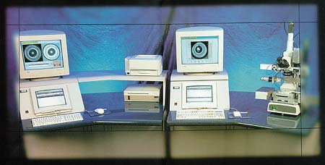

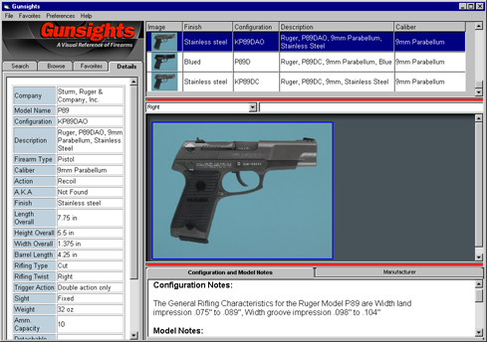



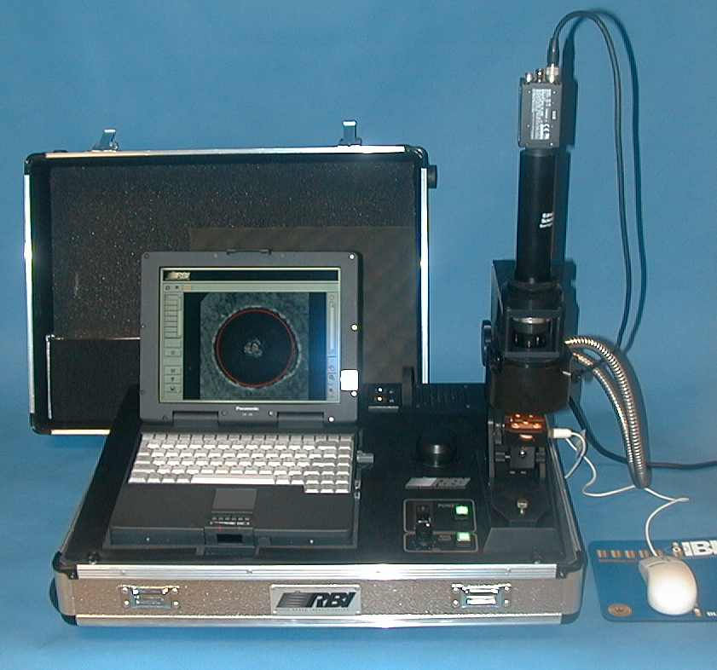
Our Products...
Forensic Solutions
Notes:
Explain briefly each product that FTI offers.
IBIS:Integrated ballistics identification system – automates ballistic information; enables law enforcement to enter fired evidence into IBIS. IBIS then creates algorithms that can be stored in database. Future fired evidence can then be compared to that database.
Gunsights: Electronic firearms reference software, high resolution photographs and detailed information on thousands of firearms
Gunetics: Secure digital record of a firearm. The “fingerprint” of the weapon is taken at the manufacturer level which can later be correlated through IBIS technology.
Matchpoint: Workstation for the firearm examiner. Additional hardware to the IBIS system allowing the examiner to review hits cases, create IBIS hit at his desk. This allows the IBIS workstation to be used for entry.
RBI: Rapid Brass Identification: Remote Cartridge Case entry station for the IBIS system. This allows remote and small agencies that cannot justify a IBIS system to enter fired cartridge case evidence and send it electronically to an IBIS Hub for correlation
BARD: Beyond A Reasonable Doubt: Suite of modules that allows for the sharing of electronic information allowing agencies involved within a case to access information from networked systems.

Slide 6
Development Structure History
I’ve got a good idea !
Some customers told me they might be interested
Let starts programming now!
We’ll write the documentation at the end of the project (why now ?)
The version 1.0 will include 100 % of the desired functionality… we’ll be the best product of the market!

Slide 7
Development Structure History
We did not document customer’s needs enough;
We have developed our versioning standard during development;
We worked 24/7 for the version 1.0… we worked 3 times the effort that we had planned;
The version 1.0 was too big and did not necessarily fulfill 100% of the customer’s expectation;
We were a small team… our documentation was incomplete:
  It was long and tedious to add new member to the development team;
  We had to rush to complete documentation for customer’s quality review;

Slide 8
Development Structure History
We’ve been extremely lucky:
Our initial idea was a technology breakthrough in law enforcement;
We have negotiated excellent sales’ contracts;
The product has been a technology and a commercial success.
With our past experience and with our company rapid growth (40 to 220 employees in 14 months) we have decided to implement a strong development structure:
We have adopted the Rational Unified Process (RUP) method

Slide 9
Effective Deployment 6 Best Practices
1. Develop Software Iteratively:
Asses risk and attack it through demonstrable progress
Produce frequent executable releases that enable continuous end user involvement and feedback
Development team stays focused on producing results, and frequent status checks help ensure that the project stays on schedule
An iterative approach also makes it easier to accommodate tactical changes in requirements, features or schedule

Slide 10
Effective Deployment 6 Best Practices
2. Manage Requirements:
Develop an approach that elicit, organize, and document required functionality and constraints;
Track and document tradeoffs and decisions;
Capture and communicate business requirements;
Use a set of pre-establish forms/document templates to that has been proven to be an excellent way to capture functional requirements
They provide coherent and traceable threads through both the development and the delivered system

Slide 11
Effective Deployment 6 Best Practices
3. Use Component-Based Architectures:
Focus on early development and baselining of a robust executable architecture, prior to committing resources for full-scale development;
Design a resilient architecture that is flexible, accommodates change, is intuitively understandable, and promotes more effective software reuse.
Components are non-trivial modules, subsystems that fulfill a clear function;
Use a well-defined architecture, either ad hoc, or in a component infrastructure such as the Internet, CORBA, and COM, for which an industry of reusable components is emerging.

Slide 12
Effective Deployment 6 Best Practices
4. Visually Model Software:
Visually model your software to capture the structure and behaviour of architectures and components;
Hide the details and write code using "graphical building blocks."
Visual abstractions helps to communicate different aspects of the software;
Allow to see how the elements of the system fit together and make sure that the building blocks are consistent within the code;
maintain consistency between a design and its implementation;
Promote unambiguous communication.
Use the industry-standard Unified Modeling Language (UML)

Slide 13
Effective Deployment 6 Best Practices
5. Verify Software Quality:
Poor application performance and poor reliability are common factors which dramatically inhibit the acceptability of today's software applications;
Hence, quality should be reviewed with respect to the requirements based on reliability, functionality, application performance and system performance;
Quality assessment must be built into the process, in all activities, involving all participants, using objective measurements and criteria
Must not treated as an afterthought or a separate activity performed by a separate group.
DO IT AT EVERY ITERATION !

Slide 14
Effective Deployment 6 Best Practices
6. Control Changes to Software:
Ability to manage change--making certain that each change is acceptable
Being able to track changes--is essential in an environment in which change is inevitable
Establish secure workspaces for each developer by providing isolation from changes made in other workspaces and by controlling changes of all software artefacts (e.g., models, code, documents, etc
Bring a team together to work as a single unit by describing how to automate integration and build management.
Iterative process = GOOD VERSIONING PRACTICES

Slide 15
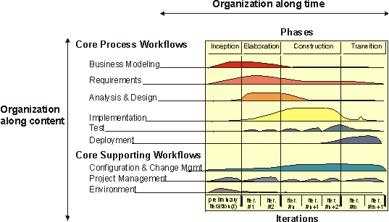
Iterative Model Graph (RUP)

Slide 16
Iterative Model Graph (RUP)
Two Dimensions
The horizontal axis:
Represents time and shows the dynamic aspect of the process as it is enacted, and it is expressed in terms of cycles, phases, iterations, and milestones.
The vertical axis:
Represents the static aspect of the process: how it is described in terms of activities, artefacts, workers and workflows.

Slide 17
Iterative Model
The software lifecycle is broken into cycles, each cycle working on a new generation of the product.
The Rational Unified Process divides one development cycle in four consecutive phases:
Inception phase
Elaboration phase
Construction phase
Transition phase

Slide 18
Inception Phase
A Vision document: a general vision of the core project's requirements, key features, and main constraints;
An use-case model (10%-20% complete);
A project glossary (may optionally be partially expressed as a domain model);
A business case, which includes business context, success criteria (revenue projection, market recognition, and so on), and financial forecast;
A risk assessment analysis;
A project plan, showing phases and iterations;
A business model, if necessary;
One or several prototypes.
Notes:
During the inception phase, you establish the business case for the system and delimit the project scope. To accomplish this you must identify all external entities with which the system will interact (actors) and define the nature of this interaction at a high-level. This involves identifying all use cases and describing a few significant ones. The business case includes success criteria, risk assessment, and estimate of the resources needed, and a phase plan showing dates of major milestones

Slide 19
Inception Phase
Lifecycle Objectives
Stakeholder concurrence on scope definition and cost/schedule estimates.
Requirements understanding as evidenced by the fidelity of the primary use cases.
Credibility of the cost/schedule estimates, priorities, risks, and development process.
Depth and breadth of any architectural prototype that was developed.
Actual expenditures versus planned expenditures.

Slide 20
Elaboration Phase
A use-case model (at least 80% complete) - all use cases and actors have been identified, and most use-case descriptions have been developed.
Supplementary requirements capturing the non functional requirements and any requirements that are not associated with a specific use case.
A Software Architecture Description.
An executable architectural prototype.
A revised risk list and a revised business case.
A development plan for the overall project, including the coarse-grained project plan, showing iterations" and evaluation criteria for each iteration.
An updated development case specifying the process to be used.
A preliminary user manual (optional… but, sooner the better!).
Notes:
The purpose of the elaboration phase is to analyze the problem domain, establish a sound architectural foundation, develop the project plan, and eliminate the highest risk elements of the project. To accomplish these objectives, you must have the "mile wide and inch deep" view of the system. Architectural decisions have to be made with an understanding of the whole system: its scope, major functionality and nonfunctional requirements such as performance requirements.

Slide 21
Elaboration Phase
Lifecycle Objectives
Is the vision of the product stable?
Is the architecture stable?
Does the executable demonstration show that the major risk elements have been addressed and credibly resolved?
Is the plan for the construction phase sufficiently detailed and accurate?
Do all stakeholders agree that the current vision can be achieved if the current plan is executed to develop the complete system, in the context of the current architecture?
Is the actual resource expenditure versus planned expenditure acceptable?

Slide 22
Construction Phase
The software product integrated on the adequate platforms.
The user manuals.
A description of the current release.
Lifecycle Objectives
Is this product release stable and mature enough to be deployed in the user community?
Are all stakeholders ready for the transition into the user community?
Are the actual resource expenditures versus planned expenditures still acceptable?
Notes:
During the construction phase, all remaining components and application features are developed and integrated into the product, and all features are thoroughly tested. The construction phase is, in one sense, a manufacturing process where emphasis is placed on managing resources and controlling operations to optimize costs, schedules, and quality. In this sense, the management mindset undergoes a transition from the development of intellectual property during inception and elaboration, to the development of deployable products during construction and transition.

Slide 23
Transition Phase
"Beta testing" to validate the new system against user expectations
Parallel operation with a legacy system that it is replacing
Conversion of operational databases
Training of users and maintainers
Roll-out the product to the marketing, distribution, and sales teams
Notes:
The purpose of the transition phase is to transition the software product to the user community. Once the product has been given to the end user, issues usually arise that require you to develop new releases, correct some problems, or finish the features that were postponed.

Slide 24
Transition Phase
Lifecycle Objectives
Achieving user self-supportability
Achieving stakeholder concurrence that deployment baselines are complete and consistent with the evaluation criteria of the vision
Achieving final product baseline as rapidly and cost effectively as practical

Slide 25
Product Release!
Is the user satisfied?
Are the actual resources expenditures versus planned expenditures still acceptable?
Notes:
At the end of the transition phase is the fourth important project milestone, the Product Release Milestone. At this point, you decide if the objectives were met, and if you should start another development cycle. In some cases, this milestone may coincide with the end of the inception phase for the next cycle.

Slide 26
Iterations and Versioning
Each phase in the Process can be further broken down into iterations.
An iteration is a complete development loop resulting in a release (internal or external) of an executable product, a subset of the final product under development, which grows incrementally from iteration to iteration to become the final system.
Therefore, through phases, it is vital to manage and synchronize documents and software versions.

Slide 27
Benefits of an Iterative Approach
Compared to the traditional waterfall process, the iterative process has the following advantages:
Risks are mitigated earlier;
Change is more manageable ;
Higher level of reuse;
The project team can learn along the way;
Better overall quality;
The profits are higher;
The customer is satisfied and… will bring you repeat business as well as good references.

Slide 28
What to Read…
Dean Leffingwell, Don Widrig, Managing Software Requirements, Addison-Wesley, 2000, 491p.
Alistair Cockburn, Writing Effective Use Cases, Addison-Wesley, 2001, 270p.
Alan W. Brown (ed.), Component-Based Software Engineering, IEEE Computer Society, Los Alamitos, CA, 1996, pp.140.
Ivar Jacobson, Magnus Christerson, Patrik Jonsson, and Gunnar Övergaard, Object-Oriented Software Engineering-A Use Case Driven Approach, Wokingham, England, Addison-Wesley, 1992, 582p.

Slide 29
Questions
?
Forensic Technology, Inc.
Michel Daigle
michel.daigle@fti-ibis.com
www.forensictechnologyinc.com
B•A•R•D, IBIS, Gunsights, MatchPoint, VSN, and CrimeSeen are registered trademarks of Forensic Technology Incorporated. Oracle and the On Oracle logo are trademarks of Oracle Corporation. Windows 95, Windows 98, Windows ME, Windows 2000, Windows CE are trademarks of Microsoft; Microsoft is a registered trademark of Microsoft Corporation in the United States and other countries. LimsLink is a registered trademark of Labtronics Incorporated. Rational, Rational Unified Process, RUP are trademark of the Rational Software Corporation.

