Slide 1
Testing Interactions Among
Software Components
Alan Williams
School of Information Technology and Engineering,
University of Ottawa
awilliam@site.uottawa.ca
www.site.uottawa.ca/~awilliam

Slide 2
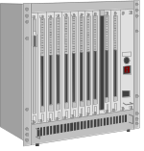

Component-Based Systems
Payment Server
Client
browser
Business
Web Server
Type:
MasterCard,
Visa,
American Express
Type:
Netscape,
Explorer
Type:
WebSphere,
Apache,
.NET
Business Database
Type:
DB/2,
Oracle,
Access
The goal: verify reliability and interoperability by testing as many system configurations as possible, given time and budget constraints.

Slide 3
Issues for Developers
Can one software model be used for all deployment configurations?
We could use configuration management, with a different version for each deployment configurations.
  Drawback: maintenance of multiple models.
Software modelling techniques do not take deployment to multiple environments into account, at the model level.
Ideal: one model could generate code (or even be executable) for any deployment configuration
  UML virtual machines?

Slide 4
Issues for Testers
Assumption: Suppose we already have a “sufficient” test suite for a single configuration.
If we do not have the resources to test all configurations, which ones should be selected for testing?
If test cases are automated, they will need modification for a particular execution environment.

Slide 5
Selecting Test Configurations
A well-known source of problems is components that function correctly on their own, but cause problems when interacting with other components.
Strategy for selecting test configurations:
  Maximize coverage of potential interactions

Slide 6
Objectives
Develop a measure that shows how well potential interactions are covered by a set of test configurations.
Determine how to achieve the highest interaction coverage with the fewest number of configurations.

Slide 7
Objectives
Develop a measure that shows how well potential interactions are covered by a set of test configurations.
Determine how to achieve the highest interaction coverage with the fewest number of configurations.

Slide 8
A test configuration is:
Browser:
Server:
Payment:
Database:
Explorer
WebSphere
Visa
DB/2
For each component, one of the available types of that component is selected.
The entire e-commerce application test suite is run for each configuration that is selected.
Notes:
Suppose that we have k parameters (system components). For parameter i, there are a set of legal values
{ 1,…, n_{i} }.
The values are independent: selecting a particular value for one parameter does not affect the selection of values for any other parameter. (See reference [1] for a strategy to handle dependencies among parameters)
There are n₁× n₂×… × n_{k} possible test configurations.
For the special case where each parameter has the same number of values n, there are n^{k} possible test configurations.

Slide 9
Formal Definition of General Problem
Let p be the number of parameters (components).
  Parameters are indexed 1,…, p.
For each parameter i, suppose that there are n_{i} possible values (component types).
  Each parameter can take a value v_{i}, where 1 ≤ v_{i} ≤ n_{i}
Assumption: parameters are independent.
  The choice of values for any parameter does not affect the choice of values for any other parameter.
  Dependencies among parameters can be resolved by creating a hybrid parameter that enumerates all legal combinations.

Slide 10
Testing in the Presence of
Polymorphism and Inheritance
Requesting
Object
Method
invocation
Service
Object
Method
Name
Parameter
Object
class hierarchy
Parameter
Object
...
...
Requester, service, and message parameter objects could be instances of various classes within the class hierarchy.

Slide 11
Testing of
Parameter Equivalence Classes
Suppose we have:
  method( a, b, c, d, e )
Determine equivalence classes for each parameter
  Example: for a, we might have:
    [-∞, -4][-3,-1][0][1,12][13,+∞]
  Select a representative value from each equivalence class
To test if parameters affect each other, we need to select combinations of equivalence classes
  Desirable if decision conditions involve more than one parameter

Slide 12
An interaction element is:
Browser:
Server:
Payment:
Database:
Explorer
Visa
Choose a subset of the parameters:
  The size of the subset is the interaction degree.
Choose specific values for the parameters.
Notes:
Suppose that we have k parameters (system components). For parameter i, there are a set of legal values
{ 1,…, n_{i} }.
The values are independent: selecting a particular value for one parameter does not affect the selection of values for any other parameter. (See reference [1] for a strategy to handle dependencies among parameters)
There are n₁× n₂×… × n_{k} possible test configurations.
For the special case where each parameter has the same number of values n, there are n^{k} possible test configurations.

Slide 13
Example
Suppose that we have three parameters.
For each parameter, there are two possible values.
  Values are :
    A, B for parameter 1.
    J, K for parameter 2.
    Y, Z for parameter 3.
Degree of interaction coverage is 2.
  We want to cover all potential 2-way interactions among parameter values.

Slide 14
Set of all possible test configurations
A
J
Y
Three parameters, two
values for each.
A
J
Z
A
K
Y
There are 2³ = 8 possible test configurations.
A
K
Z
B
J
Y
B
J
Z
B
K
Y
B
K
Z

Slide 15
Set of all possible degree 2 interaction elements
There are ( ) × 2 ² = 12 possible interaction elements.
3
2
A
J
A
Y
J
Y
A
K
A
Z
J
Z
B
J
B
Y
K
Y
B
K
B
Z
K
Z
Coverage measure:
  Percentage of interaction elements covered.

Slide 16
Test configurations as sets of interactions
One test configuration...
A
J
Y
A
J
… covers 3 possible
interaction elements.
A
Y
J
Y

Slide 17
Interaction test coverage goal
A
J
Y
A
J
Z
A
J
A
Y
J
Y
A
K
Y
A
K
A
Z
J
Z
A
K
Z
B
J
B
Y
K
Y
B
J
Y
B
K
B
Z
K
Z
B
J
Z
B
K
Y
B
K
Z
Goal: cover all interaction
elements…
…using a subset of
all test configurations.

Slide 18
Selection of test configurations for coverage of interaction elements
Interaction elements
Test configurations
A
A
J
J
Y
Y
A
J
A
Y
J
Y
A
J
A
Y
J
Y
A
J
Z
A
K
A
Z
J
Z
A
K
Y
B
J
B
Y
K
Y
A
K
Z
B
K
B
Z
K
Z
B
J
Y
B
J
Z
B
K
Y
Degree 2 coverage: 3 / 12 = 25%
B
K
Z
Degree 3 coverage: 1 / 8 = 12.5%

Slide 19
Selection of test configurations for coverage of interaction elements
Interaction elements
Test configurations
A
J
Y
A
J
A
Y
J
Y
A
J
Z
A
A
K
K
A
A
Z
Z
J
Z
A
K
Y
B
J
B
Y
K
Y
A
A
K
K
Z
Z
B
K
B
Z
K
K
Z
Z
B
J
Y
B
J
Z
B
K
Y
Degree 2 coverage: 6 / 12 = 50%
B
K
Z
Degree 3 coverage: 2 / 8 = 25%

Slide 20
Selection of test configurations for coverage of interaction elements
Interaction elements
Test configurations
A
A
J
J
Y
Y
A
J
A
Y
J
Y
A
J
Z
A
K
A
Z
J
J
Z
Z
A
K
Y
B
B
J
J
B
Y
K
Y
A
A
K
K
Z
Z
B
K
B
B
Z
Z
K
Z
B
J
Y
B
B
J
J
Z
Z
B
K
Y
Degree 2 coverage: 9 / 12 = 75%
B
K
Z
Degree 3 coverage: 3 / 8 = 37.5%

Slide 21
Selection of test configurations for coverage of interaction elements
Interaction elements
Test configurations
A
A
J
J
Y
Y
A
J
A
Y
J
Y
A
J
Z
A
K
A
Z
J
Z
A
K
Y
B
J
B
B
Y
Y
K
K
Y
Y
A
A
K
K
Z
Z
B
B
K
K
B
Z
K
Z
B
J
Y
B
B
J
J
Z
Z
B
B
K
K
Y
Y
Degree 2 coverage: 12 / 12 = 100%
B
K
Z
Degree 3 coverage: 4 / 8 = 50%

Slide 22
Choosing the degree of coverage
In one experiment, covering 2 way interactions resulted in the following average code coverage:
  93% block coverage.
  83% decision coverage.
  76% c-use coverage.
  73% p-use coverage.
  Source: Cohen, et al, “The combinatorial design approach to automatic test generation”, IEEE Software, Sept. 1996.
Another experience report investigating interactions among 2-4 components:
  Dunietz, et al, “Applying design of experiments to software testing”, Proc. Of ICSE ‘97.

Slide 23
Section summary
We have defined how to measure coverage of potential system interactions.
Strategy for choosing test configurations:
  Maximize coverage of interaction elements for a given degree.
Choose interaction degree based on:
  Degree of interaction risk that can be tolerated.
  Test budget constraints.

Slide 24
Objectives
Develop a measure that shows how well potential interactions are covered by a set of test configurations.
Determine how to achieve the highest interaction coverage with the fewest number of configurations.

Slide 25
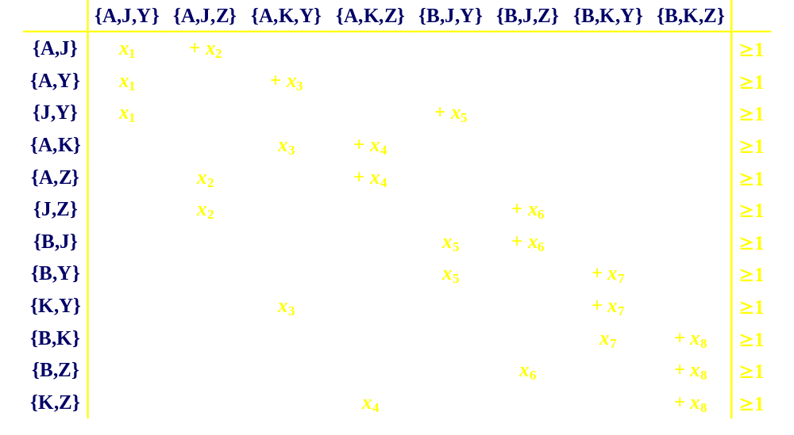
Constraint-based approach
AJY
AJZ
AKY
AKZ
BJY
BJZ
BKY
BKZ
A
J
A
Y
J
Y
A
K
A
Z
J
Z
B
J
B
Y
K
Y
B
K
B
Z
K
Z
Minimize:
x₁ + x₂ + x₃ + x₄ + x₅ + x₆ + x₇ + x₈; x_{i} ∈ {0,1}

Slide 26

Running the problem as a {0,1} integer program
process killed after running for 6.5 hours
Solution of {0,1} integer programs is an NP-complete problem

Slide 27
A linear programming approximation
Value of objective function: 9
x043 0.530351
x047 0.401344
x117 0.389934
x201 0.323851
x069 0.302597
x241 0.301478
x213 0.286215
x003 0.279507
x176 0.258343
x224 0.25652
x181 0.249479
x107 0.248555
x159 0.247746
x166 0.247169
x130 0.244542
x233 0.243054
x056 0.238081
x113 0.235705
x136 0.234124
x092 0.228301
x099 0.226595
x009 0.173559
x026 0.172155
x013 0.167052
x194 0.165232
x145 0.155093
x058 0.153223
x149 0.152299
x228 0.146957
5 parameters, 3 values for each.
Value of objective function can be achieved by setting {x₄₃, x₄₇, x₁₁₇, x₂₀₁, x₆₉, x₂₄₁, x₂₁₃, x₃, x₁₇₆, x₂₂₄, x₁₈₁, x₁₀₇, x₁₅₉, x₁₆₆, x₁₃₀, x₅₆, x₁₃₆, x₉₂} to 1, and the rest to 0.
However, this results in 18 configurations instead of the (fewest known) 11.
x156 0.135725
x190 0.129007
x081 0.123935
x100 0.123432
x024 0.120402
x094 0.119709
x119 0.118003
x165 0.11396
x077 0.101096
x005 0.087325
x189 0.0859768
x073 0.0810688
x142 0.0750125
x031 0.0683057
x215 0.0678995
x088 0.0480873
x169 0.0450714
x222 0.04304
x199 0.0277951
x116 0.0118162
x236 0.00895104
x083 0.00532082

Slide 28
Statistical Experimental Design
Used in many fields other than computer science.
Objective:
  Create an experiment to test several factors at once.
    Individual effect of each factor.
    Interactions among factors.
  Minimize the number of experiments needed.
  Facilitate result analysis.
Application to software system testing:
  Can be used in any situation where there are a set of parameters, each of which have a set of (discrete) values.

Slide 29
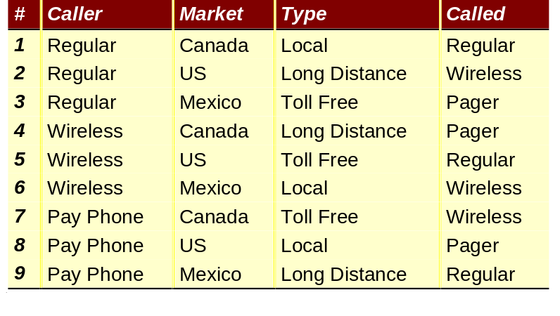
Orthogonal Arrays
Orthogonal arrays are a standard construction used for statistical experiments.
Strength 2: select any 2 columns and all ordered pairs occur the same number of times.
  Covers all 2-way interactions.
Orthogonal arrays can be found in statistical tables, or can be calculated from algebraic finite fields.
  Many existence restrictions.

Slide 30
Adaptation to Software Testing
If we are testing strictly for software interactions, we can use a smaller experimental design.
Why?
  If each component has been tested on its own, we can eliminate the need for testing for the effect of a single parameter.
  Software testing yields a discrete test result (“pass” or “fail”), rather than requiring result analysis of real valued results.
The result:
  Each interaction needs to be covered at least once, instead of the same number of times.
  Fewer configurations are required.
  The construction for this purpose is called a covering array.

Slide 31
Covering Arrays
Definition of covering array:
  If we select d columns, all possible ordered d-tuples occur at least once.
A covering array of strength d will ensure than any consistent interaction problem caused by a particular combination of two elements is detected.
Problems caused by an interaction of d + 1 (or more) elements may not be detected.
Choosing the degree of coverage defines the trade-off in risk we are making:
  Fewer test configurations versus potential uncovered interactions.

Slide 32
Recursive Covering Array Construction
Problem:
  If the range of values is 1, …, n, then an orthogonal array can handle at most n + 1 parameters.
  Existence of suitable orthogonal arrays.
Goal:
  Generate covering arrays for problems of arbitrary size.
Method:
  Assemble larger covering array from smaller building blocks.
  No heuristics.

Slide 33
Constructing Large Covering Arrays
1
1
1
1
1
2
2
2
1
3
3
3
2
1
2
3
2
2
3
1
2
3
1
2
3
1
3
2
3
2
1
3
3
3
2
1
With 3 values per parameter, an orthogonal
array can handle up to 4 parameters.

Slide 34
Constructing Large Covering Arrays
1
1
1
1
1
1
1
1
1
1
1
1
1
2
2
2
1
2
2
2
1
2
2
2
1
3
3
3
1
3
3
3
1
3
3
3
2
1
2
3
2
1
2
3
2
1
2
3
2
2
3
1
2
2
3
1
2
2
3
1
2
3
1
2
2
3
1
2
2
3
1
2
3
1
3
2
3
1
3
2
3
1
3
2
3
2
1
3
3
2
1
3
3
2
1
3
3
3
2
1
3
3
2
1
3
3
2
1
Duplicate orthogonal array three times
for 12 parameters …

Slide 35
Constructing Large Covering Arrays
1
1
1
1
1
1
1
1
1
1
1
1
1
2
2
2
1
2
2
2
1
2
2
2
1
3
3
3
1
3
3
3
1
3
3
3
2
1
2
3
2
1
2
3
2
1
2
3
2
2
3
1
2
2
3
1
2
2
3
1
2
3
1
2
2
3
1
2
2
3
1
2
3
1
3
2
3
1
3
2
3
1
3
2
3
2
1
3
3
2
1
3
3
2
1
3
3
3
2
1
3
3
2
1
3
3
2
1
Check coverage so far:
For the first column...

Slide 36
Constructing Large Covering Arrays
1
1
1
1
1
1
1
1
1
1
1
1
1
2
2
2
1
2
2
2
1
2
2
2
1
3
3
3
1
3
3
3
1
3
3
3
2
1
2
3
2
1
2
3
2
1
2
3
2
2
3
1
2
2
3
1
2
2
3
1
2
3
1
2
2
3
1
2
2
3
1
2
3
1
3
2
3
1
3
2
3
1
3
2
3
2
1
3
3
2
1
3
3
2
1
3
3
3
2
1
3
3
2
1
3
3
2
1
… we have pair-wise coverage
with the rest of the orthogonal array
(by definition) …

Slide 37
Constructing Large Covering Arrays
1
1
1
1
1
1
1
1
1
1
1
1
1
2
2
2
1
2
2
2
1
2
2
2
1
3
3
3
1
3
3
3
1
3
3
3
2
1
2
3
2
1
2
3
2
1
2
3
2
2
3
1
2
2
3
1
2
2
3
1
2
3
1
2
2
3
1
2
2
3
1
2
3
1
3
2
3
1
3
2
3
1
3
2
3
2
1
3
3
2
1
3
3
2
1
3
3
3
2
1
3
3
2
1
3
3
2
1
… but we also have pair-wise coverage with
the corresponding columns in the
duplicate orthogonal arrays.

Slide 38
Constructing Large Covering Arrays
1
1
1
1
1
1
1
1
1
1
1
1
1
2
2
2
1
2
2
2
1
2
2
2
1
3
3
3
1
3
3
3
1
3
3
3
2
1
2
3
2
1
2
3
2
1
2
3
2
2
3
1
2
2
3
1
2
2
3
1
2
3
1
2
2
3
1
2
2
3
1
2
3
1
3
2
3
1
3
2
3
1
3
2
3
2
1
3
3
2
1
3
3
2
1
3
3
3
2
1
3
3
2
1
3
3
2
1
We have also covered the
(x,x) combinations in the identical columns,
but not the (x,y) combinations.

Slide 39
Constructing Large Covering Arrays
1
1
1
1
1
1
1
1
1
1
1
1
1
2
2
2
1
2
2
2
1
2
2
2
Use reduced
array, which covers
only the (x,y)
combinations
1
3
3
3
1
3
3
3
1
3
3
3
2
1
2
3
2
1
2
3
2
1
2
3
2
2
3
1
2
2
3
1
2
2
3
1
2
3
1
2
2
3
1
2
2
3
1
2
3
1
3
2
3
1
3
2
3
1
3
2
3
2
1
3
3
2
1
3
3
2
1
3
3
3
2
1
3
3
2
1
3
3
2
1
1
2
3
This is the original orthogonal
array, with the first 3 rows and
first column removed.
2
3
1
3
1
2
1
3
2
2
1
3
3
2
1

Slide 40
Constructing Larger Covering Arrays
1
1
1
1
1
1
1
1
1
1
1
1
1
2
2
2
1
2
2
2
1
2
2
2
… and add new
configurations to
cover missing
combinations.
1
3
3
3
1
3
3
3
1
3
3
3
2
1
2
3
2
1
2
3
2
1
2
3
2
2
3
1
2
2
3
1
2
2
3
1
2
3
1
2
2
3
1
2
2
3
1
2
3
1
3
2
3
1
3
2
3
1
3
2
3
2
1
3
3
2
1
3
3
2
1
3
3
3
2
1
3
3
2
1
3
3
2
1
1
2
3
2
3
1
3
1
2
1
3
2
2
1
3
3
2
1

Slide 41
Constructing Large Covering Arrays
1
1
1
1
1
1
1
1
1
1
1
1
1
2
2
2
1
2
2
2
1
2
2
2
This covers the
remaining combinations
for the first column.
1
3
3
3
1
3
3
3
1
3
3
3
2
1
2
3
2
1
2
3
2
1
2
3
2
2
3
1
2
2
3
1
2
2
3
1
2
3
1
2
2
3
1
2
2
3
1
2
3
1
3
2
3
1
3
2
3
1
3
2
3
2
1
3
3
2
1
3
3
2
1
3
3
3
2
1
3
3
2
1
3
3
2
1
1
2
3
2
3
1
3
1
2
1
3
2
2
1
3
3
2
1

Slide 42
Constructing Larger Covering Arrays
1
1
1
1
1
1
1
1
1
1
1
1
The same scheme
applies to other
columns.
1
2
2
2
1
2
2
2
1
2
2
2
1
3
3
3
1
3
3
3
1
3
3
3
2
1
2
3
2
1
2
3
2
1
2
3
2
2
3
1
2
2
3
1
2
2
3
1
2
3
1
2
2
3
1
2
2
3
1
2
3
1
3
2
3
1
3
2
3
1
3
2
3
2
1
3
3
2
1
3
3
2
1
3
3
3
2
1
3
3
2
1
3
3
2
1
1
1
1
1
2
2
2
2
3
3
3
3
2
2
2
2
3
3
3
3
1
1
1
1
All pair-wise combinations have
now been covered
3
3
3
3
1
1
1
1
2
2
2
2
1
1
1
1
3
3
3
3
2
2
2
2
2
2
2
2
1
1
1
1
3
3
3
3
3
3
3
3
2
2
2
2
1
1
1
1

Slide 43
Constructing Larger Covering Arrays
O
O
O
R₄: columns are duplicated 4 times consecutively
R₄

Slide 44
Multistage Covering Arrays
O
O
O
O
O
O
O
O
O
R₄
R₄
R₄
R₁₂

Slide 45
Some results
Results from the recursive construction example:
  13 components, 3 types for each component.
  Number of potential test configurations: 1,594,323.
  Number of degree 2 interaction elements: 702.
  Minimum number of configurations for 100% coverage of degree 2 interaction elements: 15.
Achieving coverage of interaction elements results in a number of test configurations that is proportional to.
  The logarithm of the number of components.
  The maximum number of types for any component, raised to the power of the interaction coverage degree.

Slide 46
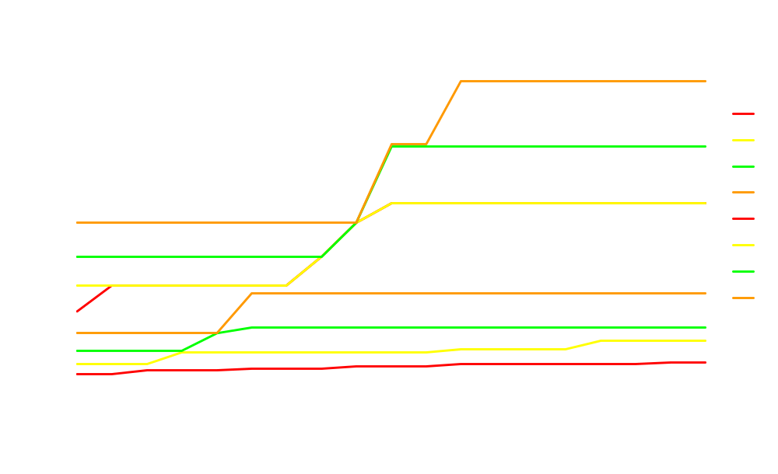
Number of configurations to cover interaction elements of degree 2

Slide 47
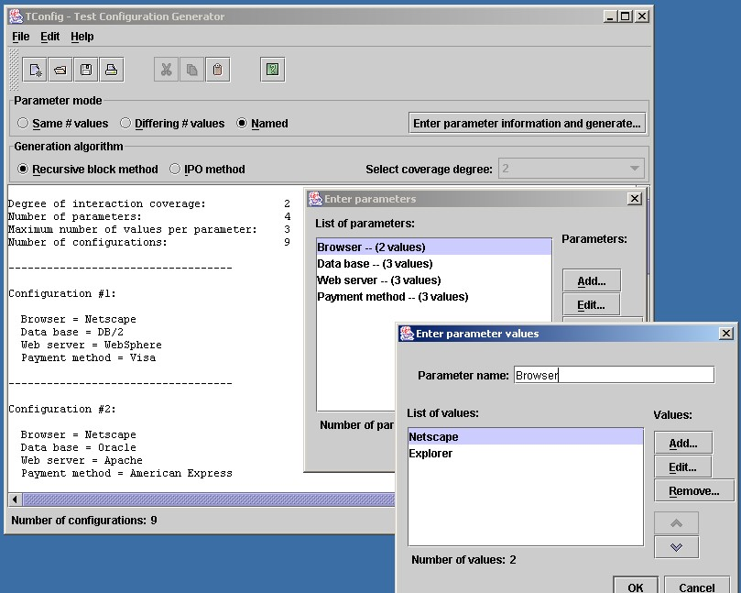
TConfig: Test configuration generator
Try it: www.site.uottawa.ca/~awilliam/TConfig.jar

Slide 48
Our example again...
Payment Server
Client
browser
Business
Web Server
Type:
MasterCard,
Visa,
American Express
Type:
Netscape,
Explorer
Type:
WebSphere,
Apache,
.NET
Business Database
Type:
DB/2,
Oracle,
Access

Slide 49
Test configurations for degree 2 coverage
Configuration
Browser
Web
Server
Payment
Data
Base
1
Netscape
WebSphere
MasterCard
DB/2
2
Netscape
Apache
Visa
Oracle
3
Netscape
.NET
AmEx
Access
4
Explorer
WebSphere
Visa
Access
5
Explorer
Apache
AmEx
DB/2
6
Explorer
.NET
MasterCard
Oracle
7
(don’t care)
WebSphere
AmEx
Oracle
8
(don’t care)
Apache
MasterCard
Access
9
(don’t care)
.NET
Visa
DB/2

Slide 50
Comments from testers:
Pre-existing regression test suites:
  “I already have a collection of tests that are working fine, and have been developed at great expense. How do I determine which additional tests need to be added to bring the test suite to a certain level of interaction coverage?”
Ensuring that desired test configurations are included by the generation method:
  “A specific set of test configurations are recommended to customers. We want to make sure those configurations are covered.”
Changes in set of allowed parameters and values:
  “What additional configurations are required if…
    … a new component is added to the system?”
    … a new version of an existing component becomes available?”

Slide 51
The road ahead
Now that we know which test configurations to select, is there a way to automatically modify test scripts for each configuration?
Design model to support deployment to multiple environments…
  Build deployment into modelling notations?
  Virtual machines for execution?

Slide 52
Thank you!
This presentation is available at:
  http://www.site.uottawa.ca/~awilliam

