Slide 1
- A brief aside -
Methodologies as Swimsuits

Slide 2
There is No Mystery
(until you return to your project)
Projects come in different shapes and sizes.
Methodologies come in different shapes and sizes.
People come in different shapes and sizes.
The people may not fit the methodology.
The people are the more important.

Slide 3
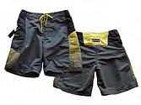
a sample methodology

Slide 4
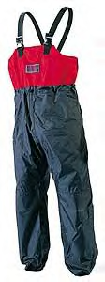
A bigger methodology

Slide 5

A smaller methodology

Slide 6
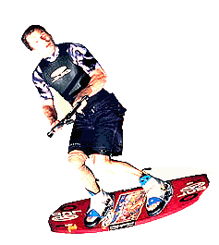
A methodology good for fooling around

Slide 7

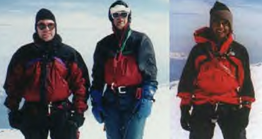
A methodology for climbing Mt. Everest

Slide 8

A light methodology for casual use

Slide 9

A heavier methodology for rugged use

Slide 10
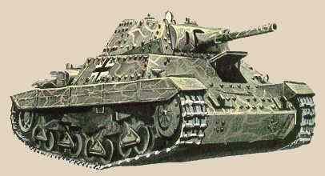
A military-spec swimsuit

Slide 11

XP

Slide 12
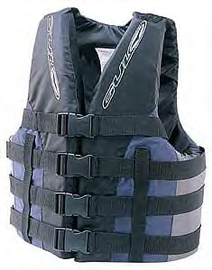
How much does the methodology cover? How much should it?

Slide 13
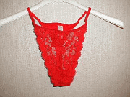
Very small - not intended to cover much

Slide 14

Intended to cover a lot

Slide 15

Is it large enough? Does it cover enough?

Slide 16

Most methodologies are too large

Slide 17
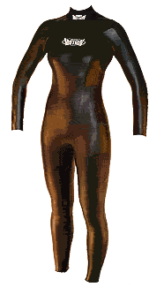
My favorite methodology - the stretch-to-fit

Slide 18
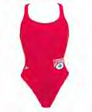
Many come in 1 piece - just put it on

Slide 19
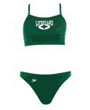
It may come in several pieces - some assembly is required

Slide 20
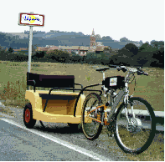
Many methodologies are home-built

Slide 21
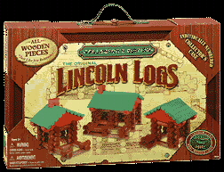
Some come in kit form

Slide 22
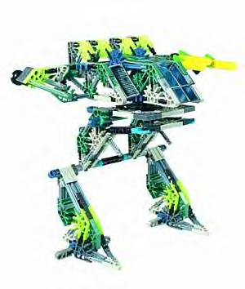

The Unified Process comes in kit form

Slide 23
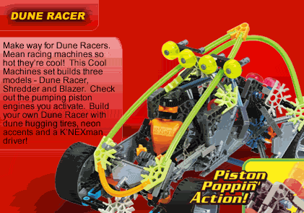
Unified Process can be mean and light

Slide 24

Or it can be mean and serious

Slide 25
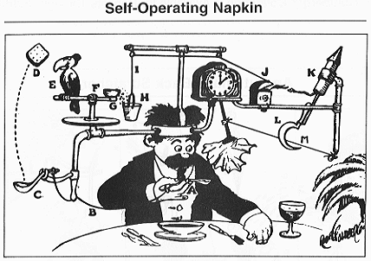
Most are overly complex

Slide 26
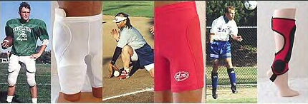
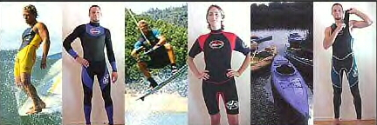
Choose your methodology to fit your purpose

