Slide 1
How to develop software ?
Mostly: don`t…
Jerzy Prekurat
jerzy@jerzy.org

Slide 2
Definition
Software Development Conference:
Long winded discussion how to do better something, that – in most cases - should not be done at all.

Slide 3
Example – `Sleepy Eye`
Large integrator (EDS):
  Developed program for ODBC data transfer
  Broken `keep-alive` loop
  Program periodically went to sleep
  Solution: write program to wake it up
World would be a better place, if those guys did nothing (or – did not exist)

Slide 4
Definition
Software:
Detailed recipe how to perform a task, preferably simple enough for a dumb thing (like a computer) to implement.

Slide 5
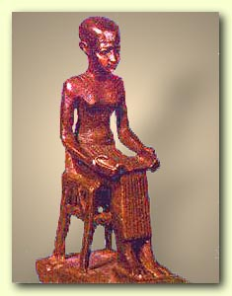
First programmer - Imhotep
Circa 2600BC
Developed software to build a pyramid
Language: hieroglyphs
Compiler: none
Interpreter: 10,000 Nubians

Slide 6
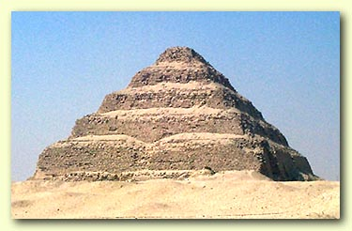
Pyramid v. 1.0
Stepped Pyramid of Djoser
A bit rough at the edges
More pyramids were built…
…but software was irretrievably lost before the end of the Old Kingdom

Slide 7
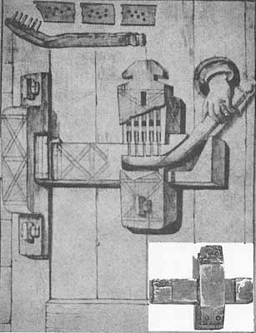
Other lost goodies…
Egyptian `Yale` lock (reinvented in 1848)
Flash of genius working within immature structure…
…just like some software today
Well, most have it`s “genius” bit set to 0

Slide 8
Monte Carlo story
Perfect method to quickly approximate results in minimal time.
Accuracy improves with additional calculations.
I had to develop it twice (in Fortran)
I counted 47 implementations by 1984, then - quit counting…
What is wrong with this picture ?
Notes:
Yes, we do have a platform we control

Slide 9
Memory management
“I am going to write memory management by Tuesday, then…” Does it sound logical ?
“I am going to design a screw (rediscover America, reinvent the wheel etc.) by Tuesday, then…” How does this sound ?
Any similarities ?
Notes:
Yes, we do have a platform we control

Slide 10
Immature structure
Lack of established mechanism to preserve the knowledge and to build on accomplishments of others
Current status of Software Development
How do we grow up ?
Notes:
Yes, we do have a platform we control

Slide 11
The nut-case…
…and the screw to fit the nut
Screw - invented by Archytas of Tarentum around 400BC…
…remained quite useless for over 2000 years…
…until the Industrial Revolution…
…everybody – including Archimedes and Heron – thought screw is a good idea, but…
…it did not fit the nut…
Notes:
Yes, we do have a platform we control

Slide 12
The nut-case continues
Antoine Thiout – circa 1750 – lathe with screw drive (just like a framework…)
  From now on craftsmen could produce much faster something that should not be created in the first place – unique screws
Joseph Whitworth – 1841 – British standard screws (55 degree – round crest)
William Sellers – 1864 – American screws (60 degrees – flat crest)
  Result: British screws did not fit American nuts until 1948…
Notes:
Yes, we do have a platform we control

Slide 13
The anti-nut case
Resistance to thread standardization: we need the screw to meet exactly the requirements of our product…
  Science necessary to calculate the exact parameters of screws did not exist until 1930`s
  See: software requirements documents…
When you design a car – there is no time for reinventing screws, hinges and the like…
  …unless you happen to be GM, then you need Torx
Notes:
Yes, we do have a platform we control

Slide 14
Software screw – TCP/IP
TCP stack was designed to recover from congestion related packet loss
Radio links – interference causes most of the loss – requires different recovery mechanism
Modification of Swansea stack – 3 days
Writing new protocol (major vendor) - >$250k…
…then – for compatibility – new protocol was used to wrap TCP
Notes:
Yes, we do have a platform we control

Slide 15
Kali VPN
Kali is a flexible, secure router/fw/VPN
    IPsec with 256-bit AES encryption
    X.509 and CLR support
    Packet filter firewall
    Services: DHCP, NTP, PPP,SSH, custom services
      Mock transaction tester
      Packet blaster link test
      OSPF
    Connectivity: xDSL, X.21, V.35, up to 7 ethernet
    Radio capability (802.11x)
All that can be implemented for <$300 per unit and more flexible than any other device
Notes:
Separately routable interfaces
Custom services can be written in a week

Slide 16
Beauty of little Kali
CBN needs sophisticated features, but not complexity and “people pleaser” gimmicks
    Need: multiple interfaces; don’t need: web based management on port 80
    Need: 256bit AES; don’t need: XAUTH extensions
Cost:
    Kali – 7 interfaces: $400
    Cisco – 3 interfaces: $15,000
Flexibility:
    We can add what we need – tests etc.
Control and more
Notes:
We can do things we could not otherwise do.

Slide 17
How did we get here ?
Incremental development
Advantages:
  Low cost
  Immediate payback…
  …pay as you go
  Immediate feedback…
  …learn as you go
  No big mistakes – no time to make them
  Incremental risk
  Open Source leverage, many modules are waiting out there
Modular design comes as a necessity
Problems:
  Never enough time…
  …we could make it better, if…
  Never enough resources…
  …we could build more, if…
  Ad-hoc architecture
  Small mistakes
  Periodic re-engineering
Management challenge: programmers always want to “boil the ocean”
Notes:
Risk significantly limited:
- open source as a starting point (tested already in some contexts)
- localized bugs – it`s in the last increment
Impossible to do with “Cobol programmers” (explain)

Slide 18
How did we get here ?
Multi-purpose development
Advantages:
  Very low cost…
  …build once, sell many times…
  …in different products
  Stability – debugged in many contexts
  Effective life cycle management
  Generic specifications
  Adaptability to new tasks
Open Standards design comes as a necessity
Problems:
  Consistency
  Versioning
  No “paper fortress” – cannot hide bad design behind “requirements document”
  Expertise – not tools
  Hostile to bad habits
  Constant back-porting
Management challenge: leader has to know what he is doing (rare)
Notes:
Economy of scale without large scale
We propose to continue and expand, 18c on the dollar

Slide 19
Case for Kali:
Freedom of choice
Need: dial-up server
    Outdated technology, mostly discontinued
    Available devices >$2000
Student added PPP server function to Kali
    Less than 3 days of work.
    Cost <$300 per device, $8500 savings on 5 devices needed
    Faster than ordering equivalent gear
Technology will be reused
    By support group (~5 more devices)
    Available for other projects

Slide 20
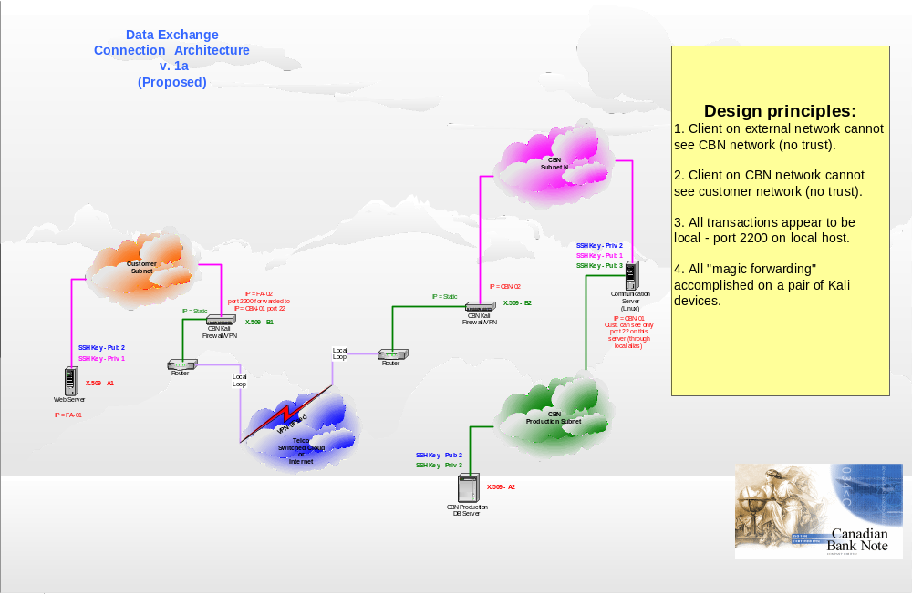
Exotic example – file transfer
Notes:
Unique solution, template for PIN, very likely to be reused elsewhere

Slide 21
Case study - Kali:
100 nodes in Guatemala
Commercial products (cost to CBN)
  Entrust CA - $250,000
  Central site devices, fail-over Cisco 3030 >$40,000
  Remote nodes – Cisco 3015 – $1,400,000
Total - $1,690,000
  Likely too expensive to implement
  Common solution: cut down security
CBN Kali products (cost to CBN)
  CBN CA - $20,000
  Central site devices, fail-over Kali 4801 - $1,000
  Remote nodes – Kali 4501 – $30,000
Total - $51,000
  Feasible on most contracts
  We can afford secure network anywhere

Slide 22
Summary
We delivered more than we promised…
…early…
…now we are victims of our own success
    Kali met all short-term objectives, including very exotic ones…
    …but all components need improvement to meet long-term objectives
    Kali was built for small scale deployment…
    …but its current deployments already exceeded small scale
How many software projects are in this position ?

