Slide 1
자연어처리 프로젝트 2차발표
2조
2013210043 권민규
2014210035 전수혁
2014210064 변지석
2019/May/22
Notes:
안녕하세요 자연어처리 프로젝트 2차발표를 맡게 된 권민규입니다.

Slide 2
Python Document Search 파이썬 문서 검색기
Notes:
저희 조는 이번 프로젝트에서 파이썬 문서 검색기를 만들려고 하는데요,

Slide 3
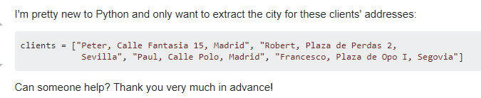




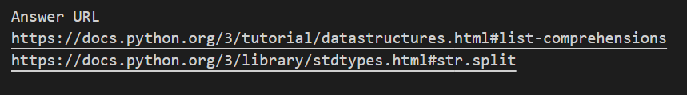
Why Python Document Search
Question Source: https://stackoverflow.com/questions/55259601/extract-certain-values-from-a-list
Notes:
왜 파이썬 문서 검색이 필요한지에 대해 예제를 준비해 왔습니다.
여기 개발자가 있고, 개발자는 저 문자열 리스트에서 문자열 맨 끝에 도시 이름만 가져오고 싶어합니다.
그래서 스택오버플로에 물어보면 사람들이 답을 해줘요. 이렇게 코드를 짜서요.
하지만 이건 공부하는데는 별 도움이 안됩니다.
진짜 도움이 되려면 이 문제를 어떤 파이썬 기능으로 해결할 수 있는지 알려줘야 하는데요,
그래서 사람들은 자기 답변 밑에 파이썬 공식 문서 링크를 걸어두고 참고하라고 해요.
저희는 여기에 집중했습니다. 이게 사람들에게 도움이 되겠구나.
실제 사람이 생각하는 내용을 파이썬의 개념으로 바꿔주는 도구가 필요하다고 생각했습니다.

Slide 4
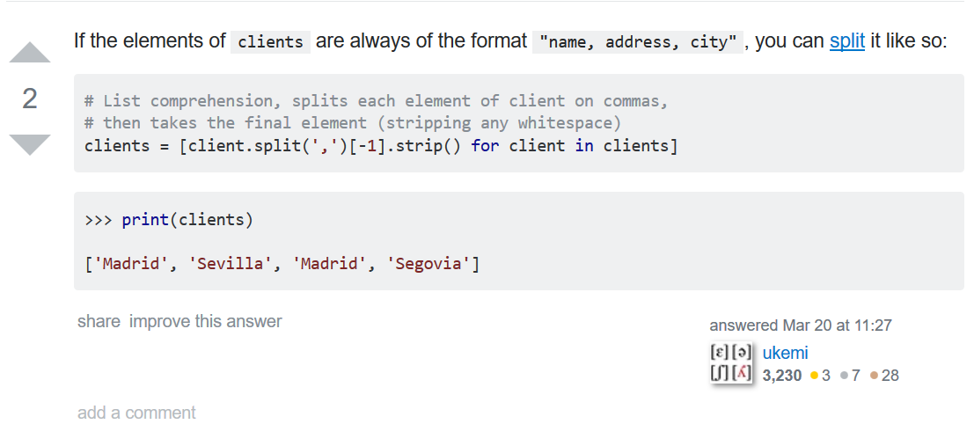
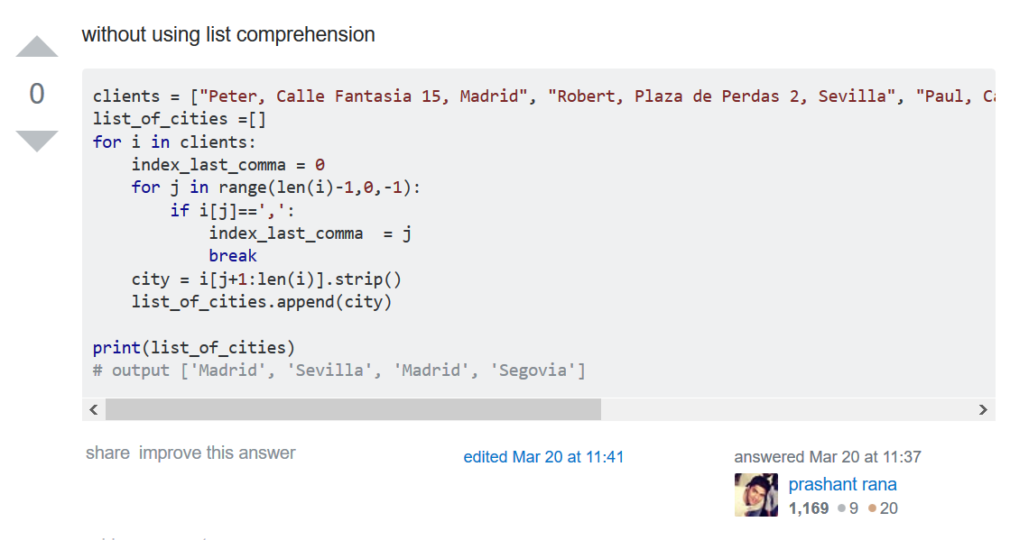
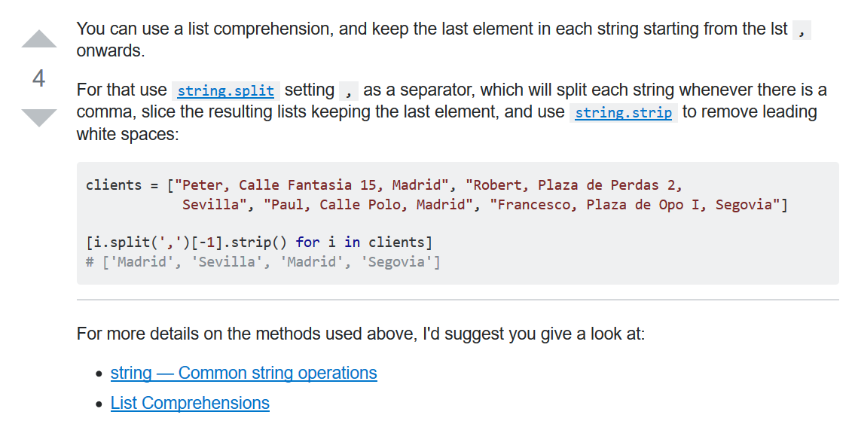
Goal
[Python] Extract certain values from a list
Notes:
그래서 저희 목표는 이겁니다.
기존의 스택오버플로에서 사람들이 답변하게 하지 않고,

Slide 5


Goal
[Python] Extract certain values from a list
Look at these URLs
https://docs.python.org/3/tutorial/datastructures.html#list-comprehensions
https://docs.python.org/3/library/stdtypes.html#str.split
Notes:
참고해야 할 파이썬 문서를 직접 알려주는 지식 서비스를 만드는 겁니다.
이 예시에선 리스트 표현법과 문자열 스플릿 메소드가 정답이고요.

Slide 6
Contents
Data mining and Preprocessing
Stackoverflow Python Q&A Dataset
Python Document
Actual Works Explained
Word/Document Vector Representation
Web Interface
Evaluation
Future Works

Slide 7
Contents
Data mining and Preprocessing
Stackoverflow Python Q&A Dataset
Python Document
Actual Works Explained
Word/Document Vector Representation
Web Interface
Evaluation
Future Works

Slide 8
Stackoverflow Python Q&A Dataset
47491 Q&As, 87 MB size
Some are duplicated Q&A (redirected question)
Constraints
[Python] tagged Q&A questions
The page should contain the link to “docs.python.org/3/”
You can download this dataset at
https://github.com/cushionbadak/PyMaker/tree/master/PyMaker/datas/object3
Unrefined data is also available at
https://github.com/cushionbadak/PyMaker/tree/master/PyMaker/datas/object2
Stackoverflow’s all user contributions are licensed under Creative Commons Attribution-Share Alike

Slide 9
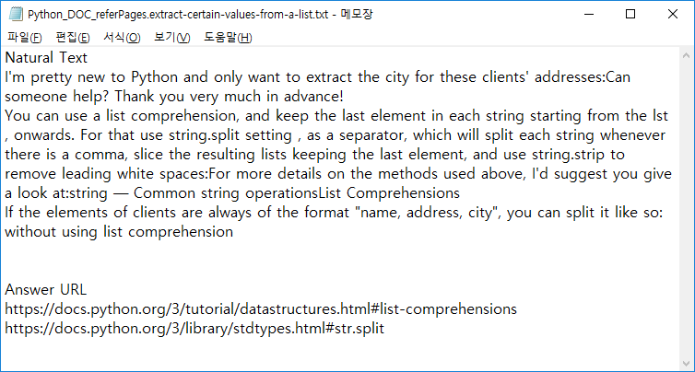
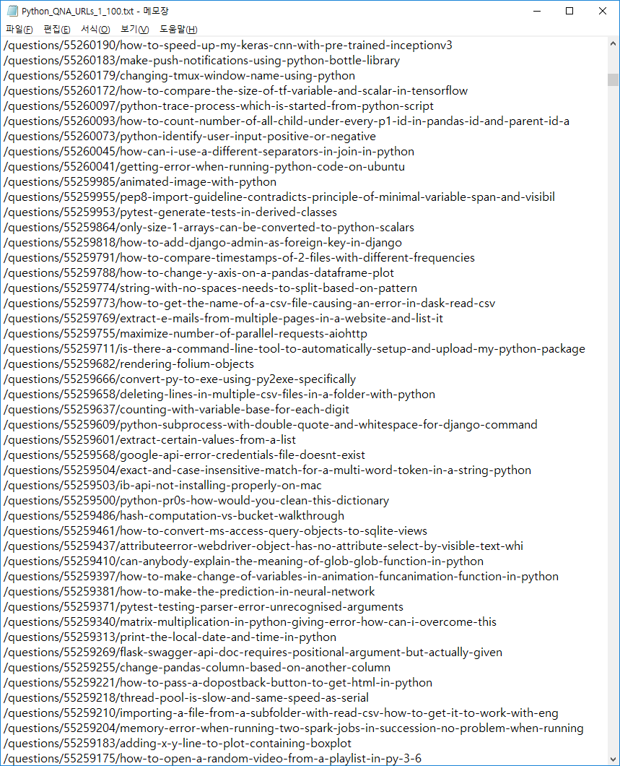
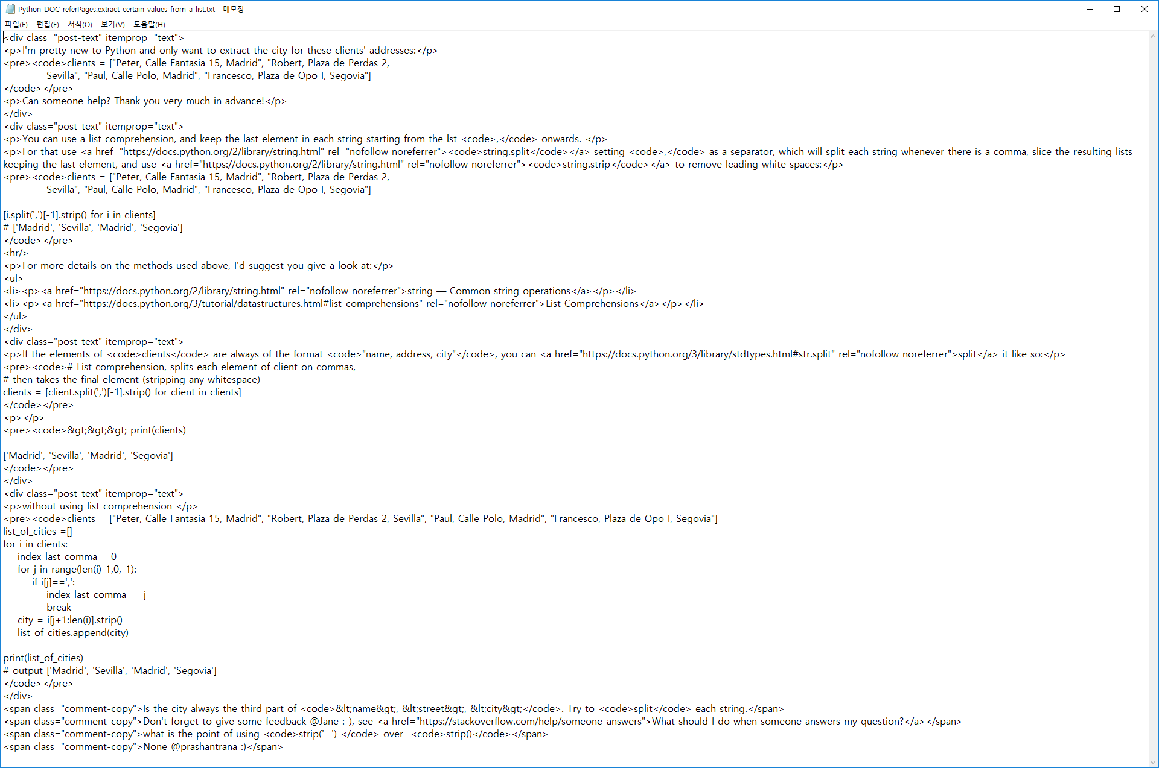
Stackoverflow Python Q&A Dataset

Slide 10
Stackoverflow Python Q&A Dataset
Chart: The Number of times mentioned for each link
X – index number of each link
Y – # of times
Small & Biased
Max: 6918
(x-index: 321)
Average: 158
(x-index: 261)
Median: 17

Slide 11
Stackoverflow Python Q&A Dataset
Construct Stackoverflow Python Q&A Dataset
We need to collect Python Document itself too

Slide 12
Contents
Data mining and Preprocessing
Stackoverflow Python Q&A Dataset
Python Document
Actual Works Explained
Word/Document Vector Representation
Web Interface
Evaluation
Future Works

Slide 13
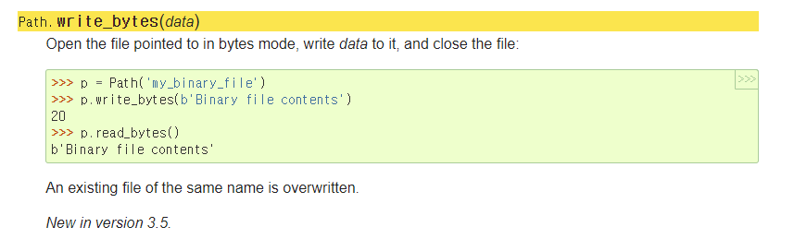
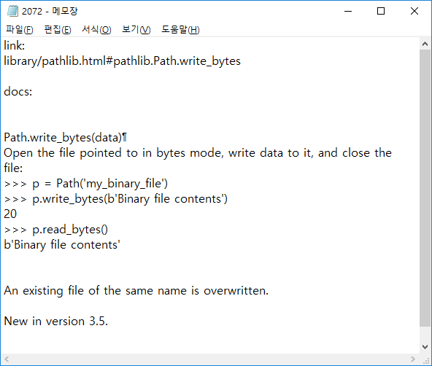
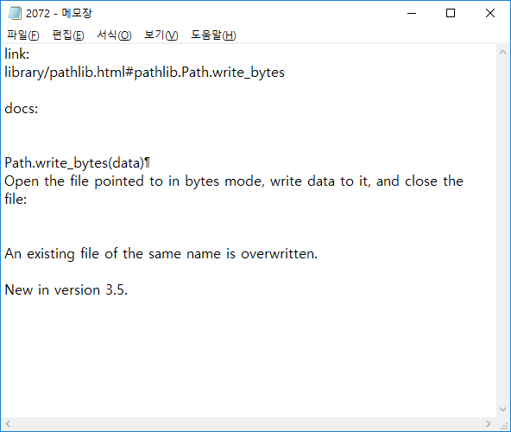
Collecting Python Document - contents

Slide 14
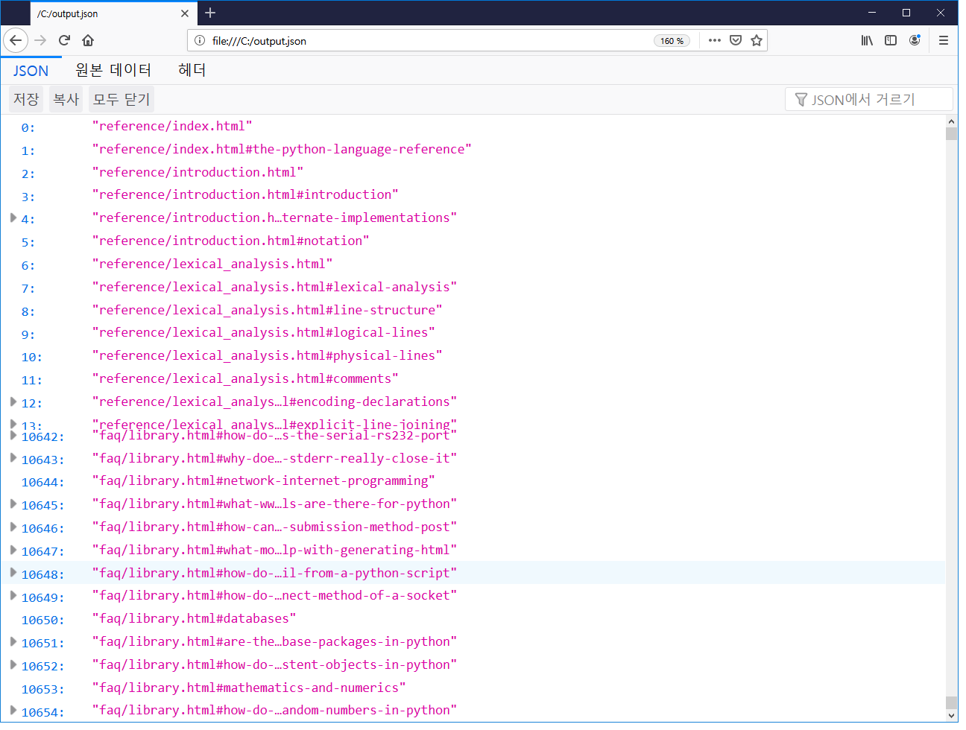
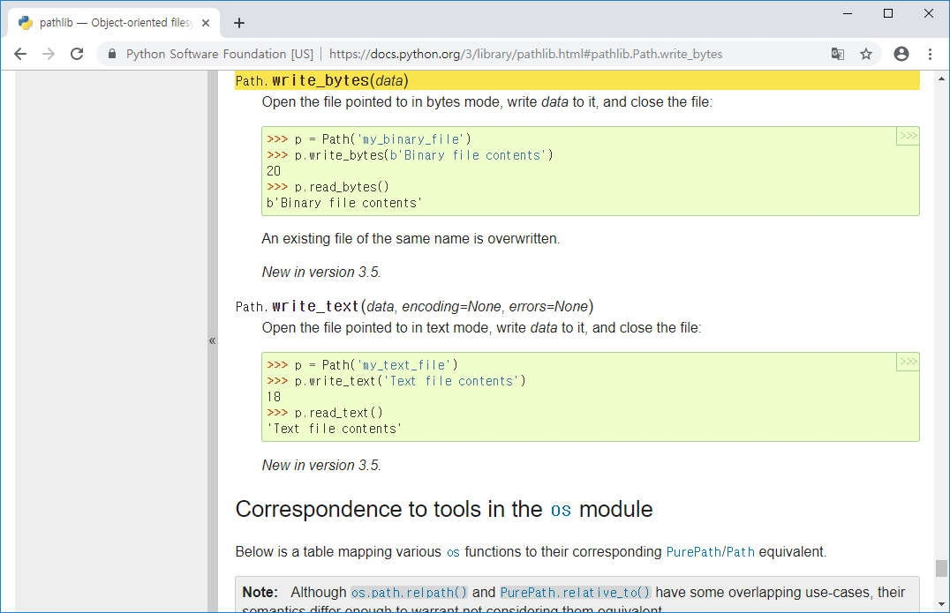
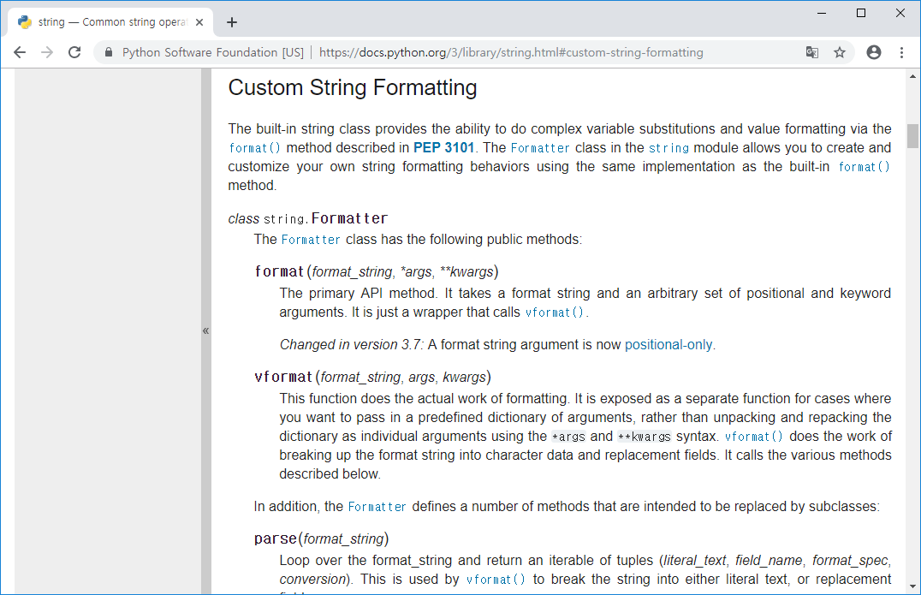
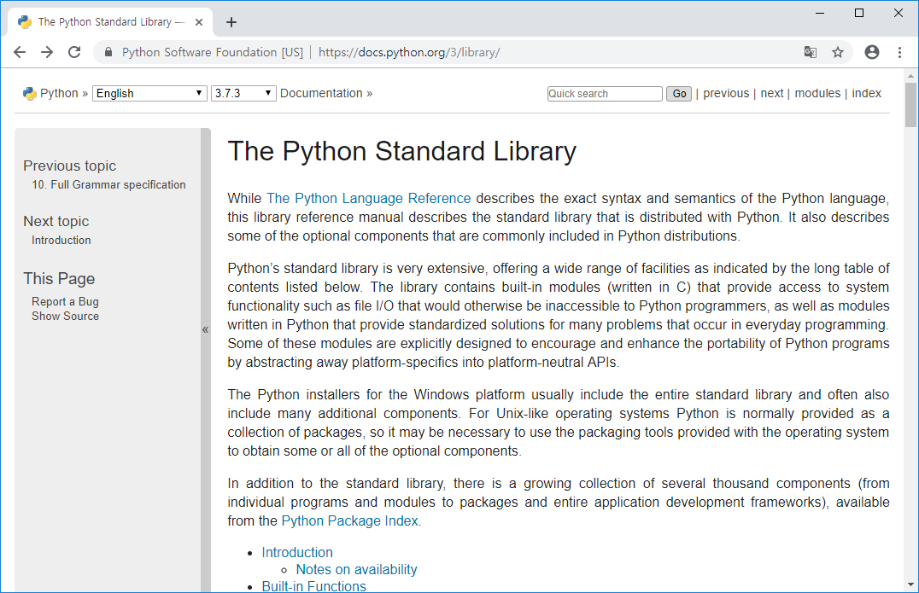
Collecting Python Document - URLs

Slide 15
Collecting Python Document
10655 Documents, 28 MB size
Some are duplicated contents
For example, https://docs.python.org/3/reference/lexical_analysis.html#keywords
contents are included in https://docs.python.org/3/reference/lexical_analysis.html
Constraints
We only collected URLs and content at https://docs.python.org/3/library/ and https://docs.python.org/3/reference/
You can download this dataset at
https://github.com/cushionbadak/PyMaker/tree/master/PyMaker/datas/object4
Licenses for Python documentation are located at the following links: https://docs.python.org/3/license.html

Slide 16
Contents
Data mining and Preprocessing
Stackoverflow Python Q&A Dataset
Python Document
Actual Works Explained
Word/Document Vector Representation
Web Interface
Evaluation
Future Works

Slide 17
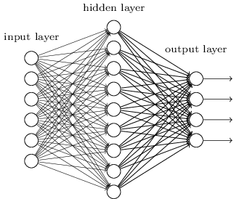
First Attempt
We believed that the bi-gram sentence classification would solve our problem
Image source: https://www.extremetech.com/wp-content/uploads/2016/05/tikz35.png
Bi-gram representation
hash(‘Hello-Python’) →
Scores for each URL
→ <1.1, 2.0, -0.7, …, 0.2>

Slide 18
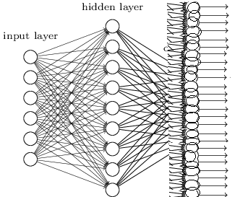
First Attempt - Problem
The size of class
There are 10655 URLs in
https://docs.python.org/3
So we reduced to 321 html file URLs

Slide 19
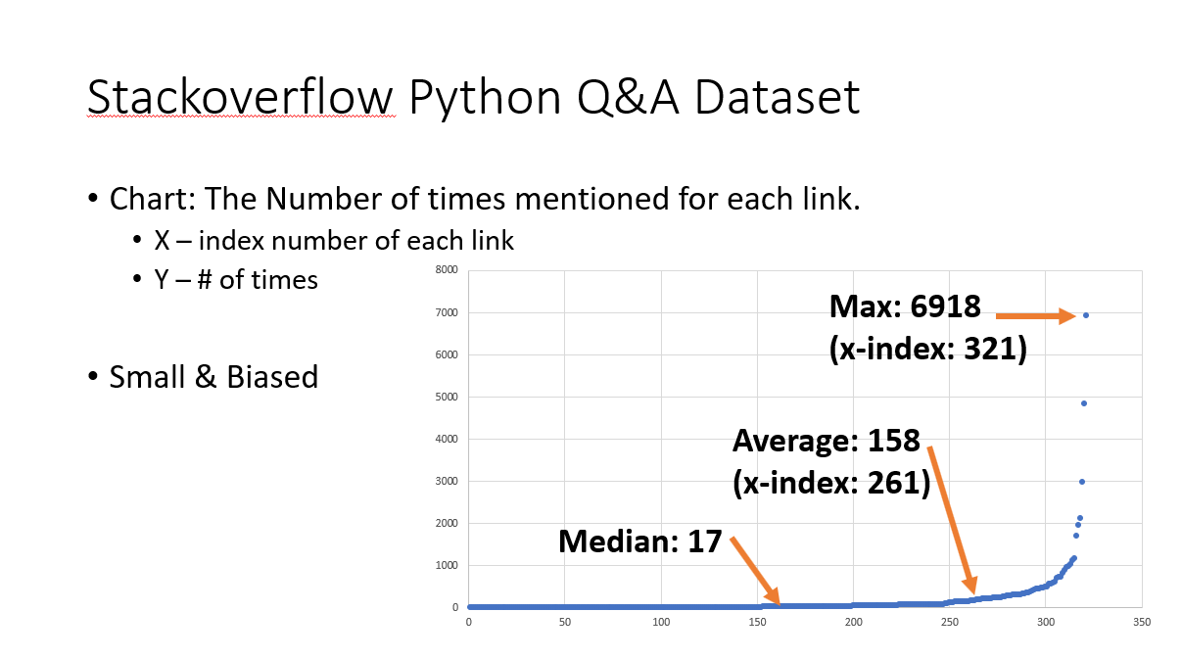
First Attempt - Problem
The size of training data

Slide 20
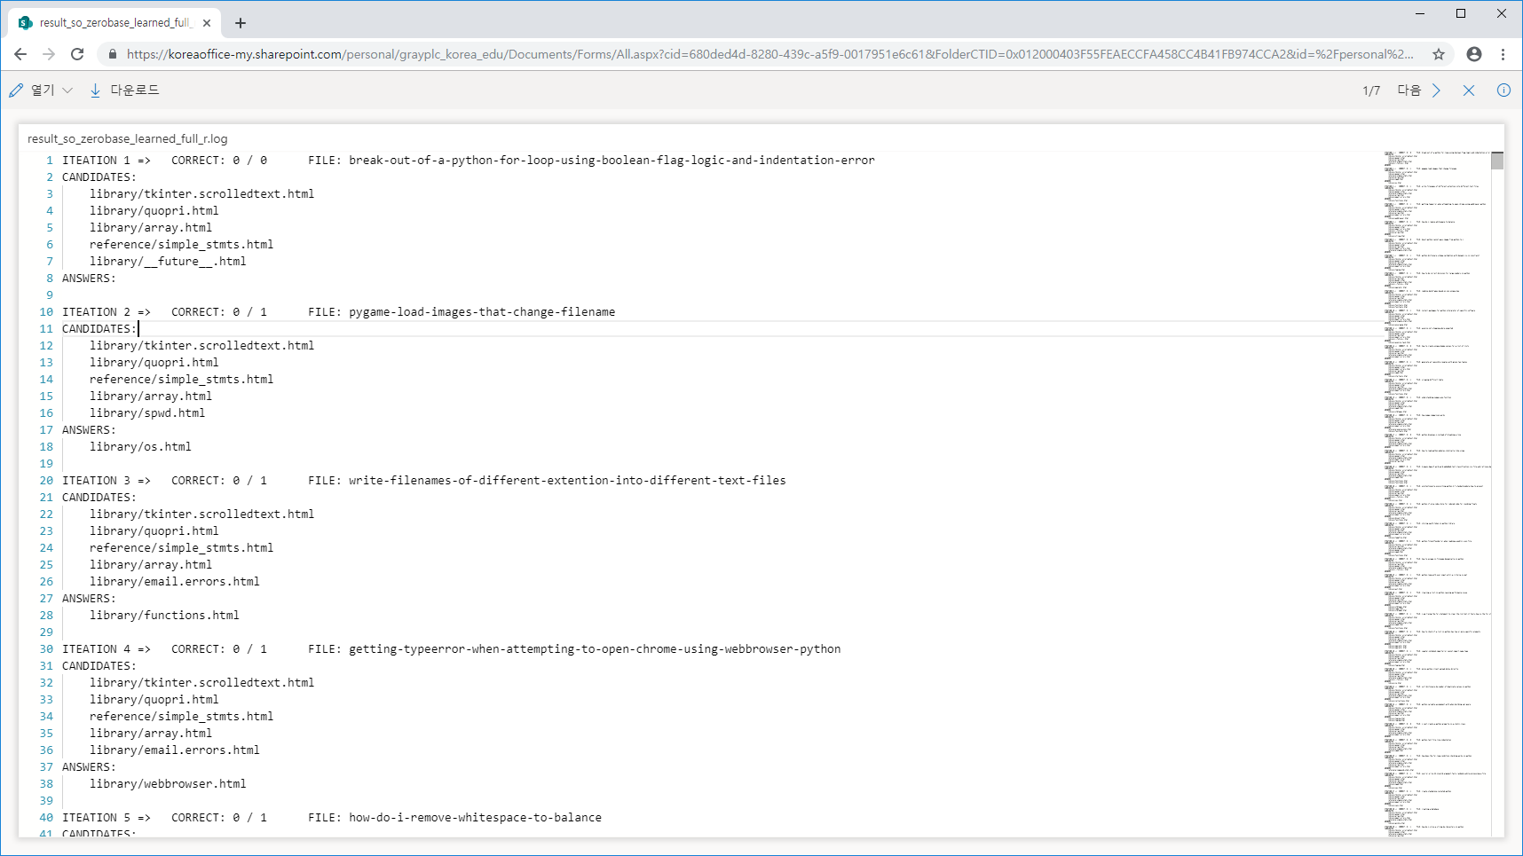
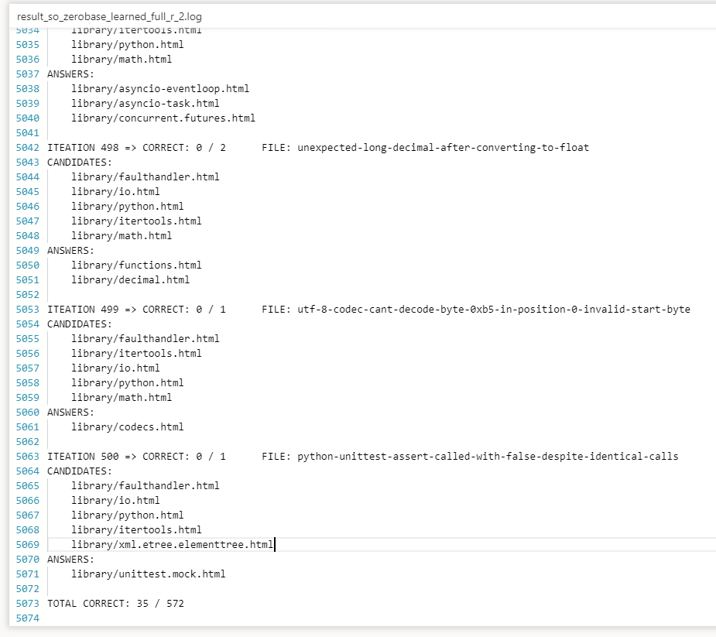
First Attempt

Slide 21
Second Attempt
Since our computing resource is limited, we decided to use pre-trained word2vec model
We use GoogleNews-vectors-negative300.bin (3.6 GB, 300-dimensional, 3 million words and phrases, trained with 100 billion Google News dataset)
https://code.google.com/archive/p/word2vec/
We use gensim library to load model
https://radimrehurek.com/gensim/

Slide 22
Second Attempt
< Classification Algorithm >
Convert every python document into vectors
The vector is obtained by adding all the words in the document as vectors
Notes:
각각의 파이썬 문서에 대해 벡터 표현을 만든다.
(파이썬 문서를 이루는 각 단어의 벡터 표현을 더해서 구한다.)

Slide 23
Second Attempt
< Classification Algorithm >
Convert every python document into vectors
The vector is obtained by adding all the words in the document as vectors
Convert query string into vector
Using the same method as 1
Notes:
질문 문장에 대해서도 1과 똑같은 방법으로 벡터 표현을 만든다.

Slide 24
Second Attempt
< Classification Algorithm >
Convert every python document into vectors
The vector is obtained by adding all the words in the document as vectors
Convert query string into vector
Using the same method as 1
Find the most similar python document using cosine similarity
Notes:
코사인 유사도를 이용해서 질문 문장과 가장 유사한 파이썬 문서를 찾는다.

Slide 25
Contents
Data mining and Preprocessing
Stackoverflow Python Q&A Dataset
Python Document
Actual Works Explained
Word/Document Vector Representation
Web Interface
Evaluation
Future Works

Slide 26
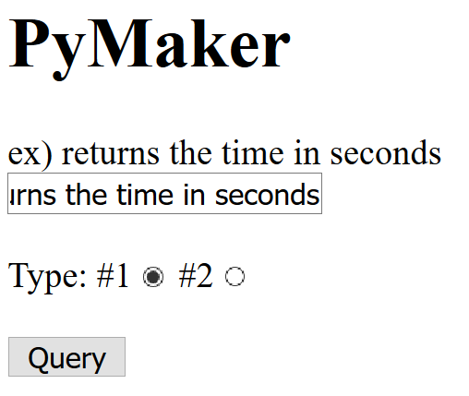
Web Interface
You can run the current version of our document search program at http://13.125.156.35:8000/Query/ (Open temporarily)

Slide 27
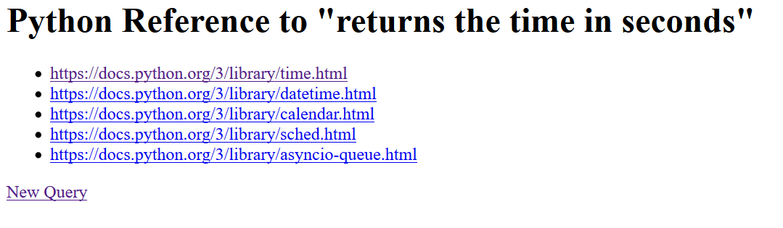
Web Interface
Result Page

Slide 28
Contents
Data mining and Preprocessing
Stackoverflow Python Q&A Dataset
Python Document
Actual Works Explained
Word/Document Vector Representation
Web Interface
Evaluation
Future Works

Slide 29
Evaluation
There are no well-known benchmarks for python
So we measured our algorithm’s classification accuracy with Stackoverflow Python Q&A Dataset
For now, our model successfully classifies 5781 of 41568 (13.9%)
The model gives 5-candidates for each given Question-title sentence
5 Random selection will show only 1.6% of accuracy
We hope to evaluate the accuracy of other web search engines on this Stackoverflow benchmark
It is hard to gather the result pages of search engines

Slide 30
Contents
Data mining and Preprocessing
Stackoverflow Python Q&A Dataset
Python Document
Actual Works Explained
Word/Document Vector Representation
Web Interface
Evaluation
Future Works

Slide 31
Future Works
We will continue to explore other methods, models for better document-to-vector representation
If possible, we will evaluate our Stackoverflow Q&A benchmark on other search engines
We will increase the usability of our Python document search engine

Slide 32
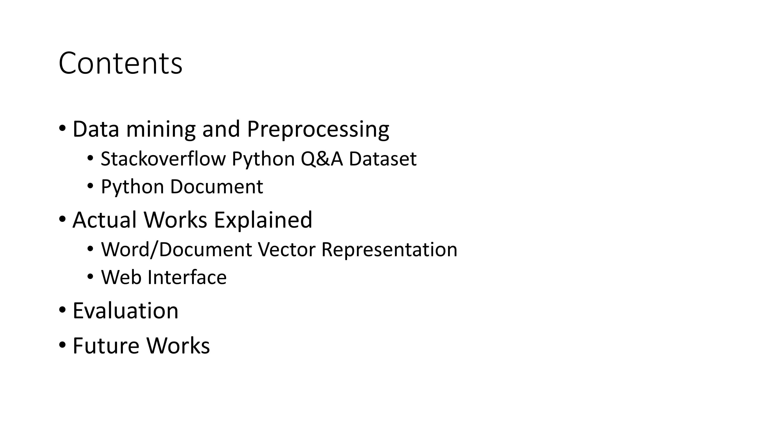
Summary

Slide 33
Summary
Creativity
It’s Python Document Search Engine!
We made our own benchmark to evaluate this problem
Technical Completeness
Document classification: Base 1.6% → Our approach 13.9%
Contribution
We publicly open our source codes and data at github
We provide web services to better understand the project

Slide 34
Q&A
Notes:
저희 발표는 여기까지입니다. 질문이나 조언 주실 것 있나요?

Slide 35
감사합니다
Notes:
감사합니다.

