Slide 1
Scheduling Web-App (FreshBook.me)
Team:
Abdiasis Abdi, Adam Jokela, Garrett Marshall, Manni Singh, Nate Goodman, Zachary Cushon
Supervisor:
Razvan Andonie

Slide 2




Problem Statement
z
Creating a functional, flexible and fair schedule that keeps everyone happy is a full time job in itself. It can take days, and sometimes weeks, to develop a good schedule. When a scheduling error is made, or a last minute change comes into play, Adam, Manager at Red Pickle, is forced to return to the drawing board and frantically try to find cover for a shift.
Adam knows there must be a better way. And he’s right. The solution to most scheduling problems can be found in modern, schedule management application.
Made by: Abdi

Slide 3
Problem Statement Cont.
Our website provides an easy and interactive way for both employers and employees to manage scheduling at work. By engaging in groups, employers can set time slots for shifts, receive scheduling options from their employees and keep track of deliveries through notes. The website will automatically create a shift schedule for the upcoming week, thus saving precious time and hassle. Additionally, it allows you to view, export and share your schedule with others.
Our scheduling application will be built with small businesses and their employees in mind. The system allows employees to log in and view a calendar with their work schedule on it. They can request time off, vacation/sick days and more. There is also an admin "overview" panel that allows an administrator to approve time off requests and other schedule related items as related to their business.
Made by: Abdi

Slide 4

Customer
The Red Pickle is a small business here in Ellensburg, they serve various different food and are locally owned!
We plan to help Rec Pickle management improve efficiency and allow for easier generation of nonconflicting schedules so everyone can be happy all while allowing the business to operate smoothly.
Made by: Abdi

Slide 5
Requirements Analysis
Our functional requirements were created with the end user in mind, it is imperative that the experience is easy and intuitive for the user. Requirements that are vital to this experience were in turn listed as hard requirements.
Certain requirements that we deemed as non-essential to the user experience, such as multiple business profiles, may not be included in the final product, and therefore were listed as soft requirements.
Made by: Nate

Slide 6
Hard Requirements
Intuitive User Interface for employer
Database for employees
Business information saved on profiles
Adjustable business hours
Made by: Nate

Slide 7
Hard Requirements
Adjustable employee availability (cannot work, prefers not to work, can work)
Employees assigned roles
Employees assigned “proficiency score” per role (1-5)
User can generate optimal schedule based on employee data
Made by: Nate

Slide 8
Soft Requirements
Calendar view
Multiple business profiles
“Available” employee list in case of sudden changes (sickness, emergency, etc.)
A tab where the employer can view a recommended amount of a product to produce based on previous sales history
Made by: Nate

Slide 9
Low Level Design
We will attempt to implement our product requirements the following way...
Generation of non-conflicting schedules will be a scheduling algorithm written in python. The algorithm should take into account each individual employees possible roles, their ranking in that role, their availability preference, and the total amount of roles that need to be filled in a given day for the business.
Generation of predicted sales, one of our soft requirements, will also be done in python and should take into account sales data history provided by the employer. The input will likely be given by manual entry that covers a finite amount of days or by having the user select a csv file where we will specify to the user that each value needs to be the amount of units sold and then the data can be from as many days as there are values in the file.
Made by: Garrett

Slide 10
Low Level Design cont.
Ability to view and edit employee roster, being able to change the employees roles, their proficiency in each role, their daily availability, and their contact info
The employer will also be able to see how many hours an employee is scheduled for (if a schedule has been generated)
Calendar for scheduling and viewing already scheduled employees will likely be imported from an existing library and then slightly changed to fit our application
Database will be designed in a way that makes it simple to access all information needed by the application and the employer.
Made by: Garrett

Slide 11
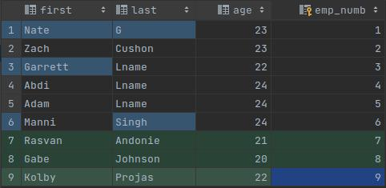
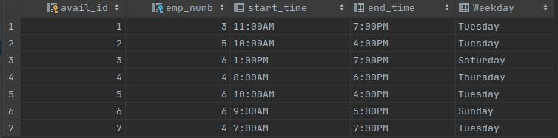
Prototype Database Design
This database is designed to link employees to their respective availability entries, each availability entry represents a block of availability
This should make it easy to find an employee that fits very specific time slots efficiently
Employee table
Holds employee information such as their proficiency score, employee ID, age etc.
Availability table
Holds day of week, start time, end time, availability ID and day of week
Made by: Zach

Slide 12
High Level Design
The web app is hosted through stellar at the domain freshbook.me
User will navigate to the website, log in or create a profile for their business, and then be able to adjust business and employee information to generate a possible work schedule.
React front end and SQLite back end is connected and given functionality using Flask.
Made by: Zach

Slide 13
High Level Design cont.
Flask uses templates that represent the front end and functionality is added to these templates by connecting front end utilities to forms(methods) written in Python
Similarly, the SQlite database is also connected to the templates using flask
Each template represents a page on the front end, and each front end page is connected together by Flask with routes declared in python that make navigating between different front end pages trivial.
Made by: Garrett

Slide 14

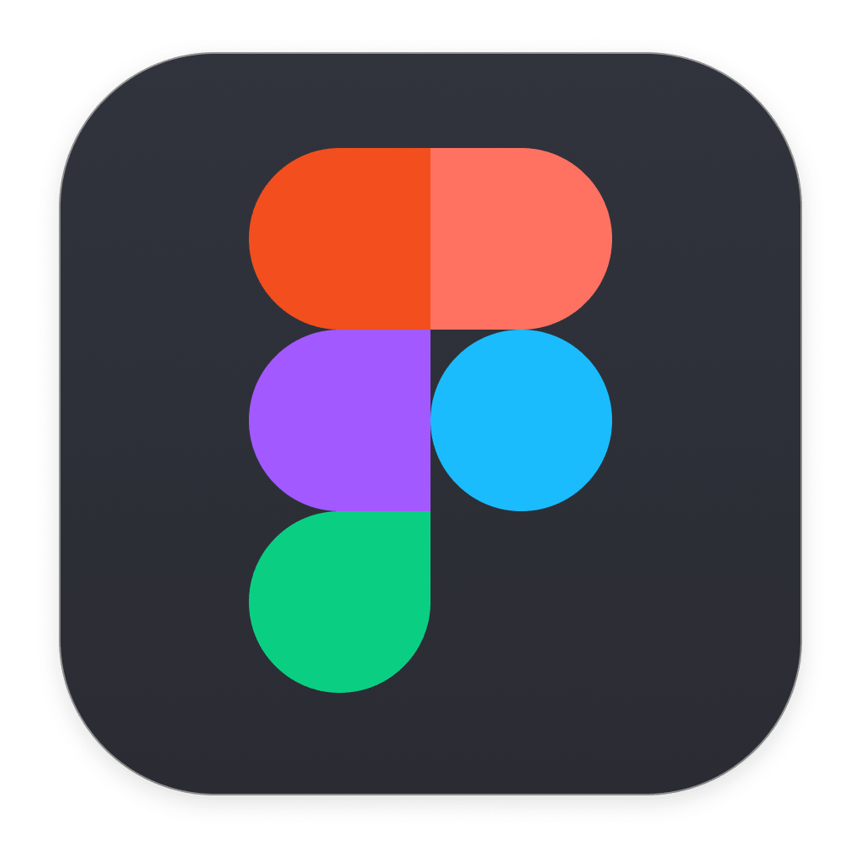


Tools
Python
SQLite
Flask
Figma
Made by: Garrett

Slide 15

SQLite
SQLite is a light weight database software capable of hosting databases locally in memory
This makes the database easier to manage and will allow for rapid testing
Made by: Zach

Slide 16
Python
We chose to use python for our backend logic because it has SQLite built in and will be convenient to interface with the database in order to make queries that will fill gaps in the schedule that is being made.
Made by: Mani

Slide 17
Figma
Figma was our tool of choice for the user interface design, we decided to use Figma since it allows for the rapid exportation of a usable prototype
Made by: Mani

Slide 18
Flask
Flask is a web framework for python and we chose it for its built in tools to help us connect and add functionality to our web application.
Makes connecting the front end to the back end a little more simple.
Had experience using flask before, so felt like a natural choice
Made by: Garrett

Slide 19
Schedule
Made by: Everyone
NAME | TASK | DUE DATE | TASK | DUE DATE | TASK | DUE DATE | TASK | DUE DATE
Abdi | Fresh Produce Page | 5/4 | Convert to react | 5/11 | Website functionality | 5/18 | Polish front end and assist with algorithm implementation | 5/25
Adam | Design algorithm to predict sales | 4/30 | Implement and adapt sales prediction algorithm | 5/11 | Refine | 5/18 | Connect algorithm to site | 5/25
Garrett | Setting up user signup and authentication | 5/4 | Start to establish flask routes to possible pages and help with algorithm design | 5/11 | Finalize flask routes, help Nate and Abdi with forms that establish website functionality | 5/18 | Help Adam and Mani connect their algorithms to the website and finalize website functionality. | 5/25
Manni | Figure out an algorithm for having minimum # of employees for each role | 5/4 | Adding functionality to the scheduling algorithm to fit the soft/hard requirements. | 5/11 | Work with Garrett and Adam to work on the missing requirements | 5/18 | Polish the algorithm and do the rest of the requirements asked by the owner. | 5/25
Nate | Business info page finished Settings page finished | 5/6 | Convert to React | 5/11 | Website functionality | 5/18 | Polish front end and assist with algorithm implementation | 5/25
Zach | Add username and password functionality | 5/6 | Upkeep database changes depending on needs and testing | 5/11 | Create helper python functions to create SQLite queries | 5/18 | Finalize database format | 5/25

Slide 20
Conclusion: Things To Improve On
Finding an efficient way to assign work for everyone
Weekly standups with extended meeting time to help keep track of the work done by each member.
Communicating on discord on the progress before and after having our bi-weekly meetings.
Have little goals rather than an overall large goal, so that way everyone is hitting a certain goal every other day rather than hitting a large goal after a week.
Made by: Adam

Slide 21
Conclusion: Things We Did Right
We met 3 times a week to discuss our goals and discuss our progress as a team and individually
We have been working as a team and helping each other every time someone has not been able to reach a certain goal. This shows the team spirit and the will to work together.
We have been able to find solutions to problems that we initially encountered and move on past it with the solutions in hand very quickly.
Made by: Adam

