Slide 1
Four part reporting structure for data analytics and/or modelling results (from DSTL/PHE/British Army discussions).
1] Concise description of the question
The scenario, and or data sources
Limitations and caveats on the approach and context.
3] Graphical representation of technical information, including uncertainty.
Nick Holliman @Binocularity
2] Concise summary of the outcome and recommended actions.
<<If you take nothing else away from this presentation this is it, highlight:
Most dangerous scenario
Most likely outcome.
>>
4] Additional detail, graphics, numerical or otherwise.

Slide 2
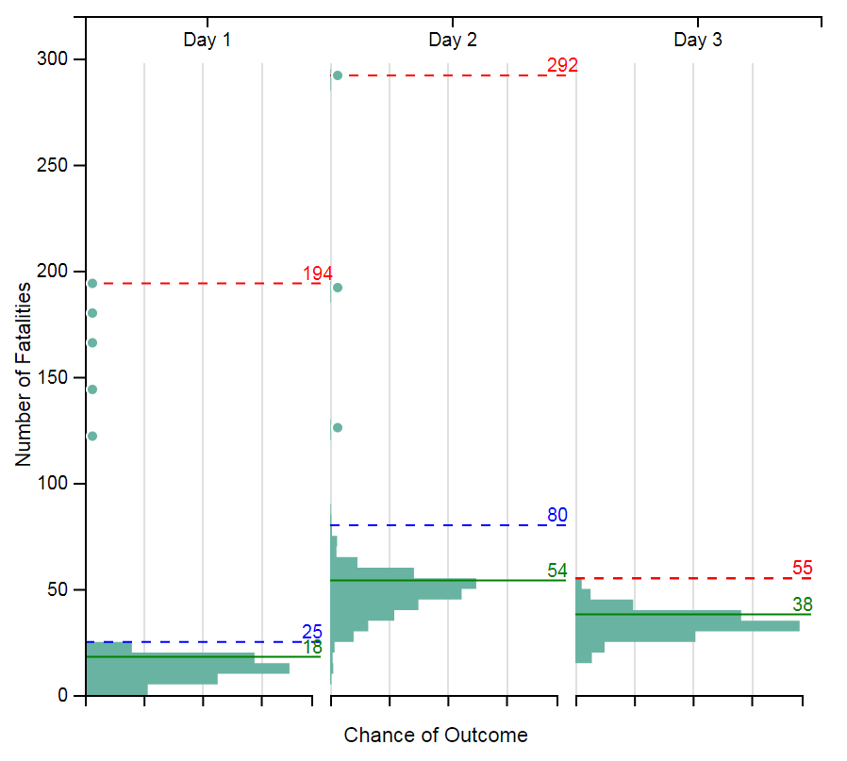
Read with reference to report xxx/xxx/x (simulated attack on seaport (SPOD), which day to evacuate)
1. Request: Which day should the Comd evacuate the AO at SPOD.
These scenario results are calculated by varying:
Wind direction Release altitude Evacuation day 1, 2 or 3 Release mass Particle size
Limitations and caveats: No other factors are accounted for. Adversary intent not included.
*The horizontal axes do not have a numeric scale as this data is for relative comparison only.
3. Chance of predicted fatalities (out of 500 possible scenarios)
2. Summary: Based on this modelling Day 1 and Day 3 are potential evacuation options, Day 2 is a weaker choice.
Day 1: The most dangerous scenario has a higher number of fatalities than day 3 but the most likely outcome has lower fatalities than day 3.
Day 2: The most dangerous scenario has a higher number of fatalities of any day
and the most likely scenario has higher fatalities than any other day.
Day 3: The most dangerous scenario has substantially lower fatalities than day 1
but the most likely scenario has higher fatalities than day 1.
Extreme scenario
1% of scenarios
Highest chance scenario
4. Predicted fatalities for each day of evacuation
 | Day 1 | Day 2 | Day 3
Most dangerous scenario | 194 | 292 | 55
In 1% of scenarios this many or more fatalities are predicted | 25 | 80 | 55
Most likely scenario | 18 | 54 | 38

Slide 3
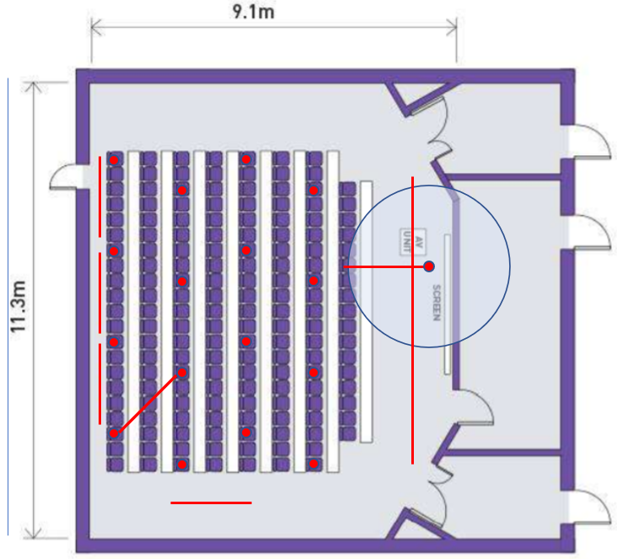
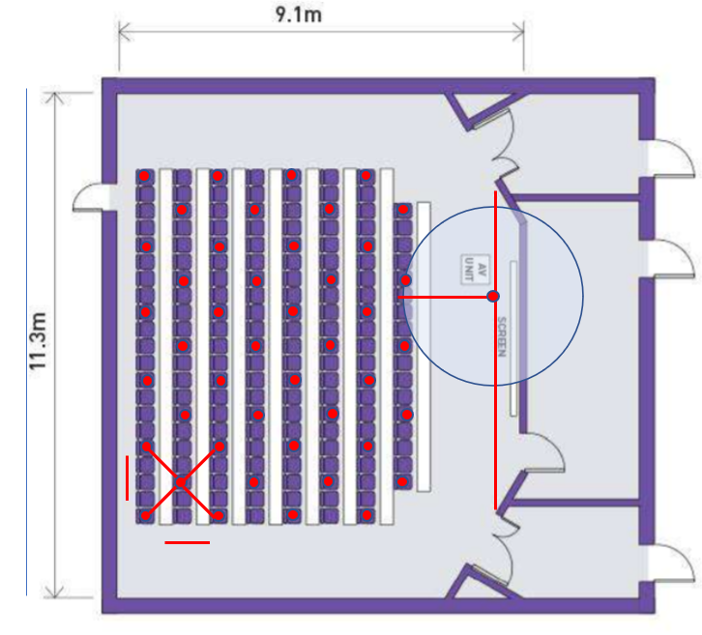
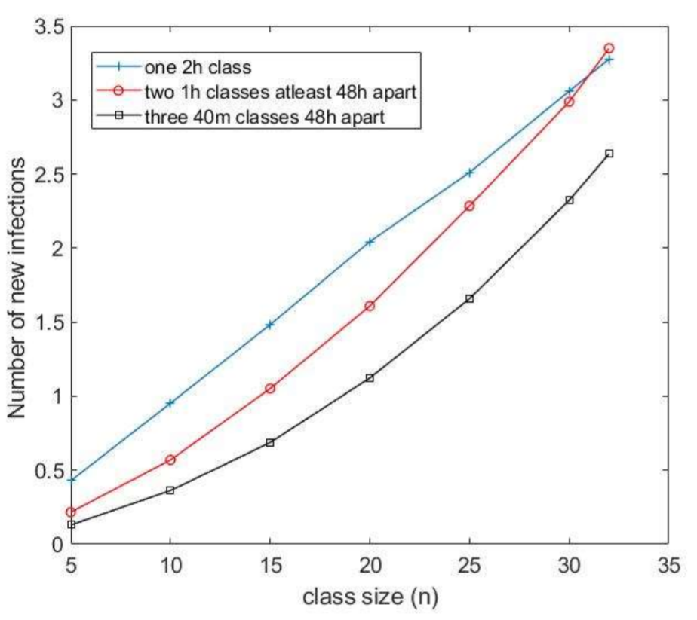
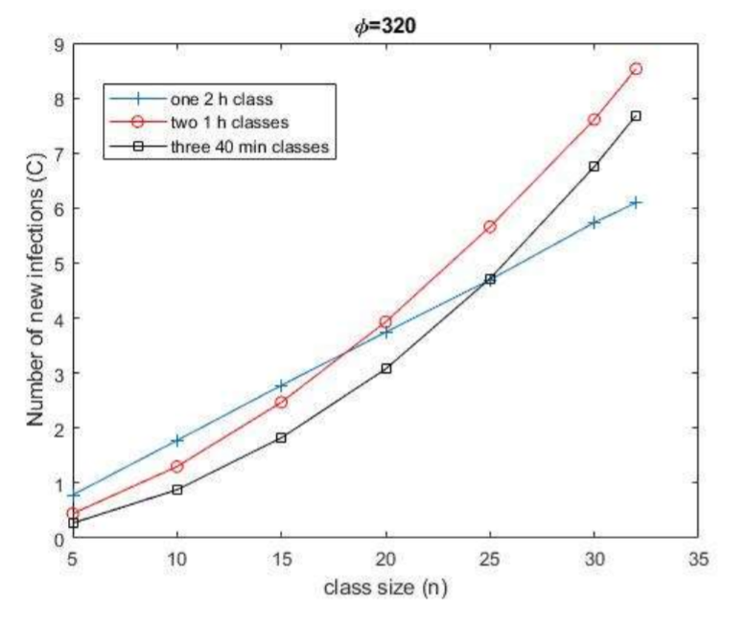
Read with reference to V-KEMS report: Unlocking Higher Education Spaces - What Can Mathematics Tell Us?
1. Request: How should 2hrs teaching per week be delivered in time
Assumptions airborne transmission scenario results are calculated with:
One infectious person initially in the room.
2 hours in person teaching per week by same staff member.
Social distancing at 2m (16 students) or 1m (28 or 44 students).
Model: one staff member and 5 to 32 students in the space.
Primary activity: lecture or seminar with a range of people talking.
2 hours in person teaching per week by same staff member.
Smaller class size N reduces infection rate I, since I is proportional to N²
Limitations and caveats: No other factors are accounted for. Reckless intent not considered.
3. Graphical Summary
164 seat lecture theatre fits 16 students (10%) at 2m soc. dist.
or up to 44 students (27%) at 1m soc. Dist.
2. Summary:
Options modelled: a) One 2 hour class
b) Two 1 hour classes 48 hours apart
c) Three 40m classes 48h apart
Best worst case choose a)
-assuming variable teaching activity & variable social distancing.
Best for low density, standard lecture levels of talking choose c)
-assuming 16 in room i.e. 2m social dist (range 0.5 to 1.5 new cases/wk)
Best for higher density, active seminar levels of talking choose a)
-assuming 32 in room i.e. 1m social dist (range 6 to 9 new cases/wk)
Lecture levels of talking
Active seminar levels of talking
6 to 9
2.5
to
3.5
0.5 to 1.5
1 to 3

Slide 4
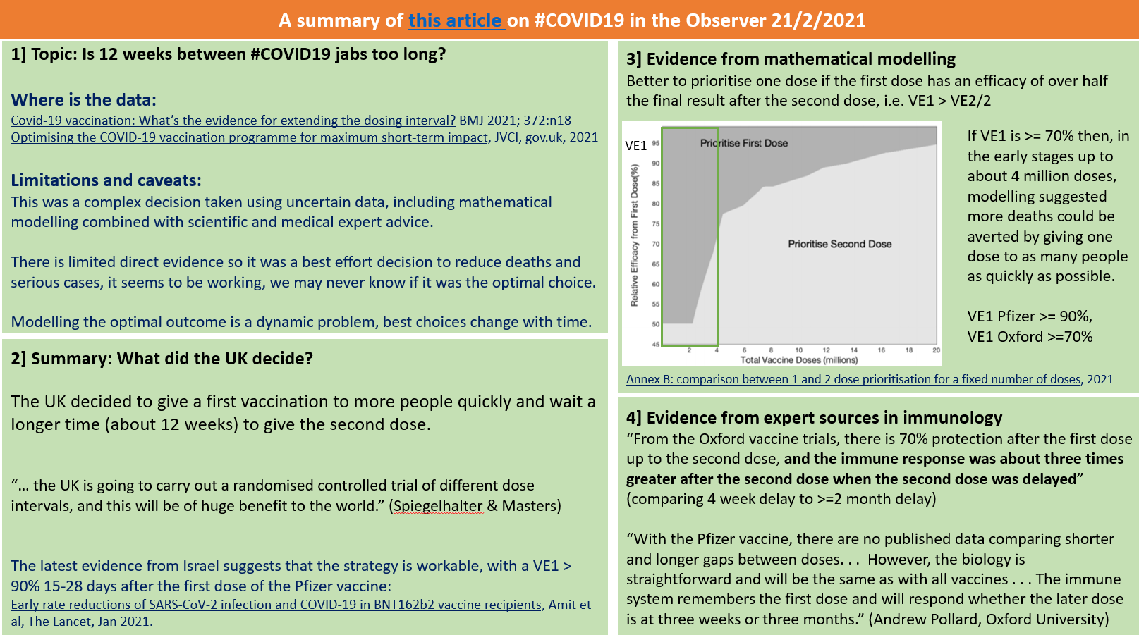

Slide 5

Four part reporting structure for data analytics and/or modelling results (from DSTL/PHE/British Army discussions).
CUSP London Data Dive 2023 Team number
Team members

Slide 6
Four part reporting structure for data analytics and/or modelling results (from DSTL/PHE/British Army discussions).
1] Concise description of the question
The scenario, and or data sources
Limitations and caveats on the approach and context.

Slide 7
Four part reporting structure for data analytics and/or modelling results (from DSTL/PHE/British Army discussions).
2] Concise summary of the outcome and recommended actions.
<<If you take nothing else away from this presentation this is it, highlight:
Most difficult/dangerous scenario
Most likely outcome.
>>

Slide 8
Four part reporting structure for data analytics and/or modelling results (from DSTL/PHE/British Army discussions).
3] Graphical representation of technical information, including uncertainty.

Slide 9
Four part reporting structure for data analytics and/or modelling results (from DSTL/PHE/British Army discussions).
4] Additional detail, graphics, numerical or otherwise.

