Slide 1
Aspect Driven Compilation for
Dataflow Designs
Paul Grigoras, Xinyu Niu, Jose G. F. Coutinho, Wayne Luk
Department of Computing, Imperial College London
Jacob Bower, Oliver Pell
Maxeler Technologies
IEEE International Conference on Application-specific Systems, Architectures and Processors
5 June 2013

Slide 2
Why Aspect Descriptions?
capture aspects of quality and their realisation
  - speed, area, power, energy
  - numerical accuracy
  - safety, security, privacy, trust
  - optimisation, monitoring, debugging
idea: decouple such descriptions from application code
  - can affect multiple modules in main application
  - can be applied to different applications
  - can be used to customize optimisations
  - can promote modularity, re-use and portability
promising approach: aspect-driven design
- pioneered in REFLECT project, does not cover dataflow
- dataflow: simple caching + control, so faster + lower power
aspect descriptions

Slide 3
Issue: Mixing Optimisations with Application Code
public RTMKernel(...) {
(...)
public KArrayType<HWVar> burst_in =
new KArrayType<HWVar>(hwFloat(8, 24), Par);
optimization.pushDSPFactor(1);
(...)
for (int i=0; i <Par; i++){
result[i][0]=
cur[0][6+i][5][5] * 2.0 –
- pp_i[i] +dvv[i]*( … ) + source[i];
}
(...)
}
Word-length optimisations
DSP Mapping
Pipeline replication
Computation

Slide 4
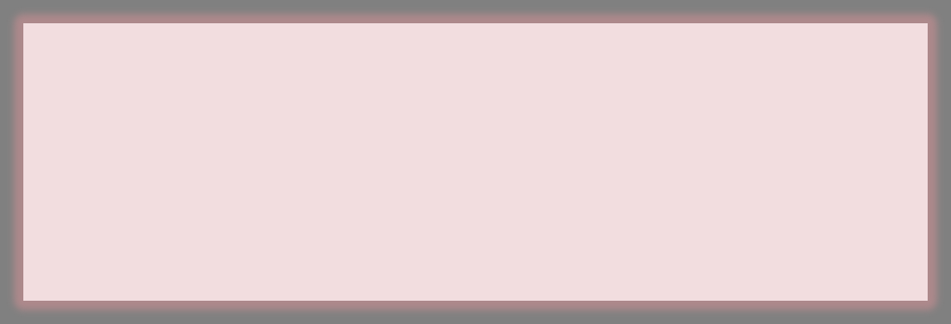



Weaver: Application + Aspect Description = Implementation
Aspect Description
aspectdef DspBalancing
select function.stmt end
apply
var pragma = "#pragma FAST DSPBalance:full”
$stmt.insertbefore “[[pragma]]”
end
condition $stmt.num_construct(MultiplyOp) >= 3
Application
void Price_FPGA(…)
…
for(int i = 0; …)
for(int j = 1; …)
real v=
s[j ] * a1
+s[j+1] * a2
+s[j-1] * a3;
void Price_FPGA(…)
…
for(int i = 0; …)
for(int j = 1; …)
#pragma FAST DSPBalance:FULL
real v = s[j ] * a1 + s[j+1] * a2
+ s[j-1] * a3;
weaver

Slide 5
Challenges
specify dataflow designs
  - adopt intuitive, concise, well-understood language
  - facilitate optimisation of existing designs
specify optimisation strategies
  - decouple non-functional descriptions from application code
  - capture transformations at multiple levels of abstraction
support design space exploration
  automate systematic exploration of design trade-offs
support development of correct and optimised designs
  - assist debugging and performance monitoring

Slide 6
Contributions
1. FAST: Facile Aspect-driven Source Transformation
  dataflow language based on C99
  simple, familiar, facilitates integration: e.g. ROSE, LARA
2. aspect-driven approach: improve efficiency + productivity
  system aspect descriptions
  implementation aspect descriptions
  exploration aspect descriptions
  development aspect descriptions
3. demonstrate automated design flow
  40% less code for RTM: oil and gas exploration code
  minimum performance overhead

Slide 7
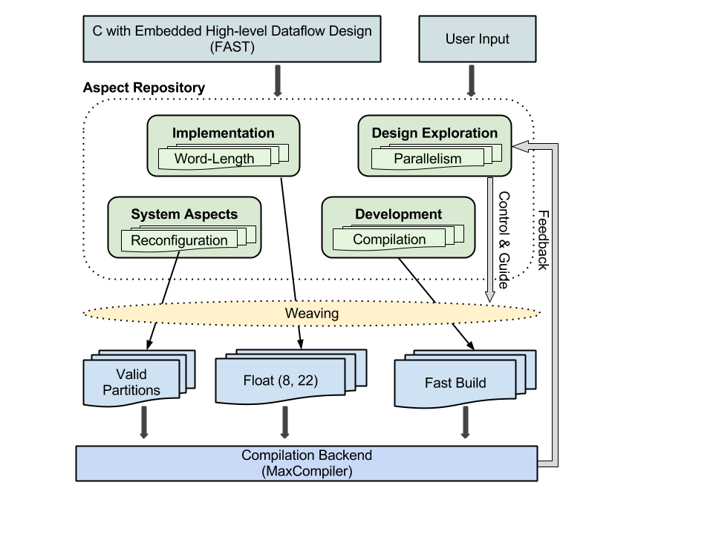
Design Flow
User Input:
Design + Parameterisation
Aspect optimisation and transformation
Multiple configurations
Compilation backend

Slide 8
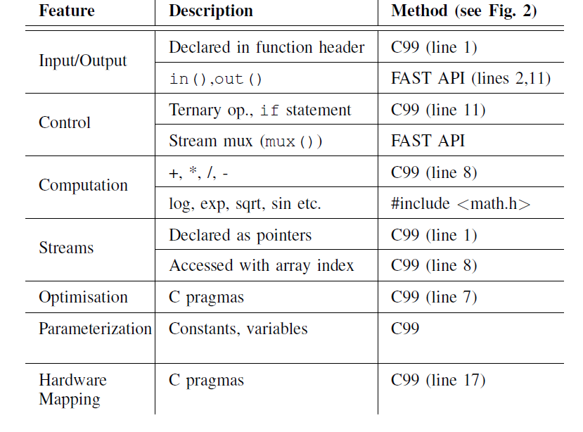
The FAST Language: Main Features
API for multiplexing streams, counters etc.
Standard math library
Most features based on vanilla C99
=> easy to understand and use

Slide 9
Aspect Descriptions
1. system aspect descriptions
– e.g. monitor performance
2. implementation aspect descriptions
– e.g. optimise word-length for operators
3. exploration aspect descriptions
– e.g. control automation of design space exploration
4. development aspect descriptions
– e.g. assist debugging

Slide 10
1. System Aspects: Hardware/Software Partitioning
  a. detect hotspots
  b. detect code patterns suitable for acceleration
  c. perform outlining transformation
  d. derive dataflow fast_f() from f()
  e. place FAST pragma to link fast_f() with f()

Slide 11
Systems Aspects: Monitorisation
aspectdef LoopMonitor
select function.loop{is_innermost} end
apply
$loop.insert before
%{monitor_instanceI("[[$loop.key]]");}%;
$loop.insert after
%{monitor_instanceE("[[$loop.key]]");}%;
end
select function.loop{is_innermost}.entry end
apply $begin.insert after
%{monitor_iterI("[[$loop.key]]");}%;
end
select function.loop{is_innermost}.exit end
apply $begin.insert before
%{monitor_iterE("[[$loop.key]]");}%;
end
end
Select innermost loops
Add instance monitor call
Select innermost loops
Add monitor calls to mark beginning and end of each iteration

Slide 12
Monitorisation: Comparison
Original Code
Woven Code
void f() {
while (I < N) {
i++;
}
}
void f() {
monitor_instanceI(“f:1”);
while (I < N) {
monitor_iterI(“f:1”);
i++;
monitor_iterE(“f:1”);
}
monitor_instanceE(“f:1”);
}
Loop key = function_name : loop position in Abstract Syntax Tree
e.g. f:2:1 (1st loop inside 2nd outermost loop of f() )

Slide 13
2. Implementation Aspects: Operator Optimisation
aspectdef DspBalancing
var op_granularity =
[{DspBalance:’full’,MultiplyOp: 5,AddOp: 5 },
{DspBalance:’balanced’,MultiplyOp:3}];
select function.statement end
apply
for (var i in op_granularity) {
var gprofile = op_granularity[i];
var match = true;
for (var k in gprofile) {
if (k != ’DspBalance’) {
match &= ($statement.num_construct(k)
>= gprofile[k]);}}
if (match) {
var pragma = ’#pragma FAST balanceDSP:’
+ gprofile.DspFactor;
$statement.insert before "[[pragma]]";
break;}}
end
end
Rules for DSP mapping:
- Full if >= 5 mults + adds,
- Balanced if >=3 mults
Check every program statement
If rules match, apply FAST balancing program

Slide 14
3. Exploration Aspects: Control Design Space Exploration
aspectdef DesignExploration
input
attribute,
start, step,
resource, resource_threshold,
config
end
config[attribute] = start;
var i = 0;
do {
var designName = genName(config);
call genFAST(designName, config);
buildFAST(designName);
config[attribute] += step; i++;
} while (@hw[designName]. resource < resource_threshold && i < LIMIT);
end
Vary design attribute until threshold for a selected resource is reached
Generate a configuration and build it
Use feedback capabilities to extract resource usage from backend reports

Slide 15
4. Development Aspects: Debugging
aspectdef WatchVar
select function.vref end
apply
$vref.parent_stmt.insert before
%{ log("[[$vref.name]]", [[$vref.name]]); }%
$vref.parent_stmt.insert after
%{ log("[[$vref.name]]", [[$vref.name]]); }%
end
condition $vref.is_out end
end
Log the value of each variable
Before and after every statement
Only if it is written to
useful for debugging when no run-time debugger available
problem:
- debug blocks influence resource usage and performance
- comment out => code may not compile => req. fix => reduce productivity
solution:
- aspect descriptions to automatically log values of variables on assignment

Slide 16
Evaluation: Reverse Time Migration (RTM)
  seismic imaging application for oil and gas exploration
    - computationally demanding
  3 dataflow kernels
    - RTM : compute intensive, multiple configurations
    - CmdWrite: memory write command generator
    - CmdRead: memory read command generator
  use run-time reconfiguration (not covered in this talk)
    - improve performance and efficiency

Slide 17
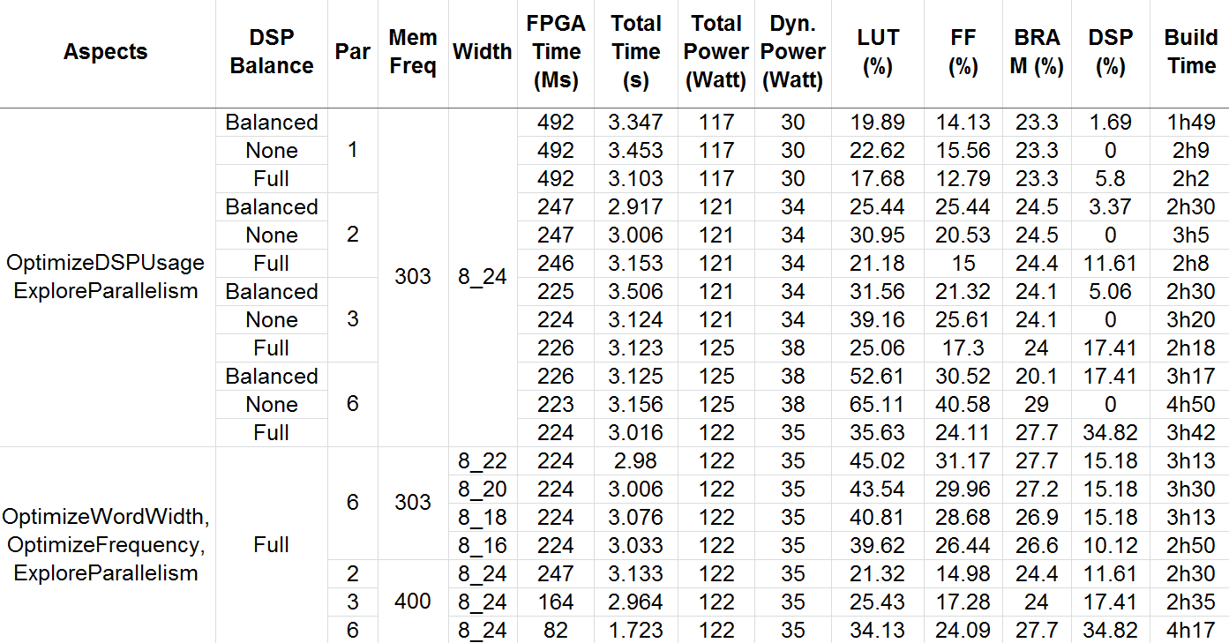
Results: Performance + Resource + Power + Built Time
1. Control DSP Mapping:
- reduce LUT/FF usage, improved timing, reduce build time
vs.
- DSP may limit parallelism

Slide 18
Results: Performance + Resource + Power + Built Time
2. Control word length
- accuracy
vs.
- resource usage

Slide 19
Results: Performance + Resource + Power + Built Time
50% reduction in DSP
(24 vs. 22 bit mantissa)
=> double parallelism

Slide 20
Results: Performance + Resource + Power + Built Time
3. Control parallelism
- increased performance
vs.
- increased build time

Slide 21
Results: Code Measures
Kernel | Aspect | FAST |  | MaxCompiler |  | Reduction
 | LOC | LOC | API Calls | LOC | API Calls | LOC | API Calls
CmdRead | 12 | 26 | 6 | 59 | 39 | 55% | 84%
CmdWrite | 12 | 28 | 39 | 79 | 56 | 64% | 30%
RTM Static | 12 | 246 | 43 | 403 | 175 | 38% | 75%
RTM RTR | 12 | 377 | 91 | 669 | 275 | 43% | 66%
  improve productivity
    fewer lines of code (LOC): easier to develop and to maintain
    fewer API calls: more intuitive, easier to learn
    automate repetitive, error-prone tasks, e.g. debug, validation
    automate exploration of optimisations

Slide 22
Current and Future Work
extend aspect descriptions
  - e.g. heterogeneous systems with multiple types of accelerators
support other application domains
  - e.g. financial simulation, medical imaging, genome processing
more standardised pragmas
  - e.g. OpenACC
use FAST as target language
  e.g. domain-specific compilers targeting FAST

Slide 23
Summary
1. FAST: Facile Aspect-driven Source Transformation
  dataflow language based on C99
  simple, familiar, facilitates integration: e.g. ROSE, LARA
2. aspect-driven approach: improve efficiency + productivity
  system aspect descriptions: e.g. monitor performance
  implementation aspect descriptions: e.g. optimise operators
  exploration aspect descriptions: e.g. control exploration
  development aspect descriptions: e.g. assist debugging
3. demonstrate automated design flow
  40% less code for RTM: oil and gas exploration code
  minimum performance overhead

