Slide 1
Develop Software Solutions to Enhance Educational Infrastructure and Connectivity in Rural Areas
CSE7301 University Project
Review-2
Batch Number: G-08
Roll Number | Student Name
20211CSE0680 | ANKITHA HUDEGAL
20211CSE0682 | ARPITHA G
Under the Supervision of,
Mr. Md Ziaur Rahman
Assistant Professor
School of Computer Science and Engineering
Presidency University
Name of the Program: CSE
Name of the HoD: Dr. Asif Mohammed.
Name of the Program Project Coordinator: Dr. Jayanthi. K.
Name of the School Project Coordinators: Dr. Sampath A K.

Slide 2
Abstract
Education in rural India faces significant challenges due to inadequate infrastructure, limited internet connectivity, and restricted access to quality learning resources. These barriers hinder students from receiving a comprehensive education, widening the urban-rural education gap. This project aims to bridge these gaps by leveraging software solutions tailored for rural educational institutions.The proposed solution integrates multiple innovative components: cloud-based virtual classrooms for live and recorded lessons, educational resource management systems to optimize textbook and digital content distribution, internet connectivity optimization tools for stable access, and e-learning content creation platforms to generate curriculum-based multimedia lessons. Additionally, mobile learning apps with offline access will ensure uninterrupted learning in low-bandwidth regions, while data analytics for infrastructure planning will assist in efficient resource allocation and policy-making.By implementing these solutions, the project seeks to enhance accessibility, engagement, and learning outcomes for students in rural areas. The comprehensive approach will empower educational institutions, improve connectivity, and contribute to the overall development of rural education in India.

Slide 3
Github Link
Link to our project: Link

Slide 4
Literature Survey
Serial Number | Paper
1 | Enhancing the teaching of natural sciences in rural environments through educational videos
2 | Online education in rural India—Issues and challenges
3 | E-Learning in Rural India
4 | The Digital Revolution in India: Bridging the Gap in Rural Technology Adoption
5 | An effective path for rural teachers to use digital education resources in Chinese underdeveloped areas: A study based on grounded theory
6 | E-Learning for Rural Development in India: Closing Disparities and Empowering Communities
7 | The challenges and solutions of technology integration in rural schools: A systematic literature review
8 | A study on challenges and solutions for implementing digital literacy programmes in India's rural areas
9 | Rural schools and the digital divide: Technology in the learning experience
10 | Scrutinizing E-Learning in Rural India: COVID-19 Pandemic

Slide 5
Objectives
Enhance Digital Learning Access
Provide a structured online platform to facilitate remote education for students in rural areas.
Develop a virtual classroom system with live and recorded sessions for flexible learning.
Optimize Educational Resource Management
Create a digital repository for books, study materials, and e-learning content.
Ensure efficient distribution and access to learning resources.
Improve Connectivity and Infrastructure
Develop tools to optimize internet connectivity for seamless online learning.
Enable offline access to essential educational content through mobile applications.
Personalized Learning Experience
Implement a user-friendly Dashboard for students, teachers, and administrators to track progress and engagement.
Provide insights through data analytics to improve learning outcomes.
Promote Community Engagement and Collaboration
Establish an interactive Community section for students and educators to share knowledge and experiences.
Encourage discussions, mentorship, and peer-to-peer learning.
Ensure Scalability and Sustainability
Design the platform to be adaptable for different educational institutions and learning environments.
Use modern technologies to maintain a visually appealing, responsive, and user-friendly interface.

Slide 6
Existing Methods with Drawbacks
Traditional Classroom-Based Learning
Method: Education is delivered in physical classrooms with textbooks and face-to-face teaching.
Drawbacks: Limited infrastructure, lack of trained teachers, and unavailability of quality learning materials in rural areas hinder effective education.
Offline Learning with Printed Materials
Method: Schools provide printed books and notes to students for self-study.
Drawbacks: No interactive learning experience; outdated and limited content; students struggle without proper guidance.
Government E-Learning Portals (e.g., SWAYAM, DIKSHA)
Method: Online platforms provide free digital courses and study materials.
Drawbacks: Requires stable internet access, which is often unavailable in rural areas; lacks interactive engagement for students.
Mobile Learning Apps (BYJU’S, Unacademy, Vedantu, etc.)
Method: Mobile apps provide interactive video lessons, quizzes, and live classes.
Drawbacks: Subscription costs make them inaccessible to underprivileged students; heavy reliance on internet connectivity limits their usability in remote areas.

Slide 7
Proposed Method
Centralized Digital Learning Platform
The platform will serve as a one-stop solution for students, teachers, and educational institutions in rural areas, offering a structured and accessible online learning experience. It will integrate essential educational services such as virtual classrooms, resource management, and community engagement into a single digital ecosystem, simplifying the process of accessing quality education.
Virtual Classroom and Live Learning
A cloud-based virtual classroom will be implemented to enable live streaming of lectures, real-time interaction, and recorded sessions for later access. Interactive tools like quizzes, discussion boards, and collaborative whiteboards will enhance student engagement and improve learning outcomes.
Educational Resource Management System
The platform will provide a centralized repository for managing textbooks, digital content, and multimedia learning materials. Teachers will be able to upload, organize, and distribute study materials efficiently, while students can access and download content even in low-connectivity environments.
Mobile and Web Accessibility
To maximize reach, the platform will be developed as both a web application and a mobile, ensuring accessibility across different devices.

Slide 8
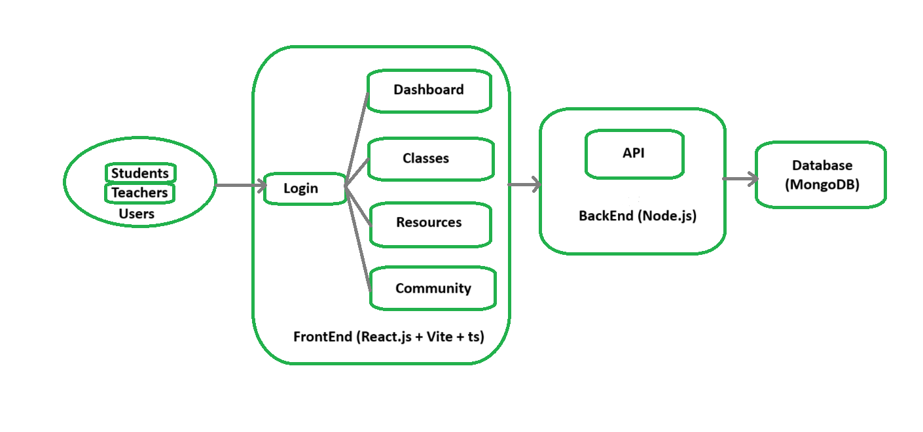
Architecture Diagram

Slide 9
Modules
Technology Stack Components:
Front-end: React.js, Tailwind CSS (for responsive web interface)
Back-end: Node.js with Express.js (for handling API requests and server-side logic)
Database: MongoDB
Authentication & Security: JWT: For secure authentication.
API Integration: RESTful APIs (for fetching mandi prices, retail data, etc.)
Hosting: Netlify or Vercel (for web app deployment)

Slide 10
Software and Hardware Details
Software Requirements:
Operating System: Windows/Linux/Mac
Mobile/Web Framework: React.js (web)
Database: MongoDB
Programming Language: JavaScript (React.js)
API Framework: REST API
IDE: Visual Studio Code
Version Control: GitHub
Hardware Requirements:
Processor: Intel i5 or higher
RAM: 8GB or more
Storage: 256GB SSD or more

Slide 11
Timeline of the Project (Gantt Chart)
Project Initialization
Requirement Gathering & Analysis [03/02/25 - 08/02/2025]
Technology Stack Setup [11/09/25 - 21/02/25]
Design Phase
System Architecture Design [15/02/25 – 25/02/25]
UI/UX Design [25/02/25 – 05/03/25]
Backend Development [10/03/25 – 01/04/25]
Frontend Development [06/03/25 – 01/04/25]
Development Phase
Deployment & Documentation
Database Integration [15/03/25 – 01/04/25]
Deployment [02/04/25 – 12/04/25]
Final Documentation [13/04/25 – 20/4/25]

Slide 12
References
[1] M. Campaña-Cordova, F. Castillo-Ledesma, J. Oleas-Orozco, H. Moncayo, and F. Avilés-Castillo, "Enhancing the teaching of natural sciences in rural environments through educational videos," in Proc. IEEE, 2024. [Online]. Available: [Link]
[2] V. R. Bhanotu, "Online education in rural India—Issues and challenges," in A Study on Corporate Governance Practices in USA, UK & India: A Comparative Analysis, Dec. 2023. [Online]. Available: [Link]
[3] P. Kumar and A. Das, “E-Learning in Rural India,” IJSET, vol. 5, no. 2, pp. 10-15, 2016. [Online]. Available: [Link].
[4] A. Sharma and B. Nair, “The Digital Revolution in India: Bridging the Gap in Rural Technology Adoption,” SpringerOpen, vol. 12, no. 3, pp. 225-238, 2024. [Online]. Available: [Link].
[5] Y. Zeng, Y. Zheng, X. Li, and H. Ma, "An effective path for rural teachers to use digital education resources in Chinese underdeveloped areas: A study based on grounded theory," in Proc. IEEE, 2024. [Online]. Available: [Link]

Slide 13
References
[6] V. B. Hans, “E-Learning for Rural Development in India: Closing Disparities and Empowering Communities”, Srinivas University, Mangalore, India, Jan. 22, 2024. [Online]. Available: [Link]
[7] F. Mustafa, H. T. M. Nguyen, and A. Gao, "The challenges and solutions of technology integration in rural schools: A systematic literature review," Int. J. Educ. Res., vol. 126, p. 102380, May 2024. [Online]. Available: [Link]. doi: 10.1016/j.ijer.2024.102380.
[8] J. S. Kumar and D. Shobana, "A study on challenges and solutions for implementing digital literacy programmes in India's rural areas," in Proc. ICSSR-Sponsored Int. Seminar on Building a Cognitive Enterprise through AI-Powered Transformation: A Digital Paradigm for Societal and Tribunal Success in Rural Areas, Coimbatore, Tamil Nadu, India, Jul. 2024. [Online]. Available: [Link]
[9] E. Kormos and K. Wisdom, "Rural schools and the digital divide: Technology in the learning experience," Tech. Pedagog. Educ., vol. 11, no. 1, pp. 25–39, 2021. [Online]. Available: [Link]
[10] Scrutinizing E-Learning in Rural India: COVID-19 Pandemic, ScienceOpen, [Online]. Available: [Link]

Slide 14

Project work mapping with SDG
The developed software solution focuses on enhancing education infrastructure and connectivity in rural areas.
Aligns with SDG 4 – Quality Education by:
Promoting inclusive and equitable access to learning resources.
Utilizing digital platforms to support education in remote areas.
Supports SDG 9 – Industry, Innovation and Infrastructure by:
Improving digital infrastructure in rural regions.
Fostering technological innovation in underserved areas.

Slide 15


