Slide 1
PROJECT TITLE: Customer service chatbot with AI
PIP2001 Capstone Project
Batch Number: CSE-G08
Roll Number | Student Name
20211CSE0679 | Sudheshna
20211CSE0680 | Ankitha Hudegal
20211CSE0682 | Arpitha G
20211CSE0690 | K Pavithra
Under the Supervision of,
Mr. Md Ziaur Rahman
Assistant Professor
School of Computer Science and Engineering
Presidency University
Roll Number | Student Name
Name of the Program: Computer Science And Engineering
Name of the HoD: Dr. Asif Mohammed H.B
Name of the Program Project Coordinator: Mr. Amarnath J.L & Dr. Jayanthi. K.
Name of the School Project Coordinators: Dr. Sampath A K / Dr. Abdul Khadar A / Mr. Md Ziaur Rahman

Slide 2
CONTENTS
Introduction
Literature Review
Existing method Drawback
Proposed Method
Objectives
Methodology
Architecture
Hardware/software components
Timeline of Project
Expected Outcomes
Conclusion
Git-hub Link
References
Project work mapping with SDG

Slide 3
Introduction
Customer Service Chatbots: AI-powered chatbots in customer service use natural language processing (NLP) to understand and respond to customer queries, adapting to context, intent, and user needs. They can simulate human conversation and continuously improve based on past interactions.
Role of Travel Agents and Tour Operators: Travel agents and tour operators act as intermediaries between travelers and service providers (e.g., airlines, hotels, transport), offering seamless booking and ensuring a smooth travel experience. They also help protect tourists from potential issues during their trips.

Slide 4
Literature Review
Papers | Advantages | Limitations
Author: Elitza Stoilova Title: AI Chatbots as a Customer Service and Support Tool. Published Year: 2021 | 24/7 Availability Cost Efficiency Enhanced Customer Engagement | Customer Familiarity with Technology Limited Understanding Training Required
Authors: Naim Zierau, Michael Hausch, Olivia Bruhin, Matthias Söllner Title: Towards Developing Trust-Supporting Design Features for AI-Based Chatbots in Customer Service Published Year: December 2020 | Trust-building framework User-centered approach Scalable insights | Preliminary results Narrow focus Limited empirical testing

Slide 5
Papers | Advantages | Limitations
Authors: Jagbir Kaur, Ashok Choppadandi, Pradeep Kumar Chenchala, Varun Nakra, Pandi Kirupa Gopalakrishna Pandian Title: Case Studies on Improving User Interaction and Satisfaction using AI-Enabled Chatbots for Customer Service Published Year: May 2019 | Enhanced user interaction Continuous learning Scalability | Privacy concerns Technical issues Limited emotional intelligence
Authors: Nikhil Patel, Sandeep Trivedi Title: Leveraging Predictive Modeling, Machine Learning Personalization, NLP Customer Support, and AI Chatbots to Increase Customer Loyalty Published Year: April 2020 | Improved customer loyalty Automation Data-driven insights | Privacy concerns Limited emotional intelligence Technical challenges

Slide 6
Papers | Advantages | Limitations
Author: Chenzhuoer Li et al Title: Research on Artificial Intelligence Customer Service on Consumer Attitude and Its Impact during Online Shopping Published: 2020 | 24/7 Availability Neutrality Cost Efficiency | Communication Issues Resistance Trust Issues
Author: Krishna Kumar Nirala, Nikhil Kumar Singh, and Vinay Shivshanker Purani Title: A survey on providing customer and public administration based services using AI: chatbot Published: January 3, 2022 | Efficiency Cost-effectiveness Scalability | Data dependency Conversational limitations Customization and integration challenges

Slide 7
Papers | Advantages | Limitations
Author: Ty Ebsen, Richard S. Segall, Hyacinthe Aboudja, and Daniel Berleant Title: A Customer Service Chatbot Using Python, Machine Learning, and Artificial Intelligence Published: 2024 | Efficiency Versatility Detailed Answers | Complexity Performance
Authors: Moataz Mohammed, Mostafa M. Aref Title: Chatbot System Architecture Published Year: 2020 | Clear architecture breakdown Practical real-world examples Focus on chatbot components | Limited multi-turn conversation handling Lacks user experience focus

Slide 8
Papers | Advantages | Limitations
Authors: Prissadang Suta, Xi Lan, Biting Wu, Pornchai Mongkolnam, Jonathan H. Chan Title: An Overview of Machine Learning in Chatbots Published Year: 2020 | Thorough machine learning overview Detailed chatbot development process Mind-map visualization of research finding | Lacks focus on chatbot security Limited practical case studies
Authors: Martin Adam, Michael Wessel, and Alexander Benlian Title: AI-based chatbots in customer service and their effects on user compliance Published Year: March 17, 2020 | Cost-effectiveness Efficiency Social Presence | Expectations Gap Lack of Emotional Intelligence

Slide 9
Existing method Drawback
Traditional customer service systems rely on human agents, which can lead to high operational costs, slower response times, and limited availability.
Rule-Based Systems: Limited flexibility and scalability; struggle with complex queries.
Retrieval-Based Models: May lack personalization and context-awareness, leading to generic responses.
Task-Oriented Chatbots: Often rigid; may not handle off-topic conversations well, resulting in poor user experience.

Slide 10
Proposed Method
This method of building a travel booking chatbot, as in the example provided in the code, includes several major concepts, including user interaction, language localization, voice input, dynamic user flow, and booking management. The method takes into account a combination of speech recognition, dynamic conversation flows, and interactive UI elements to lead the users through the booking process.

Slide 11
Objectives
To design an AI-powered chatbot that effectively resolves customer queries.
To reduce average response time in customer service interactions.
To improve customer satisfaction through personalized responses.
To analyze customer feedback for continuous improvement.

Slide 12
Methodology
Step 1: Accepting Users Query:
The Chatbot will accept any user’s Query.
Step 2: Analyzing the Query:
The Chatbot will analyze the user’s asked query and check for the most appropriate solution for it in the Database.
Step 3: Reply to Query:
The Chatbot will provide solution to the user’s query if it finds a solution in the Database.
Step 4: If Solution Not Found:
If no solution is available to the query the chatbot will redirect the user to the customer support admin and the admin will provide the solution to the user and also will add the new query and solution into the chatbot for future use.

Slide 13
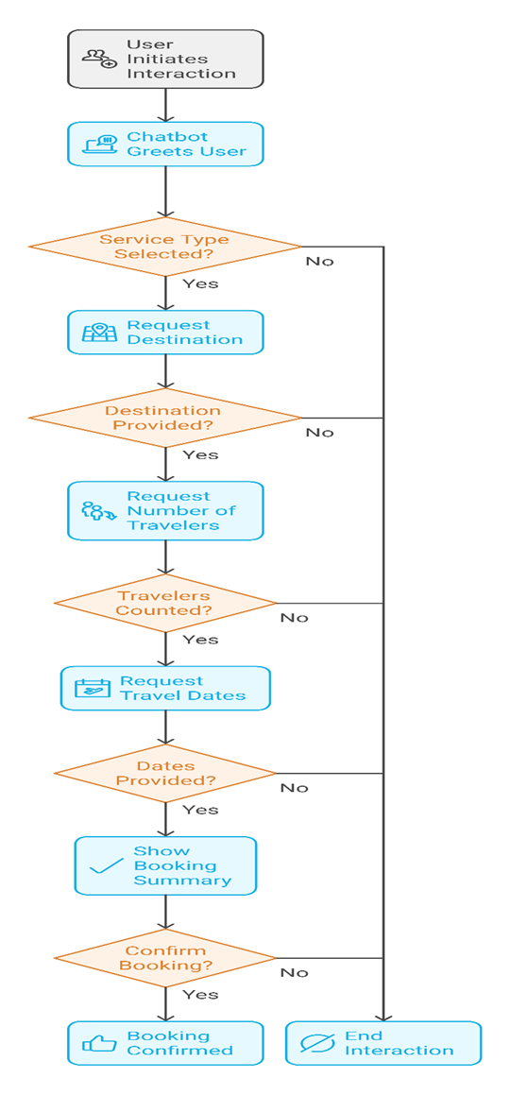
Architecture

Slide 14
Hardware/software components
Software Requirements:
Operating System: Windows/Linux/Mac
Programming Language: Javascript
IDE: Visual Studio Code
Hardware Requirements:
Processor: Intel i5 or AMD RYZEN i5 or higher
RAM: 8GB or more
Storage: 256GB SSD or more

Slide 15
Timeline of Project
Project Initialization
Requirement Gathering & Analysis [18/09/24 - 22/09/2024]
Technology Setup [23/09/24 - 24/09/24]
Design Phase
System Architecture Design [25/09/24 – 28/10/24]
Backend Development (NLP engine) [02/11/24 – 10/11/24]
Frontend Development (Web App) [20/11/24 – 09/11/24]
Development Phase
Deployment & Documentation
Database Integration [11/11/24 – 14/11/24]
Deployment [15/11/24 – 16/12/24]
Final Documentation [17/12/24 – 19/12/24]

Slide 16
Expected Outcomes
A fully functional AI-based chatbot capable of handling customer queries efficiently.
Reduction in customer service response time.
Improved customer satisfaction through personalized responses.
Cost reduction in customer service operations.
Provide real-time assistance 24/7
Minimize the need for human intervention while maintaining high service quality.

Slide 17
Conclusion
The integration of a travel booking chatbot into a business offers significant revenue-driving benefits, especially through the upselling and cross-selling of products. It can analyze customers' preferences and suggest upgraded flights, lounge access, travel insurance, or exclusive tours. It can also bundle services, offering discounted hotel stays or car rentals with the flight, increasing transaction value and promoting comprehensive packages tailored to customers' needs.

Slide 18
Github Link
Github Link- https://github.com/customerservicechatbot

Slide 19
References
Adam, M., Wessel, M., & Benlian, A. (2020). AI-based chatbots in customer service and their effects on user compliance. Electronic Markets, 31, 427–445. https://doi.org/10.1007/s12525-020-00414-7
Stoilova, E. (2021). AI chatbots as a customer service and support tool. ROBONOMICS: The Journal of the Automated Economy, 2, 21. https://journal.robonomics.science/index.php/rj/article/view/21
Kaur, J., Choppadandi, A., Chenchala, P. K., Nakra, V., & Pandian, P. K. G. (2019). Case studies on improving user interaction and satisfaction using AI-enabled chatbots for customer service. International Journal of Transcontinental Discoveries, 6(1), 29-34. https://internationaljournals.org/index.php/ijtd/article/view/98

Slide 20
Project work mapping with SDG
SDG 9: Industry, Innovation, and Infrastructure
A Customer Service Chatbot with AI fits into SDG 9 as it harnesses technological advancements for communication infrastructure and service delivery improvement. It fosters innovation through the automation of processes for customer service, with increased efficiency and reduced response times. In addition, AI-powered chatbots enhance accessibility and inclusivity by allowing businesses to reach diverse customers effectively even in remote areas, contributing to sustainable and scalable industrial growth.

Slide 21
Psuedocode
CLASS TravelChatbot:
PROPERTIES:
currentStep = "greeting"
language = "en"
isListening = false
bookingData = {
serviceType: "",
destination: "",
travelers: "",
dates: "",
preferences: "",
hotelDetails: {
roomType: "",
nights: "",
hotelAmenities: ""
},

Slide 22
Psuedocode
carRentalDetails: {
carType: "",
rentalDays: "",
pickupLocation: "",
dropOffLocation: ""
}
}
translations = {
"en": {dictionary of English translations},
"es": {dictionary of Spanish translations}
}
CONSTRUCTOR:
Initialize speech recognition if supported
Initialize UI elements
Bind event listeners
Start chat with greeting

Slide 23
Psuedocode
FUNCTION initialize():
Display greeting message
Display service selection prompt
Adjust layout for current device
FUNCTION handleInput(userInput):
IF userInput is empty THEN
Show error message
RETURN
Add user message to chat
Show processing message
SWITCH currentStep:
CASE "destination":
Save destination
Ask for number of travelers
Set currentStep to "travelers"

Slide 24
Psuedocode
CASE "travelers":
Save travelers count
Ask for travel dates
Set currentStep to "dates"
CASE "dates":
Save dates
Show booking summary
Set currentStep to "confirmation"
CASE "confirmation":
IF user confirms THEN
Generate booking reference
Show confirmation
Reset booking

Slide 25
Psuedocode
ELSE
Cancel booking
Reset state
END IF
FUNCTION handleServiceSelection(service):
Save selected service type
Ask for destination
Set currentStep to "destination"
Hide service selector
FUNCTION toggleLanguage():
Switch between "en" and "es"
Update UI text elements
Update speech recognition language

Slide 26
Psuedocode
FUNCTION handleSpeechInput():
IF speech recognition supported THEN
IF currently listening THEN
Stop listening
ELSE
Start listening
Set recognition language
Show listening prompt
END IF
ELSE
FUNCTION showBookingSummary():
Format booking details
Display summary
Ask for confirmation

Slide 27
Psuedocode
FUNCTION confirmBooking():
Generate random reference number
Show confirmation message
Reset booking data
Set currentStep to "complete"
FUNCTION resetBooking():
Clear all booking data
Reset to initial state
Show service selector
HELPER FUNCTIONS:
addMessage(text, isBot) - Add message to chat
scrollToBottom() - Scroll chat to latest message
speak(text) - Convert text to speech
adjustLayoutForMobile() - Handle responsive design
updateUILanguage() - Update UI text based on language

Slide 28
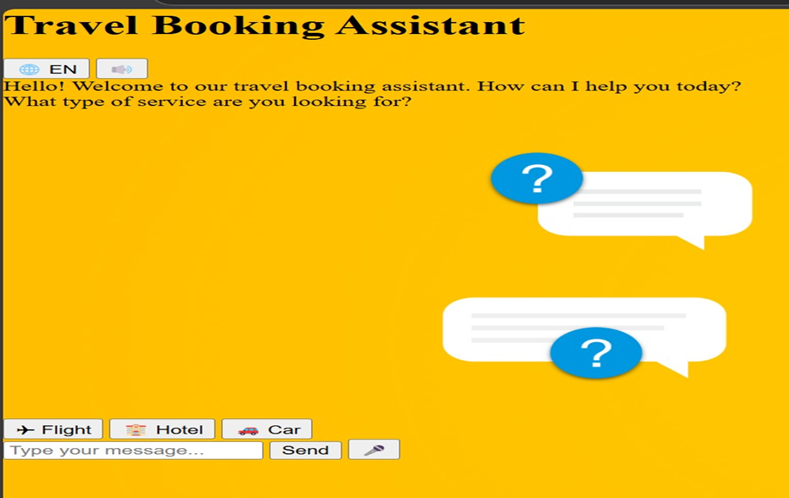
Screenshots

Slide 29
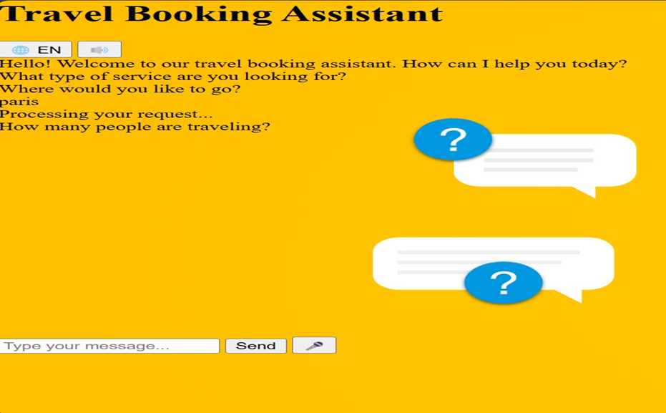
Screenshots

Slide 30
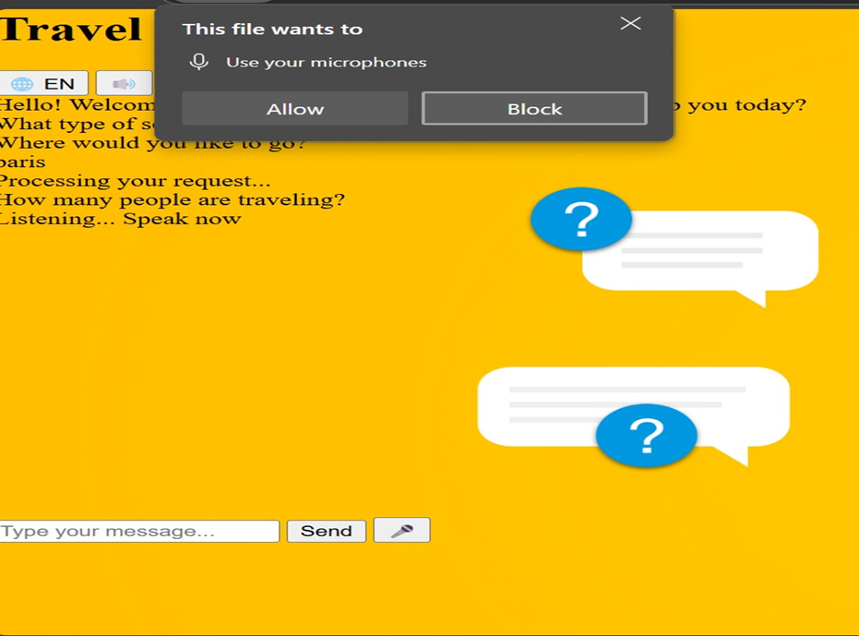
Screenshots

Slide 31
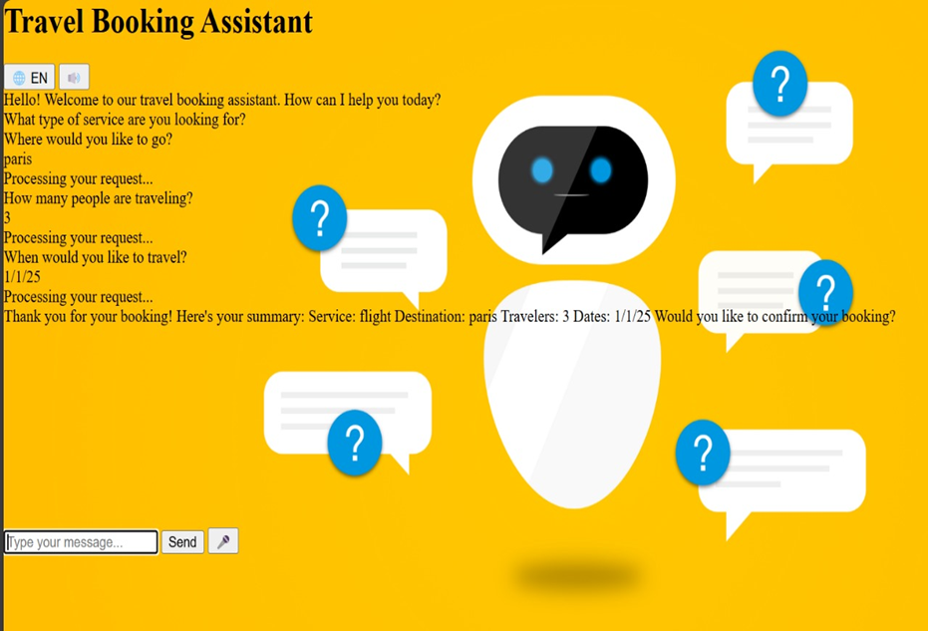
Screenshots

Slide 32
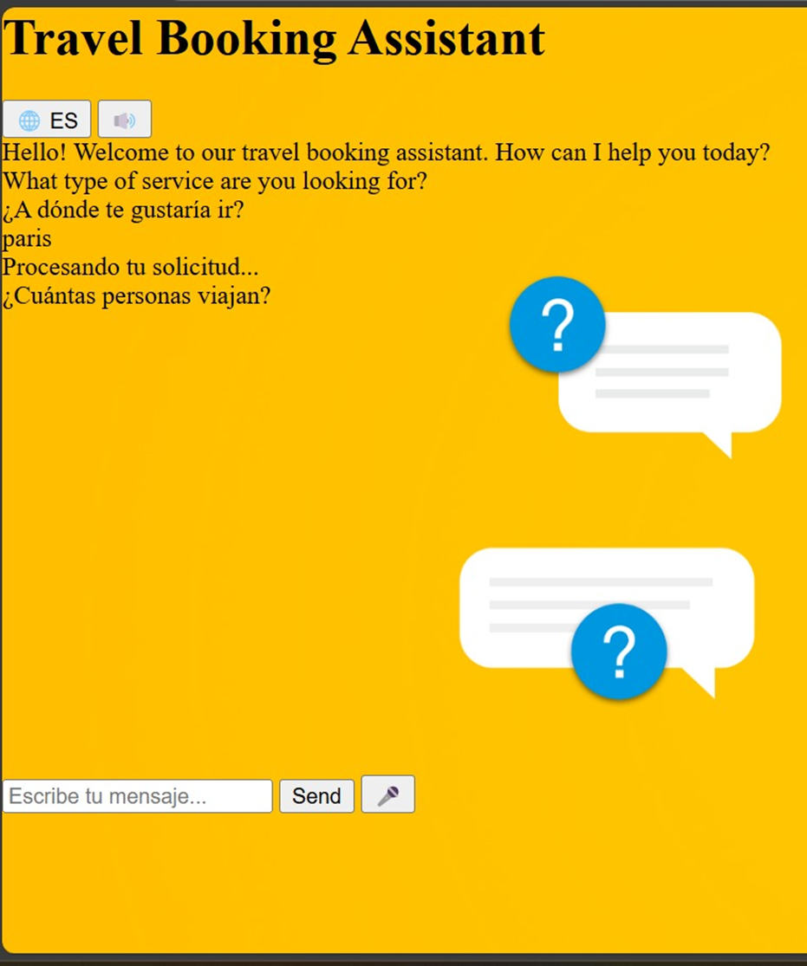
Screenshots

Slide 33
Thank You

