Slide 1
PIP4004 - INTERNSHIP Final Review Presentation Web Development
Student Details
Name | Sudheshna Shahabadi K Pavithra
Roll No | 20211CSE0679, 20211CSE0690
Section | 8CSE07
Batch No. | G-08
Under the Supervision of,
Mr. Md Ziaur Rahman
Assistant Professor
School of Computer Science and Engineering
Presidency University
Name of the Program: Computer Science And Engineering
Name of the HoD: Dr. Asif Mohammed H.B
Name of the Program Project Coordinators: Mr. Amarnath J.L & Dr. Jayanthi. k.
Name of the School Internship Coordinator: Mr. Md Ziaur Rahman

Slide 2
Contents
About Organization
Working domain
About your team and reporting Manager
Challenges Faced in Internship
Objectives of the work
Literature Review
Proposed Work
Problem Statement
System Requirements
Advantages of Proposed Work
Sample Login Page UI Design
Upgraded UI Design
Screenshots of the final outcome
Conclusion
Internship Roadmap
Github Link

Slide 3
About Organization
UPTOSKILLS is one of India's largest Skill-Tech companies, focused on providing free skill development programs to students and professionals. Founded in 2015, the organization has trained over 1.2 million individuals and collaborated with more than 10,000 colleges. Their mission is to empower youth with industry-relevant skills for successful careers through innovative and accessible learning solutions.
Products & Services:
Skill Development & Certification Courses: Offers both technical and non-technical training.
On/Off Campus Training & Placement: Provides training programs that prepare students for job opportunities.

Slide 4
About Organization
Entrepreneurship Programs: Focuses on empowering rural areas through skill-based entrepreneurship.
Corporate Training & Brand Awareness Campaigns: Supports businesses in upskilling employees and increasing brand presence.
Clients & Impact:
UPTOSKILLS has placed over 76,000 students in various industries and provided 1,321+ internship opportunities. The company works closely with academic institutions and businesses to bridge the gap between education and employment.

Slide 5
Working domain
In the internship at UptoSkills Tech Foundation in the Web Development domain, We will work on various aspects of website creation and maintenance, gaining hands-on experience in coding, and design.
Technology we will be using are:
Frontend Development – HTML, CSS, JavaScript, and frameworks.
Backend Development – Node.js, Python, Ruby or PHP for server-side logic.
Importance of Web Development in the Industry:
Business Growth: A strong web presence helps businesses reach wider audiences.
User Experience: A well-designed website improves engagement and conversion rates.

Slide 6
About your team and reporting Manager
Our team consist of 26 members, which is divided into two sub groups.
Our team has one main team leader. One sub group is led by the main team leader and another group by the sub group leader.
We all work on the tasks assigned by the respective team leaders and complete the tasks within the given deadline.
Our reporting manager is Mr. Shivam Agarwal
Working on Human Resource Management Software

Slide 7
Challenges Faced in Internship
Limited Openings: Government internships may have fewer openings compared to private firms. Many positions are not widely advertised.
Complex Application Process: Applications often require multiple forms, approvals, and background checks.
Competitive Selection: Government portals attract numerous applicants due to credibility and resume value.

Slide 8
Objectives of the work
Develop technical skills in HTML, CSS, JavaScript, and Node.js.
Gain real-world experience through the assigned tasks.
Enhance teamwork by collaborating with the team members.
Improve soft skills like communication, time management, and documentation.

Slide 9
Literature Review
The HRMS Features webpage is designed to provide an integrated system for managing HR functions.
The literature review assesses existing HR management systems, their effectiveness, and the need for improved UI/UX elements to enhance user experience.
Various web design principles and HRMS best practices were analyzed to ensure an optimized, accessible, and interactive platform.

Slide 10
Proposed Work
Top Banner: Highlights mobile app availability and download options.
Navigation Menu: Provides links to Features, Documentation, Blogs, and Contact.
Hero Section: Introduces HRMS Features with a compelling heading and description.
Features Grid: Showcases HRMS functionalities such as Employee and Asset Management.
Footer Section: Contains legal information, company details, and social media links.

Slide 11
Problem Statement
Current HRMS platforms often lack user-friendly navigation, effective call-to-action placements, and interactive elements, leading to reduced engagement and usability issues. The goal is to design a well-structured webpage that enhances HRMS adoption by improving clarity, accessibility, and interactivity.

Slide 12
System Requirements
Frontend: HTML, CSS, JavaScript for structure and styling.
External Dependencies: Font Awesome icons, JavaScript scripts for navigation and banner handling.
Hosting & Deployment: Web server supporting CSS, JavaScript, and HTML-based applications.

Slide 13
Advantages of Proposed Work
Enhanced User Experience: Simplifies HRMS navigation with a clean and structured layout.
Improved Feature Representation: Clearly defines various HRMS functions.
Interactive UI Elements: Click-enabled feature links and intuitive navigation for better engagement.
Effective Call-to-Action (CTA): Optimized download buttons and menu links guide users seamlessly.

Slide 14
Sample Login Page UI Design
The login page for an HR Management System has a clean and structured layout. At the top, there is a header that includes the title "HR Management System" and a subtitle "Recruitment & Onboarding Portal.“
Below this, the login form consists of a username field (filled with "ram_123") and a password field (filled with "Ram@123"), which includes a visibility toggle icon.
Additionally, there is a "Remember me" checkbox and a "Forgot password?" link for user convenience.
A prominent "Sign in" button, styled in purple, is placed below these fields. At the bottom of the form, users are given the option to continue as either an "HR Admin" or a "Candidate", indicating role-based login access.

Slide 15
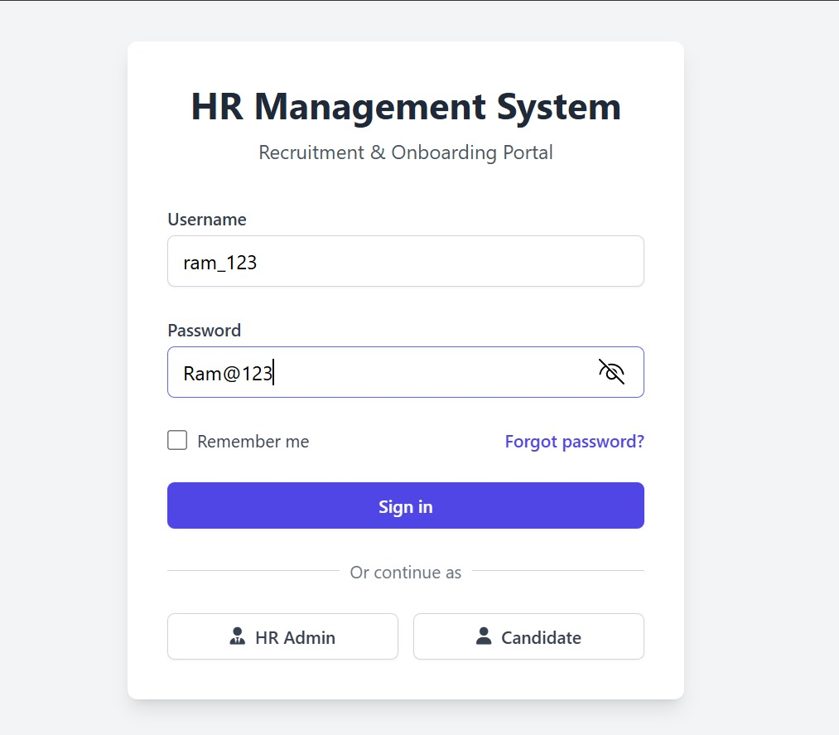
Screenshot

Slide 16
Upgraded UI
The HR & Candidate Management System is a web-based application designed to streamline HR operations and enhance candidate interactions. It provides role-based access, allowing HR personnel and candidates to log in through a secure authentication system.
The login page offers role selection (HR or Candidate) and includes session persistence using LocalStorage. HR users can access a feature-rich dashboard where they can view candidate statistics, add new candidates, assign project managers and team leads, and manage onboarding status.
Additionally, they can edit or delete candidate profiles while ensuring that data remains secure through session-based access control.

Slide 17
Upgraded UI
candidates are provided with a dedicated dashboard that offers an intuitive view of their profile details, assigned PM and TL, and onboarding information.
They can also download their offer letter, making the hiring process seamless. A key feature of this dashboard is the social feed, where HR teams can post company announcements, and candidates can interact with team members.
The system is built using HTML, Tailwind CSS, and JavaScript, ensuring a modern, responsive, and interactive user experience.

Slide 18
Upgraded UI
The system incorporates several security measures, including role-based access control, preventing unauthorized users from accessing HR functionalities. Currently, the project utilizes LocalStorage for data handling, but future enhancements include integrating a real database (such as Firebase or MySQL) for secure data storage, implementing OAuth-based authentication for better security, and adding email notifications for offer letters and onboarding updates.
The HR & Candidate Management System effectively reduces manual effort, enhances candidate engagement, and simplifies HR workflows, making it a valuable tool for organizations managing employee onboarding and recruitment.

Slide 19
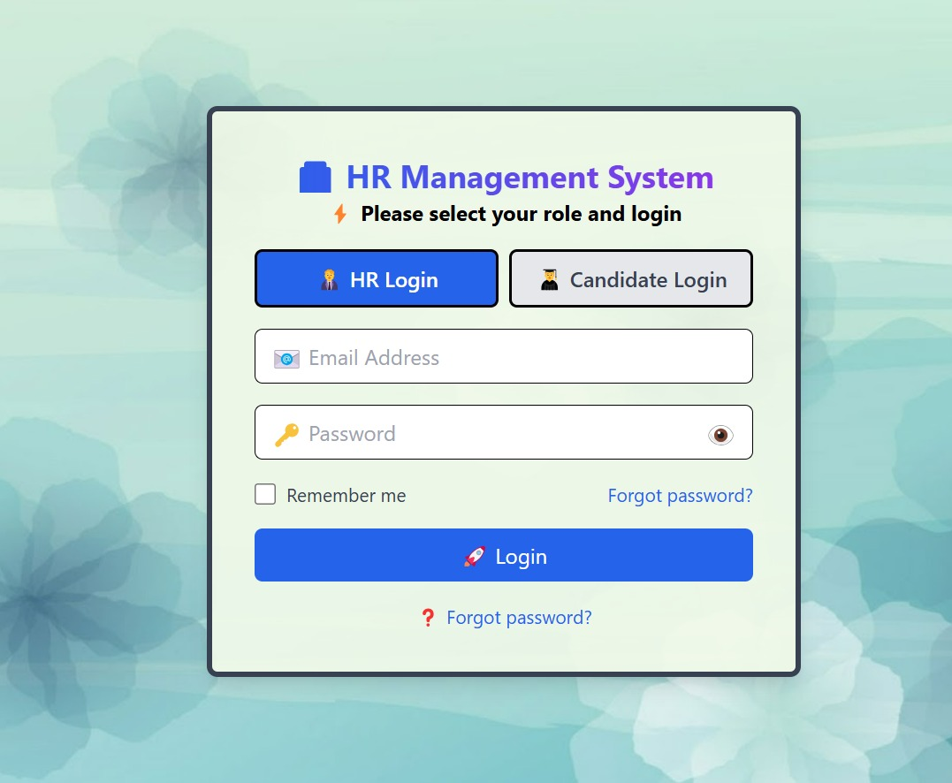
Screenshot of Login Page

Slide 20
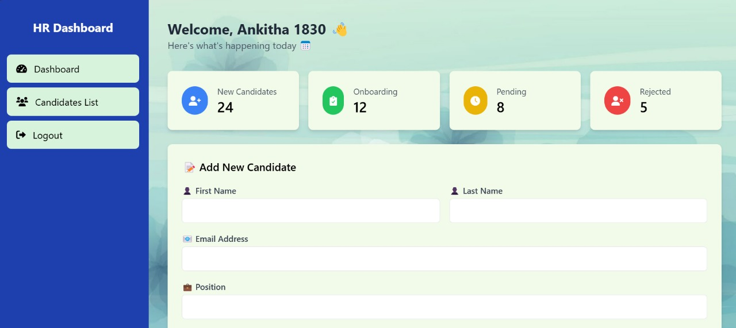
Screenshot of HR Page

Slide 21
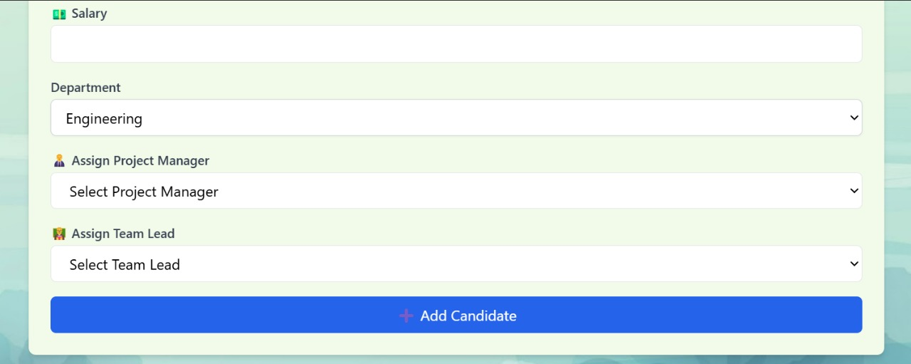
Screenshot of HR Page

Slide 22
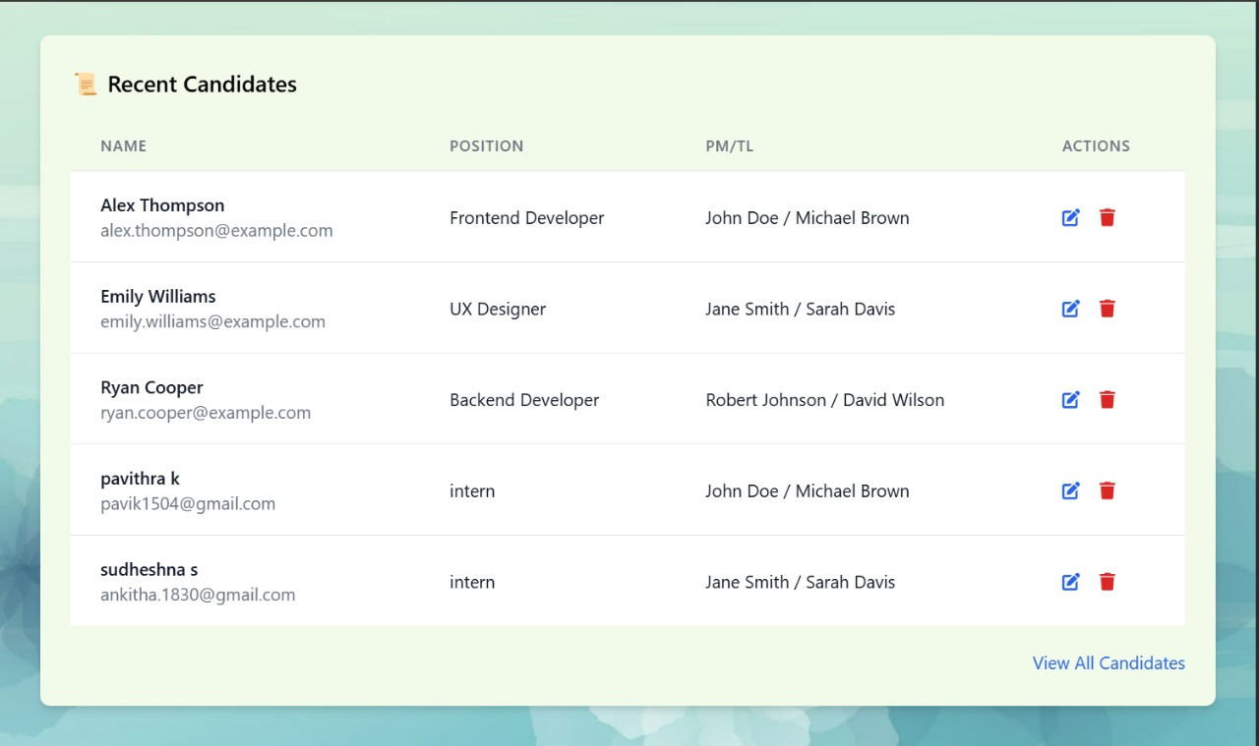
Screenshot of HR Page

Slide 23
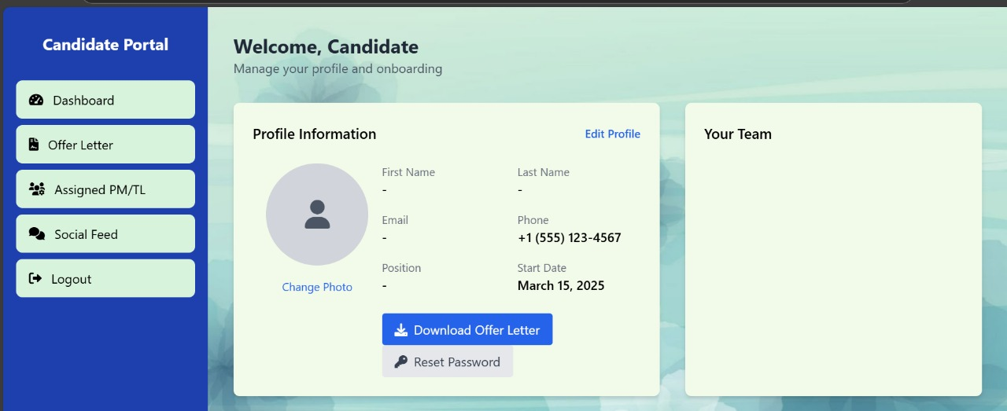
Screenshot of Candidate Page

Slide 24
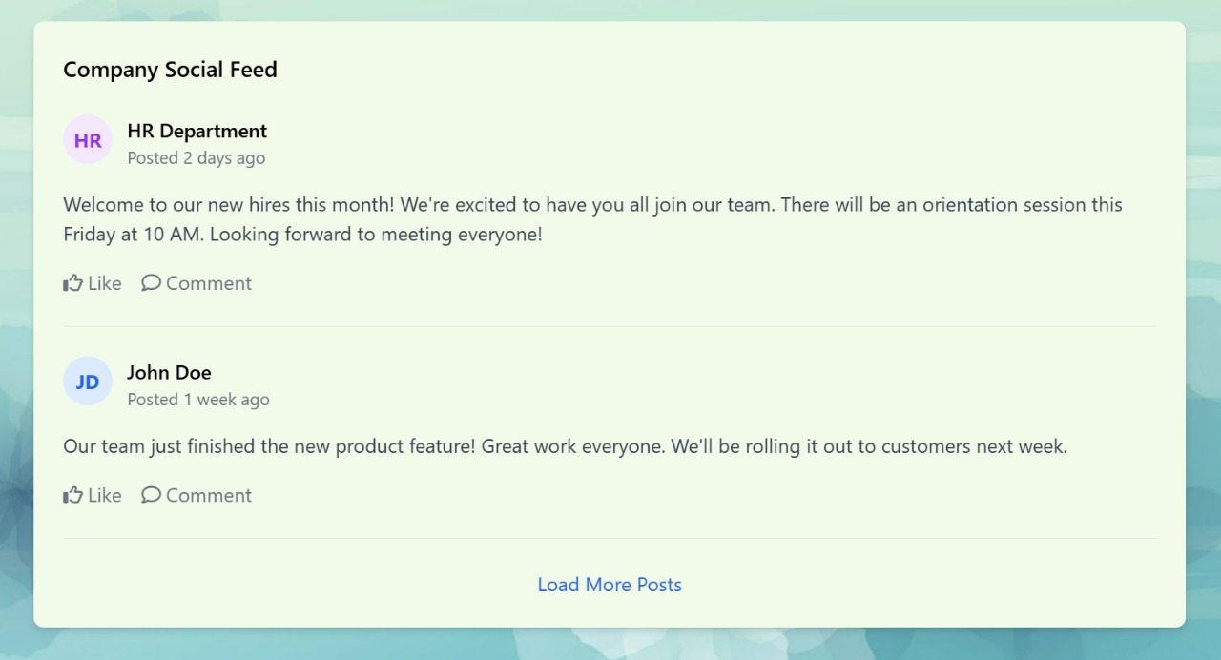
Screenshot of Candidate Page

Slide 25
Pseudocode
Login page:
Function renderLoginPage():
Display email and password fields
OnSubmit:
Call authenticateUser(email, password)
Function authenticateUser(email, password):
If email and password match in database:
Redirect to dashboard based on user role (HR or Candidate)
Else:
Show login error

Slide 26
Pseudocode
2. HR Dashboard:
Function renderHRDashboard():
Display navigation bar
Fetch list of candidates from database
Display each candidate’s profile, status, and actions (view, accept, reject)
Function viewCandidateProfile(candidateID):
Fetch full details of candidate by ID
Display profile with skills, resume, etc.
Function changeCandidateStatus(candidateID, newStatus):
Update status in database
Refresh candidate list

Slide 27
Pseudocode
3. Candidate Dashboard:
Function renderCandidateDashboard():
Display candidate information (name, application status, etc.)
Allow candidate to upload resume or edit profile
Function uploadResume(file):
Validate file format
Save file to server/storage
Update candidate’s resume path in database
Function editCandidateProfile(newDetails):
Validate input
Save changes to database

Slide 28
Pseudocode
4. Routing:
Route "/" → renderLoginPage()
Route "/dashboard/hr" → renderHRDashboard()
Route "/dashboard/candidate" → renderCandidateDashboard()
Route "/profile/:id" → viewCandidateProfile(id)

Slide 29
Pseudocode
5. Database Schema:
User {
id: string
name: string
email: string
password: string
role: "HR" | "Candidate"
resumeUrl?: string
profileDetails?: object
applicationStatus?: string
}

Slide 30
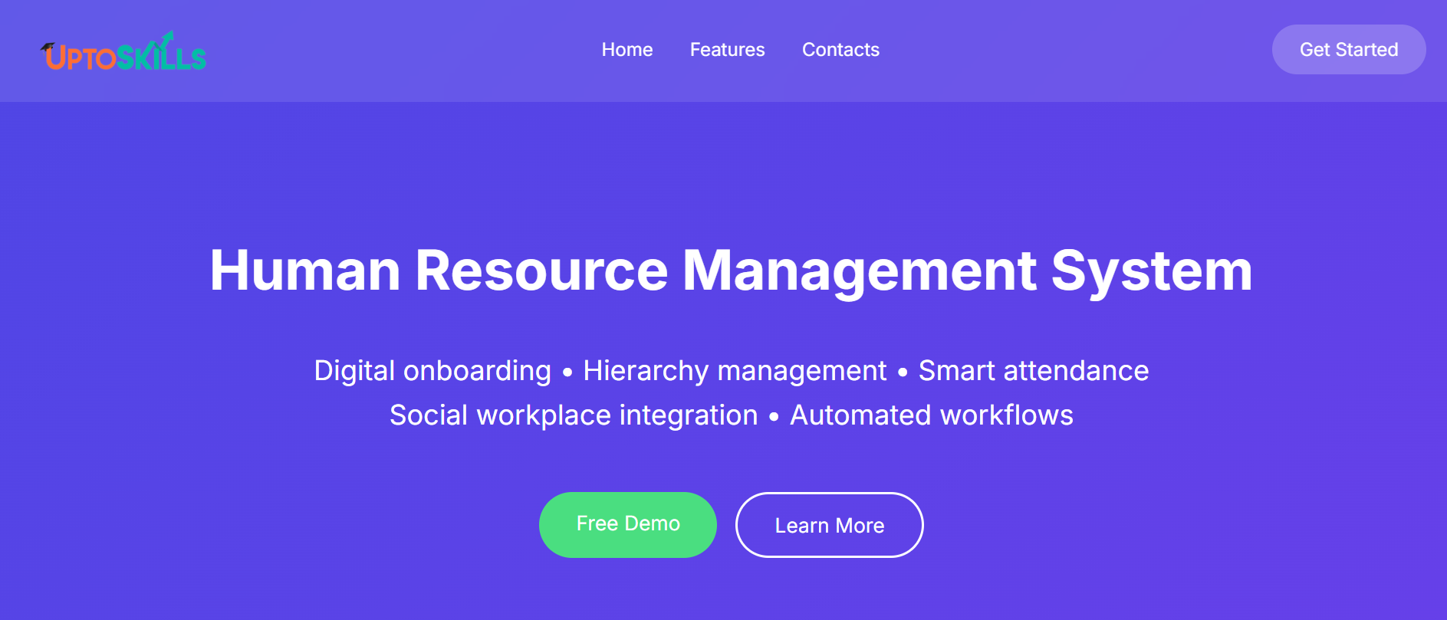
Screenshot of Final Outcome

Slide 31
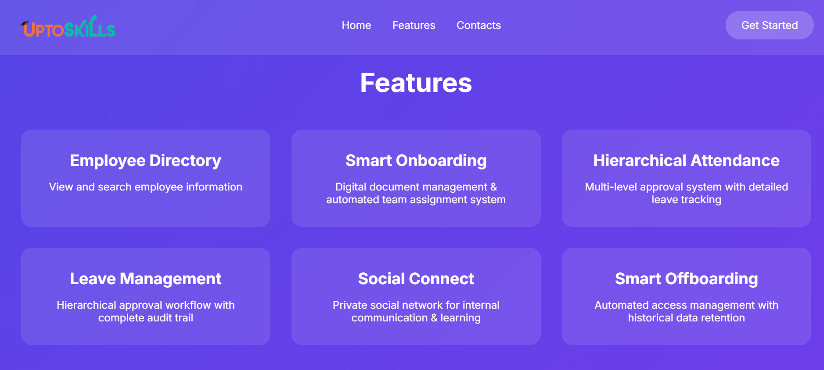
Screenshot of Final Outcome

Slide 32
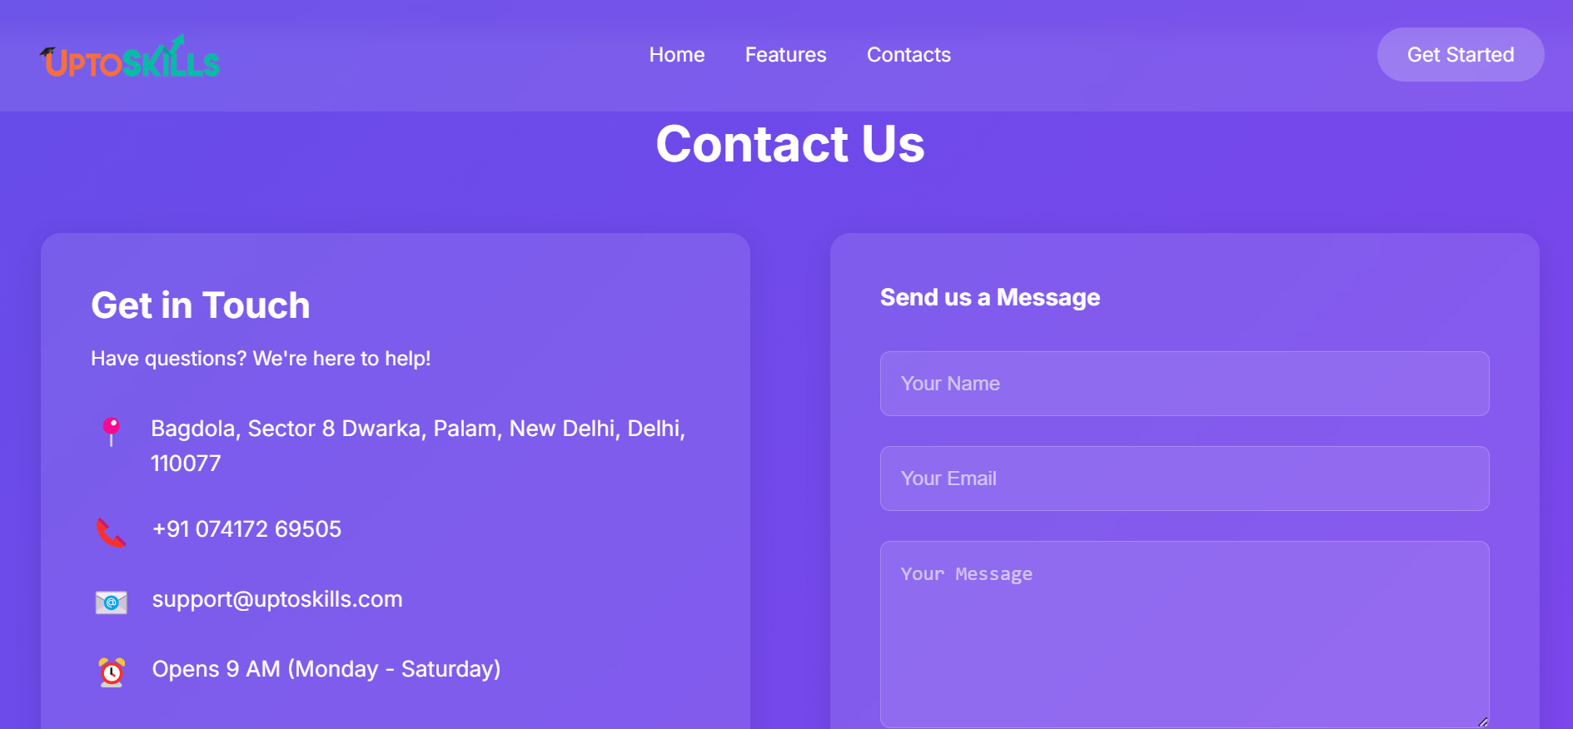
Screenshot of Final Outcome

Slide 33
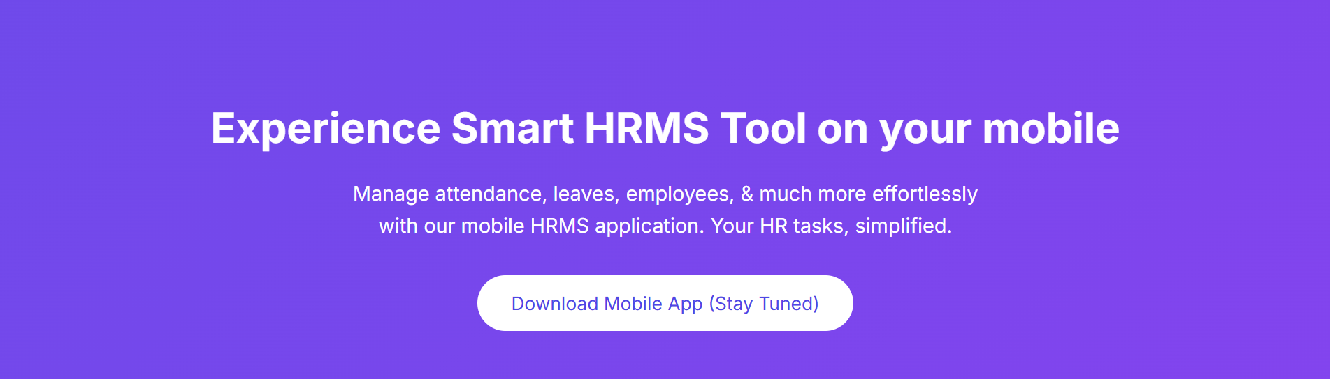
Screenshot of Final Outcome

Slide 34
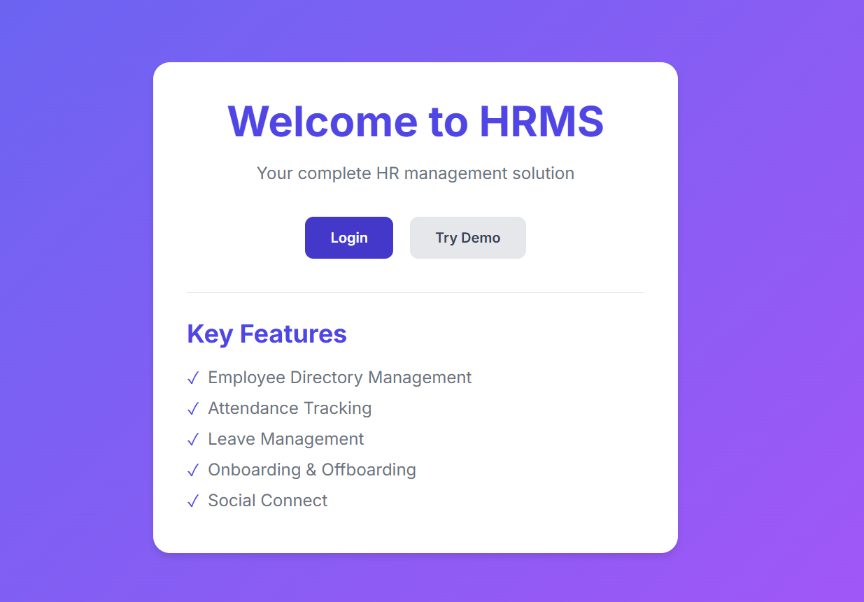
Screenshot of Final Outcome

Slide 35
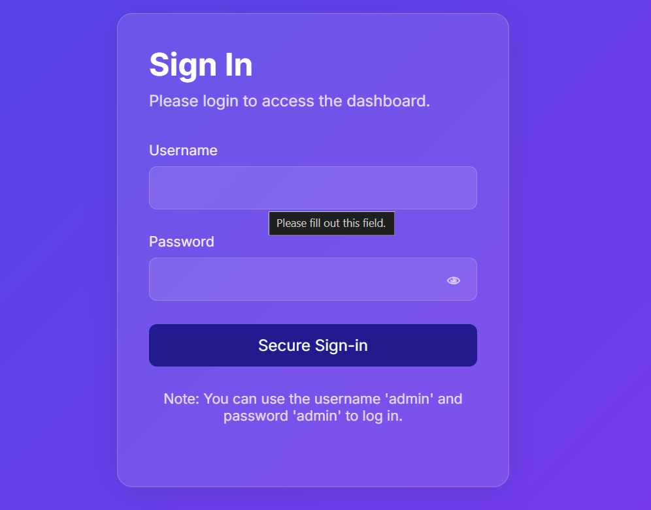
Screenshot of Final Outcome

Slide 36
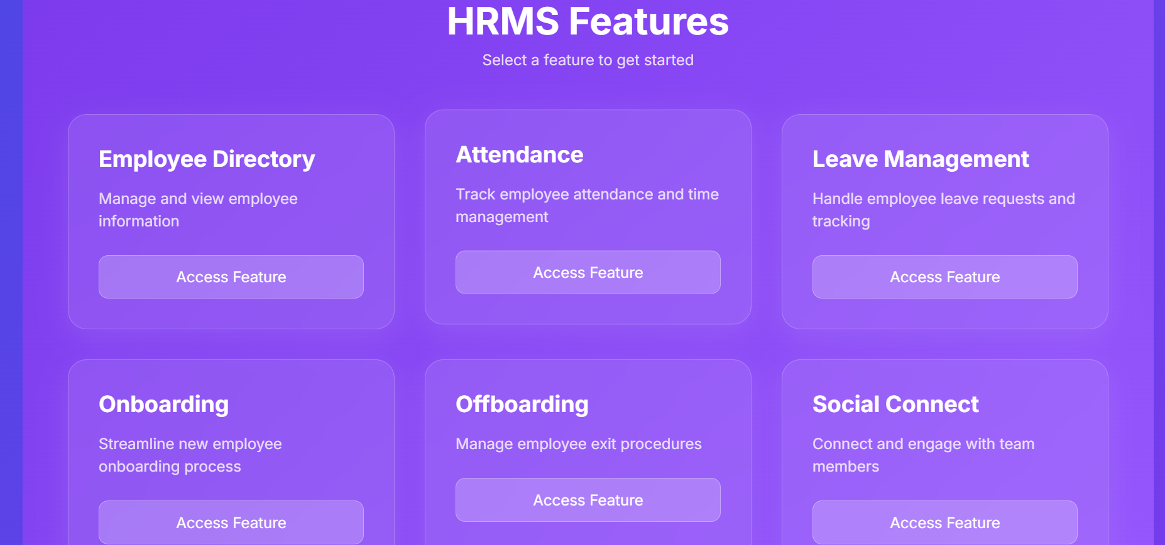
Screenshot of Final Outcome

Slide 37
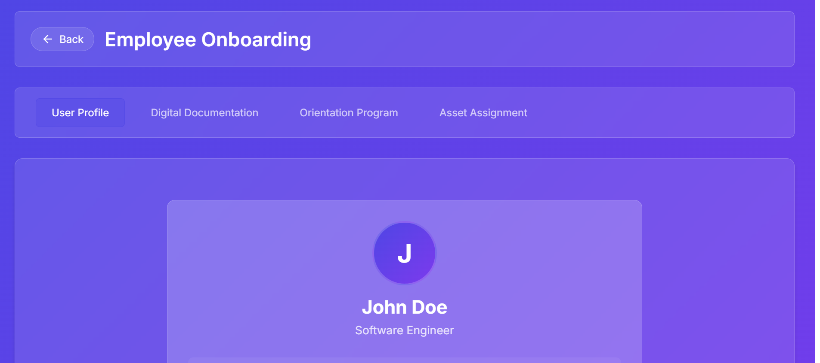
Screenshot of Final Outcome

Slide 38
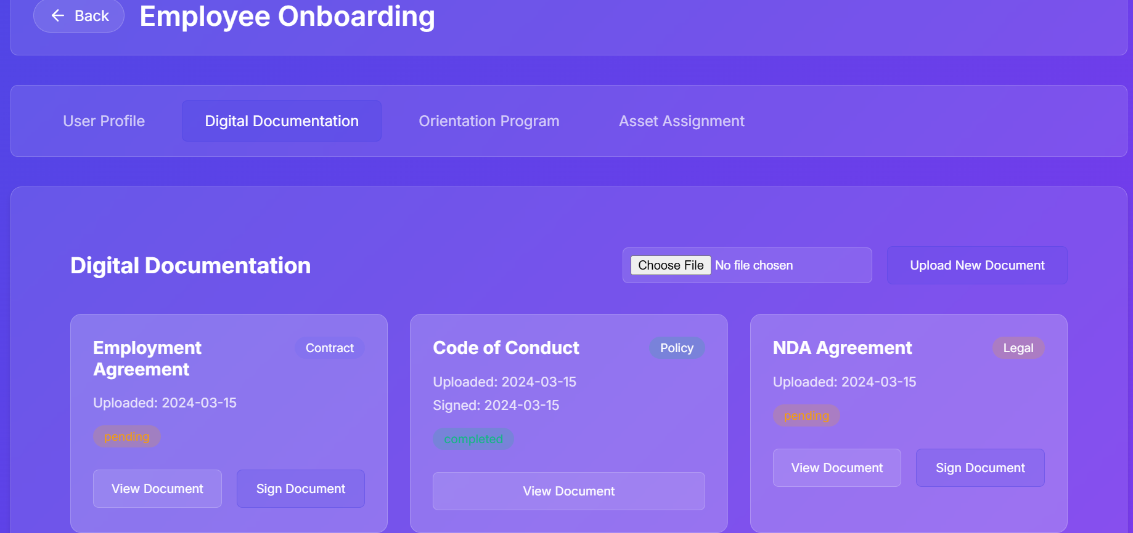
Screenshot of Final Outcome

Slide 39
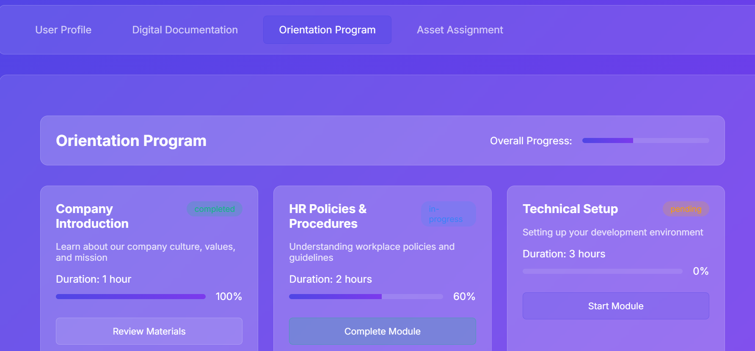
Screenshot of Final Outcome

Slide 40
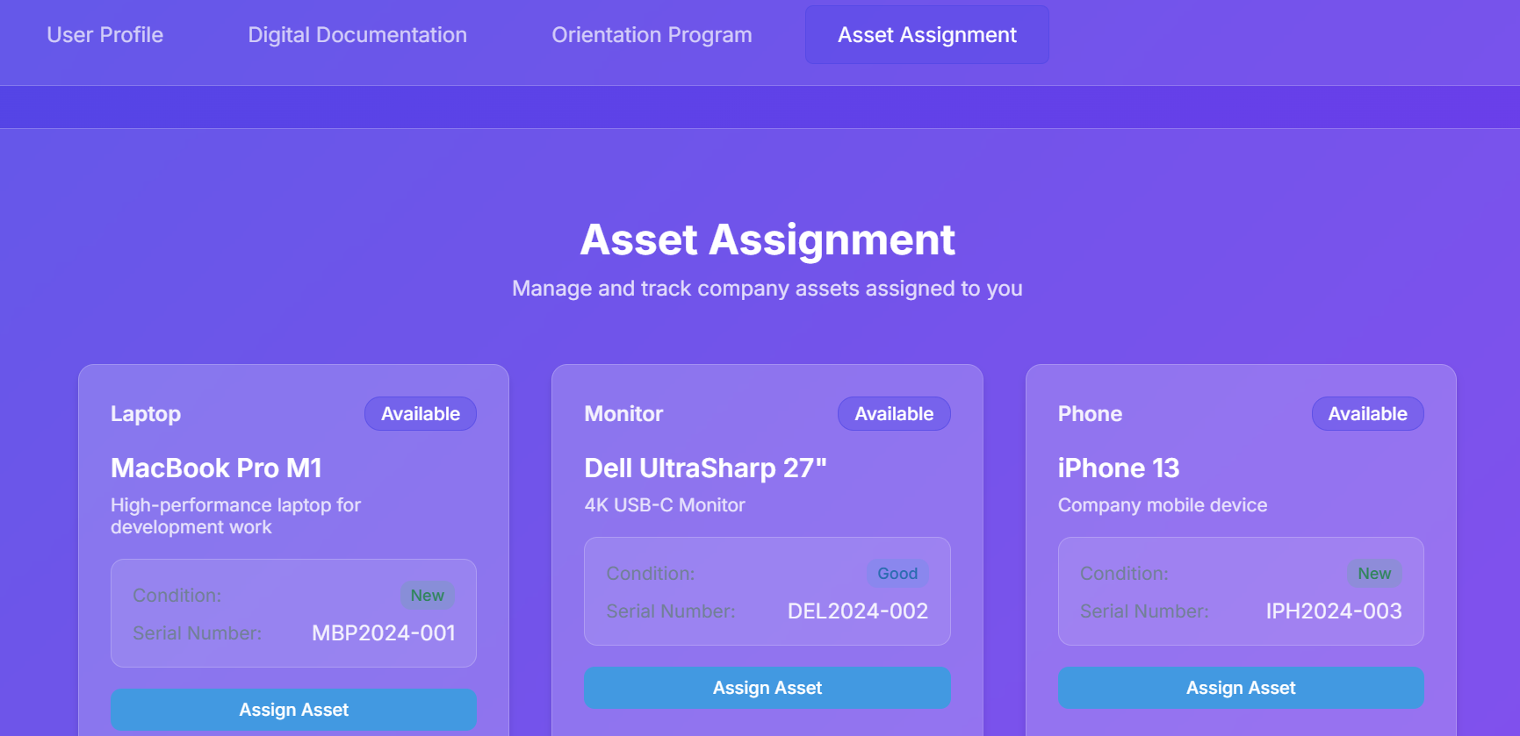
Screenshot of Final Outcome

Slide 41
Conclusion
The HR Management System effectively automates and simplifies the primary HR processes, providing an easy-to-use and responsive interface for both job applicants and HR professionals. With a secure login mechanism and role-based dashboards, the application effectively separates access rights, allowing users to interact only with the features specific to their roles. It has the capability of handling efficient candidate data management, recruitment processes, and HR interactions while having a clean and sleek UI design based on HTML, Tailwind CSS, and JavaScript.

Slide 42
Internship Road Map
Review 0
Our first task was to create the homepage of uptoskills website using HTML and CSS.
Review 1
We will work on the front-end part of the Web Development in collaboration with the team members.
Review 2
We will work on the back- end part of the Web Development
Review 3
in collaboration with the team members.
We will collaboratively work on the assigned tasks using the frameworks.

Slide 43
Github Link
https://github.com/customerservicechatbot/internship

Slide 44
Q&A

Slide 45
Thank you !!

