Slide 1

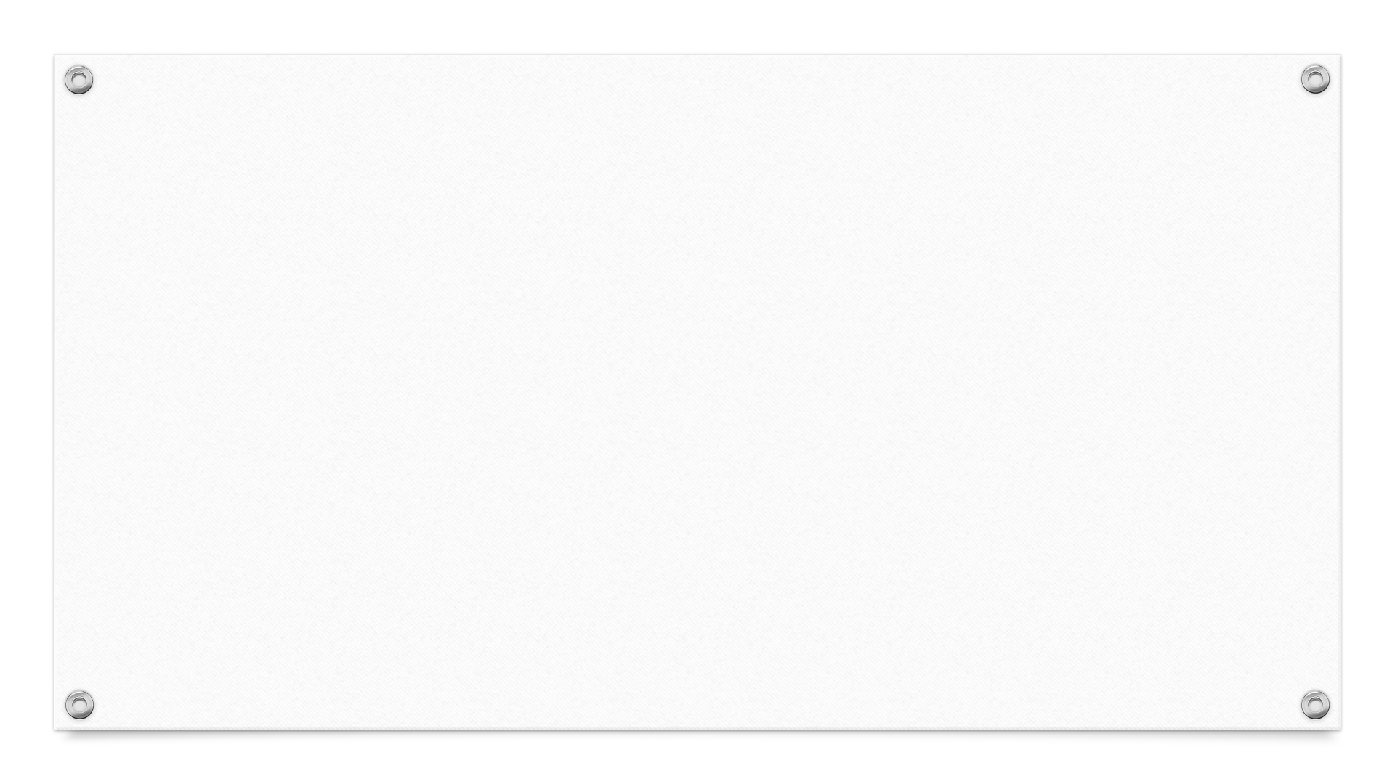
CS325 Project
AR Scene Editor UI By Team 1
Calvin Boey Siu Hoe
Leong Jun Ming
Wang Yidi
Brandon Ng Jun Jie
Wong Zi Feng

Slide 2







Application of User-Centered Design
Analysis of user needs
Prototype
Informal Feedback
Iterate on Design
Final Application
Formal Feedback
Notes:
We are applying user centered design that we learnt in the lesson, as we don’t have the time to iterate on the design flow many time, so we tried to do it as much as possible within the limited time span.

Slide 3

Assumptions
Assumes that no special behaviour will be made through EZAR like Application Logic
Assumes that the configuration will be able to be read by the AR system.
Assume that objects that our editor deals with are pre-set objects and are unable to change any configuration except to place them into different areas into the scene.

Slide 4
Iterations
Our UI has gone through several Iterations
1st Lo-Fi prototype
2nd Lo-Fi Prototype
1st Hi-Fi prototype
Final Prototype
Notes:
mentioning about iterations, we improve our prototype with each iteration and for each updated prototype, we add new relevant functionalities that improves our user experience and software functionalities that are closely related to our target user. We made 3 prototypes and a final one in total within the iterations of our design process.

Slide 5



Considerations
User Analysis
Persona
Task Analysis
Basic User Task
User Flow Diagram
Limitations
Notes:
For Design consideration, our plan is to create a clear user image by using a persona of our typical user and we take

Slide 6
Design Goals
We want our UI to
Look easy, but has a lot of extended functionalities
Big buttons
Functionalities are targeted specifically to our User
Notes:
We are aiming to make our Design simple and looks learnable at one glance. Bug buttons and only a few displayed functionalities will make our editor looks easily learnable and thus attract users to try out the software.
To be able to do that, we will limit our functionalities to only important functionalities to the targeted Users.

Slide 7
Draft Persona
Name: Bob Boberson
Age: 32
Description: General Public, Would like to user the software to build any Scene for AR Environment
Not Familiar with technology
Have good knowledge of what they want to create
Tempered, would like to know how our product works quickly
Notes:
At the start of the project, we our aim is to release the UI to general public who would like to use our UI to create any kind of environment, the target is more diverse and general.

Slide 8
Basic User Task
Users need to be able create, edit, open and view configurations files.
Virtual Objects Add, Edit, Delete
Export into AR system configuration file.
Notes:
We decided to only put basic task analysis intro the user task section because all other functionalities has the purpose to serve as a better UI to improve the user’s experience on these functionalities.

Slide 9
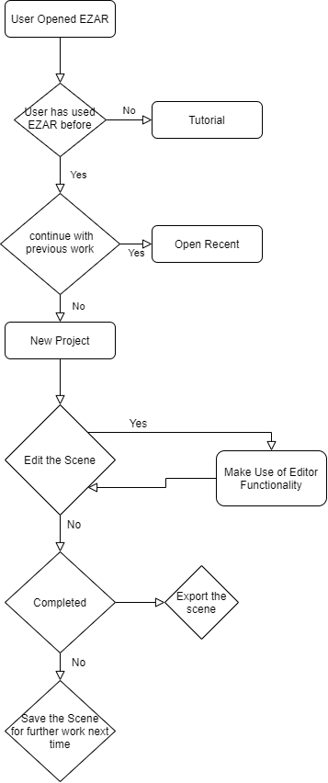
User Flow Diagram
Basic Editor Functionality includes:
Translate
Rotate
Scale
Undo
Redo

Slide 10

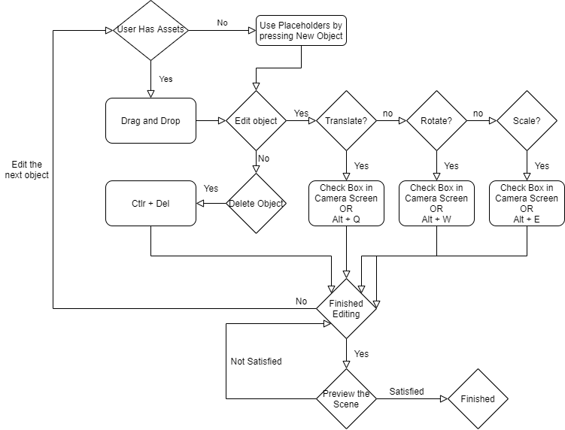
User Flow Diagram
More Detailed Diagram of how user is going to use the editor functionalities.

Slide 11
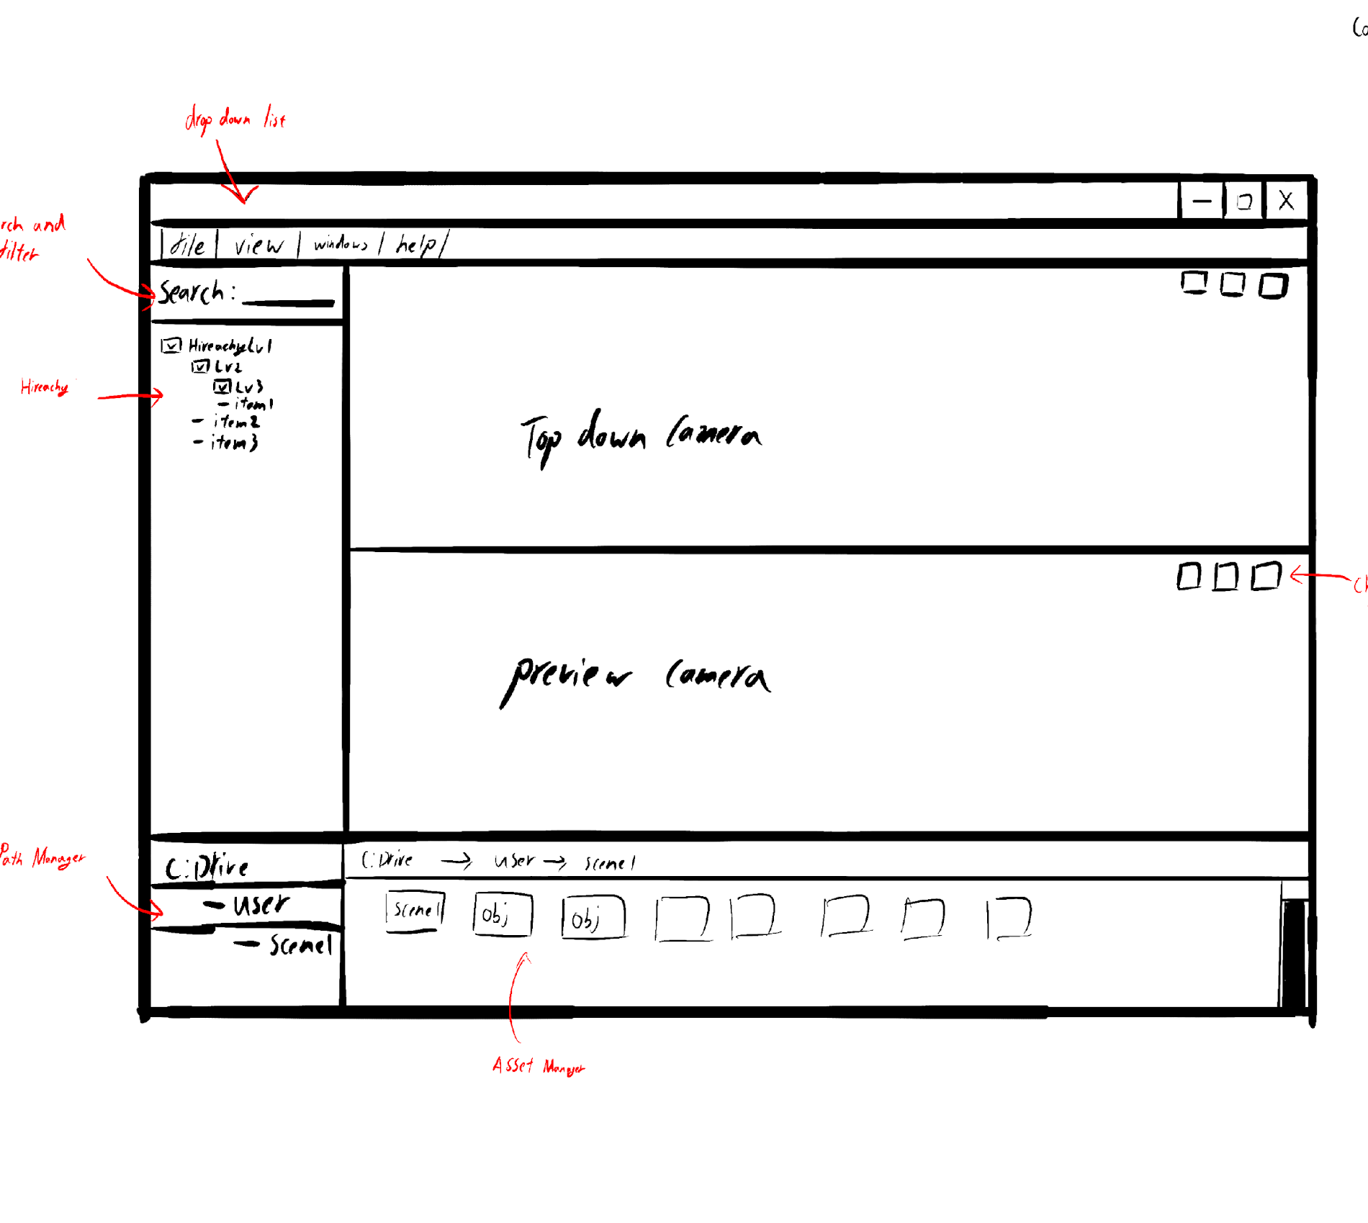
1st Lo-Fi Prototype
Hand Drawn
The Graphical Design we are aiming for is
Simple
Aligned
Symmetrically balanced
Notes:
Start with Pen & Paper LoFi proto
Went clean and simple layout with
interface areas being top, left or bottom aligned
Symmetrically balanced

Slide 12
Persona
Name: Bob Boberson
Age: 32
Description: Professional Urban Planner, will at least know basic technical knowledge, Might have used a similar app.
Familiar with particular softwares
Unity
Maya
Working in AR Industry
Have good knowledge of what they want to create
Busy with other works too, don’t have much time to spend editing the scene
Professionals would like to simulate virtual object in the real environment
Urban planner's job is to develop plans for the use of land and revitalization of urban zones.
Notes:
We refined our person to be more specific.
Targeting urban planner with basic technical knowledge
He has experience in software such as Unity & Maya.
Working in AR industry and
Wants a fast and easy to simulate urban environments.

Slide 13
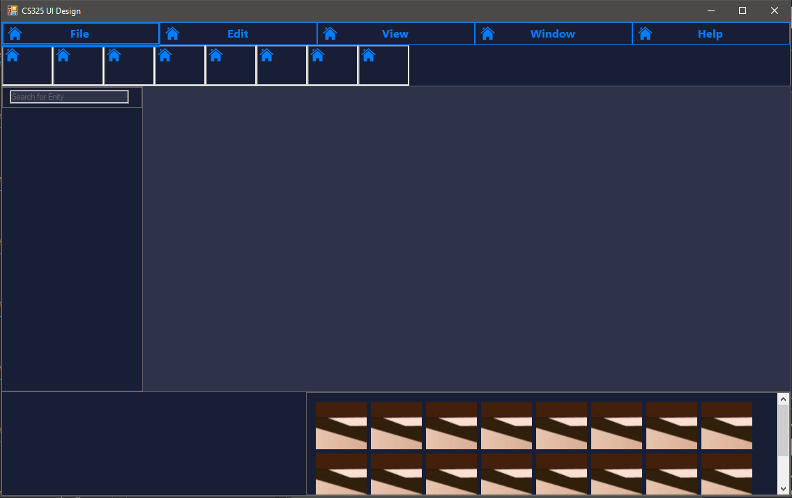
2nd Lo-Fi Prototype
Made with C# .Net
Colour Scheme is determined to be using darker colours.
Icons will be highlighted when selected
Drop Down List change into tabs, bigger button for user
Notes:
From the Pen & Paper prototype, we moved to use C# .Net
Came up with dark blue colour scheme
Blue is a relaxing colour
Dark background helps contrast with foreground & UI elements
Visual feedback by highlighting button border of icons
In general changed to make use of tabs instead of drop down list, follow our design goal of having bigger buttons.

Slide 14
Menu Bar
Elements in this section are designed to be horizontally long to make use of the top screen edge border limit. It was made narrowly tall to ensure that it does not take more screen space as necessary.
Notes:
Elements are top aligned and span screen wide.
Make use of top edge border limit
Short height to not take unnecessary screen space

Slide 15
Bookmarks Bar
In the 2nd prototype, we changed the drop-down list to a bookmark bar.
The pop-up bar when any of the Menu Bar elements is highlighted
Using steering law, we made these elements taller than the Menu Bar to allow for easier navigation horizontally while within the Bookmarks Bar.
These elements use a square design so as to better make use of icons.

Slide 16
Hierarchy Window
From user analysis, we determined that the user is familiar with Unity.
In order to make it familiar for the user, we designed a similar hierarchy window which displays objects in the scene in a similar way.

Slide 17
Asset Manager
Designed to be like Unity’s assets explorer window.
Makes use of boxes to allow for use of icons.
Notes:
Icon for user memory load reduction

Slide 18
Camera view screen
Double Camera View Screen
Top Camera for Editing
Bottom Camera for Previewing
Spawn a User in the middle of the screen by default
Selected object will be highlighted with red border
Selected object will have translate/rotate/scale UI appear on them according to edit mode
Notes:
Highlight red border is visual feedback
also similar to Unity & Maya highlighting feature

Slide 19
User Feedback
Lighter Color Scheme
More Shortcut Keys
Single Camera
Inspector
Notes:
Based on User feedback for the Lo-fi Prototype, we decided to make several changes to the design for the Hi-Fi prototype such as *list from slide*

Slide 20
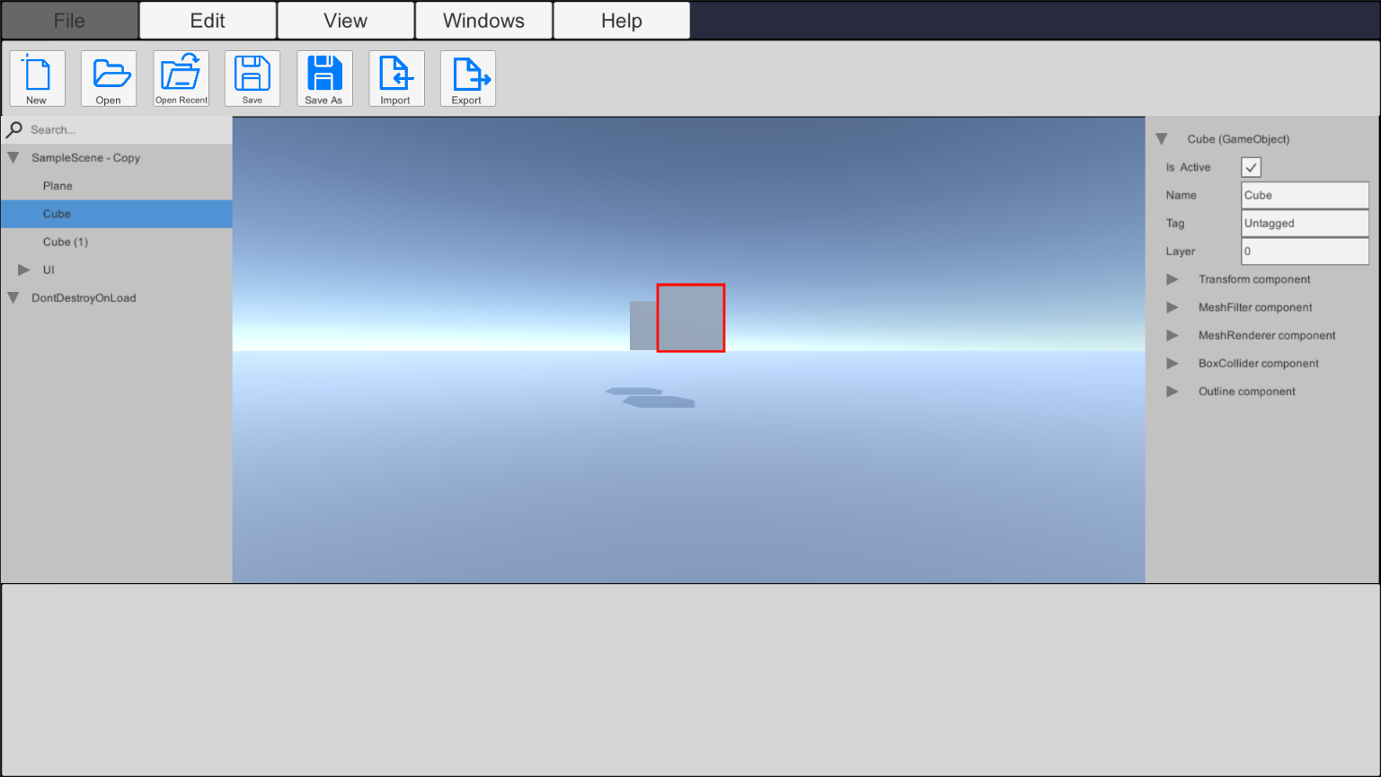
First Hi-Fi Prototype
Made in Unity
Notes:
One of the major changes from Lo-Fi to Hi-Fi is the platform used. We moved from C# .net to Unity.
Based on feedback from BAGDs, we found out that a light theme is more widely accepted among designers, so we switched from a dark theme with blue accents, to a light theme but with the same blue accents.
Another thing designers like is Shortcuts, because no one likes their time wasted, and shortcuts is a way to make their workflow faster.
Next, the you’ll notice that there is only 1 screen now. We realized that having 2 viewport makes both really small, is a poor use of space, and is hard to work with, so we moved the switching of camera to another button to be further elaborated later.
We added in an inspector because designers would like to edit the values manually.

Slide 21
Main Camera
Single Main Camera
Right Click Drop Down List
New Object
Cut
Copy
Paste
Delete Object

Slide 22
Inspector
Down List to Show Editable Components
All

Slide 23
Bookmark Bar: File
New
Open
Open Recent
Save
Save as
Export
Import
Notes:
Export is used to export the scenes the designer is working on to be placed into the AR headsets
Import is used to import assets and scenes to be modified by the designer

Slide 24
Bookmark Bar: Edit
Select All
Undo
Redo
Cut
Paste
Preference
Project Settings
Notes:
Preference is used to change settings of the EZAR itself
Project Settings is to change setting for the current project itself

Slide 25
Bookmark Bar: View
2D View
3D View
Show Grid
Scene Preview
Notes:
Because we removed the 2 split screen design into a single screen, the 2D/3D view buttons are there to switch between the 2
2D View gives users a bird-eyes view of the scene, so along with the Grid, designers are able to place objects more accurately.
Scene Preview is done specifically for our target customer

Slide 26
Bookmark Bar: Windows
Camera View
Hierarchy
Asset Manager
Inspector
Notes:
These Windows buttons are used to close each of the widgets on the screen now.

Slide 27
Bookmark Bar: Help
About
Documentation
Tutorial
Tooltip
Check for Updates
Release Notes
Licenses
Contact Us

Slide 28

What's Left?
Polishing
User Experience
Better Short-cuts
Notes:
After the first hi-fi prototype, what is left would be to polish the UI, focus on giving better user experience and having better shortcuts

Slide 29
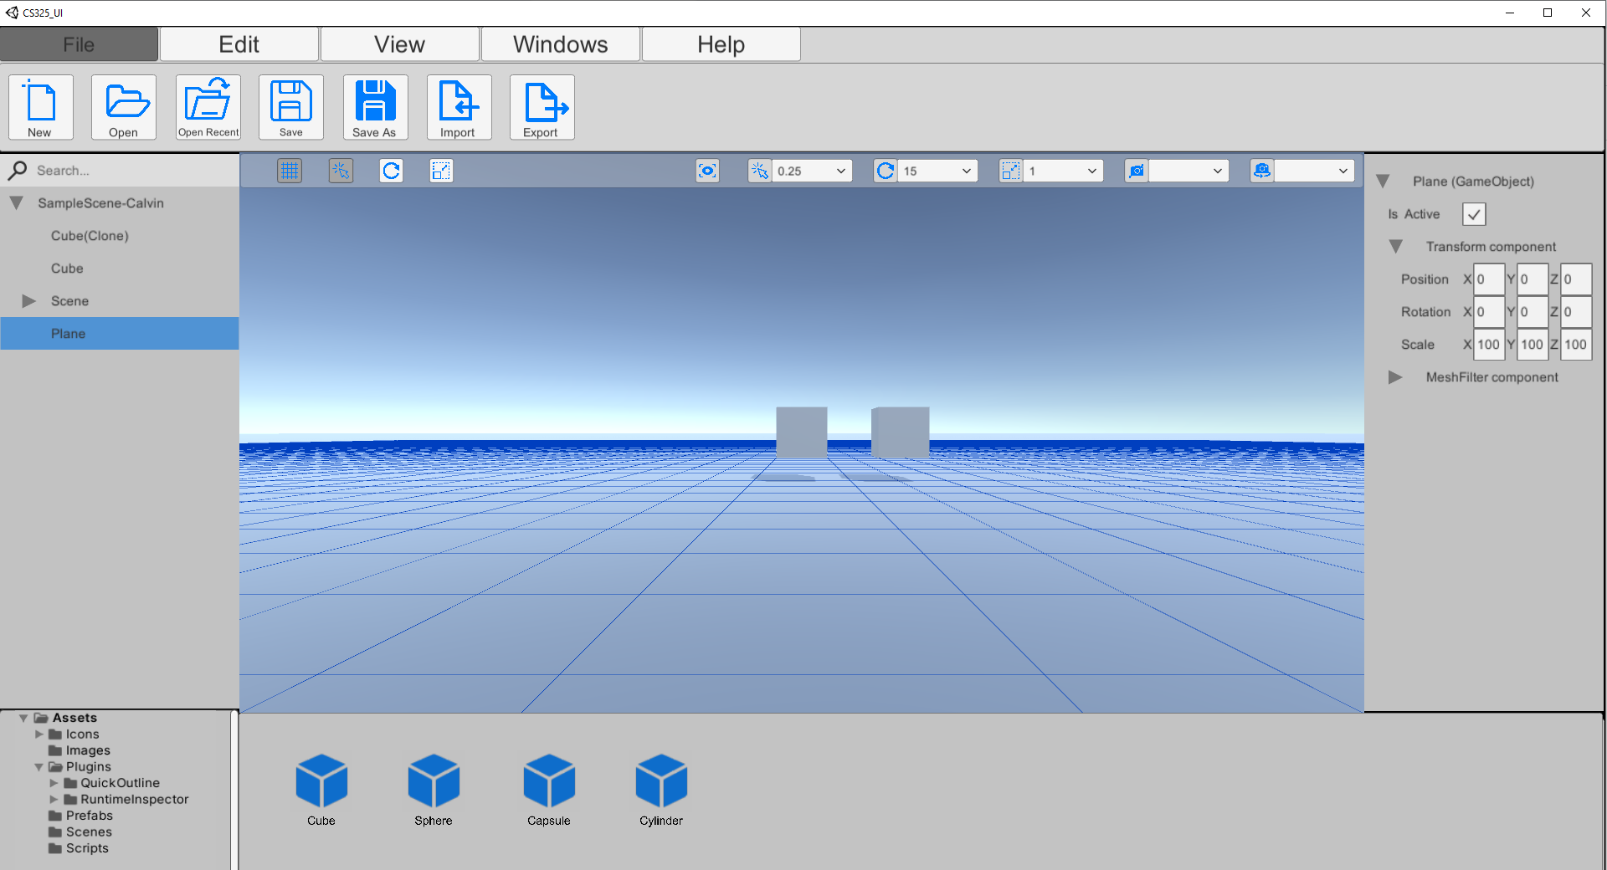
Final Prototype
Better quality and functionality
Pop-Up Dialogue box
New Toolbar shortcuts
Asset Manager
File Manager
Notes:
Here is our final prototype. It has more quality and extra functionality. The new features includes the pop-up dialogue boxes, the toolbar shortcuts, the asset and file managers.

Slide 30
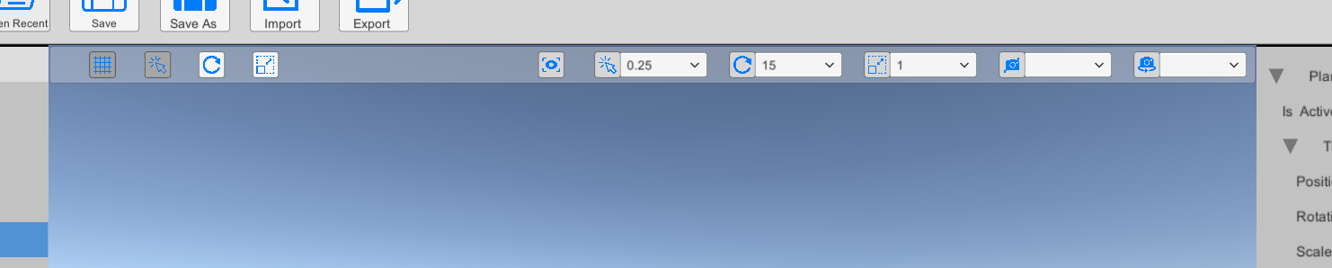
Toolbar
Show/hide Grid
Translate , Rotate, Scale mode radio button
Snapping drop down list
Camera Rotate and translate speed
Notes:
The new feature tool bar consist of many new property that we think the user will need frequently. The first functionality included is the show and hide grid, having it will definitely help user with urban planning tasks, however the grid might be distracting in preview mode. As our target user might want to constantly preview their designs, we decided to add the show and hide grid to make their life easier. Although the preview mode and show/hide gride can be found in the tabs above, we wanted to make the UI more flexible and therefore added it into the toolbar. The next functionality would be the translate,rotate and scale buttons, it comes in the form of the radio button to show that you can only be in 1 mode at any point in time, the mode can also be triggered with shortcut keys. We also added multiple dropdowns for user to select the different settings for camera speed and object snapping. Finally, to help users recognize the buttons, icons will be used thus increasing the desirability of the buttons and boost familiarity of the buttons, however in the event that user do not understand the button, tooltips will be shown for each of the icons to explain the buttons.

Slide 31
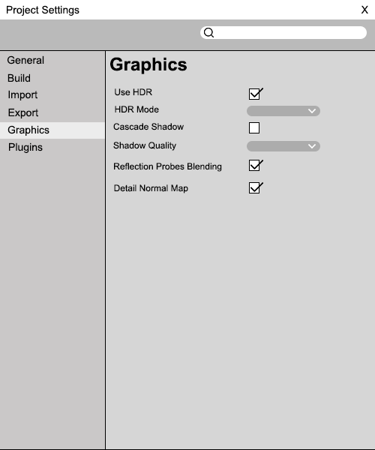
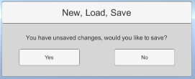
Pop-Up Dialogue box
3 different types of dialogue box:
Notification dialogue box
Interactable dialogue box
Loading dialogue box
Notes:
The 3 different type of dialogue boxes we have came up with is, notification, interactable and loading. We will be using 2 preset type of dialogue box size in order for our UI To be more consistent throughout the application. These includes the yes and no button placements, it will be same throughout the application.

Slide 32
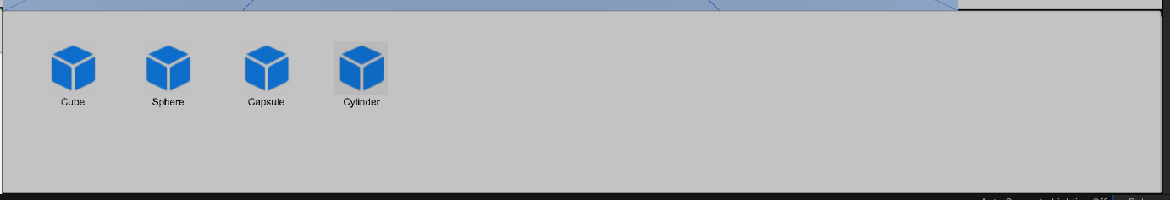
Asset manager
Displays all the available Assets in the current file directory
Supports drag and drop
Icons to show different objects
Notes:
Next would be the asset manager. In here, user will be able to see all the available assets in the current file directory. It supports drag and drop into the scene to create the assets. Icons are used to show the different objects.

Slide 33
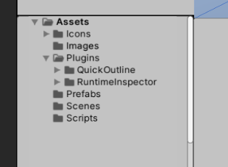
File Manager
Show which directory the user is at right now
Enable quick access of directory
Notes:
Lastly, the file manager. The user can see which file directory the user is in right now. This enables quick access to any directory.

Slide 34

Functionality Demo

Slide 35

Thank you

