Slide 1
風扇音頻瑕疵偵測
107AB8001 蔡雯惠
108378042 劉明達
108378056 施祈安
106370123 李昱德
Notes:
Expert System with Applications應用專家系統

Slide 2
01 Introduction
CONTENTS
02 Difference
03 Preprocessing
04 Train
05 Test

Slide 3
Introduction

Slide 4
Introduction
風扇資料分為OK 與 NG 兩類音頻(.wav)檔
OK：230筆
NG：32筆

Slide 5
Difference

Slide 6
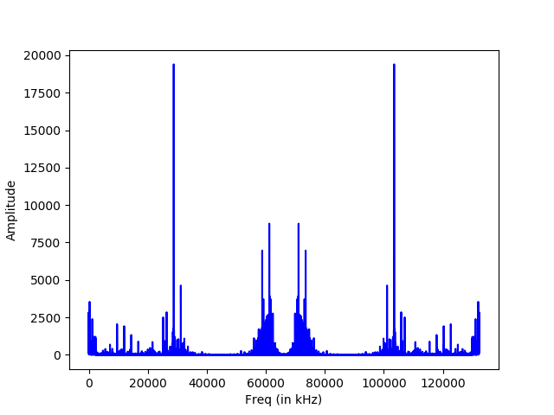
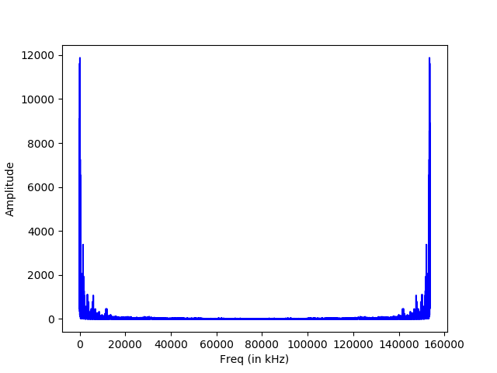
Difference
OK
NG

Slide 7
Preprocessing

Slide 8
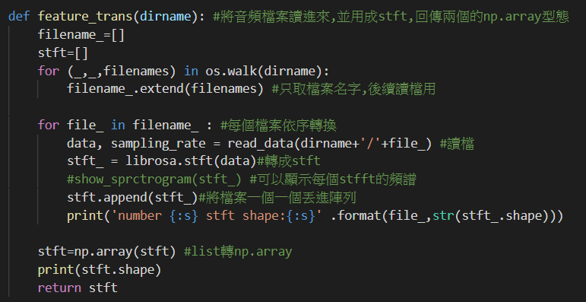
Preprocessing

Slide 9
Train

Slide 10
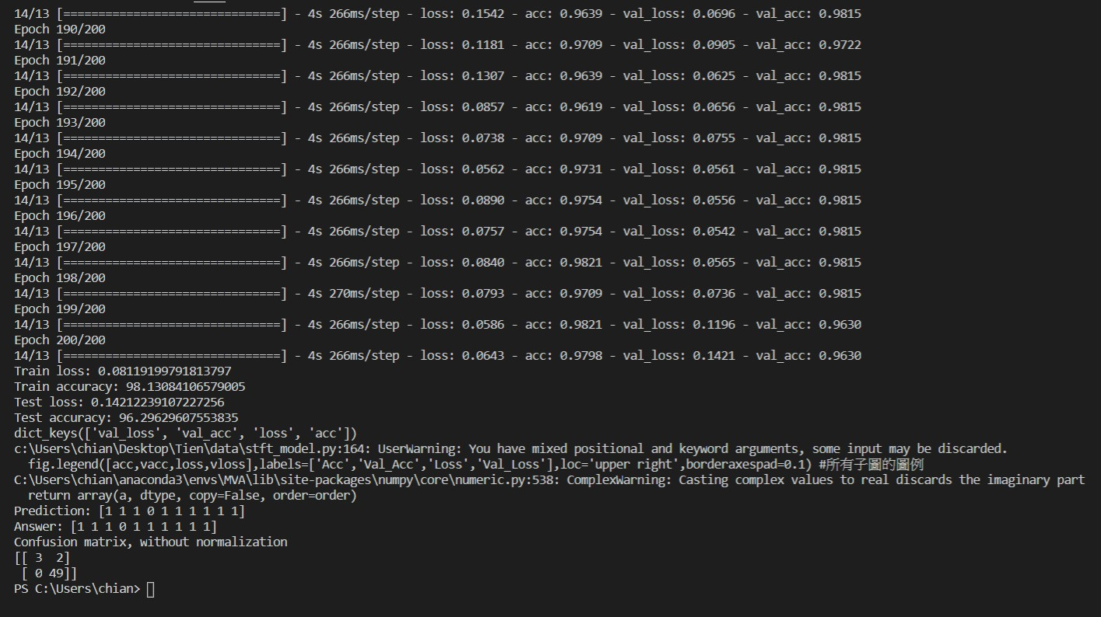
Train

Slide 11
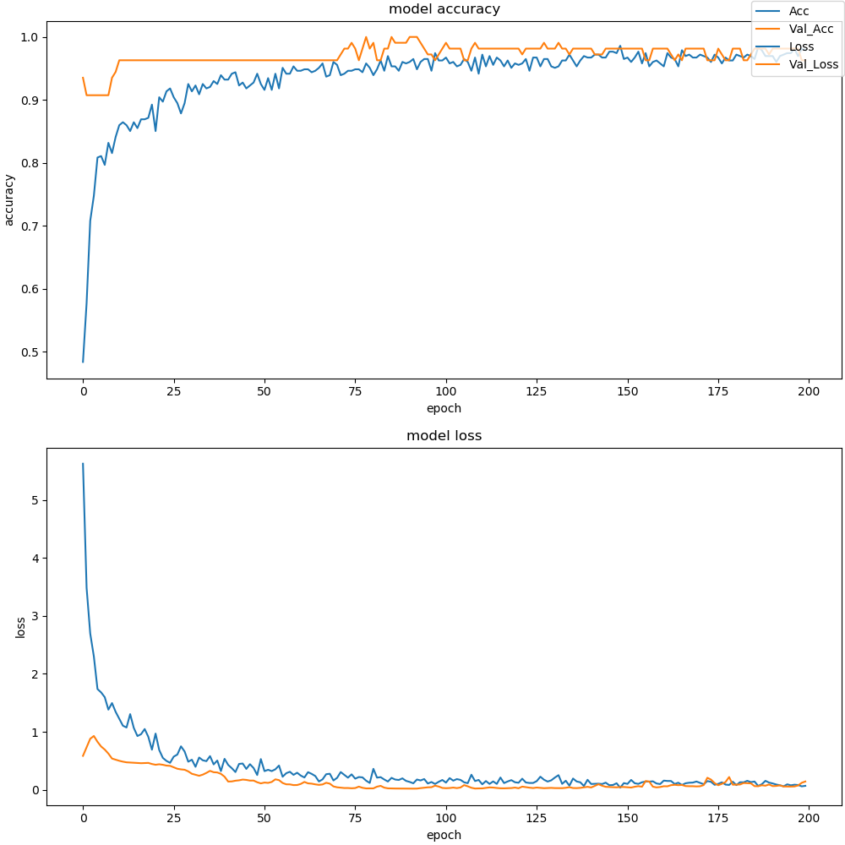
Train

Slide 12
Test

Slide 13
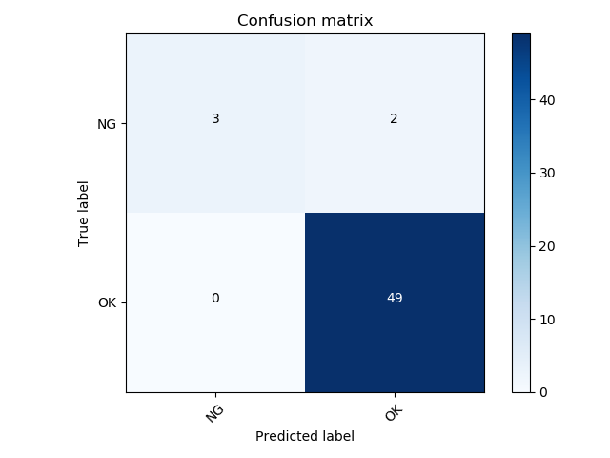
Test- Confusion Matrix

Slide 14
THANK YOU
FOR WATCHING

