Slide 1

A Midterm Project Report created by
Seth Jones[sj9@hood.edu]
Shelby Vaughn[skv4@hood.edu]
April 4, 2022

Slide 2
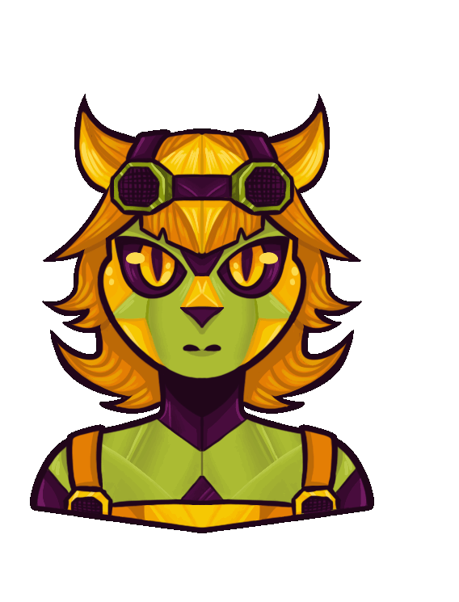
What was the project about?
Project Description
Project Background
The goal was to create a website that can allow for the conversion of text into speech inputs, as well as microphone inputs into parsed text.
  Objectives
    Get the website front-end functional
    Receive Text from prompt, parse into voice API
    Receive Mic feed, process in Speech-to-text API
    Create and design visual attributes of website
Prior Solutions Related
  Text-To-Speech Websites
  Speech-To-Text Sites/Services
    Fall Short: Being separate or even monetized services that can make functionality frustrating for everyone to use.
Our Plan/Expected Results
    Have a website that does both text-to-speech and speech-to-text on one site
    Can provide several voice options for speech-to-text options
    Have a simple and visually appealing design that draws attention and ease of functionality

Slide 3
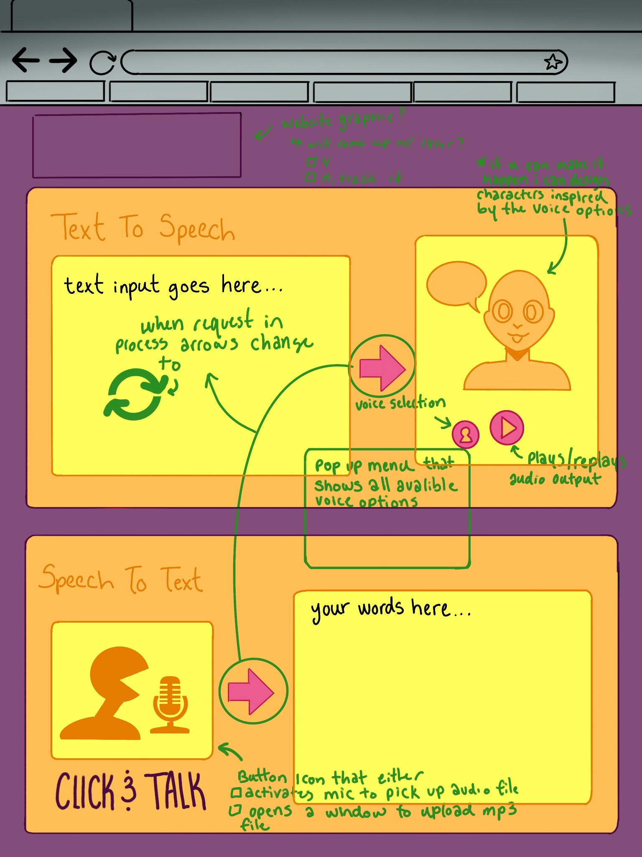
Technical Description
Basic Functions:
Basic Website Front-end to hold functions
Converts text input into virtually simulated speech
Converts mic input into parsed text
Optional Functions:
Can change the voice/character options
Mascot characters that represents voice options
Output:
Audio Clip generated by Text API
Parsed Text generated by Speech API
Platforms/Tools Used:
HTML, JavaScript, CSS
What has been produced?
Website Front End
Working Text-To-Speech Functionality
Working Speech-To-Text Functionality
Visual Prototype Of Website in Development
Notes:
Describe its size in terms of classes, lines of code, how robust it is.

Slide 4
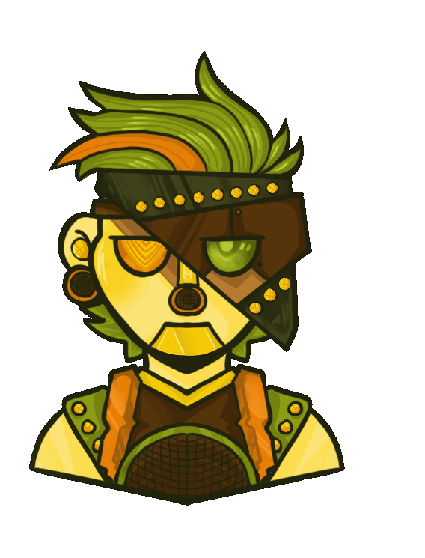
Status…
https://streamable.com/sfvi54
Notes:
Status… (insert pic of software “in action”)

Slide 5
Project Process
Effort
Lessons Learned
The team operated separately, coming together to communicate major changes and implementations.
We took an agile methodology approach that way we could work separately an in chunks that broke the project into manageable chunks. However, it required a lot of constant communication that made it difficult to keep up some weeks.
Seth: Front-End, Back-End
Shelby: Website Design, Visual Assets, CSS
Easy:
Website Front-End
Adding Names to list
Difficult:
Needing HTTPS (Pluto domain is HTTP for some reason!) for Chrome to allow microphone use
Adding a stop button for TTS
Missed communication due to both members working in isolation
Trying to find an STT API that worked in Pluto

Slide 6
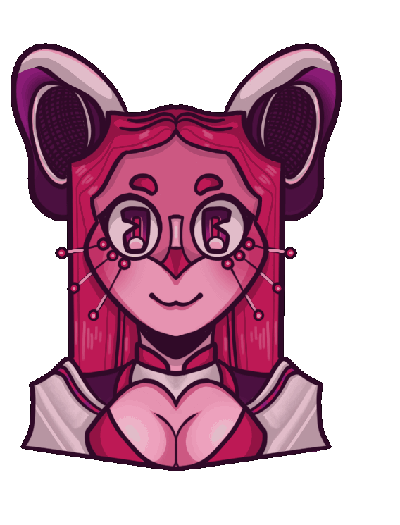
Expected Activities
Whats Left? | Will… | By…
Doing the CSS | Finish development and stylization through CSS sheet | The end of the semester
Adding a nice box for Speech to Text | … | The end of the week
Adding buttons for Speech to Text | … | The end of the week
Notes:
Insert table with what's left to do, how we will do it, and expected finish

