Slide 1
Video Tracking System Based on DirectShow
He Jinshou
Zhang Chong
Deng Fuqin
Wang Zhenming

Slide 2
Contents
Objective
Introduction to DirectX9.0 /DirectShow
How to Use DirechShow For Video Tracking?
Video Tracking Algorithms
Experiment Results & Discussion

Slide 3
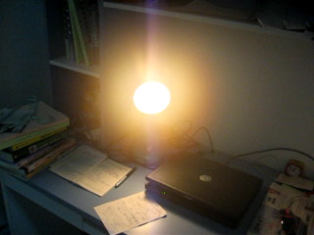
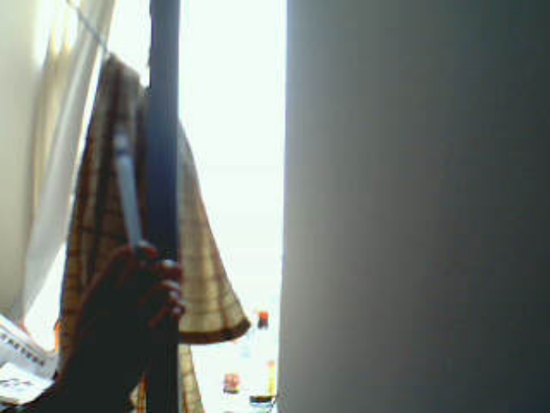
Objectiveness:
Tracking a moving object in a video real time
Basic tools:
Visual C++ 6.0, DirectX9.0 SDK

Slide 4
DirectX 9.0 Components
DirectX Graphics combines the Microsoft DirectDraw® and Microsoft Direct3D® components of previous DirectX versions into a single application programming interface (API) that you can use for all graphics programming. The component includes the Direct3D extensions (D3DX) utility library, which simplifies many graphics programming tasks.
Microsoft DirectInput® provides support for a variety of input devices, including full support for force-feedback technology.
Microsoft DirectPlay® provides support for multiplayer networked games.
Microsoft DirectSound® can be used in the development of high-performance audio applications that play and capture waveform audio.
Microsoft DirectMusic® provides a complete solution for both musical and non-musical soundtracks based on waveforms, MIDI sounds, or dynamic content authored in DirectMusic Producer.
DirectSetup is a simple API that provides one-call installation of the DirectX components.
DirectX Media Objects provide support for writing and using data-streaming objects, including video and audio encoders, decoders, and effects.
Microsoft DirectShow® provides for high-quality capture and playback of multimedia streams.

Slide 5
DirectShow System Overview
The Challenge of Multimedia
Multimedia streams contain large amounts of data, which must be processed very quickly.
Audio and video must be synchronized so that it starts and stops at the same time, and plays at the same rate.
Data can come from many sources, including local files, computer networks, television broadcasts, and video cameras.
Data comes in a variety of formats, such as Audio-Video Interleaved (AVI), Advanced Streaming Format (ASF), Motion Picture Experts Group (MPEG), and Digital Video (DV).
The programmer does not know in advance what hardware devices will be present on the end-user's system.

Slide 6
The DirectShow Solution
DirectShow is designed to address each of these challenges:
Its main design goal is to simplify the task of creating digital media applications on the Windows® platform, by isolating applications from the complexities of data transports, hardware differences, and synchronization.
To achieve the throughput needed to stream video and audio, DirectShow uses DirectDraw® and DirectSound® whenever possible. These technologies render data efficiently to the user's sound and graphics cards.
DirectShow synchronizes playback by encapsulating media data in time-stamped samples.
To handle the variety of sources, formats, and hardware devices that are possible, DirectShow uses a modular architecture, in which the application mixes and matches different software components called filter

Slide 7
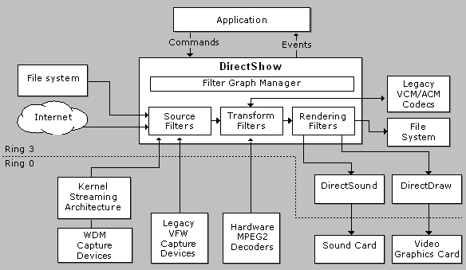
The architecture of directshow

Slide 8
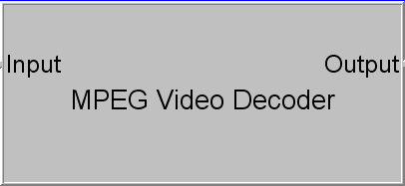
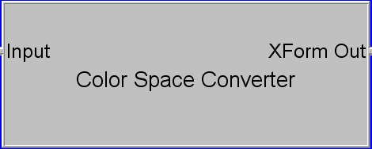
Filters
The basic building block of DirectShow is a software component called a filter. A filter generally performs a single operation on a multimedia stream
Example:
MPEG Filter Color Converter filter

Slide 9
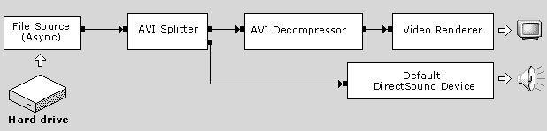
Filter Graph
Filter Graph Manager
DirectShow provides a high-level component called the Filter Graph Manager which manages the individual filters in a filter graph and controls the flow of data through the graph

Slide 10
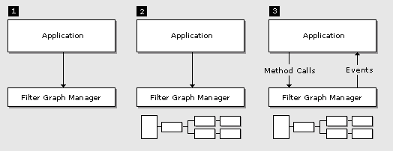
Writing a DirectShow Application
DirectShow is based on COM; the Filter Graph Manager and the filters are all COM objects.
You should have a general understanding of COM client programming before you begin programming DirectShow.

Slide 11
Writing a DirectShow Application
The application creates an instance of the Filter Graph Manager.
The application uses the Filter Graph Manager to build a filter graph. The exact set of filters in the graph will depend on the application.
The application uses the Filter Graph Manager to control the filter graph and stream data through the filters. Throughout this process, the application will also respond to events from the Filter Graph Manager.
When processing is completed, the application releases the Filter Graph Manager and all of the filters.

Slide 12
How to write a filter?
  Step 1. Choose a Base Class
  Step 2. Declare the Filter Class
  Step 3. Support Media Type Negotiation
  Step 4. Set Allocator Properties
  Step 5. Transform the Image
  Step 6. Add Support for COM
More Information,see MSDN…

Slide 13
Video Tracking Algorithms
Converting Color Space
Tracking Algorithms Based on Brightness
  Rectangle algorithm
  An Improved Algorithm
Tracking Algorithms Based on Static Background

Slide 14
Color Space
The most important and sensitive feature in the lamp tracking is brightness, So we will track lamp based on its brightness.
YUV is the color space that has this very component that we are seeking for
a conversion is required from the typical RGB24 input format to YUV
  Y=0.299R+0.587G+0.114B
  U=-0.148R-0.289G+0.437B
  V=0.615R-0.515G-0.100B
For more fast computing speed, we use Y=(R+G)>>1 to compute the brightness.

Slide 15
Rectangle algorithm
The rectangle algorithm keeps track of four points in each frame, the top most, left most, right most and bottom most points where the brightness exceeds a certain threshold value.
Initialize left=inf, right=0,top=inf, bottom=0
For each pixel p(x,y)
Compute the Luminance of the pixel use Y=(R+G)>>1
If the Luminance is larger than threshold, then
If left>x then left=x
If right<x then right=x
If top<y then top=y
If bottom>y then bottom=y
End if
End for

Slide 16
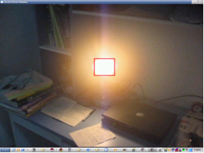
Rectangle algorithm
A rectangle can be constructed from these points which tells us where the bright object is.
The border of the rectangle is then simply replaced by a predefined color.
For x=left to right
Mark pixel p(x,top) with RED color.
Mark pixel p(x,bottom) with RED color.
End if
For y=top to bottom
Mark pixel p(left,y) with RED color.
Mark pixel p(right,y) with RED color.
End if

Slide 17
An Improved Algorithm
This algorithm tracks
objects by identifying
segments that make
up the object on the
screen. Each segment
consists of the head
and the length of the
segment. The object
is constructed by
grouping together the
segments.
Init an empty list which consists the struct QSEG{x,y,length} .
For y=1 to height of the image
QSEG Qseg={0,0,0};
For x=1 to width of the image
If the brightness of p(x,y) > threshold then
If sqseg.length==0 then
Qseg.x=x
Qseg.y=y
Qseg.length=1
Else
Qseg.length++
End if
End if
End for
if Qseg.length>0 then Add Qseg to the list.
End for

Slide 18
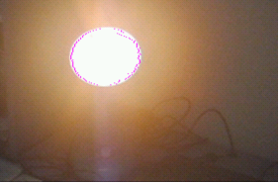
An Improved Algorithm
Now we can draw the object
For each element qseg in the list
Mark pixel p(qseg.x,qseg.y) with RED color
Mark pixel p(qseg.x+qseg.length,qseg.y) with RED color
End for
Experiment result:

Slide 19
Tracking Algorithms Based on Static Background
If the background is not moving, then we can compute the differences of brightness between the foreground and the background, If the difference is Large Enough, then we treat it as
some thing stands there.
Main frames of tracking algorithm:
For each pixel in one frame image
Compute the difference of pixel values between background image and foreground image
If the difference is larger than the threshold value, then
Make a mark on the pixel which denotes the pixel as object tracked
End if
End for

Slide 20
Tracking Algorithms Based on Static Background
There are some kinds of ways to get the background image:
  The background image is given before tracking
    This is the easiest way. But it often works not as good as we think, since the image in the video is always changing for the changing of weather or the camera’s parameters
  The background image is calculated from the video by algorithm.
  There are many different algorithms for computing the background images, but most of them are time consuming. We use a relative simple algorithms to compute the background image, results shows the algorithms is effect, but still needs improving.

Slide 21
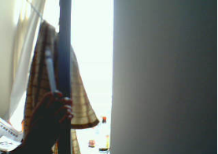
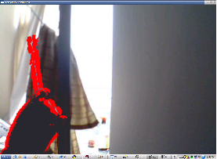
Tracking Algorithms Based on Static Background
  Compare the current frame with the previous one. It's useful in video compression when you need to estimate changes and write only the changes, not the whole frame. Also it is an effective and efficient method for video tracking.
  Things become worse, when the object moves slowly
Experiment result:

Slide 22
Analysis & Discussion
Different algorithms for different application
  The first algorithm is based on brightness, It can be applied in tracking very bright or very dark objects whose Luminance are very distinct from the background.
  The second algorithm is based on static background and can only tracks moving objects. It can be used in such fields where the camera is fixed, such as traffic monitoring, hotel monitoring, and so on.

Slide 23
Future work:
Analysis & Discussion
  The algorithms just use pixel gray value, do not use other information such as object geometry structure which is always used by our human’s vision system.
  In the second algorithm, if the background can not obtained directly, we must extract it from the video, This is a very hard work, The methods in this project is VERY preliminary. The algorithms we introduce are still need improving.

Slide 24
Thank you very much!

