Slide 1

DIGITAL PORTFOLIO
STUDENT NAME: R.GIRIJA
REG.NO AND NMID: autanm102cnu44csc12
DEPARTMENT: B.Sc COMPUTER SCIENCE
COLLEGE: C. KANDASWAMI NAIDU WOMEN’S COLLEGE
Page
01

Slide 2
PROJECT TITLE
Online Academic Portfolio for Students
Page
01

Slide 3


AGENDA
Problem Statement
Project Overview
End User
Tools and Technologies
Portfolio Design and Layout
Features and Functionality
Results and Screenshots
Conclusion
Github link
Page
03

Slide 4
Problem Statement
Students often struggle to present their academic achievements and skills in an organized digital format. A centralized online portfolio is needed to showcase their profile for academic and career opportunities.
Page
04

Slide 5
Project Overview
Portfolio Contains About, Projects, Skills, Contact and pictures
Main idea:
The project focuses on developing a web-based platform for students to create and manage their academic portfolios . The system provides an easy-to-use interface for updating and maintaining profiles. The platform serves as a digital space that bridges the gap between students’ academic growth and external opportunities.
Page
04

Slide 6
End User
Students
Job Seekers
Professionals
Teachers
Page
04

Slide 7
Tools and Techniques
HTML - Pages, Sections
CSS - Colour, Font, Layout
Javascript - Interactive, Navigation, Form Validation
VS Code - Implementation Code Editor
Github
Page
04

Slide 8
Portfolio Design and Layout
The portfolio is designed with a clean and modern interface to ensure easy navigation.
It includes well-structured sections such as Home, About, Skills, Projects, and Contact.
A responsive layout is used so the portfolio works smoothly on desktops, tablets, and mobiles.
The design highlights the student’s academic profile, achievements, and projects in an organized manner.
Page
04

Slide 9
Features and Functionality
Students can create and update their personal details, academic records, skills, and achievements.
Provides a clean, user-friendly interface for building and managing portfolios.
Generates a professional digital portfolio that can be shared with teachers, recruiters, and institutions.
Page
04

Slide 10
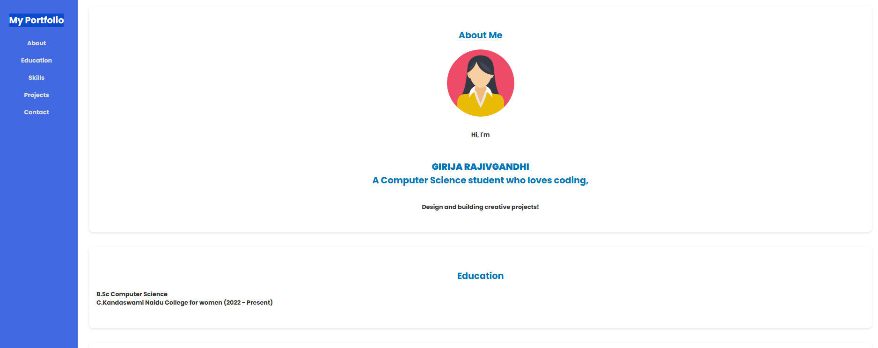
Results and Screenshots
Page
06

Slide 11
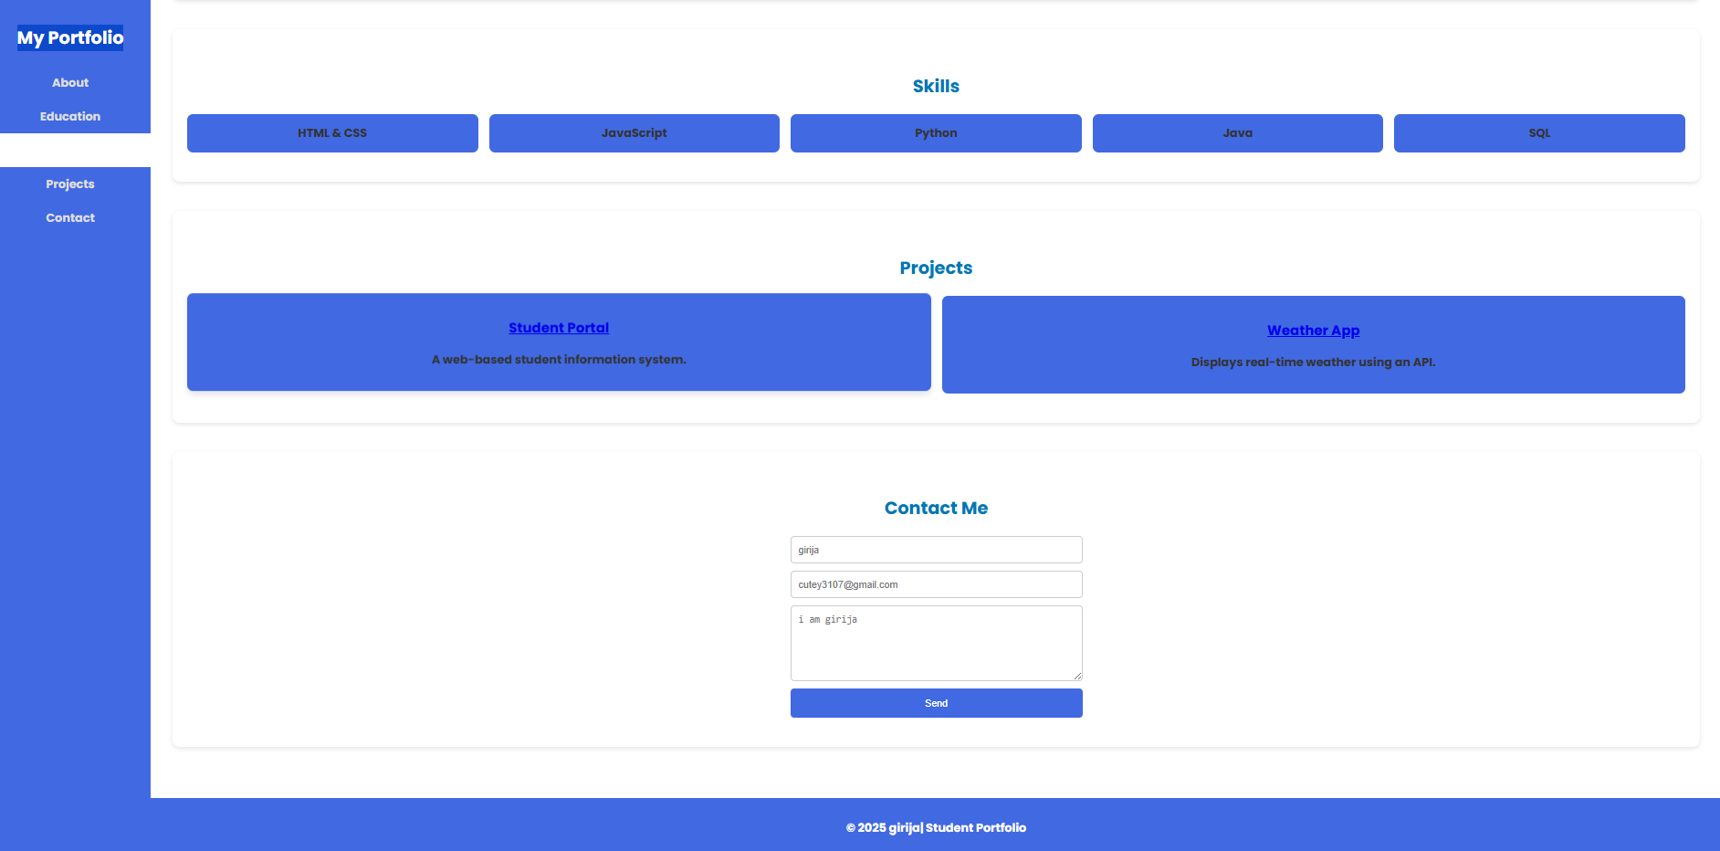
Results and Screenshots
Page
06

Slide 12
Conclusion
The Online Academic Portfolio for Students provides an effective digital platform where students can systematically showcase their academic achievements, skills, projects, and personal details. By offering a user-friendly and responsive design, the system ensures that portfolios are easily accessible and professionally presented. It not only helps students maintain an organized record of their progress but also creates opportunities for them to share their profiles with teachers, recruiters, and institutions. This centralized platform bridges the gap between academic growth and career opportunities, thereby supporting students in building a strong professional identity for their future endeavors.
Page
09

Slide 13
Thank
You.
Page
10

