Slide 1

Seattle Metro Home Price Predictive Model
Prepared for Microsoft
March 15, 2021

Slide 2
Presentation outline
Outline
Business Objective
Data and Methods
Proposal #1: Go After Animation Genre First
Proposal #2: Authorize Budget of $131M or $93M
Proposal #3: Strike Deal With Top 20 Actor
Next Steps

Slide 3








Which types of movies to target?
Business Objective
Business Objective: Microsoft has decided to create a new movie studio but wants actionable, analytical guidance on what types of films perform best.
How to compete with powerhouse film companies?

Slide 4
Data and Methods
Analysis Background
Data Sources (6)
IMDB Titles, Ratings, Principals, Actor Names
The Numbers Movie Budgets & Sales
Box Office Mojo Gross Sales
Data Filters
Years inclusive 2010-2018
Only matches between IMDB and TN/BOM
Excluded genres (11): Reality-TV, Talk-Show, Adult, Short, Game-Show, War, Horror, Western, News, Musical, Documentary
Deemed “non-core”, TV-series or inappropriate content
Key Methods Used
Data Cleansing, De-duplicate, Merge Data, Data Profiling, Calculations, Genre Splitting, Correlation, Standard Deviation, Mean, Median, Plotting
Primary limitation
Budget and gross sales data only match IMDB titles for between 1.5K to 3K titles
Still confident in conclusions as good cross-section of major films included
Additional technical details available upon request

Slide 5
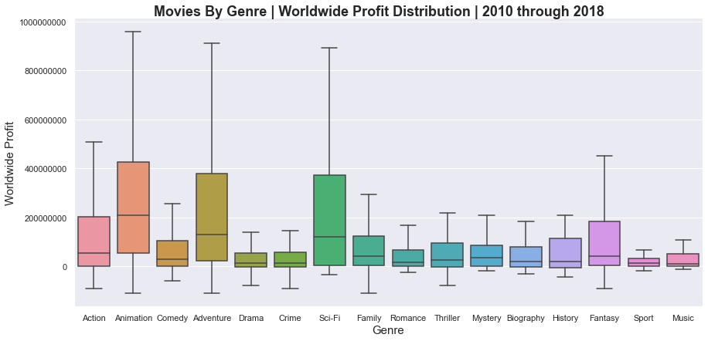
Proposal #1: Go After Animation genre first
Animation
Animation ranked #1 in Worldwide Profit metrics amongst all genres:
$208M Median Profit
$55M 25th Percentile
0.99 Coefficient Variation (CV)
Animation is the most consistently profitable genre (18% more consistent than #2 Adventure). This reduces risk.
The 97 Animation movies in our sample also had the highest median Worldwide Gross Sales of $322M

Slide 6
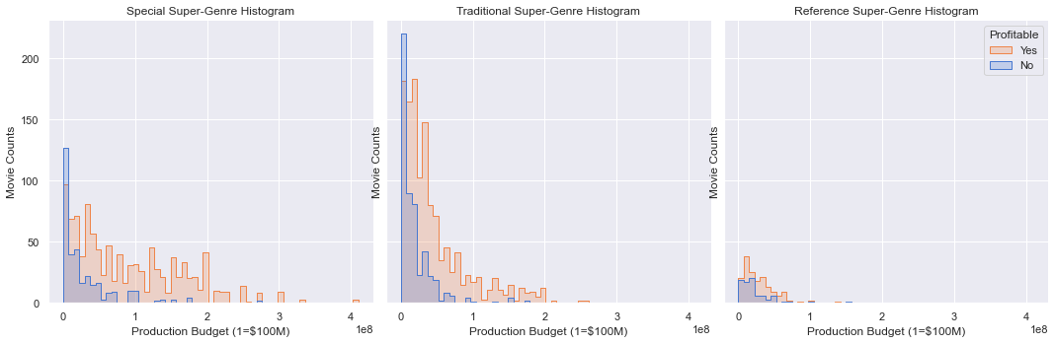
Proposal #2: Authorize A Budget of $131M or $93M
Minimum Budget
Target
$131M
Midpoint
Target
$93M
Midpoint
Not
Recommended
Committing to an ideal Production Budget increases chances of a profitable movie
Special: $112M to $150M (50% better chance)
Traditional: $75M - $112M (40% better chance)
** Smaller production budgets correlate with higher movie loss rates **
Super-Genre groups genres into similar categories
Special: Action, Sci-Fi, Thriller, Mystery, Adventure, Fantasy
Traditional: Animation, Family, Comedy, Drama, Crime, Romance
Reference: Music, Sport, History, Biography

Slide 7
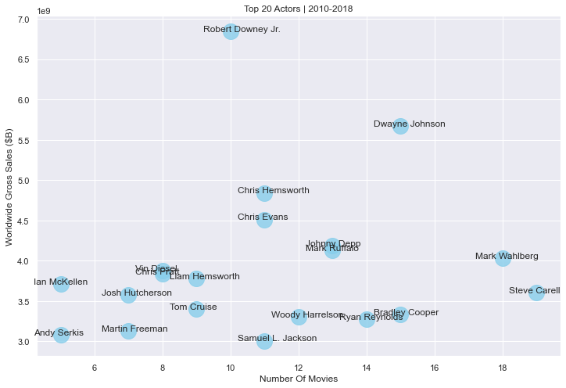
Proposal #3: Strike a deal with one of the Top 20 actors
Top Actors
Profits are highly correlated (0.98) with worldwide gross sales
Top 20 actor’s average
11 movies
$3.9B sales
Top Actors Benefits
Consistency
Consumer favorites
Franchise players
Marketing lift
Most Consistent Actors Andy Serkis , Ian McKellen, Josh Hutcherson, Vin Diesel, Robert Downey Jr., Tom Cruise

Slide 8
Conclusions
Next Steps
Recommendations
Proposal #1: Go After Animation Genre First
Proposal #2: Authorize Budget of $131M or $93M
Proposal #3: Strike Deal With Top 20 Actor
Next Steps
Suggest full-day workshop deep-dive
Engage broader team
Formulate business plan
Executive awareness of investment size
Questions?

Slide 9
thanks
“In God we trust, all others bring data.” – Edward Deming
Insight Consulting Group is a boutique consulting firm specializing in analytics, business intelligence, strategy, data visualization, and data warehousing for Fortune 500 client accounts.
Visit www.insightconsultinggrp.com for more information.
Please contact us at:
Chuck Utterback, Principal 770.298.3169
chuck.utterback@insightconsultinggrp.com
https://github.com/cutterback
https://www.linkedin.com/in/chuckutterback/

