Slide 1

Seattle Metro Home Price Predictive Model
Prepared for Seattle Realco
March 15, 2021

Slide 2
Today’s Model Review
Outline
Business Objective
Data and Methods
Model Progression
Model Fit Plot
Model Prediction Sample Home
Next Steps

Slide 3

expected price of a home?
Business Objective
Business Objective: Seattle Realco wants to empower agents with a tool to ballpark expected home prices when working with buyer/seller clients
R e q u i r e m e n t s
Find best initial prediction model for Seattle area home prices
Model performance significantly better than using "averages”
Predictor inputs into model commonly available for new home buyers/sellers
Explain relative influence that each predictor has on overall model predictions

Slide 4
Data and Methods
Analysis Background
Data Source
King County homes sales (May 2014 - May 2015)
Target Variable: Sales Price
Raw Source Features
Date Sold, Year Built, Floors, Bedrooms, Bathrooms, Condition, Grade
Living sq. ft., Basement sq. ft, Lot sq. ft., Closest 15 neighbors average living and lot sq. ft.
Zip code, Latitude-Longitude, Waterfront, View indicators
Features Engineered
Log transformations, Renovation indicator, Basement indicator, Grade group, Miles from Seattle, Zip price-per-sqft decile, Zip price-per-sqft median
Model Type
Multiple linear regression model with cross-validation
technical details available on request and at github

Slide 5
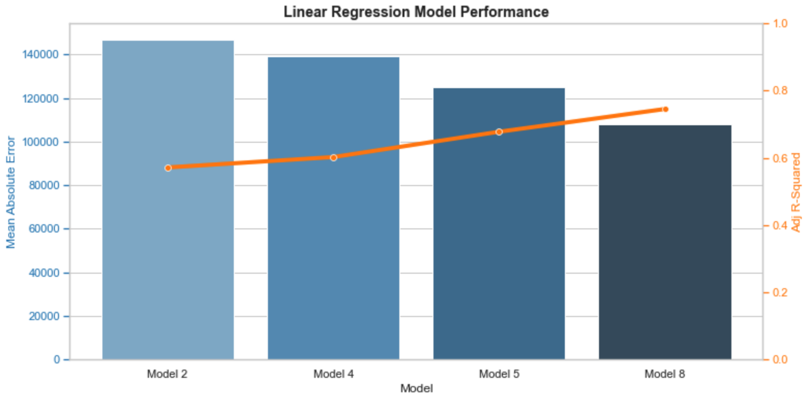
MODEL PREDICTIONS
Model Summary
Best Model
Model 8 performed best with 74% of variance explained
0.745 Adjusted R-squared
$108K Mean Absolute Error
$182K Root Mean Sq. Error
0.00 P-Value
Variables in Model 8
Target: Price
Predictors (10):
Sq. Ft. Living Space
Sq. Ft. Per Bedroom
View
Grade
Condition
Waterfront
Basement Indicator
Renovation Indicator
Miles From Seattle
Zip code Median Price-Per-Sq. Ft.

Slide 6
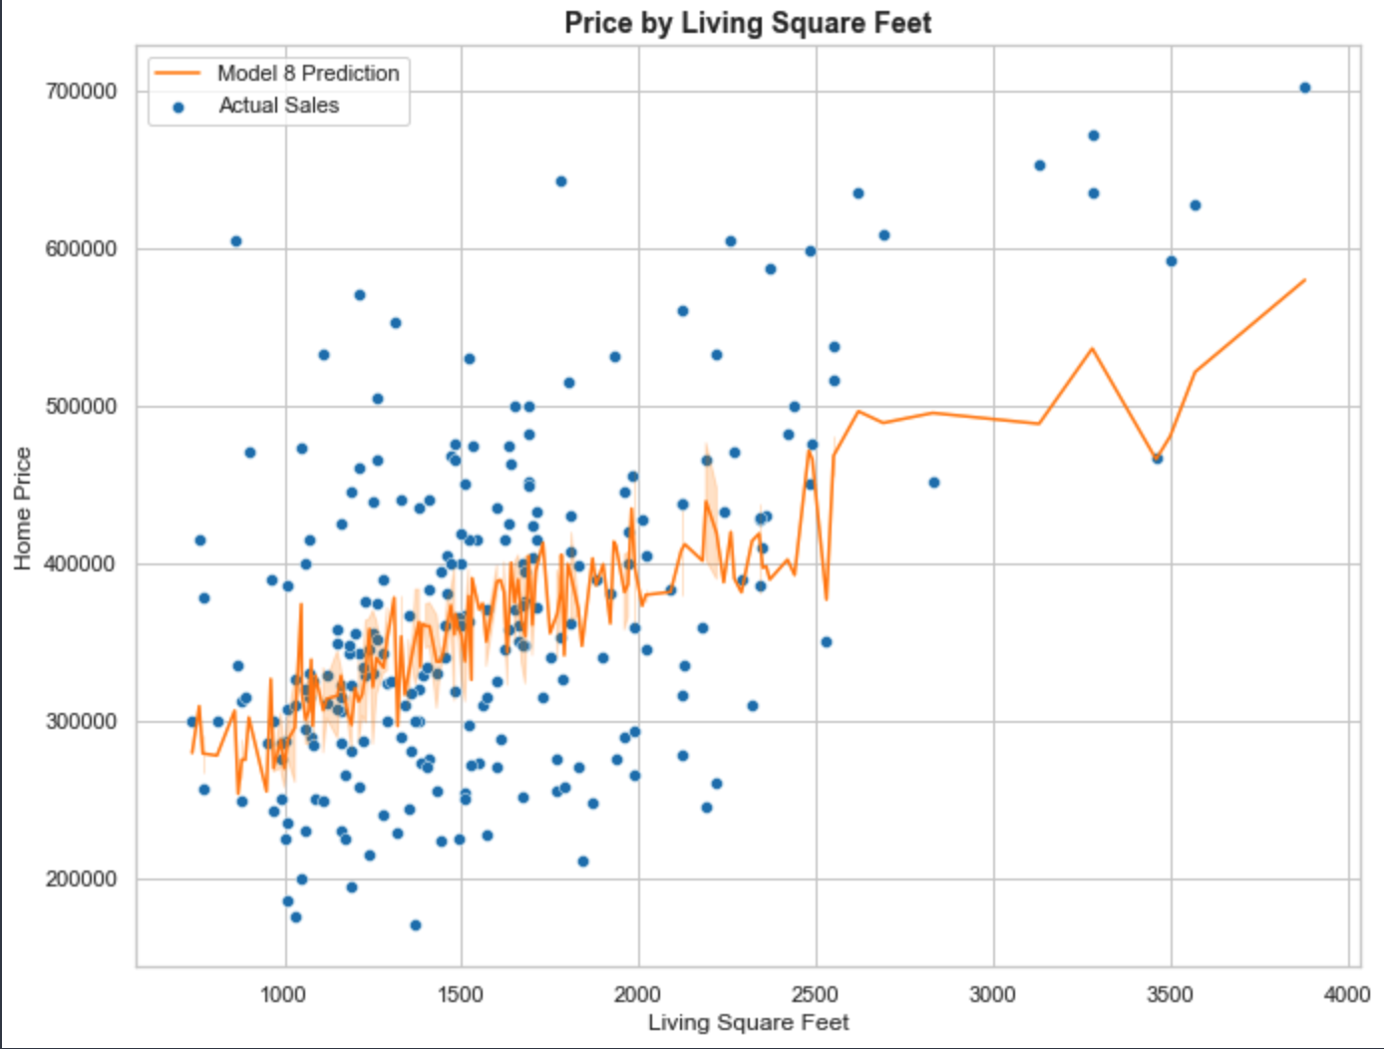
Model Fit Against Living Sq. Ft.
Example Fit
Model 8 includes 10 predictor variables
Plot shows predictions against test data
X = Sq. Ft. Living Space
Y = Home Price
…filtered by these 7 predictors (244 sales)
View = 0 (none)
Grade = 7 (average)
Condition = 3 (average)
Waterfront = 0 (none)
Basement Indicator = 0 (none)
Renovation Indicator = 0 (none)
Zip code Median Price-Per-Sq. Ft. between $200-$300
…and allowing any value on these final two variables
Miles From Seattle
Sq. Ft. Per Bedroom
Sample Home
Next Slide
Plot filtered to show 244 of 4,320 test data points

Slide 7
Let’s Review a Real Test Case
Prediction Example
Sample Test Home
Model Feature | Rainy Paradise | Feature Contribution
Model Constant | N/A | 23%
Living Sq. Ft. | 2,530 | 26%
Sq. Ft. Per Bedroom | 506 | 5%
View | 0 (None) | 0%
Grade | 7 (Average) | 9%
Renovation | 0 (No) | 0%
Waterfront | 0 (No) | 0%
Basement | 0 (No) | 0%
Condition | 3 (Average) | 2%
Miles From Seattle | 6.95 | 0.2%
Zip Code Price Per Sq. Ft. | $201.82 | 36%
Home Name: “Rainy Paradise”
Home ID: 2780910100
Zip Code: 98038
Year Built: 2004 Date Sold: 12/18/2014
Sales Price: $349,900
Model Sensitivity
If Waterfront +$189K
If Renovation +$54K
If Basement +$9K
If Grade 10 +$240K
Due to nature of model,
multiple features changes would not be directly additive
Predicted Home Price
$375,586
Actual Sales Price
$349,900
Model Variance
$25,686

Slide 8
Next Steps
Next Steps
Suggest half-day technical workshop deep-dive
Begin socializing to broader team
Capture requirements for sales tool integration
Continue iterating model for improvements
Questions?

Slide 9
thanks
“In God we trust, all others bring data.” – Edward Deming
Insight Consulting Group is a boutique consulting firm specializing in analytics, business intelligence, strategy, data visualization, and data warehousing for Fortune 500 client accounts.
Visit www.insightconsultinggrp.com for more information.
Please contact us at:
Chuck Utterback, Principal 770.298.3169
chuck.utterback@insightconsultinggrp.com
https://github.com/cutterback
https://www.linkedin.com/in/chuckutterback/

