Slide 1

Seattle Metro Home Price Predictive Model
Prepared for Seattle Realco
March 15, 2021

Slide 2
Today’s Model Review
Outline
Business Objective
Data and Methods
Model Progression
Model Fit Plot
Model Examples
Next Steps

Slide 3

expected price of a home?
Business Objective
Business Objective: Seattle Realco wants to empower agents with a tool to ballpark expected home prices when working with buyer/seller clients
R e q u i r e m e n t s
Find best initial prediction model for Seattle area home prices
Model performance significantly better than using "averages”
Predictor inputs into model commonly available for new home buyers/sellers
Explain relative influence that each predictor has on overall model predictions

Slide 4
Data and Methods
Analysis Background
Data Source
King County homes sales (May 2014 - May 2015)
Target Variable: Sales Price
Raw Source Features
Date Sold, Year Built, Floors, Bedrooms, Bathrooms, Condition, Grade
Living sq. ft., Basement sq. ft, Lot sq. ft., Closest 15 neighbors average living and lot sq. ft.
Zip code, Latitude-Longitude, Waterfront, View indicators
Features Engineered
Log transformations, Renovation indicator, Basement indicator, Grade group, Miles from Seattle, Zip price-per-sqft decile, Zip price-per-sqft median
Model Type
Multiple linear regression model with cross-validation
technical details available on request and at github

Slide 5
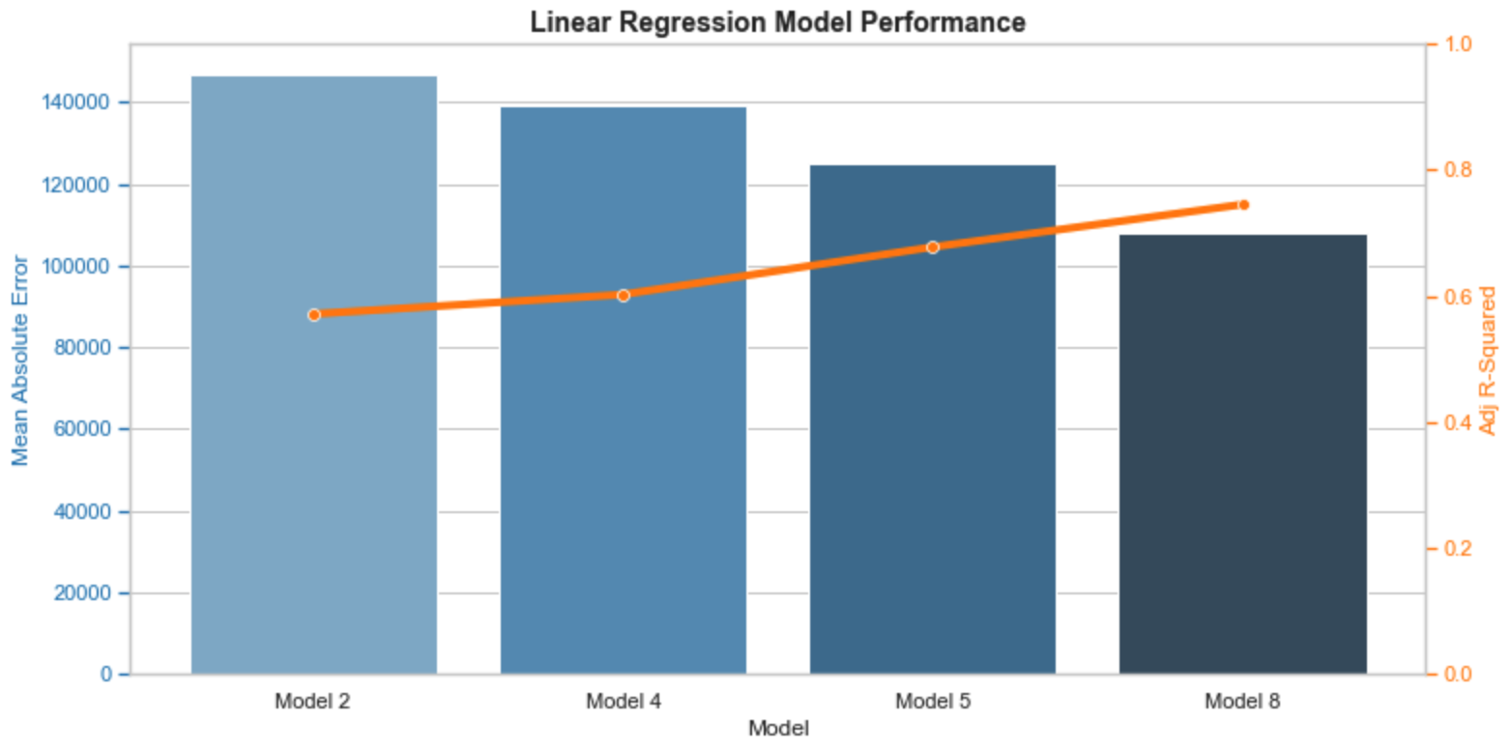
MODEL PROGRESSIONS
Model Summary
Best Model
Model 8 was best performing model:
0.745 Adjusted R-squared
$108K Mean Absolute Error
0.00 P-Value
Variables in Model 8
Target: Price
Predictors:
Sq. Ft. Living Space
Sq. Ft. Per Bedroom
View
Grade
Condition
Waterfront
Basement Indicator
Renovation Indicator
Miles From Seattle
Zip code Median Price-Per-Sq. Ft.

Slide 6
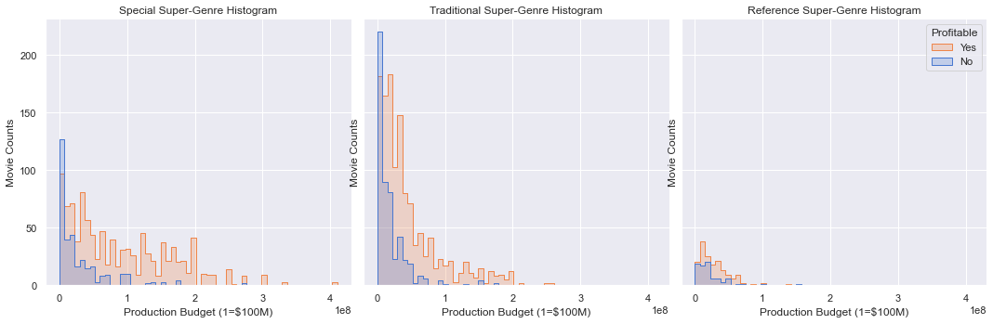
Proposal #2: Authorize A Budget of $131M or $93M
Minimum Budget
Target
$131M
Midpoint
Target
$93M
Midpoint
Not
Recommended
Committing to an ideal Production Budget increases chances of a profitable movie
Special: $112M to $150M (50% better chance)
Traditional: $75M - $112M (40% better chance)
** Smaller production budgets correlate with higher movie loss rates **
Super-Genre groups genres into similar categories
Special: Action, Sci-Fi, Thriller, Mystery, Adventure, Fantasy
Traditional: Animation, Family, Comedy, Drama, Crime, Romance
Reference: Music, Sport, History, Biography

Slide 7
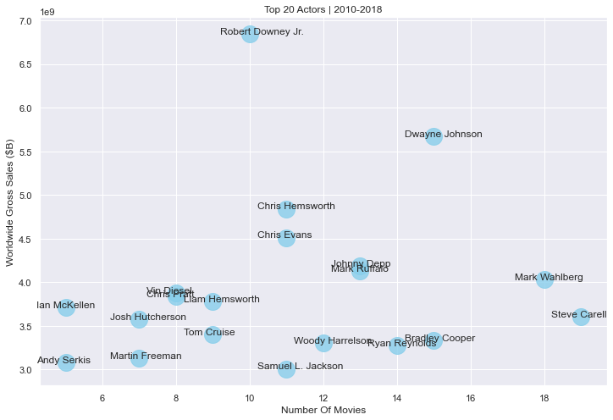
Proposal #3: Strike a deal with one of the Top 20 actors
Top Actors
Profits are highly correlated (0.98) with worldwide gross sales
Top 20 actor’s average
11 movies
$3.9B sales
Top Actors Benefits
Consistency
Consumer favorites
Franchise players
Marketing lift
Most Consistent Actors Andy Serkis , Ian McKellen, Josh Hutcherson, Vin Diesel, Robert Downey Jr., Tom Cruise

Slide 8
Conclusions
Next Steps
Recommendations
Proposal #1: Go After Animation Genre First
Proposal #2: Authorize Budget of $131M or $93M
Proposal #3: Strike Deal With Top 20 Actor
Next Steps
Suggest full-day workshop deep-dive
Engage broader team
Formulate business plan
Executive awareness of investment size
Questions?

Slide 9
thanks
“In God we trust, all others bring data.” – Edward Deming
Insight Consulting Group is a boutique consulting firm specializing in analytics, business intelligence, strategy, data visualization, and data warehousing for Fortune 500 client accounts.
Visit www.insightconsultinggrp.com for more information.
Please contact us at:
Chuck Utterback, Principal 770.298.3169
chuck.utterback@insightconsultinggrp.com
https://github.com/cutterback
https://www.linkedin.com/in/chuckutterback/

