Slide 1
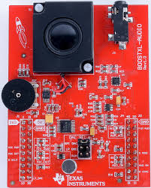
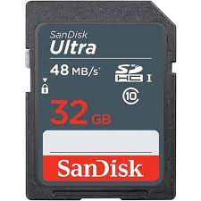
MP3 Player with MSP432 Launchpad and BoostXL-Audio
Implemented with YAHAL (Yet Another Hardware Abstraction Library)
- C++ based
- Clean interfaces / reusable drivers
- Multitasking kernel
- Integrates ports of 3rd-party libraries (see below)
SD reader
MP3 decoder
audio output
FatFs
MP3
buffer
(4kB)
libmad
PCM
buffer
(2x1152
samples)
scale/
mono
conv.
PCM
FIFO
TIMER32
IRQ handler
sd_spi_drv
DMA
spi_msp432
4096 samples
(16 bits each)
spi_msp432
samplerate detection (44.1/48kHz)

