Slide 1
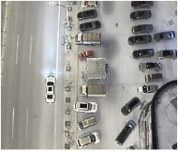
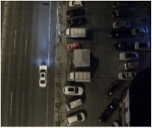
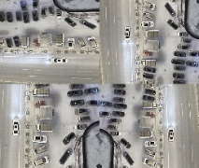
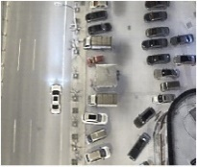
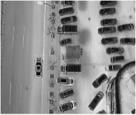
HVI Multi-Modality Image Fusion (HMIF)
Input visible
Image Augumen
-tion(flip，rotation…)
Fourier Fusion
Block
Fourier Conver Branch
Encoder
Fuse
Decoder
Multi-scale Conver Branch

Slide 2
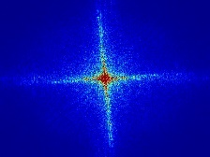
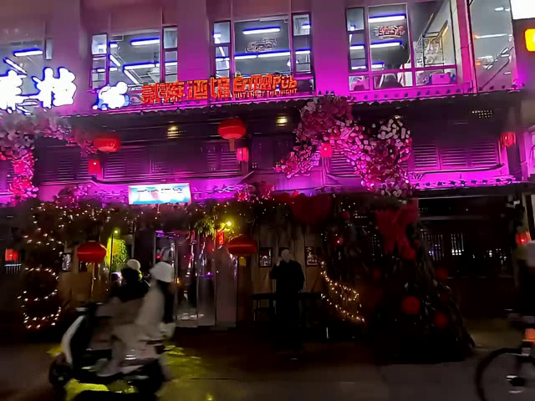


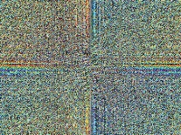
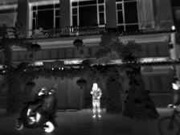



Infrared and Visible Fusion Stage
Spatial and Texture Reconstruction Stage
sigmoid
Fourier Processing
$$A_{v}$$
\
Fourier Processing
Fourier Processing
Encoder
Decoder
Input visible
FFT
IFFT
C
$$P_{v}$$
X
Spatial Processing
Spatial Processing
Spatial Processing
FFT
$$P_{i}$$
Input Infrared
: Fourier Process
: Division
: Mul
: Concat
: Conv 3x3
\
X
C

Slide 3




Infrared and Visible Fusion Stage
Spatial and Texture Reconstruction Stage
FFT
$$P_{i}$$
Input Infrared
Fourier Processing
$$P_{v}$$
\
Fourier Processing
Fourier Processing
Encoder
Decoder
Input visible
FFT
IFFT
C
$$A_{v}$$
X
Spatial Processing
Spatial Processing
Spatial Processing
sigmoid
Pre-trained Model
$$A_{v}$$
: Fourier Process
: Division
: Mul
: Concat
: Conv 3x3
FFT
\
X
C

Slide 4
(a)Fourier Processing(FP) Block
Amplitude
Conv1X1
Relu
Conv1X1
Input
FFT
+
Output
Phase
Conv1X1
Relu
Conv1X1
(b)Spatial Processing(SP) Block
Input
Conv3X3
Relu
Conv3X3
+
Output
Notes:
Note:
These visuals can represent a multi-directional array (3D)
Author: Elvis Saravia (ellfae@gmail.com)

Slide 5
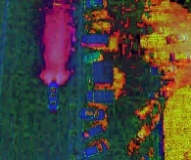
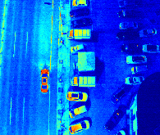
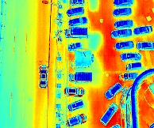
HVI Trans
Enhancement Fusion Network
HVT
Skip Connection
K
Visible HV Map
Skip Connection
HV Feature
2X
PHVIT
CAB
C
CAB
CAB
CAB
Visible Itensity Map
C
Itensity Feature
Infrared Itensity Map
Notes:
Note:
These visuals can represent a multi-directional array (3D)
Author: Elvis Saravia (ellfae@gmail.com)

