Slide 1


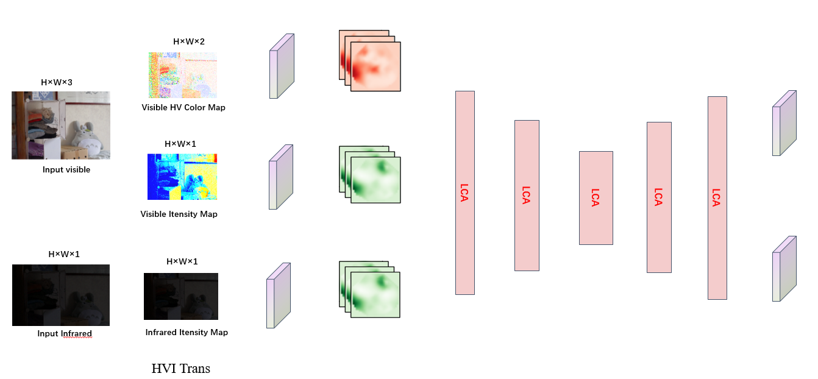
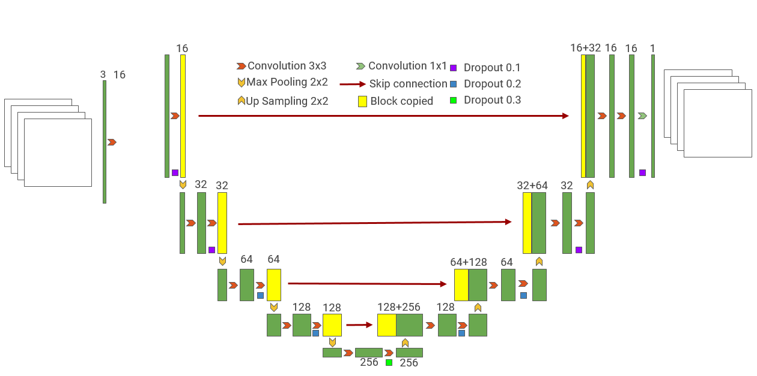
Image
Augumention
(flip，rotation,
translation…)
HVI-Fuser
HVI-Fuser
Ai
Av

Slide 2
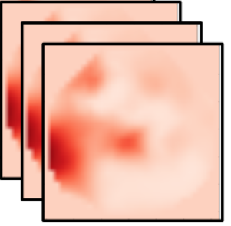

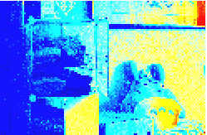
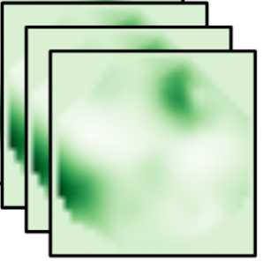
H×W×2
H×W×3
Visible HV Color Map
Conv
H×W×1
Conv
Input visible
Conv
Conv
LCA
LCA
LCA
LCA
Conv
LCA
Visible Itensity Map
Conv
H×W×1
H×W×1
Conv
Input Infrared
Infrared Itensity Map
HVI Trans
Notes:
Note:
These visuals can represent a multi-directional array (3D)
Author: Elvis Saravia (ellfae@gmail.com)

Slide 3



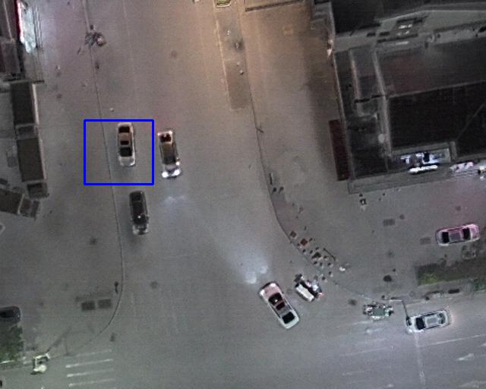
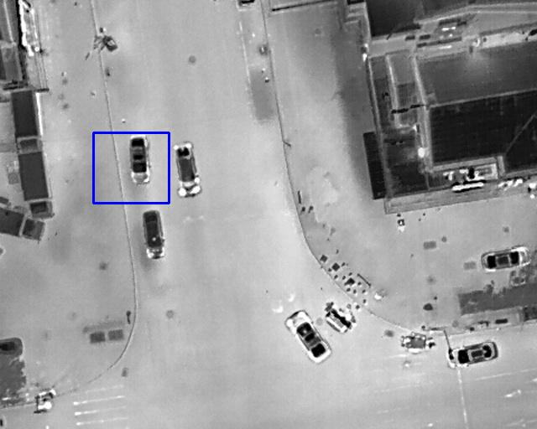
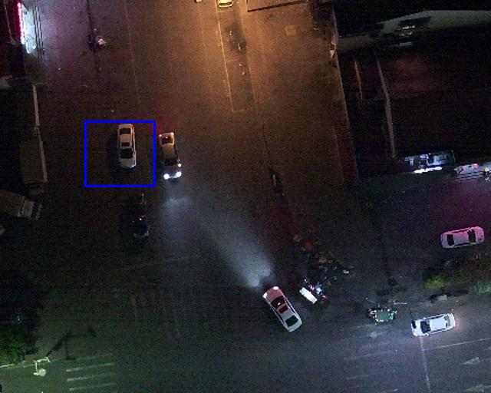
Infrared
Visible
EMMA
EMMA
EMMA
EMMA
Infrared
Visible
EMMA
EMMA
EMMA
Ours

