Slide 1
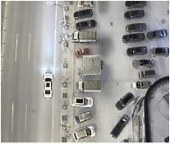
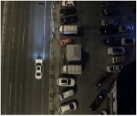
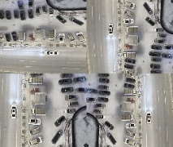
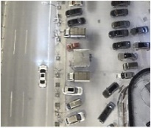
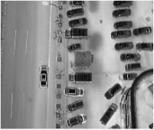
HVI Multi-Modality Image Fusion (HMIF)
Input visible
Image Augumen
-tion(flip，rotation…)
Fourier Fusion
Block
Fourier Conver Branch
Encoder
Fuse
Decoder
Multi-scale Conver Branch

Slide 2
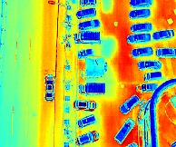
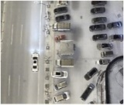
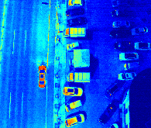



Fourier Conver Branch
$$A_{v}$$
C
Encoder
Decoder
FFT
IFFT
Fuse
$$P_{v}$$
C
Multi-scale Conver Branch
FFT
$$P_{i}$$
Cross
Attention
Concat
Density-k
Conv 3x3
I-branch
Conv 3 x 3
HV-branch
Conv 3 x 3
C
K

Slide 3

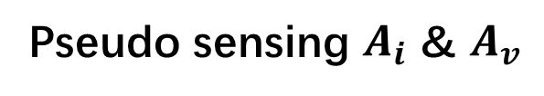
Pseudo sensing $A_{i}$ & $A_{v}$
16
16+32
16
16
1
Convolution 3x3
Convolution 1x1
Dropout 0.1
Max Pooling 2x2
Skip connection
Dropout 0.2
Up Sampling 2x2
Block copied
Dropout 0.3
Parameter Freeze
32
32
32+64
32
64
64
64+128
64
128
128
128+256
128
256
256
Notes:
By @avsthiago

Slide 4
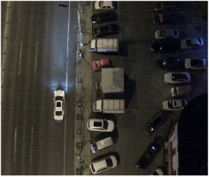





$$A_{v}$$
C
H×W×3
Input visible
FFT
Input Infrared
IFFT
$$P_{v}$$
C
Fusioned Image
FFT
$$P_{i}$$
Cross
Attention
Concat
Density-k
Conv 3x3
I-branch
Conv 3 x 3
HV-branch
Conv 3 x 3
C
K
Notes:
Note:
These visuals can represent a multi-directional array (3D)
Author: Elvis Saravia (ellfae@gmail.com)

Slide 5
$$A_{v}$$
C
FFT
Input Infrared
IFFT
$$P_{v}$$
C
FFT
$$P_{i}$$
Cross
Attention
Concat
Density-k
Conv 3x3
I-branch
Conv 3 x 3
HV-branch
Conv 3 x 3
C
K
Notes:
Note:
These visuals can represent a multi-directional array (3D)
Author: Elvis Saravia (ellfae@gmail.com)

Slide 6
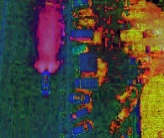
HVI Trans
Enhancement Fusion Network
HVT
Skip Connection
K
Visible HV Map
Skip Connection
HV Feature
2X
PHVIT
CAB
C
CAB
CAB
CAB
Visible Itensity Map
C
Itensity Feature
Infrared Itensity Map
Notes:
Note:
These visuals can represent a multi-directional array (3D)
Author: Elvis Saravia (ellfae@gmail.com)

