Slide 1


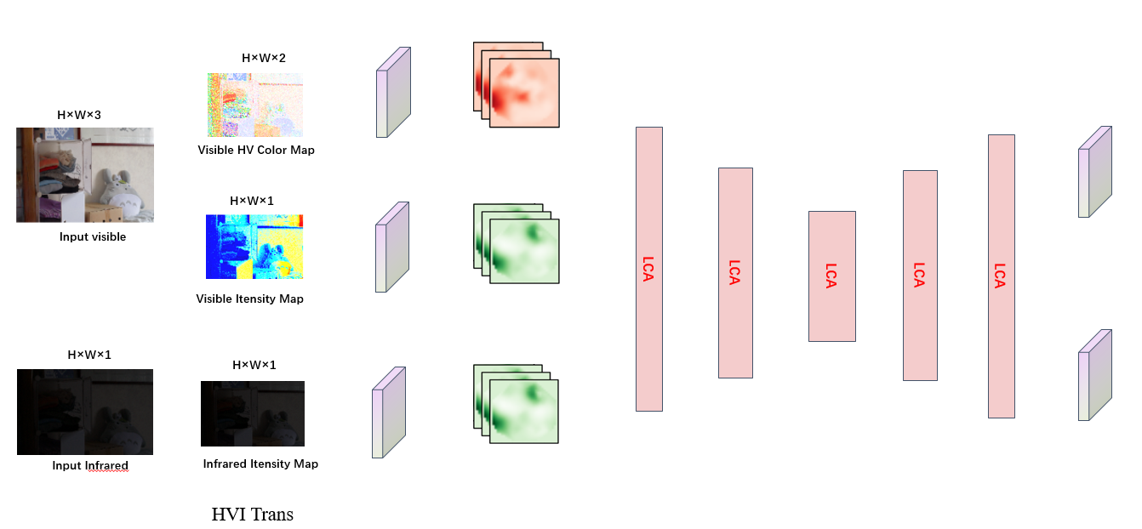
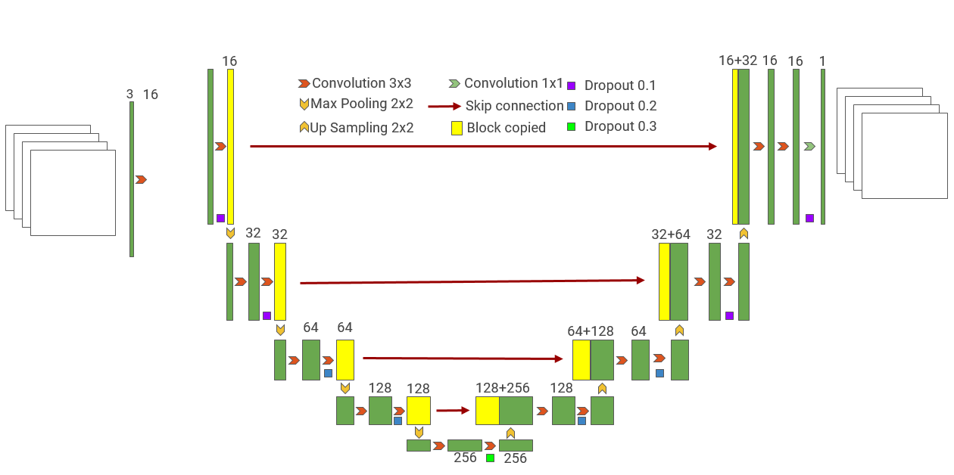
Image
Augumention
(flip，rotation,
translation…)
HVI-Fuser
HVI-Fuser
Ai
Av

Slide 2

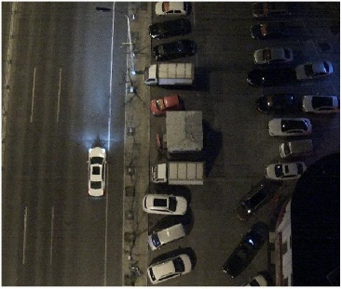
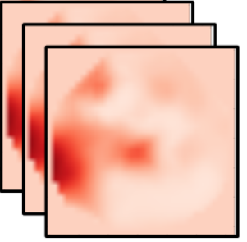
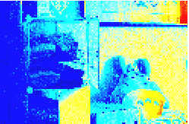
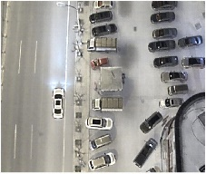
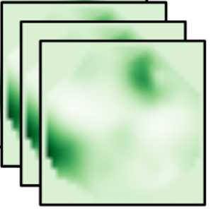
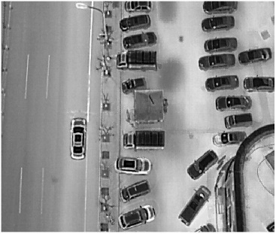
HVI Trans
H×W×3
Conv
Visible HV Color Map
Conv
Conv
HV Feature
Conv
CAB
CAB
CAB
CAB
Input visible
CAB
Visible Itensity Map
Conv
H×W×1
Conv
Conv
Itensity Feature
Input Infrared
Infrared Itensity Map
Notes:
Note:
These visuals can represent a multi-directional array (3D)
Author: Elvis Saravia (ellfae@gmail.com)

Slide 3



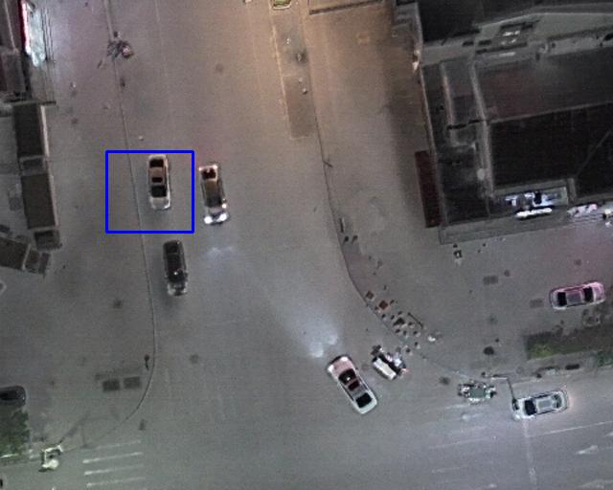
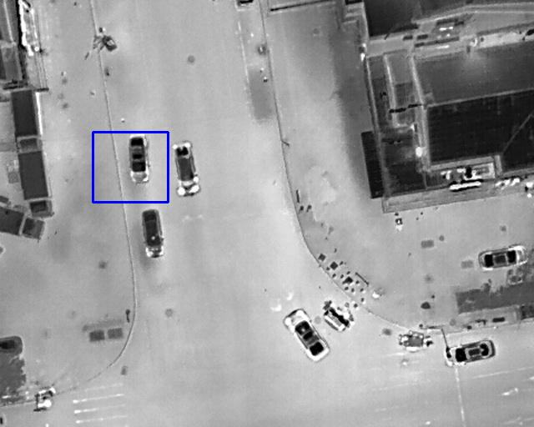
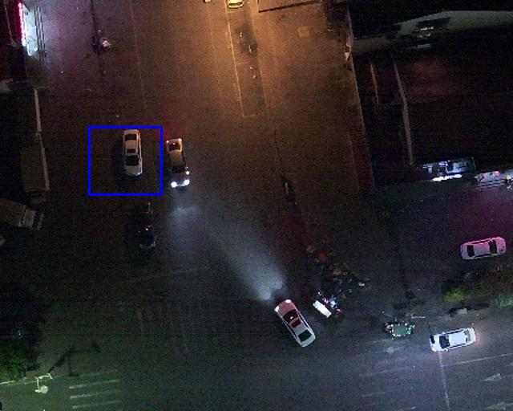
Infrared
Visible
EMMA
EMMA
EMMA
EMMA
Infrared
Visible
EMMA
EMMA
EMMA
Ours

