Slide 1
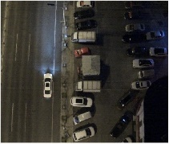
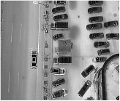
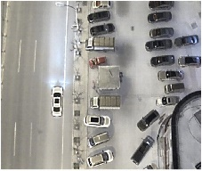
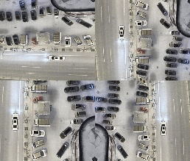
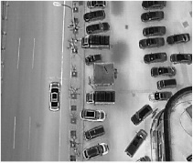
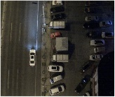
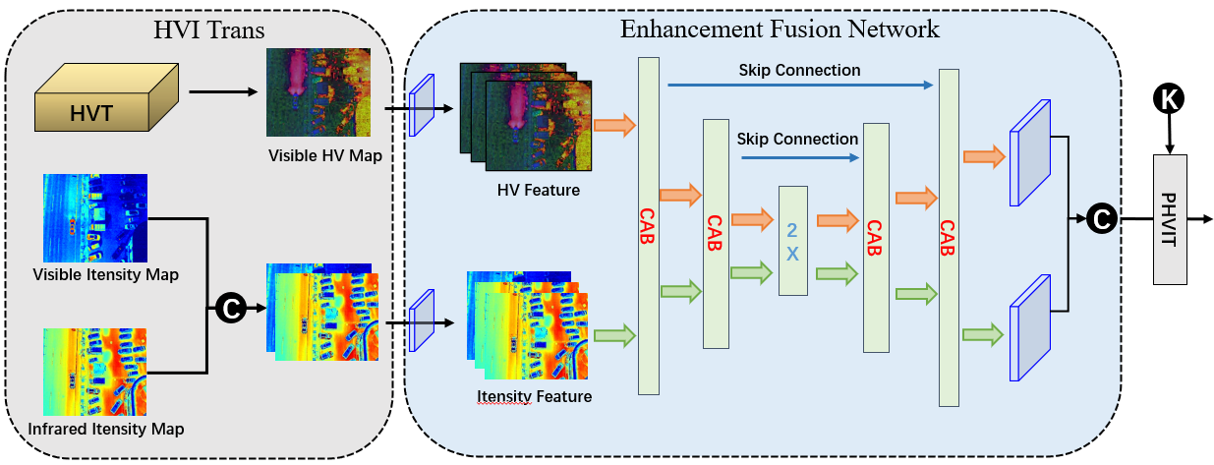
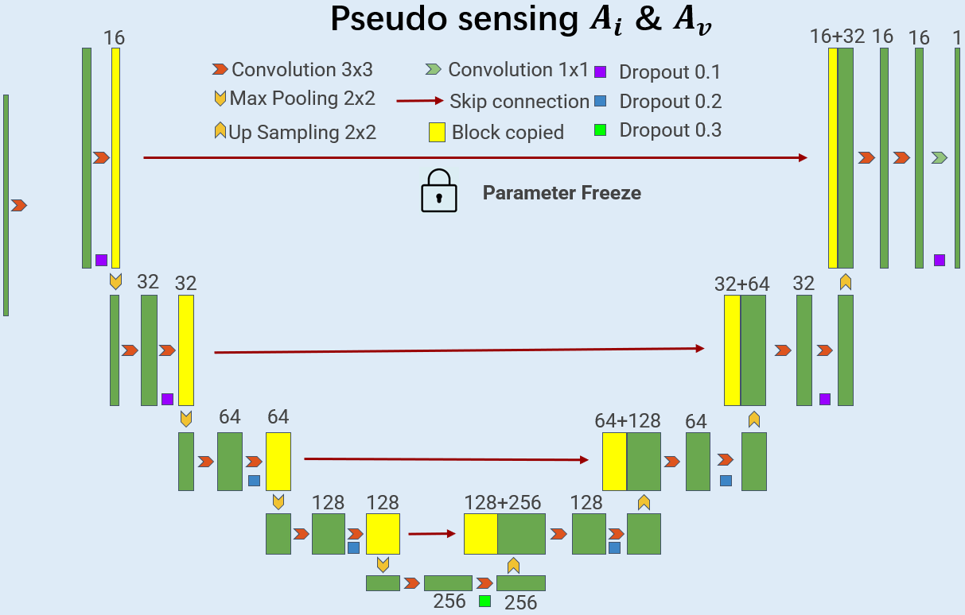





HVI Multi-Modality Image Fusion (HMIF)
Input visible
$$L\left(A_{v}\left(f\right),v\right)$$
$$L\left(f_{t},\hat{f_{t}}\right)$$
$$A_{v}$$
Image Augumention
(flip，rotation,
translation…)
HVI
Fuser
HVI
Fuser
$$A_{i}$$
Input Infrared
$$L\left(A_{i}\left(f\right),i\right)$$

Slide 2

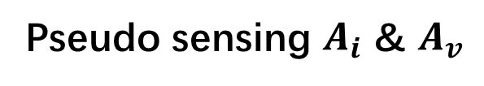
Pseudo sensing $A_{i}$ & $A_{v}$
16
16+32
16
16
1
Convolution 3x3
Convolution 1x1
Dropout 0.1
Max Pooling 2x2
Skip connection
Dropout 0.2
Up Sampling 2x2
Block copied
Dropout 0.3
Parameter Freeze
32
32
32+64
32
64
64
64+128
64
128
128
128+256
128
256
256
Notes:
By @avsthiago

Slide 3

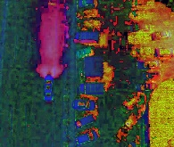
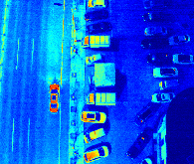

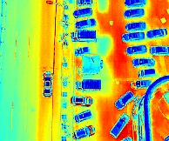
HVI Trans
Enhancement Fusion Network
H×W×3
HVT
Skip Connection
K
Visible HV Map
Skip Connection
H×W×3
HV Feature
2X
PHVIT
Input visible
CAB
C
CAB
CAB
H×W×1
CAB
Visible Itensity Map
Fusioned Image
C
Itensity Feature
Infrared Itensity Map
Input Infrared
Cross
Attention
Concat
Density-k
Conv 3x3
I-branch
Conv 3 x 3
HV-branch
Conv 3 x 3
C
K
Notes:
Note:
These visuals can represent a multi-directional array (3D)
Author: Elvis Saravia (ellfae@gmail.com)

Slide 4
HVI Trans
Enhancement Fusion Network
HVT
Skip Connection
K
Visible HV Map
Skip Connection
HV Feature
2X
PHVIT
CAB
C
CAB
CAB
CAB
Visible Itensity Map
C
Itensity Feature
Infrared Itensity Map
Notes:
Note:
These visuals can represent a multi-directional array (3D)
Author: Elvis Saravia (ellfae@gmail.com)

