Slide 1
COMPAS Recidivism Racial Bias
- Chaitanya Vallabhaneni

Slide 2
What is COMPAS?
COMPAS (Correctional Offender Management Profiling for Alternative Sanctions) is a popular commercial algorithm, designed by the Software Company Northpointe Inc, used by judges and parole officers for scoring criminal defendant’s likelihood of reoffending (recidivism).
However, it has been shown that the algorithm is biased in favor of white defendants, and against black inmates, based on a 2 year follow up study (i.e who actually committed crimes or violent crimes after 2 years). The pattern of mistakes, as measured by precision/sensitivity is notable.

Slide 3
Why is this Important?
ProPublica, an organization specializing in investigative journalism who conducted the initial analysis mentions that “black defendants were often predicted to be at a higher risk of recidivism than they actually were”.
Their analysis found that black defendants who did not recidivate over a two-year period were nearly “twice as likely to be misclassified as higher risk compared to their white counterparts”. This is disconcerting. The algorithm essentially segregates based on race and fails to serve equal justice.

Slide 4
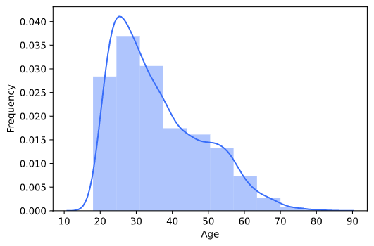
Exploratory Data Analysis on COMPAS data

Slide 5
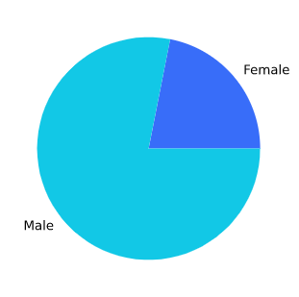
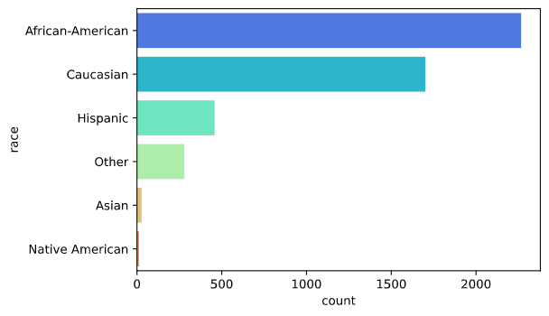

Slide 6
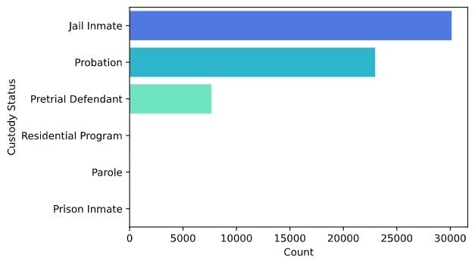
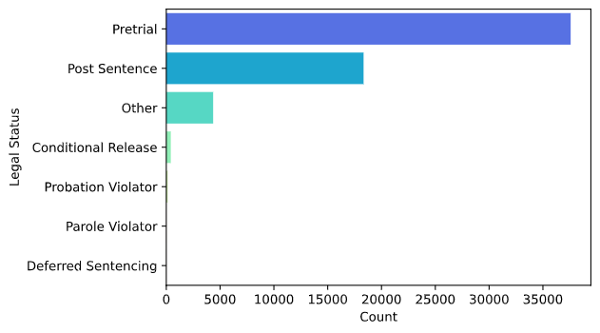

Slide 7
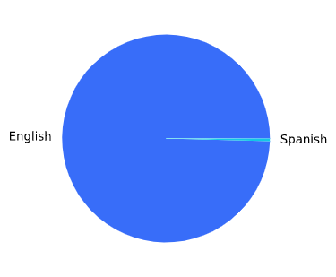
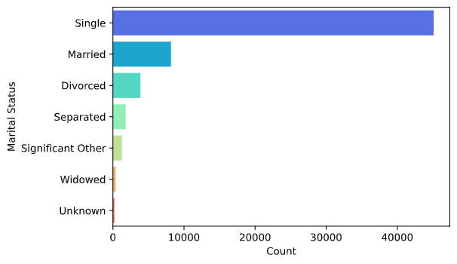

Slide 8
Machine Learning Models and Results
Nearest Neighbors 0.6123110151187905
Linear SVM 0.652267818574514
RBF SVM 0.6641468682505399
Decision Tree 0.6754859611231101
Random Forest 0.6673866090712743
Neural Net 0.6749460043196545
AdaBoost 0.66792656587473
Naive Bayes 0.6241900647948164
QDA 0.6452483801295896
LogisticRegression 0.6652267818574514

Slide 9
Conclusion
Decision trees model performs the best
DecisionTreeClassifier(criterion='entropy', max_features=6, min_samples_leaf=8)
Based on the exploratory data analysis and machine learning modelling conducted throughout this study, the COMPAS model does in fact segregate based on race factors and incorrectly predicts the risk of recidivism based on an unevenly distributed collection of data skewed heavily towards African Americans.

