Slide 1

Fall 2020 Group 7 Final Project
Querying Via Voice Input using Google Web Speech API
TEAM MEMBERS
Lance Luo Radhika Dube
Arwa EL-Hawwat Chaitanya Vallabhaneni Praneeth Chandra Thota

Slide 2
Goal of our Project
We want our web application to be able to:
Receive voice input as
verbatim SQL queries
natural speech & free text
Transform the voice input to valid SQL queries
Run the query in our backend database(s)
Display the result on our web app
Do it all for free!

Slide 3
Web App Layout
We built this project using
EC2 instance
Web Interface
Python Flask (Server)
Database (RDS and Redshift)
Docker Container (to run microservices)
Visit our application here : http://52.204.76.71/

Slide 4
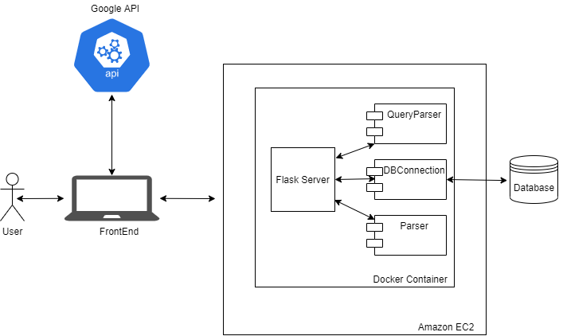
Architecture

Slide 5
Questions We Considered
To implement our Parser, we considered the following questions:
How accurately can our speech input be translated into text?
What words/phrases should we store in our backend to mimic SQL query keywords?
How to handle special characters like:
“” , * _ ()
numbers and spaces

Slide 6
Speech to Query
Speech to Text
Alexa Skill (had some drawbacks)
Google API (worked better)
Text to Query
Standard NLP libraries (customization issues)
Implemented our own Parsing libraries

Slide 7
Our Strategy - Google API
Used Google API webkitSpeechRecoginition
Advantages over Alexa Skills
Functionality
Accuracy
Scalability
Debugging
We used a backend Python script to parse input and extract queries

Slide 8



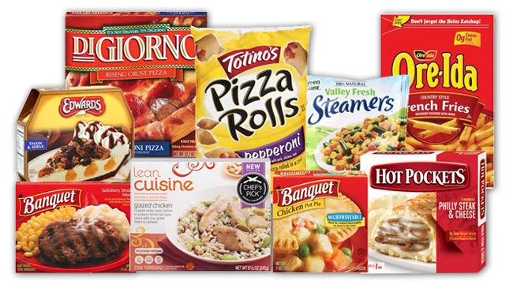


SQL Queries
“select department from departments where department like "____"”
“select department maximum of department_id as test from departments”
“select all from products order by product_name descending”
“select count of department_id as test from products group by department_id having count of test greater than 100”

Slide 9



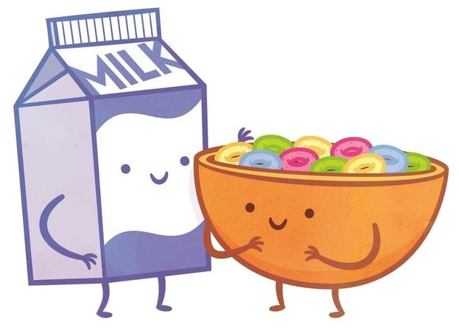
Free Text Queries
“what is the most popular product”
“return all products starting with chocolate”
“find the location of peach mango juice”
“in which department is peanut butter cereal”

Slide 10


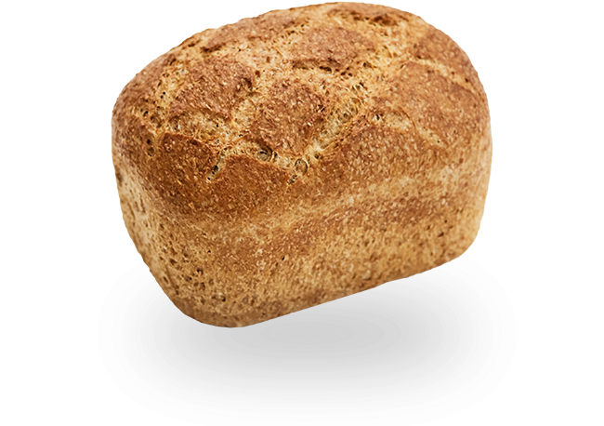
Free Text Queries
“where is dry nose oil”
“display the top 10 most popular products in the aisle of butter”
“show the most popular product in the department of bakery”
“get the top 7 departments with the least products”

Slide 11
References
https://developers.google.com/web/updates/2013/01/Voice-Driven-Web-Apps-Introduction-to-the-Web-Speech-API
https://www.google.com/intl/en/chrome/demos/speech.html

Slide 12
Thanks!
Any questions?

