Slide 1
GrubHub Campus
Carter Gray, Connor Vail, Zachary Hamilton

Slide 2
The purpose of this project is to design and create an application similar to that of GrubHub or Postmates specifically for campus use.
Business Rules
Flat fee of $5 for each delivery
A person can orders food one to many times
Each order is from one and only one restaurant
Food providers must me approved to be included in the database
Data will be used to gain insight on the nutrition and eating habits of campus
Drivers must be approved students
We will only deliver on campus at an approved derivery

Slide 3
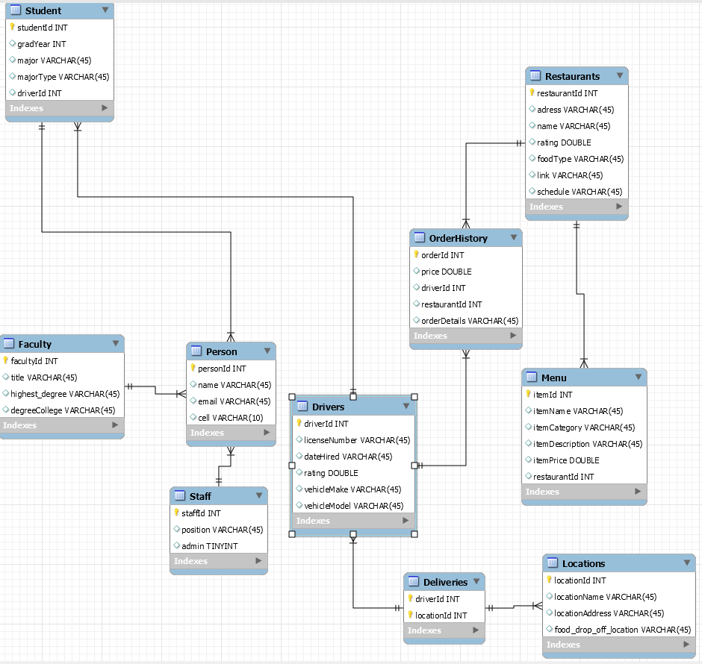

Slide 4
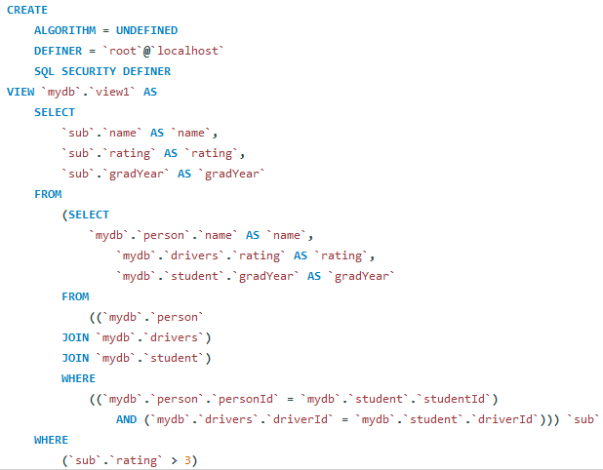
View 1

Slide 5
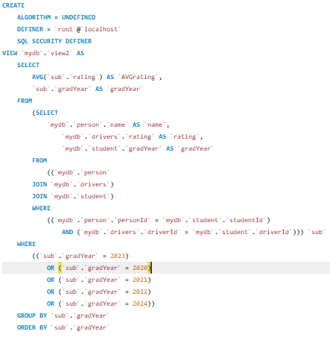
View 2

