Slide 1
Meeting 7: TODO
02/09/2020, Milano
Alessio Russo
Carmelo Valore

Slide 2
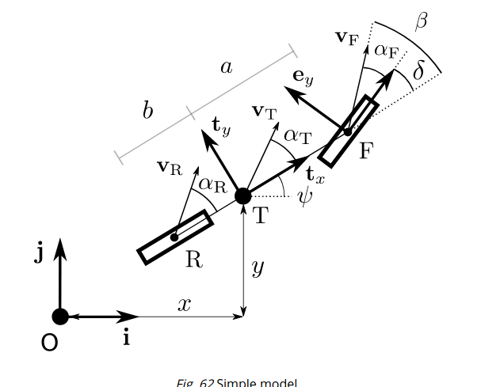
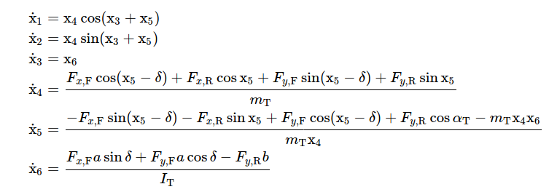
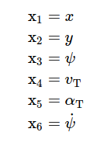
Dynamic bicycle model
2
Alessio Russo, Carmelo Valore
Notes:
Inserire qui gli slip

Slide 3
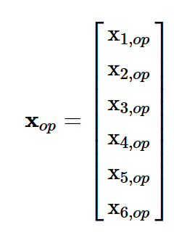
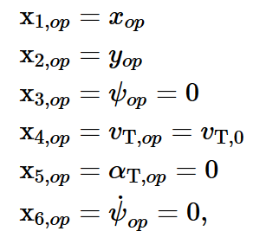
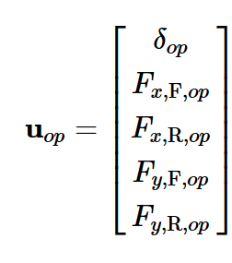
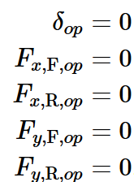
Linearized model
Linearize model:
@ operating point
3
Alessio Russo, Carmelo Valore

Slide 4
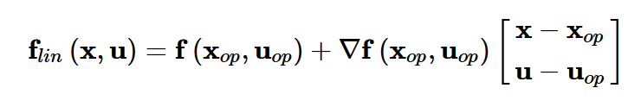
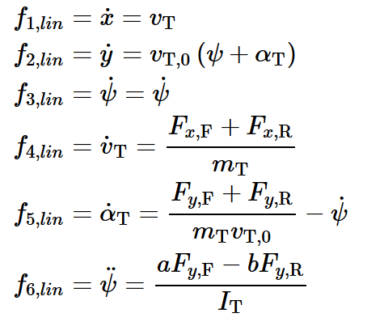
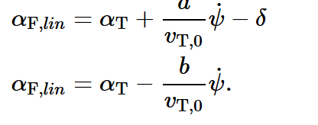
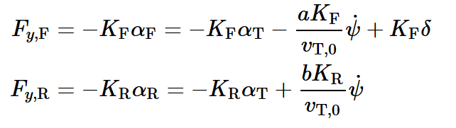
Linearized model
Linearized model:
Linear slips:
Linear tyre model:
4
Alessio Russo, Carmelo Valore

Slide 5
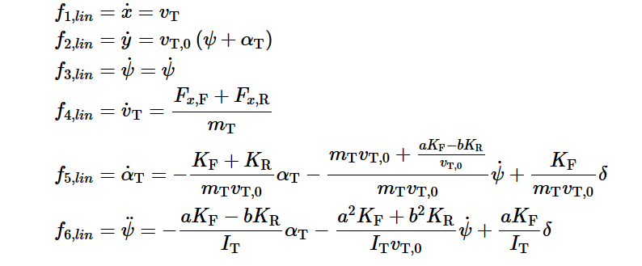
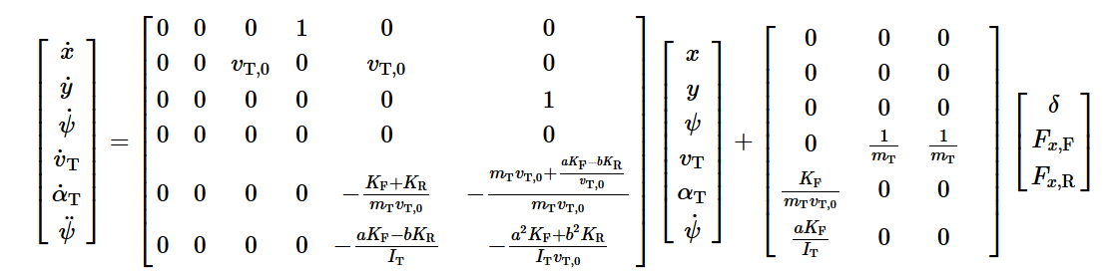
Linearized model
Linearized model:
5
Alessio Russo, Carmelo Valore

Slide 6
Lateral controller
Screenshot del modello di mori
Starting from this model we obtain the transfer function from the steering angle and the error
Screenshot transfer function (se serve)
6
Alessio Russo, Carmelo Valore

Slide 7
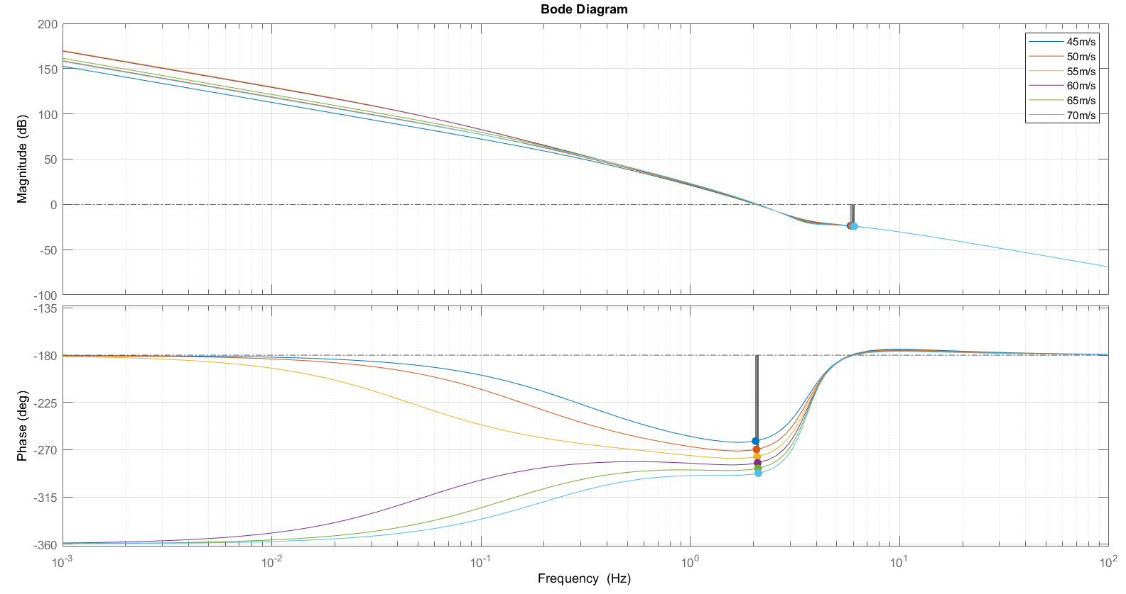
Lateral controller
This is the Bode diagram of G(s)
7
Alessio Russo, Carmelo Valore

Slide 8
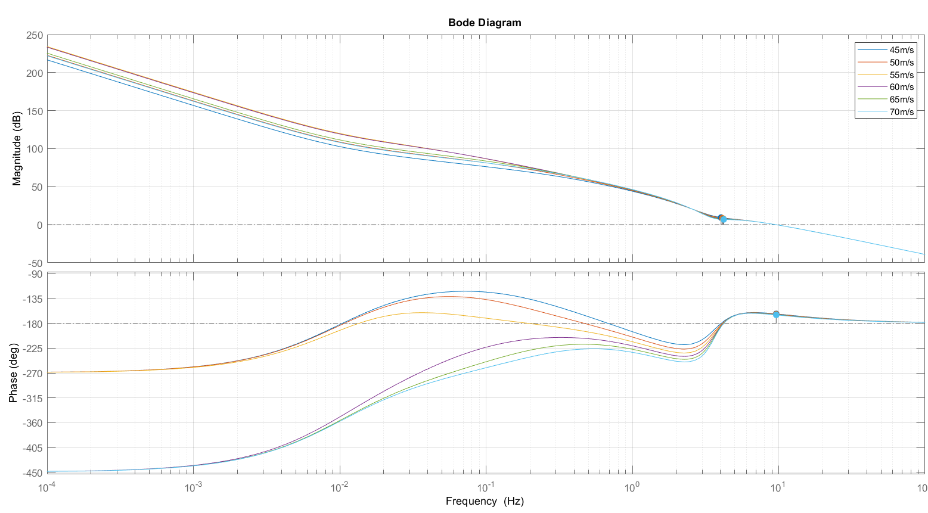
Lateral controller
We have built a regulator containing:
two zeros in 0.01 Hz
two poles in 0 and 2 Hz
gain 0.01
The Bode diagram of the
loop function obtained
is the following:
8
Alessio Russo, Carmelo Valore

Slide 9
Lateral controller
Now we introduce in the model the notion of lookahead
9
Alessio Russo, Carmelo Valore

Slide 10

Questions
10
Alessio Russo, Carmelo Valore

Slide 11
Questions
Lateral controller
We tried our best but probably do not get the point:
We do not undersand, in Mori’s thesis (and some literature papers too), how error’s dynamic is actually related to the the distance to the path
How to choose our requirements of the regulator? (e.g. bandwidth of the open-loop function)
Should we include the dynamic of the error in the complete model, or it’s just used to project the regulator, and then our «search for minimum distance reference point» algorithm have to be used?
High speed problem(?)
We also tested other controllers, such as «pure pursuit» controller and «dynamic Stanley controller» but for our high speeds (> 45m/s) they do not work well
11
Alessio Russo, Carmelo Valore

Slide 12
Meeting 6: Control
12

