Slide 1
Meeting 3 : Review of our steps towards race car simulation
21/05/2020, Milano
Alessio Russo
Carmelo Valore

Slide 2
Introduction
Our steps
  Generate the track (trajectories to be followed)
  Add vehicle based on dynamic bicycle model (ego vehicle)
  Add other “static” opponents following a predefined trajectory
  Make ego vehicle to follow the track (path following*)
  Create a fuel tank model to account for time-varying mass of the ego
  Take into account air flow effects when moving behind an opponent

Slide 3
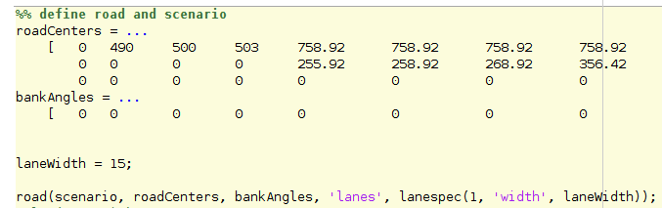
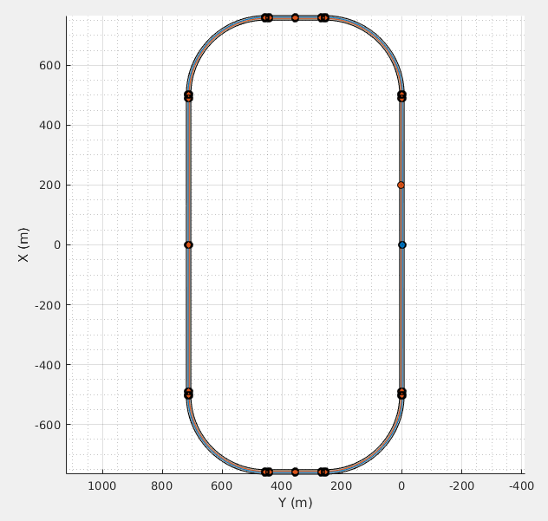
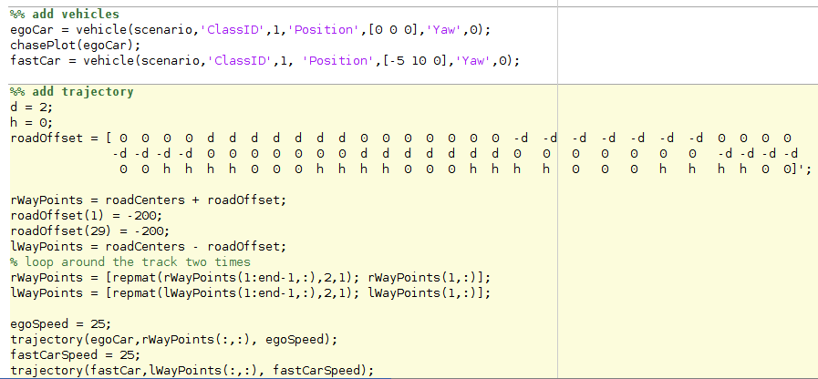
1. Generate the track (trajectories to be followed)

Slide 4
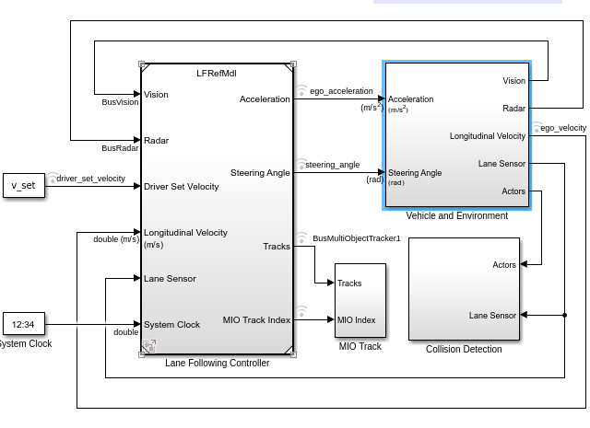
2. Add vehicle based on dynamic bicycle model

Slide 5
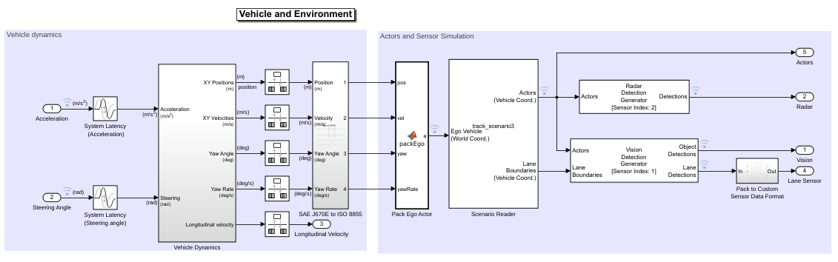
2. Add vehicle based on dynamic bicycle model

Slide 6
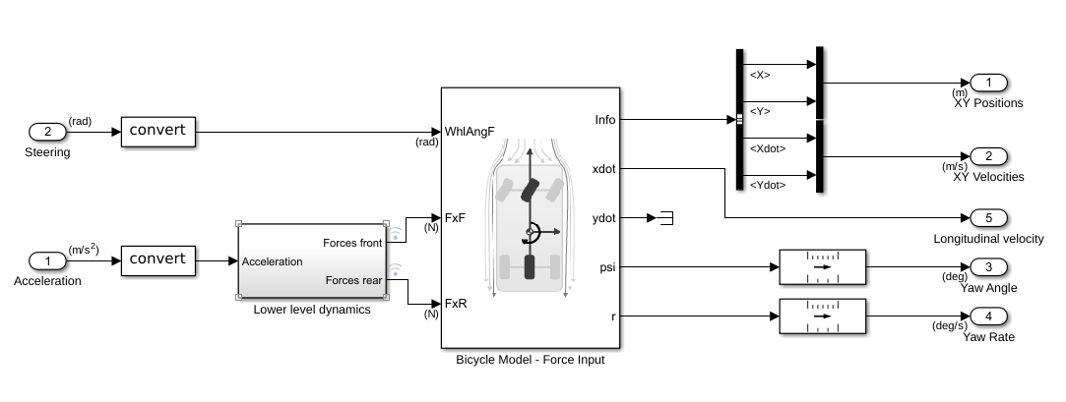
2. Add vehicle based on dynamic bicycle model

Slide 7
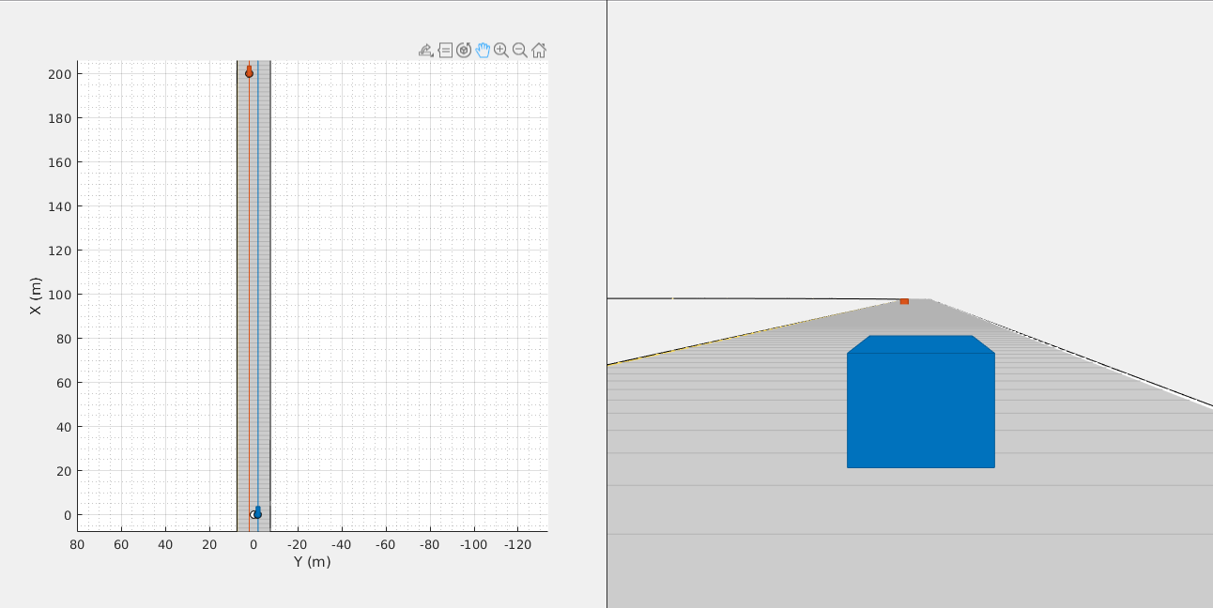
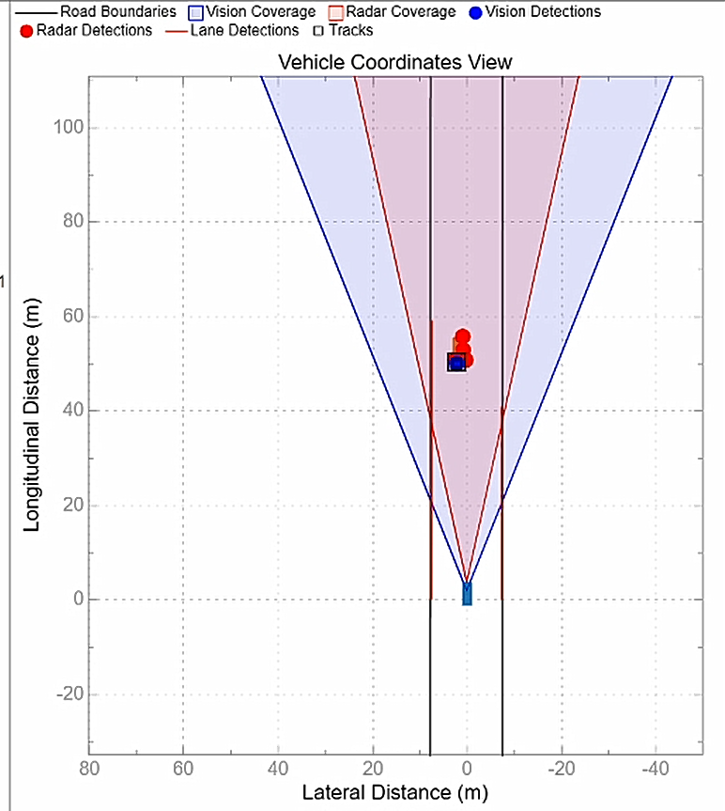
3. Add other “static” opponents following a predefined trajectory

Slide 8
4. Make ego vehicle to follow the track (path following)

Slide 9
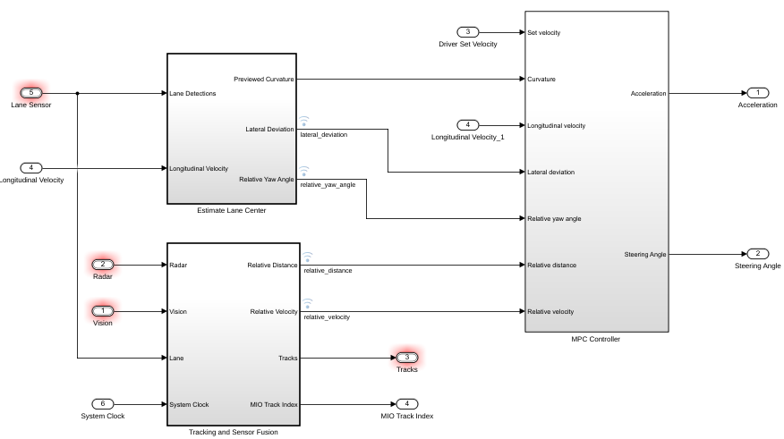
4. Make ego vehicle to follow the track (path following)

Slide 10
4. Make ego vehicle to follow the track (path following)

Slide 11
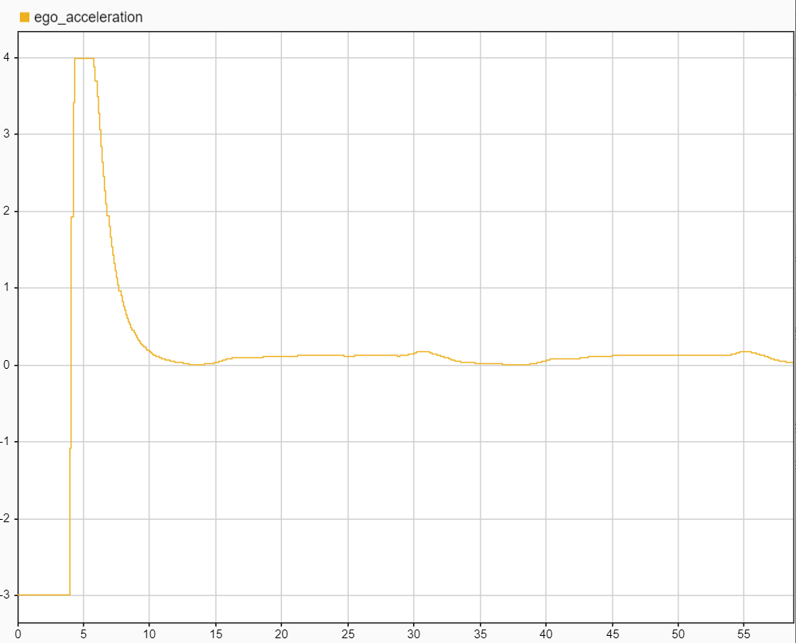
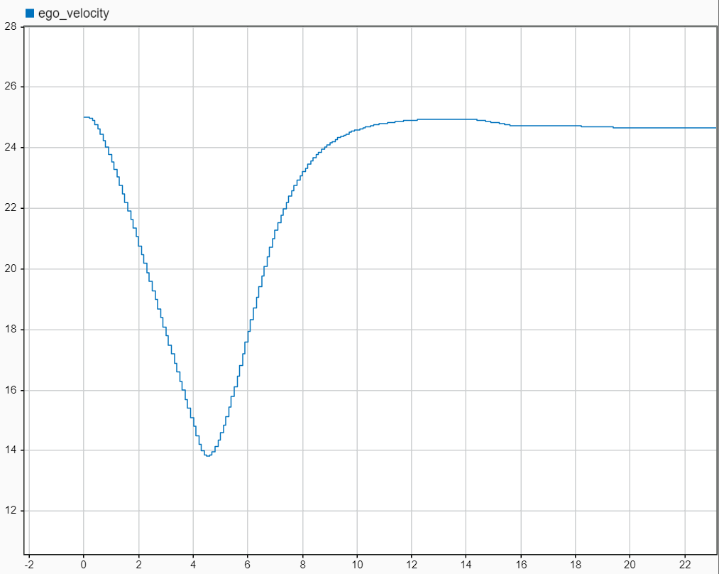
4. Make ego vehicle to follow the track (path following)

Slide 12
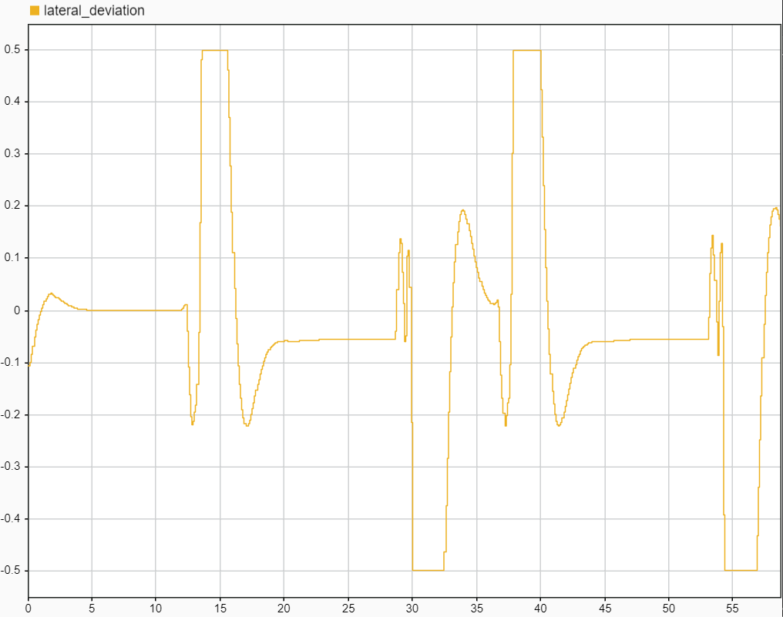
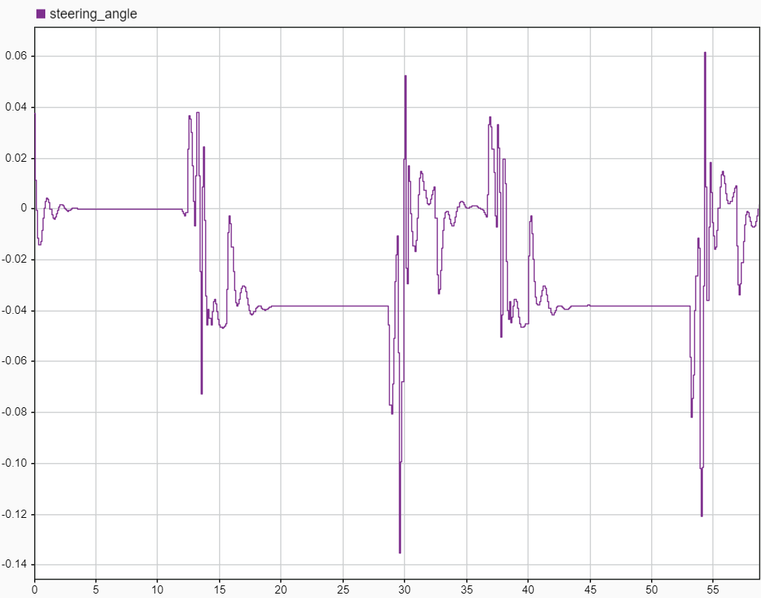
4. Make ego vehicle to follow the track (path following)

Slide 13

Questions

Slide 14
Questions
Considerations about what we have done so far
  Lane following + sensors?
  Predefined blocks?
  MPC and vehicles parameters for high speed?
  ..
Technical issues
  Fuel tank model - time varying mass ?
  ..

