Slide 1
Meeting 7: Lateral controller
02/09/2020, Milano
Alessio Russo
Carmelo Valore

Slide 2
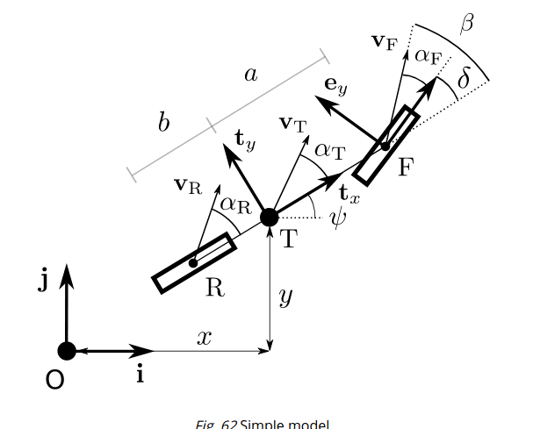
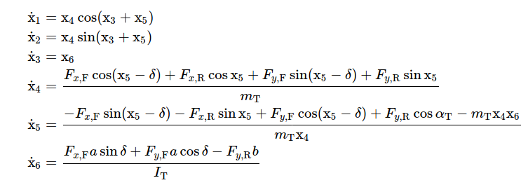
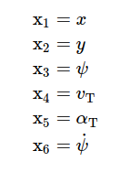
Dynamic bicycle model
2
Alessio Russo, Carmelo Valore
Notes:
Inserire qui gli slip

Slide 3
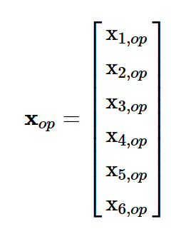
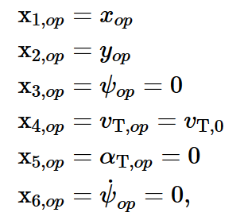
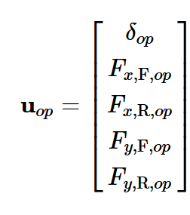
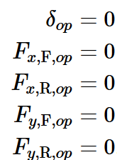
Linearized model
Linearize model:
@ operating point
3
Alessio Russo, Carmelo Valore

Slide 4
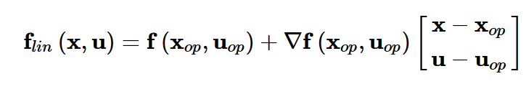
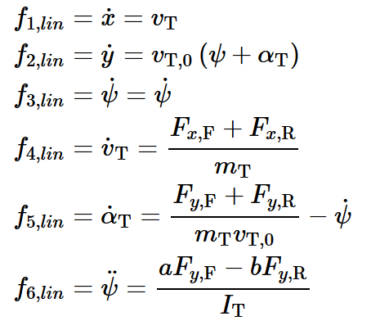
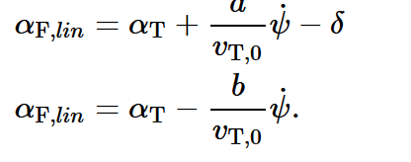
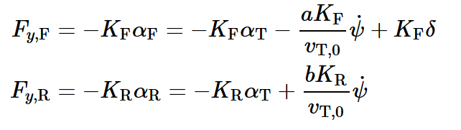
Linearized model
Linearized model:
Linear slips:
Linear tyre model:
4
Alessio Russo, Carmelo Valore

Slide 5
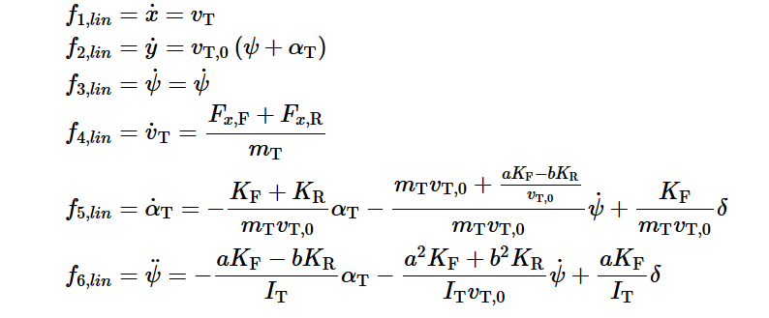
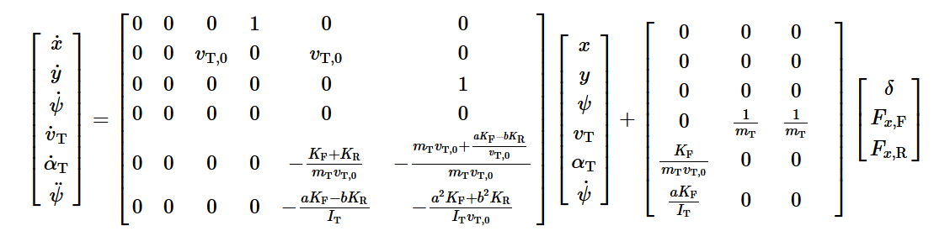
Linearized model
Linearized model:
5
Alessio Russo, Carmelo Valore

Slide 6
Lateral controller
We implemented 3 main versions:
Controller based on the model without lookahead
2 different controllers based on the model with lookahead
6
Alessio Russo, Carmelo Valore

Slide 7
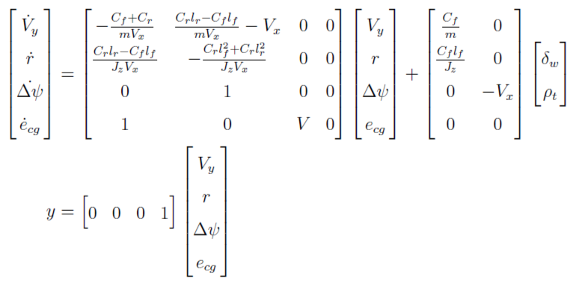
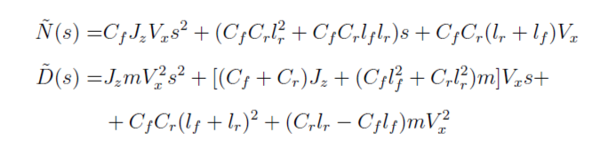

Lateral controller without Lookahead
- The linearized model seen so far can also be
represented in this way.
Here we added two more states:
The heading angle error
The lateral error
Considering different velocity speeds for the value Vx we defined the following transfer function G(s) from the steering angle
to the output
7
Alessio Russo, Carmelo Valore

Slide 8
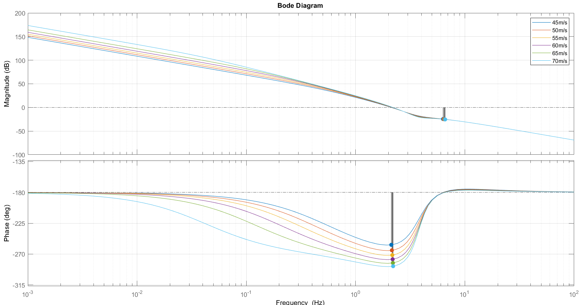
Bode diagram of G(s) at different velocity speeds
8
Alessio Russo, Carmelo Valore
Notes:
Senza lookahead con il regolatore di mori con gain cambiato a 0.01, le funzioni sono stabili ma ci sono oscillazioni forti già in partenza, senza feed-forward

Slide 9
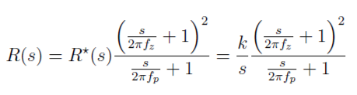
Lateral controller without Lookahead
From that transfer function we obtain the following regulator R(s) with structure:
Pole in 2 Hz
Zero in 0.01 Hz
Gain 0.01
Combining the results we define the function L(s) = R(s)*G(s)
L(s) is stable with each considered velocity
The bandwidth is around 9.5 Hz
The phase margin is around 15 deg
Despite of the stability of the obtained Bode diagram, the simulation results are not satisfactory. The error oscillates too much even along the straight path and this makes the simulation run very slow.
9
Alessio Russo, Carmelo Valore
Notes:
Senza lookahead con il regolatore di mori con gain cambiato a 0.01, le funzioni sono stabili ma ci sono oscillazioni forti già in partenza, senza feed-forward

Slide 10
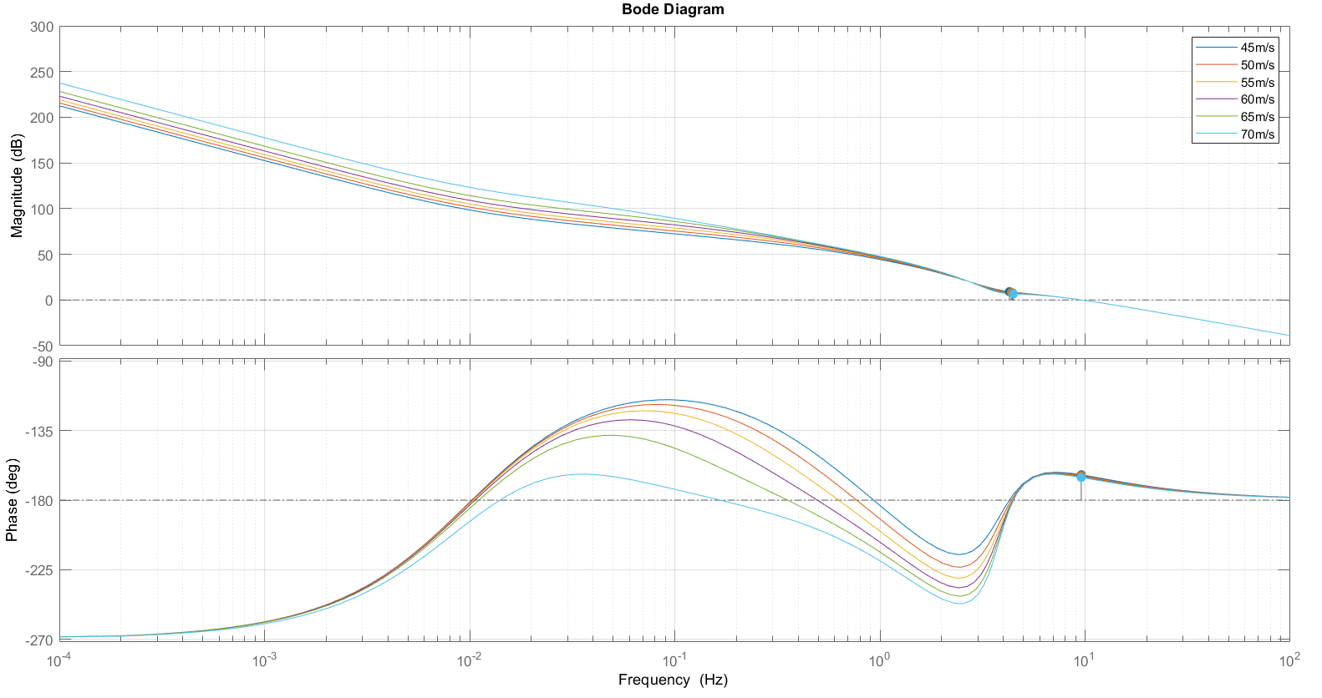
Bode diagram of L(s) at different velocity speeds
10
Alessio Russo, Carmelo Valore
Notes:
Senza lookahead con il regolatore di mori con gain cambiato a 0.01, le funzioni sono stabili ma ci sono oscillazioni forti già in partenza, senza feed-forward

Slide 11
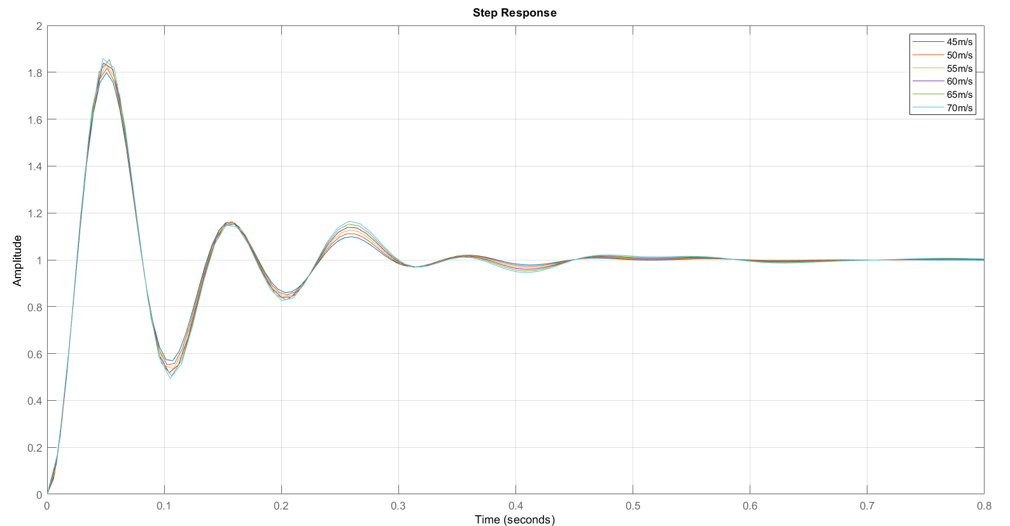
Step response of the system at different velocity speeds
11
Alessio Russo, Carmelo Valore
Notes:
Senza lookahead con il regolatore di mori con gain cambiato a 0.01, le funzioni sono stabili ma ci sono oscillazioni forti già in partenza, senza feed-forward

Slide 12
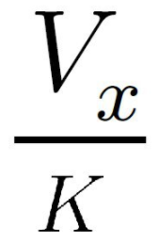
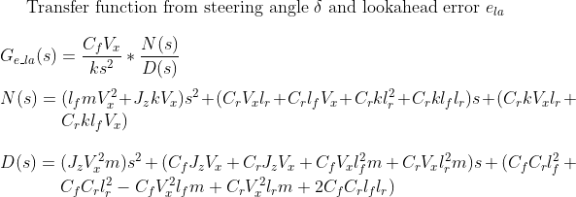
Lateral controller with Lookahead (first version)
This model is the same as the one before but we considered a Lookahead distance with value
La = V_x/k where k = 3.
The lookahead distance defines an additional
error e_La = La*delta(psi).
This error sums up to the original output
e = e_La + e_cg
Considering different velocity speeds for the value Vx we defined the following transfer function G(s) from the steering angle to the output
12
Alessio Russo, Carmelo Valore

Slide 13
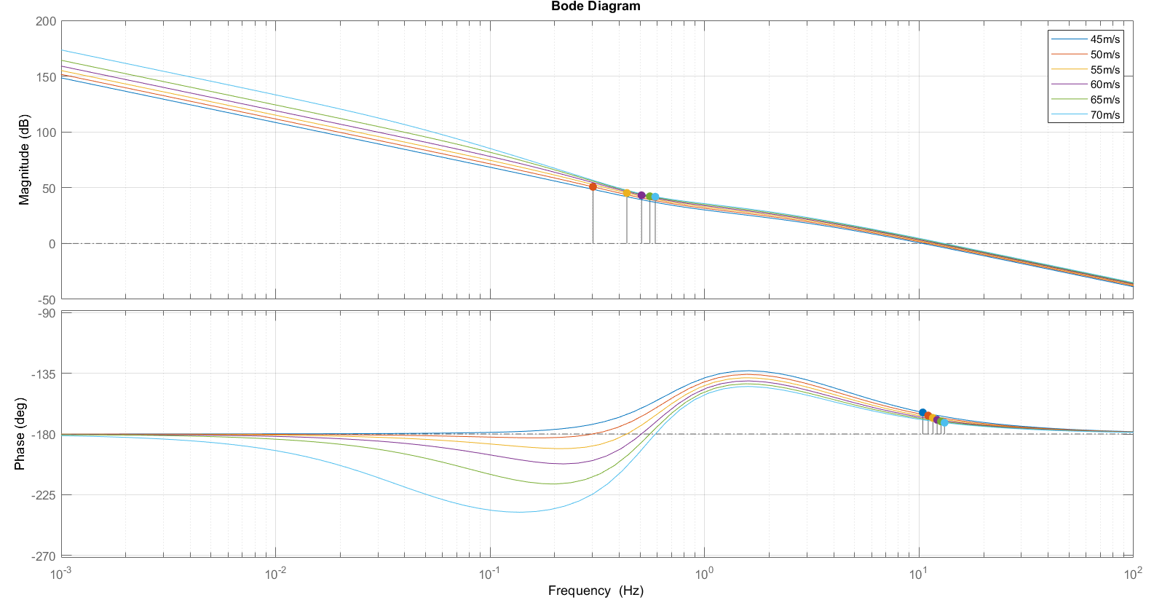
Bode diagram of G(s) at different velocity speeds
13
Alessio Russo, Carmelo Valore

Slide 14
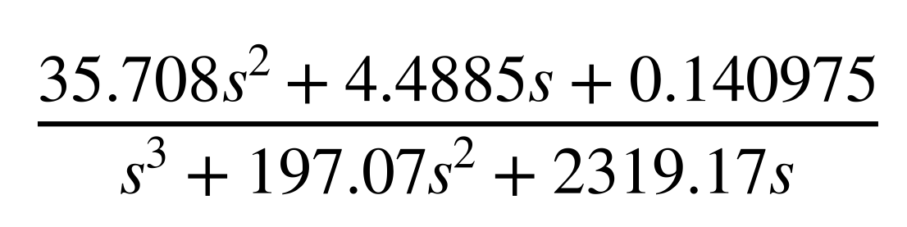

Lateral controller with Lookahead (first version)
From that transfer function we obtain the following regulator R(s) with the structure:
That can also be seen showing that:
Gain 6*10^-5
Integrator
One pole in 2 Hz
One pole in 29.4
Two zero in 0.01 Hz
Combining the results we define the function L(s) = R(s)*G(s)
L(s) is stable with each considered velocity
The bandwidth is around 4 Hz
The phase margin is around 45 deg
14
Alessio Russo, Carmelo Valore

Slide 15
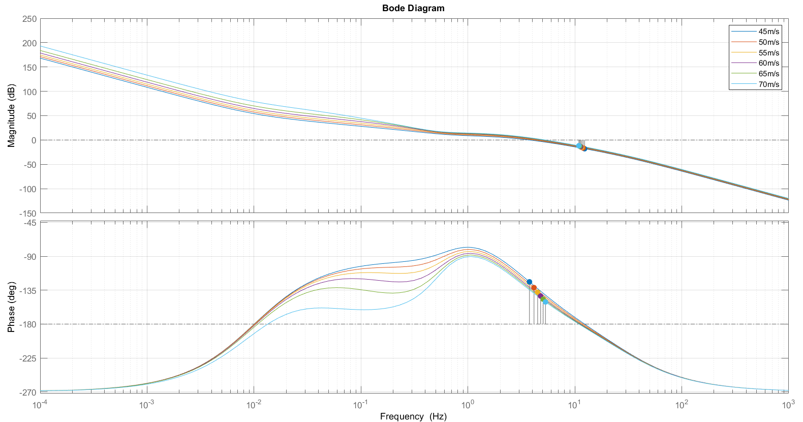
Bode diagram of L(s) at different velocity speeds
15
Alessio Russo, Carmelo Valore
Notes:
Senza lookahead con il regolatore di mori con gain cambiato a 0.01, le funzioni sono stabili ma ci sono oscillazioni forti già in partenza, senza feed-forward

Slide 16
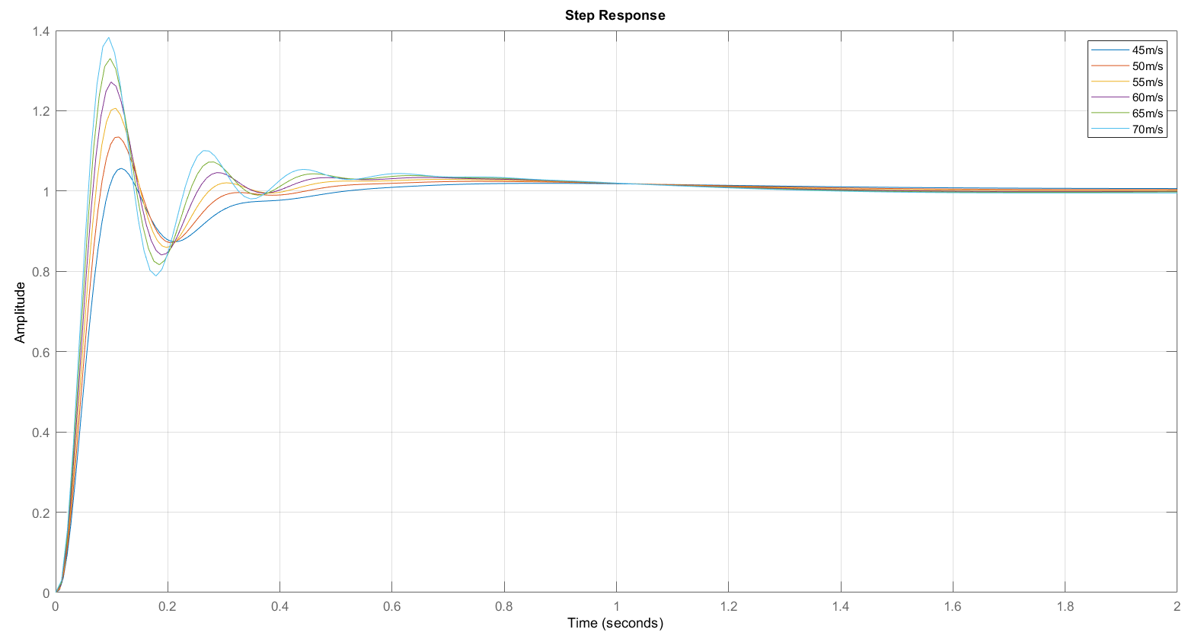
Step response of the system at different velocity speeds
16
Alessio Russo, Carmelo Valore
Notes:
Senza lookahead con il regolatore di mori con gain cambiato a 0.01, le funzioni sono stabili ma ci sono oscillazioni forti già in partenza, senza feed-forward

Slide 17
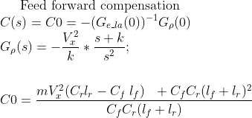
Lateral controller with Lookahead (first version)
Lookahead varies instantly according to the velocity Vx scaled by a factor 1/k with k = 3
We implemented the feed-forward mechanism: the value of the curvature referred to the current position of the vehicle is multiplied by the value C_0
17
Alessio Russo, Carmelo Valore

Slide 18
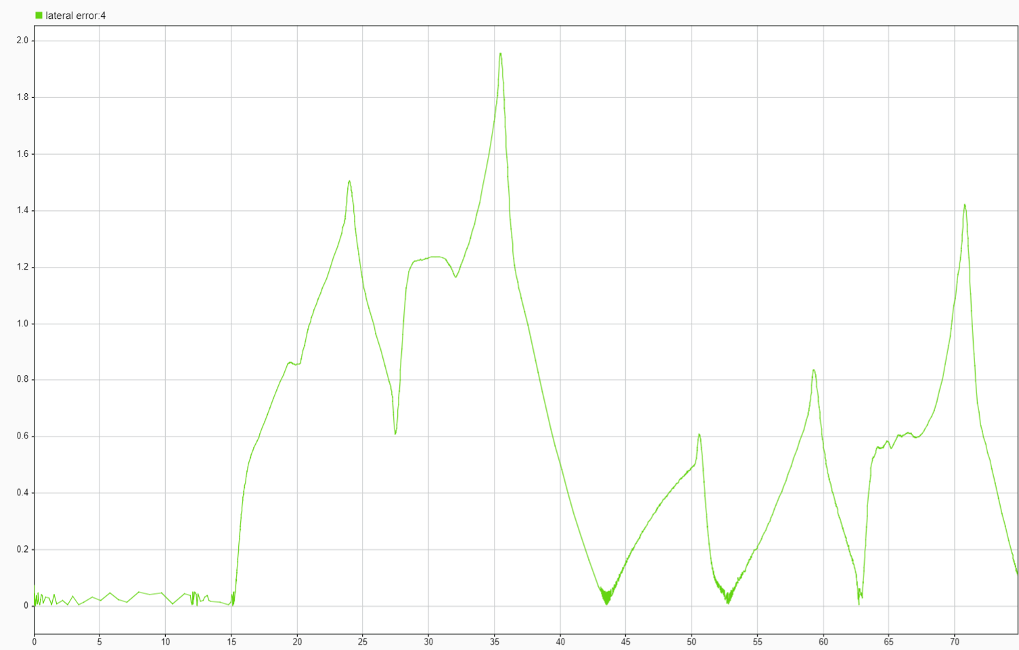
Lateral error of simulation (first version with lookahead)
18
Alessio Russo, Carmelo Valore

Slide 19
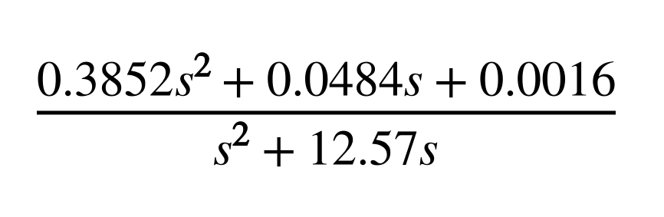

Lateral controller with Lookahead (second version)
Starting from the function G(s) obtained with the addition of the error of lookahead we also defined the following regulator R(s):
That can also be seen showing that:
Gain 1.3*10^-4
Integrator
One pole in 2 Hz
Two zero in 0.01 Hz
Combining the results we define the function L(s) = R(s)*G(s)
L(s) is stable with each considered velocity
The bandwidth is around 7 Hz
The phase margin is around 35 deg
19
Alessio Russo, Carmelo Valore

Slide 20
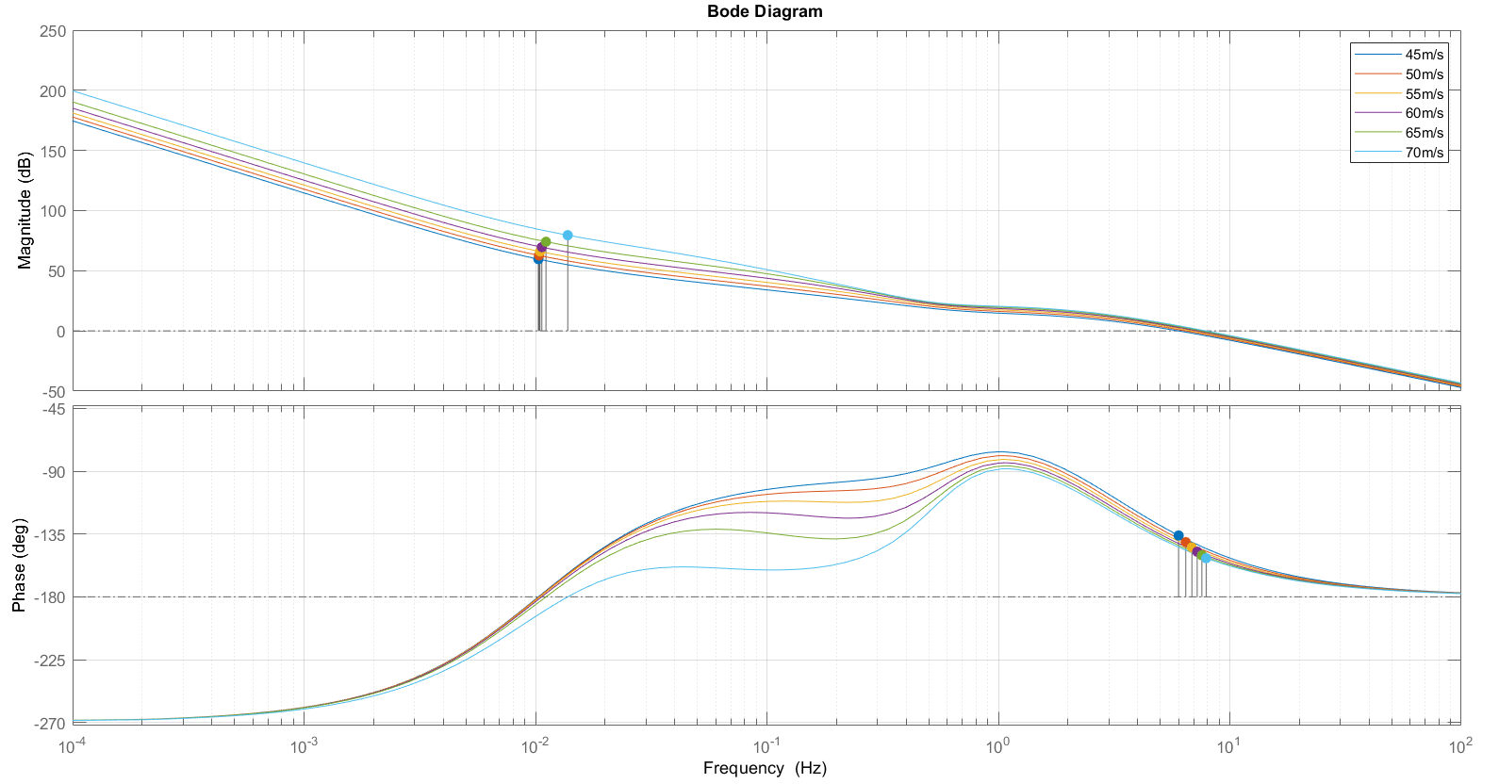
Bode diagram of L(s) at different velocity speeds
20
Alessio Russo, Carmelo Valore
Notes:
Senza lookahead con il regolatore di mori con gain cambiato a 0.01, le funzioni sono stabili ma ci sono oscillazioni forti già in partenza, senza feed-forward

Slide 21
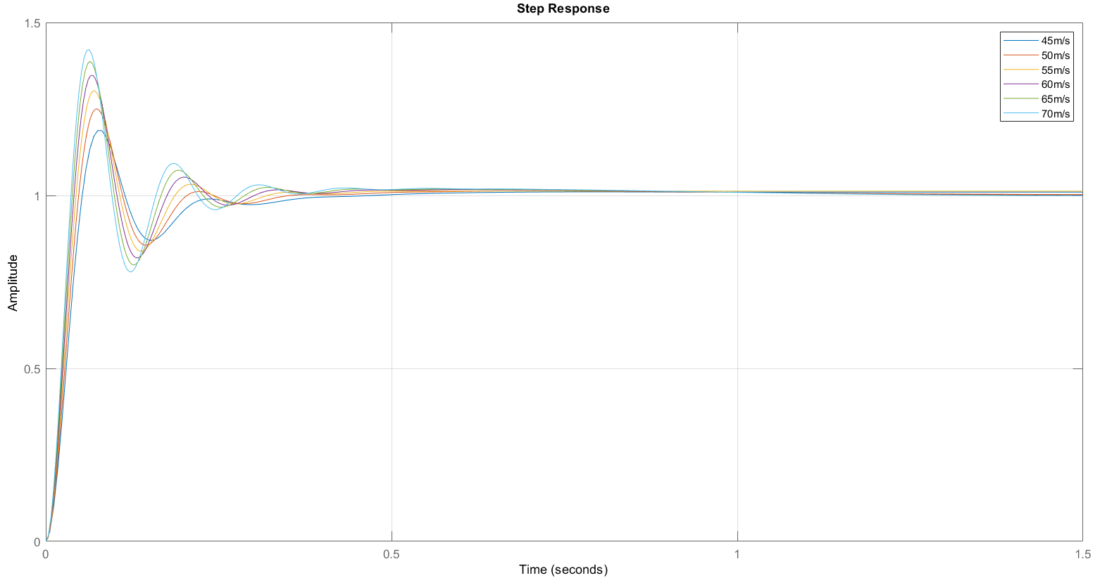
Step response of the system at different velocity speeds
21
Alessio Russo, Carmelo Valore
Notes:
Senza lookahead con il regolatore di mori con gain cambiato a 0.01, le funzioni sono stabili ma ci sono oscillazioni forti già in partenza, senza feed-forward

Slide 22
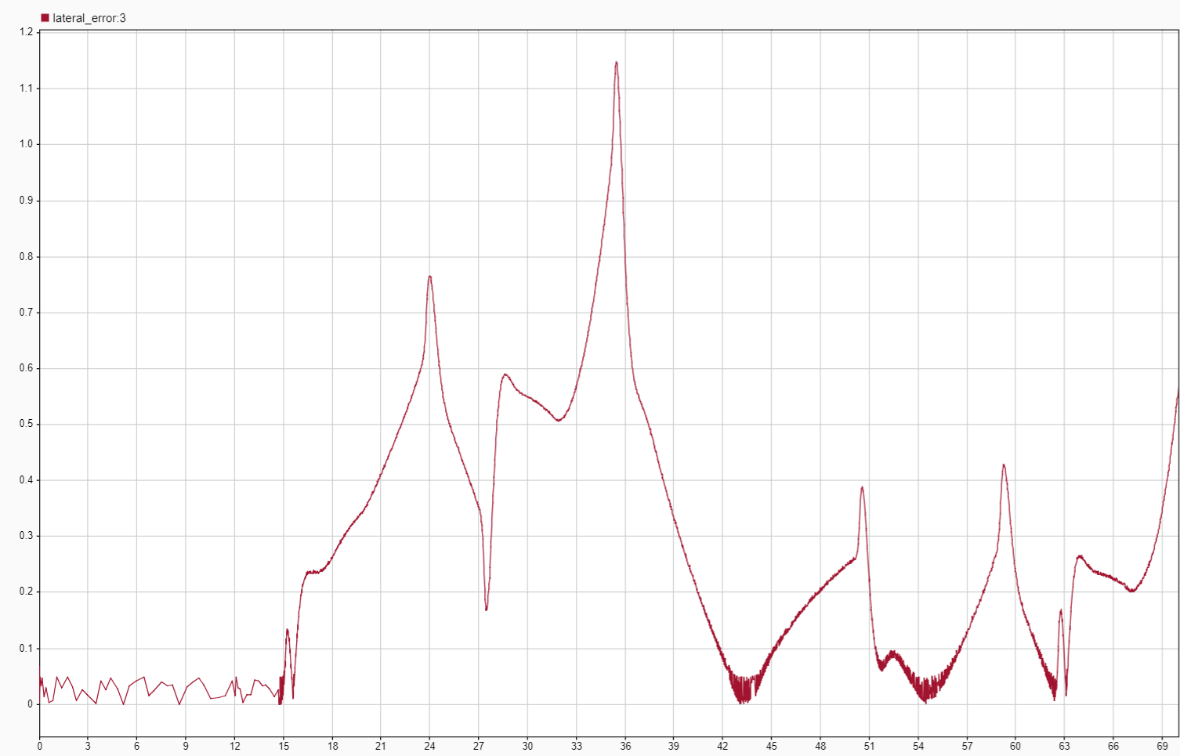
Lateral error with lookahead (second version)
22
Alessio Russo, Carmelo Valore
Notes:
Senza lookahead con il regolatore di mori con gain cambiato a 0.01, le funzioni sono stabili ma ci sono oscillazioni forti già in partenza, senza feed-forward

Slide 23
Meeting 7: Lateral Control
23

