Slide 1
Meeting 5: TO DO
03/07/2020, Milano
Alessio Russo
Carmelo Valore

Slide 2
Overview
What we have done since last meeting:
Parameters adjusted using new provided data
Vehicle’s parameters
Banking
Introduced a steering ratio
Simulations run to test the model
Control
Longitudinal control
Lateral control
2
Alessio Russo, Carmelo Valore

Slide 3
Adjusted parameters
Parameters adjusted using new provided data
Vehicle’s parameters
Banking
Banking values are stored inside an array indexed using the curvilinear abscissa
Step size considered is 0.1 for the curvilinear abscissa
Introduced a steering ratio
3
Alessio Russo, Carmelo Valore

Slide 4
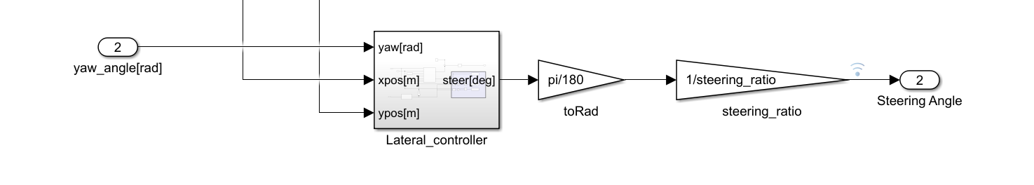
Adjusted parameters
Parameters adjusted using new provided data
Vehicle’s parameters
Banking
Introduced a steering ratio
4
Alessio Russo, Carmelo Valore

Slide 5
Simulations
7 simulations have been run:
Non-accelerating straight path
Accelerating straight path
Accelerating straight path on a banked road
Accelerating-Braking straight path
Constant steer and incresing velocity path
Sinusoidal wave path
Constant speed and increasing steering angle
5
Alessio Russo, Carmelo Valore

Slide 6
Simulations
ADD ALL SLIDES OF SIMULATIONS HERE?
6
Alessio Russo, Carmelo Valore

Slide 7
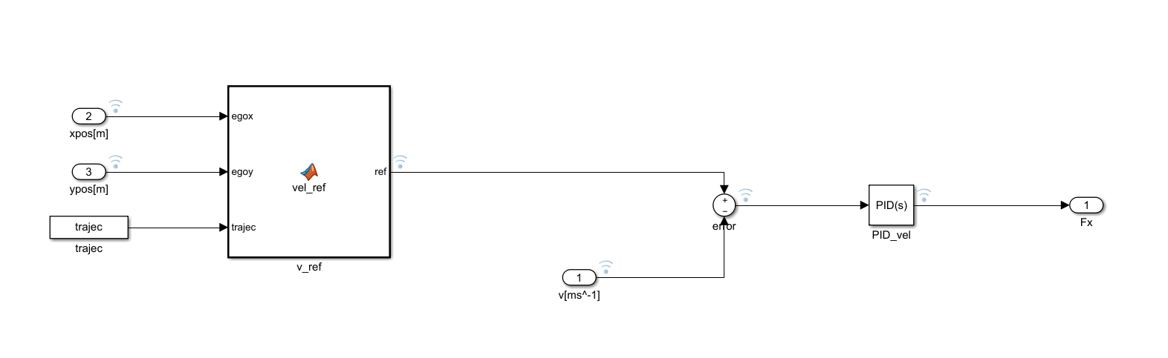
Longitudinal control
Control
Longitudinal control
Lateral control
Proportional (P): 3000
Integral (I): 0
Derivative (D): 0
7
Alessio Russo, Carmelo Valore

Slide 8
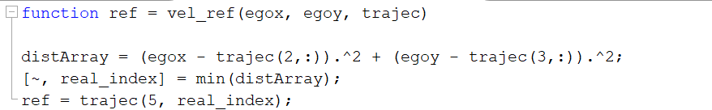
Longitudinal control
Control
Longitudinal control
Lateral control
8
Alessio Russo, Carmelo Valore

Slide 9
Longitudinal control
Row 5 of matrix trajec contains the desired velocity profile
Define the index of the point on the reference trajectory which is the nearest to the vehicle
Return the velocity that the vehicle should have depending on its position
9
Alessio Russo, Carmelo Valore

Slide 10
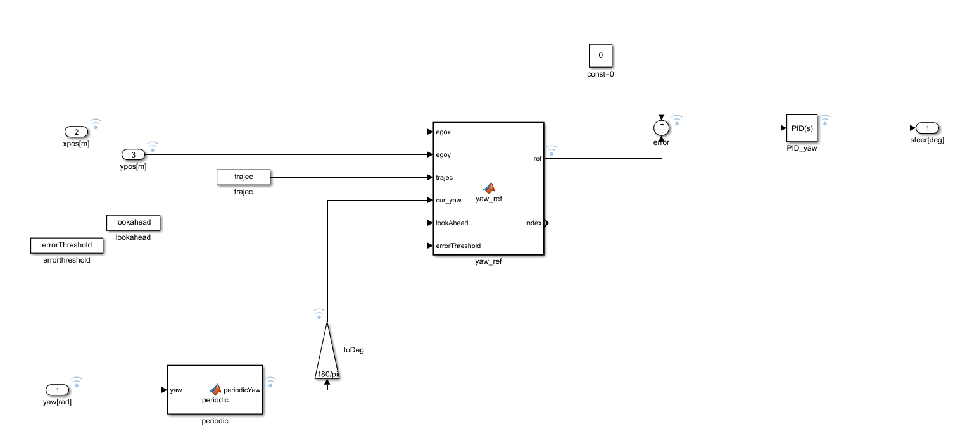
Lateral control
Control
Longitudinal control
Lateral control
Proportional (P): 3
Integral (I): 0
Derivative (D): 0
10
Alessio Russo, Carmelo Valore

Slide 11
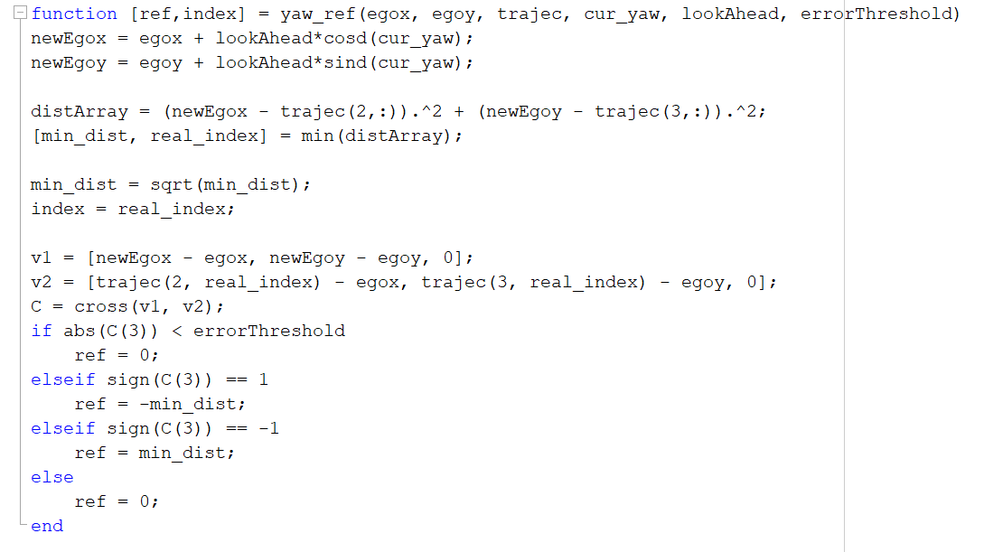
Lateral control
Control
Longitudinal control
Lateral control
11
Alessio Russo, Carmelo Valore

Slide 12
Lateral control
Compute the virtual point
Define:
the minimum distance (error) between the virtual point and the reference trajectory
The index of the point on the reference trajectory which is the nearest to the virtual point
12
Alessio Russo, Carmelo Valore

Slide 13
Lateral control
Establish the sign of the error given that the vehicle is on the left or on the right wrt the desired trajectory
Done using the cross product
13
Alessio Russo, Carmelo Valore

Slide 14

Questions
14
Alessio Russo, Carmelo Valore

Slide 15
Questions
Consider banking in the dynamic model (see pdf..)
Fuel consumption (sim
15
Alessio Russo, Carmelo Valore

Slide 16
Meeting 5: TO DO
16

