Slide 1
Final presentation:
02/09/2020, Milano
Alessio Russo
Carmelo Valore

Slide 2
Dynamic bicycle model
Introduction /objectives
2
Alessio Russo, Carmelo Valore
Notes:
Inserire qui gli slip

Slide 3
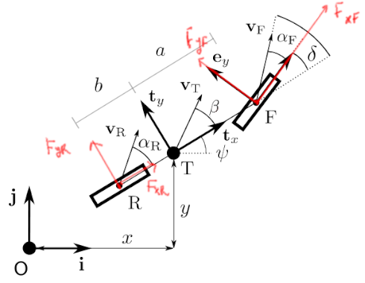
Dynamic bicycle model
Dynamic bicycle model
Pacejka tyre model
Aerodynamic forces
Fuel consumption model
Tyre wear model
Banking
Slipstream
3
Alessio Russo, Carmelo Valore
Notes:
Inserire qui gli slip

Slide 4
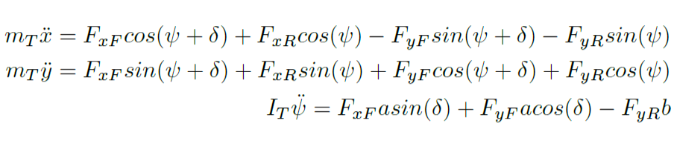
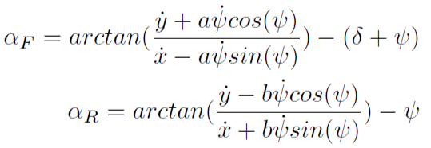
Dynamic bicycle model
Initial equations
Equilibrium with respect to the inertial frame Oij
4
Alessio Russo, Carmelo Valore
Notes:
Inserire qui gli slip

Slide 5
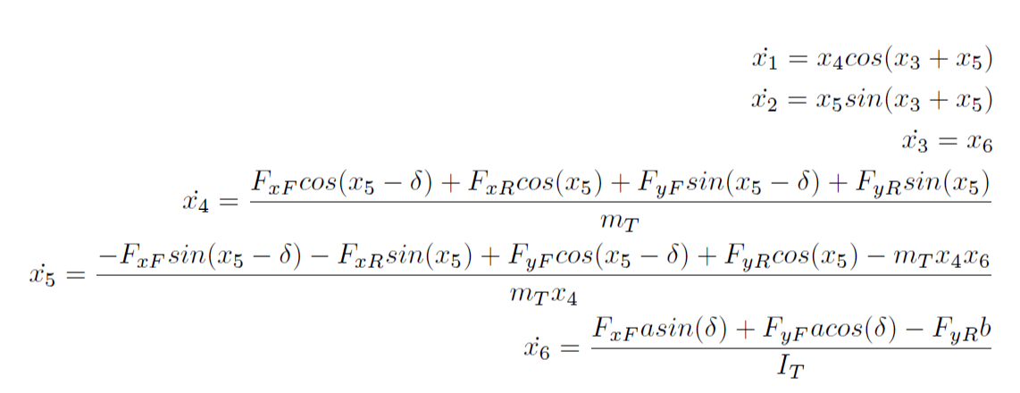
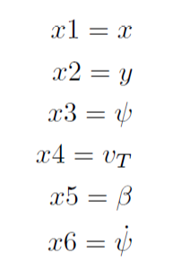
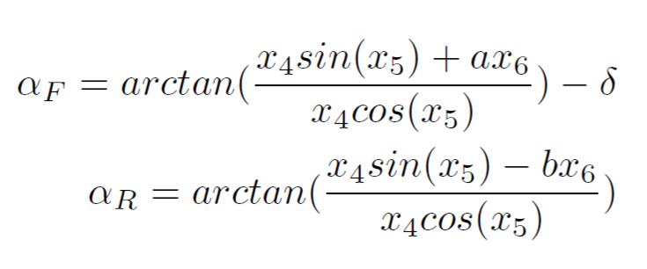
Dynamic bicycle model
We set the followings as the states of the model
So we derived the state equations
5
Alessio Russo, Carmelo Valore
Notes:
Inserire qui gli slip

Slide 6
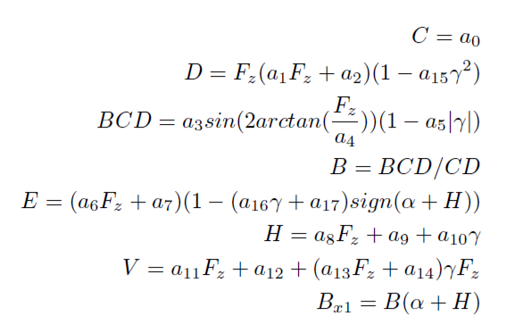
Pacejka tyre model
Pacejka formula derived
from experimental data
Takes as input:
the slip angle α
vertical load on the tyre F_{z}
the amplitude D
6
Alessio Russo, Carmelo Valore
Notes:
Inserire qui gli slip

Slide 7

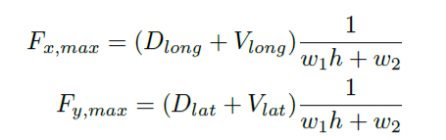
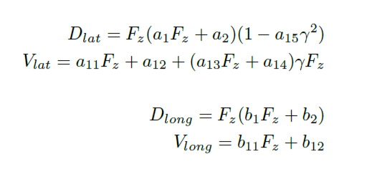
Friction ellipse (slide 1)
The physics of the tyre model is represented
through the friction ellipse
The ellipse dimension depends on:
the wear of the tyre h
the vertical load F_{z}
w₁ and w₂ that are parameters that regulate the scaling according to h
7
Alessio Russo, Carmelo Valore
Notes:
Inserire qui gli slip

Slide 8
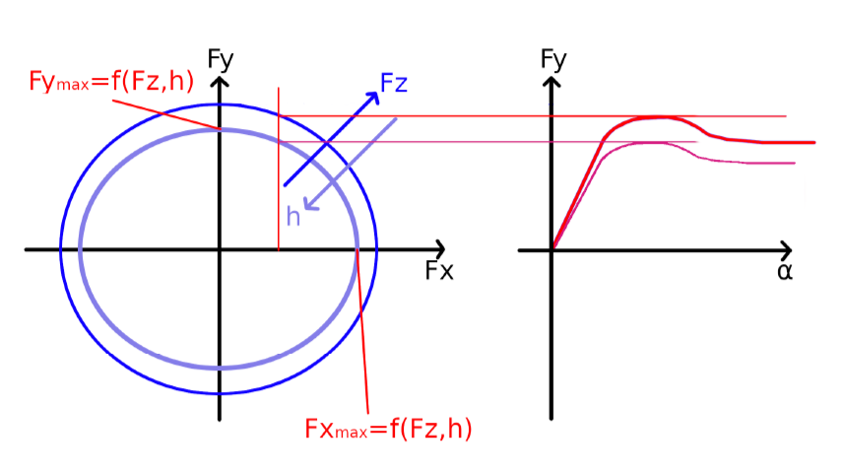
Friction ellipse (slide 2)
The control variable F_{x} determines F_{y} on the ellipse
The output of the Pacejka will be scaled according to F_{y}
We set the peak of the Pacejka (D_{lat} + V_{lat}) = F_{y}
8
Alessio Russo, Carmelo Valore
Notes:
Inserire qui gli slip

Slide 9

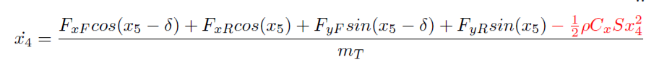
Aerodynamic forces
The drag force impacts on the body acceleration equation
Its contribution is negative because the applied force is opposite to the vehicle velocity
The contribution of the lift force increases the vertical load
Linear dependency with air density, drag/lift coefficient and area S of the considered surface. Square dependency with body velocity
9
Alessio Russo, Carmelo Valore
Notes:
Inserire qui gli slip

Slide 10
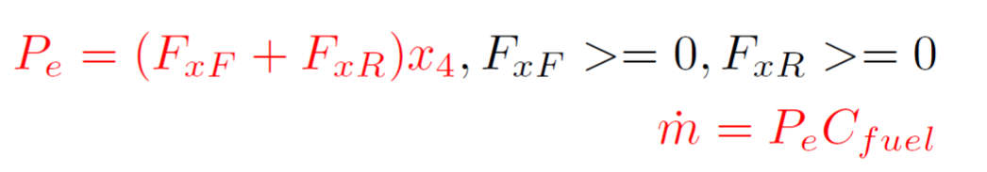
Fuel consumption model
Fuel consumption has been modelled by taking into account the power output
P = 0 while braking
P is multiplied by a C_{fuel} coefficient to express fuel consumption
10
Alessio Russo, Carmelo Valore
Notes:
Inserire qui gli slip

Slide 11
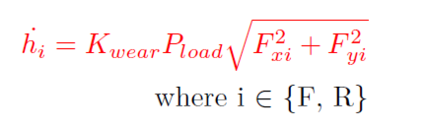
Tyre wear
Based on the Archard model for tyre wear
The model has been converted in order to take into account, instead of the sliding velocity, the forces acting on the wheels
So it depends on:
The vertical load pressure P_{load} = F_{z} / Tyre_contact_area
Forces F_{x} and F_{y} acting on the wheel
K_{wear} coefficient opportunely chosen
11
Alessio Russo, Carmelo Valore
Notes:
Inserire qui gli slip

Slide 12
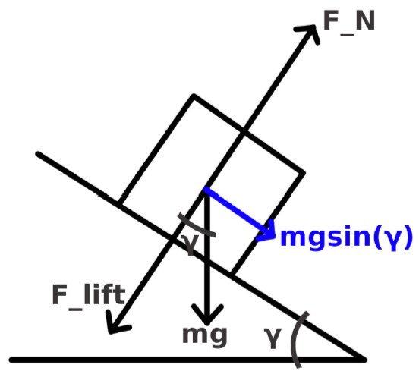
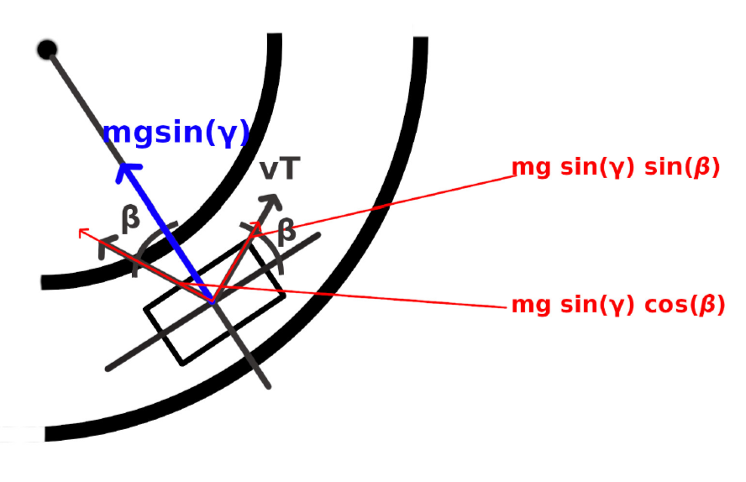
Banking (slide 1)
Banking has been considered in the model equations to take into acount the shape of Indianapolis circuit
To simplify the model, the car is assumed to always travel with in parallel with respect to the tangent of the curve. In this way we only consider the projection of the weight force along the road surface
Lateral view
Top view
12
Alessio Russo, Carmelo Valore
Notes:
Inserire qui gli slip

Slide 13
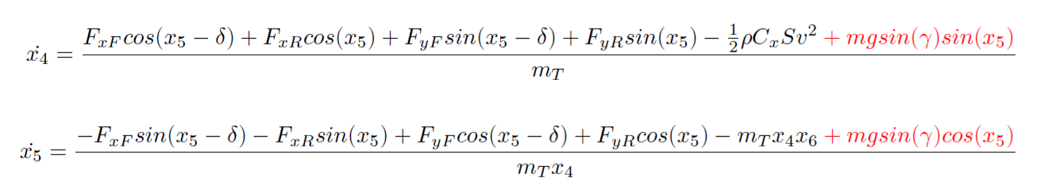
Banking (slide 2)
Given our assumptions, the projection mg*sin(γ) will
be directed to the center of the curve. Thus, we
projected it again to consider it into our state equations
13
Alessio Russo, Carmelo Valore
Notes:
Inserire qui gli slip

Slide 14
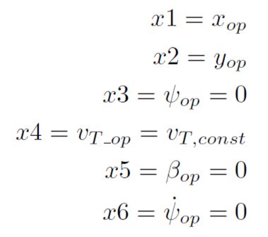
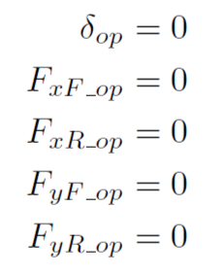
Controller
The model presented so far is not linear
We first need to linearize the model to design a regulator on it
We choose as operating point for linearization a point where we assume that the vehicle is moving on a straight path with a constant longitudinal speed
On the right we can see the value of
states and inputs at the considered
operating point
14
Alessio Russo, Carmelo Valore

Slide 15

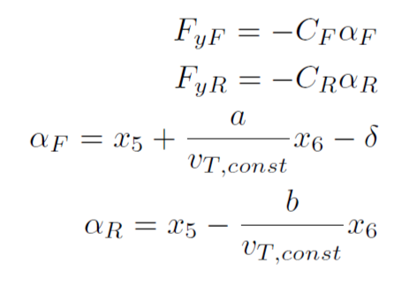
Controller
Expanding the system in a Taylor series we have
Considering linear tyre model and linear version of the slip angles
15
Alessio Russo, Carmelo Valore

Slide 16
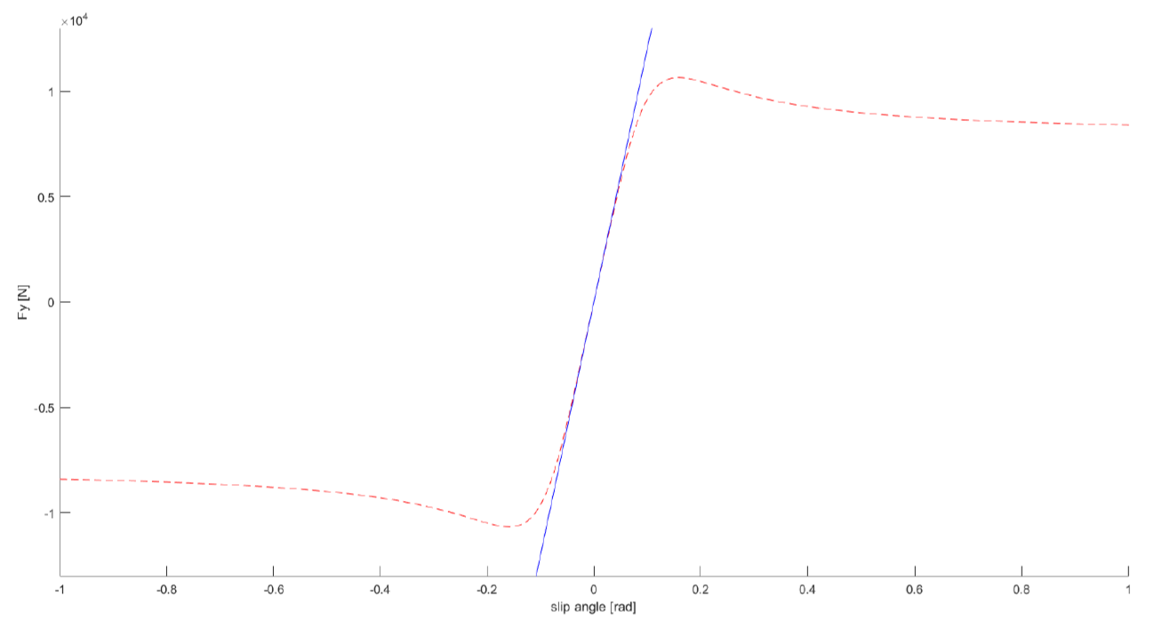
Controller
The value for C_{F} and C_{R} has been chosen to best approximate the Pacejka tyre model in the case of small angles according to the mean vertical load on each wheel
16
Alessio Russo, Carmelo Valore

Slide 17
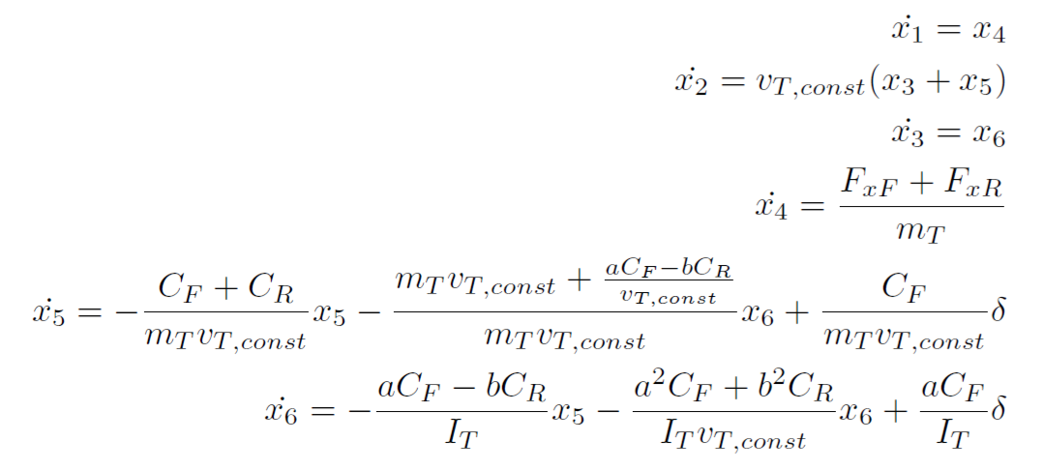
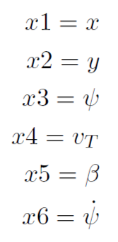
Controller
So we obtain the linearized model
17
Alessio Russo, Carmelo Valore

Slide 18

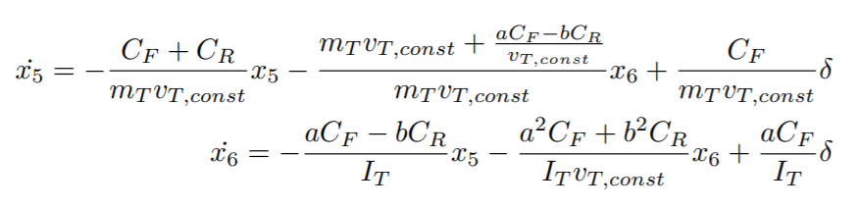
Controller
From the linearized model we first neglect the longitudinal dynamics and consider
18
Alessio Russo, Carmelo Valore

Slide 19
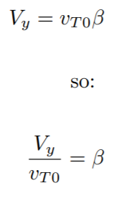

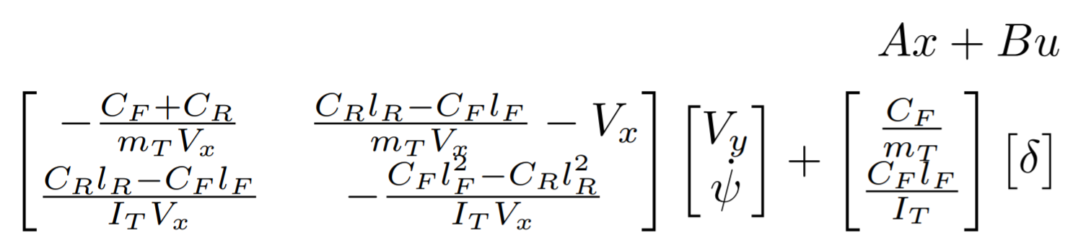
Controller
Then we make a change in the states by exploiting the following assumption that v_{T0} corresponds to V_{x} and β is small
Thus obtaining
19
Alessio Russo, Carmelo Valore

Slide 20
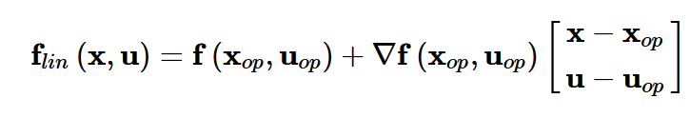
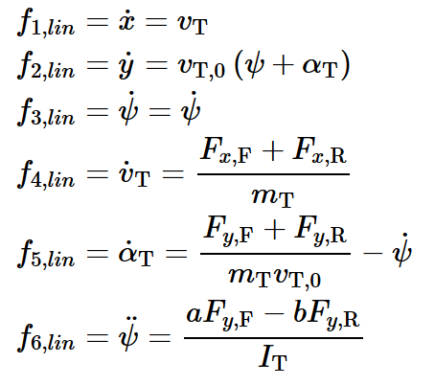
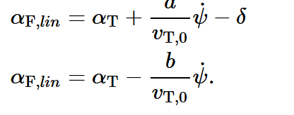
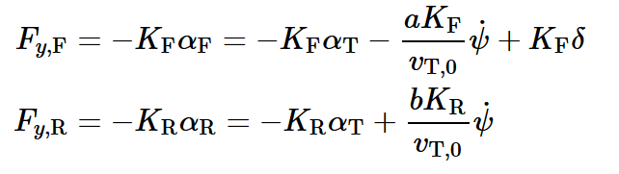
Linearized model
Linearized model:
Linear slips:
Linear tyre model:
20
Alessio Russo, Carmelo Valore

Slide 21
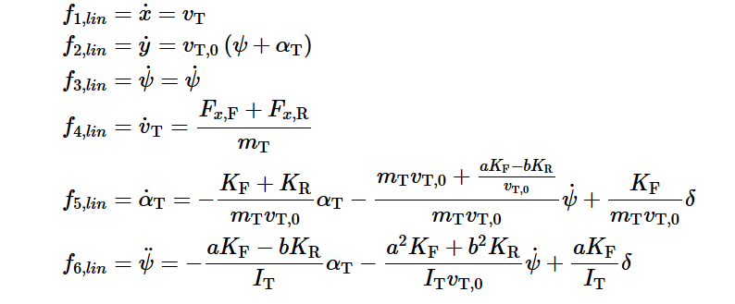
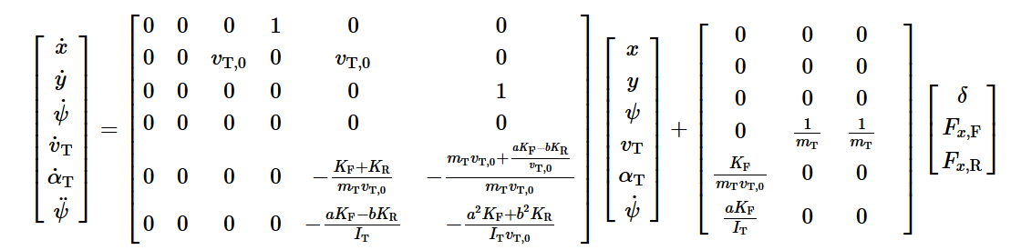
Linearized model
Linearized model:
21
Alessio Russo, Carmelo Valore

Slide 22
Lateral controller
We implemented 3 main versions:
Controller based on the model without lookahead
2 different controllers based on the model with lookahead
22
Alessio Russo, Carmelo Valore

Slide 23
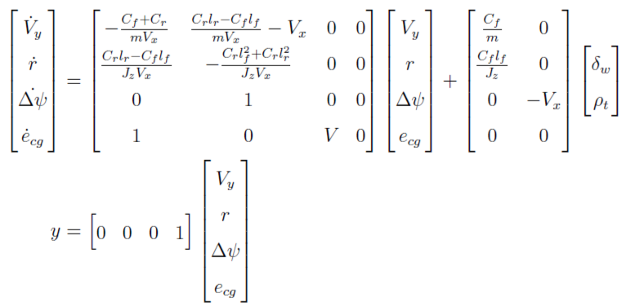
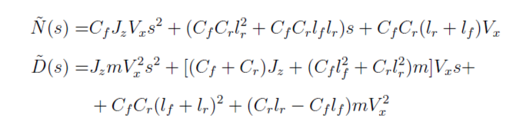

Lateral controller without Lookahead
- The linearized model seen so far can also be
represented in this way.
Here we added two more states:
The heading angle error
The lateral error
Considering different velocity speeds for the value Vx we defined the following transfer function G(s) from the steering angle
to the output
23
Alessio Russo, Carmelo Valore

Slide 24
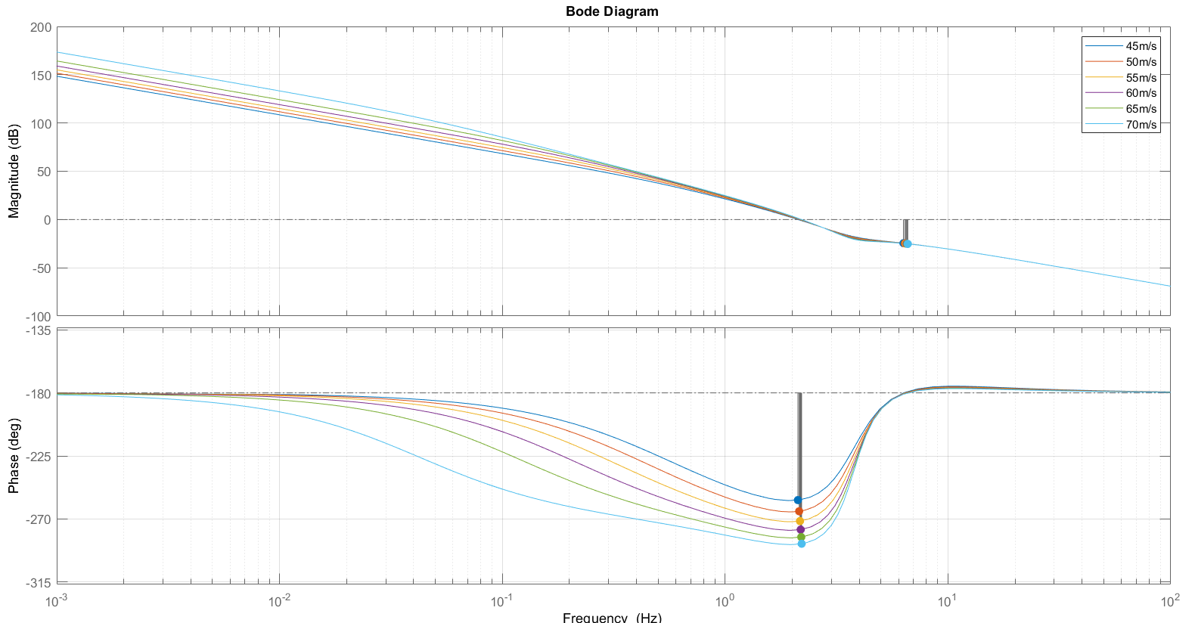
Bode diagram of G(s) at different velocity speeds
24
Alessio Russo, Carmelo Valore
Notes:
Senza lookahead con il regolatore di mori con gain cambiato a 0.01, le funzioni sono stabili ma ci sono oscillazioni forti già in partenza, senza feed-forward

Slide 25
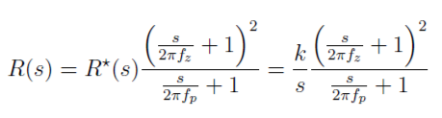
Lateral controller without Lookahead
From that transfer function we obtain the following regulator R(s) with structure:
Pole in 2 Hz
Zero in 0.01 Hz
Gain 0.01
Combining the results we define the function L(s) = R(s)*G(s)
L(s) is stable with each considered velocity
The bandwidth is around 9.5 Hz
The phase margin is around 15 deg
Despite of the stability of the obtained Bode diagram, the simulation results are not satisfactory. The error oscillates too much even along the straight path and this makes the simulation run very slow.
25
Alessio Russo, Carmelo Valore
Notes:
Senza lookahead con il regolatore di mori con gain cambiato a 0.01, le funzioni sono stabili ma ci sono oscillazioni forti già in partenza, senza feed-forward

Slide 26
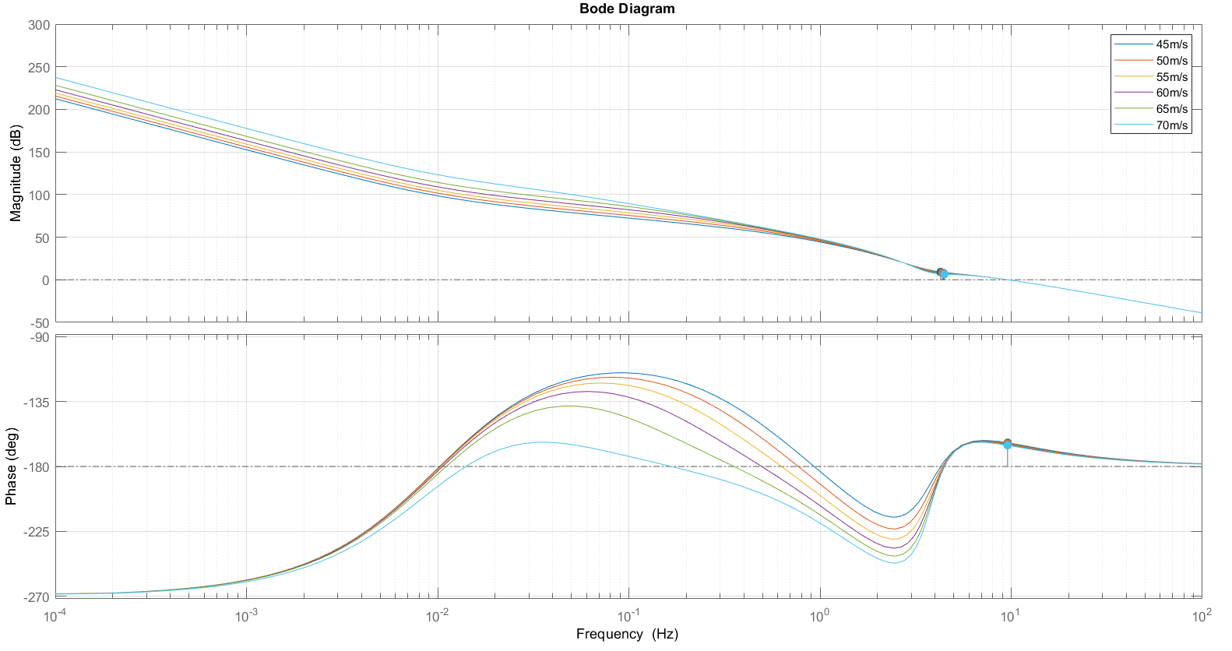
Bode diagram of L(s) at different velocity speeds
26
Alessio Russo, Carmelo Valore
Notes:
Senza lookahead con il regolatore di mori con gain cambiato a 0.01, le funzioni sono stabili ma ci sono oscillazioni forti già in partenza, senza feed-forward

Slide 27
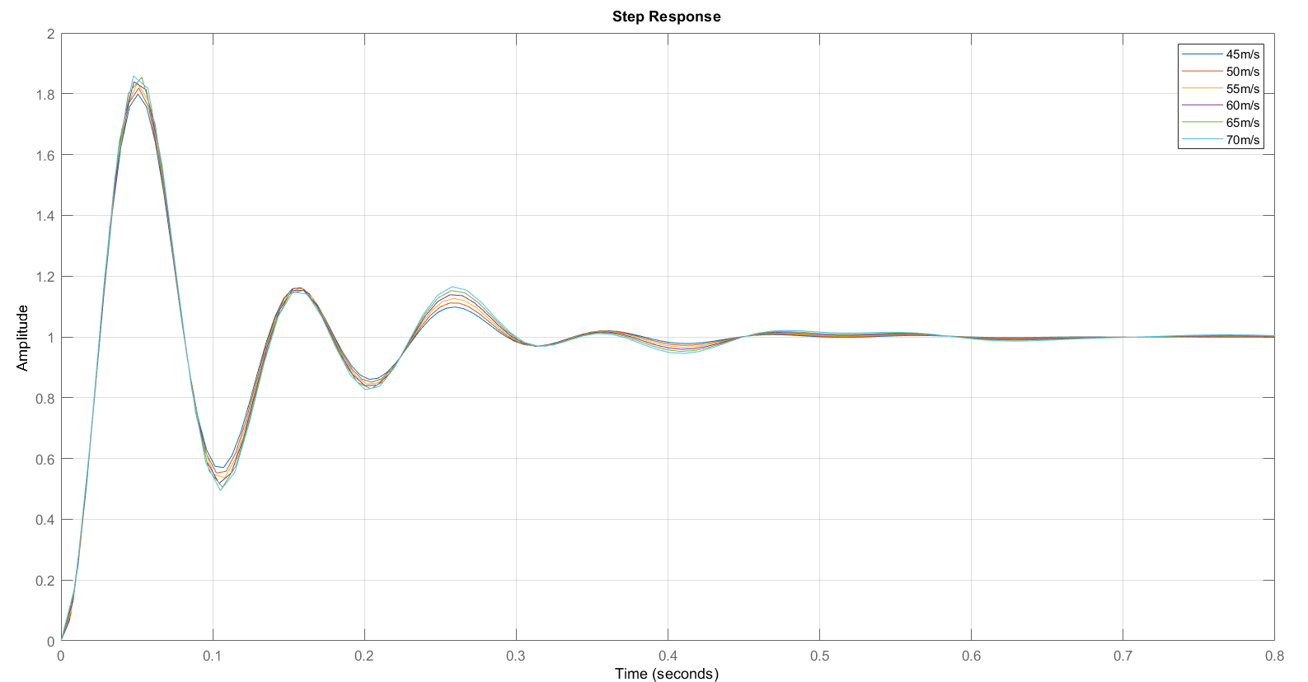
Step response of the system at different velocity speeds
27
Alessio Russo, Carmelo Valore
Notes:
Senza lookahead con il regolatore di mori con gain cambiato a 0.01, le funzioni sono stabili ma ci sono oscillazioni forti già in partenza, senza feed-forward

Slide 28
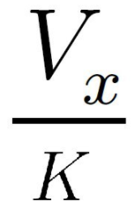
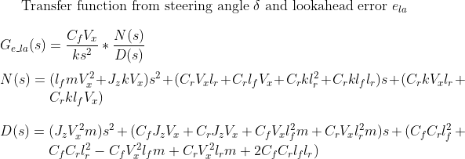
Lateral controller with Lookahead (first version)
This model is the same as the one before but we considered a Lookahead distance with value
La = V_x/k where k = 3.
The lookahead distance defines an additional
error e_La = La*delta(psi).
This error sums up to the original output
e = e_La + e_cg
Considering different velocity speeds for the value Vx we defined the following transfer function G(s) from the steering angle to the output
28
Alessio Russo, Carmelo Valore

Slide 29
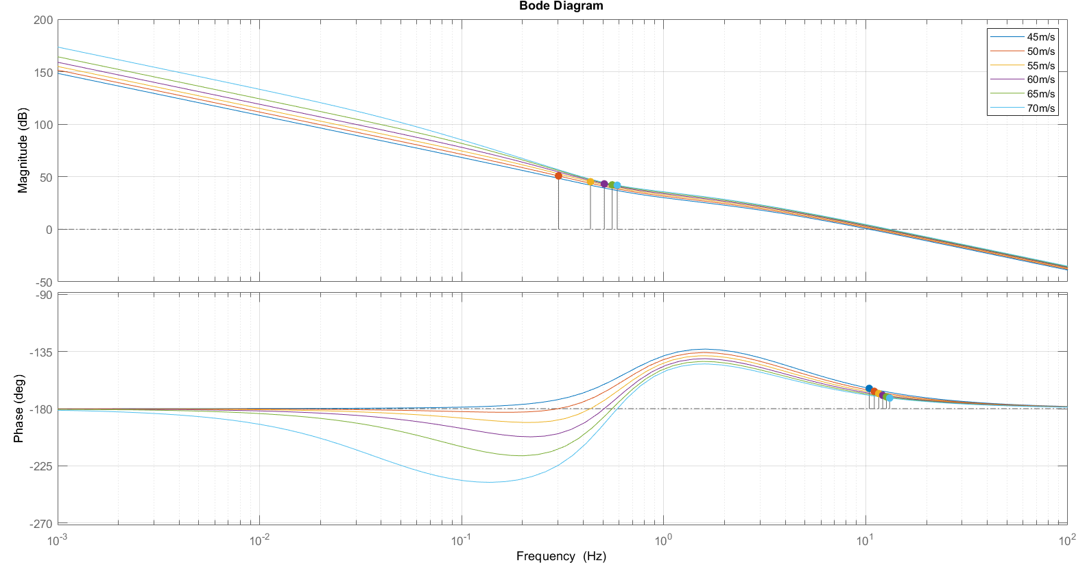
Bode diagram of G(s) at different velocity speeds
29
Alessio Russo, Carmelo Valore

Slide 30
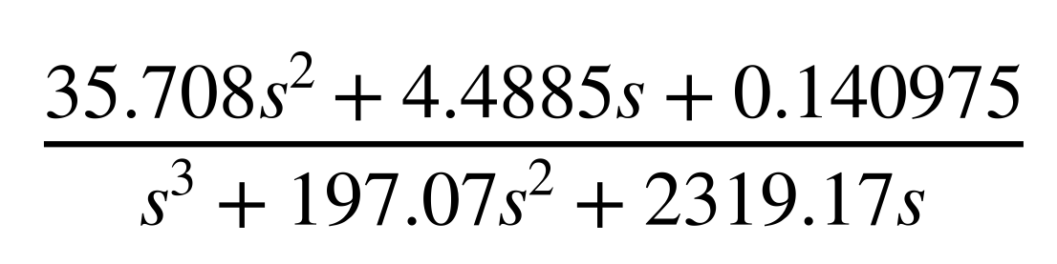

Lateral controller with Lookahead (first version)
From that transfer function we obtain the following regulator R(s) with the structure:
That can also be seen showing that:
Gain 6*10^-5
Integrator
One pole in 2 Hz
One pole in 29.4
Two zero in 0.01 Hz
Combining the results we define the function L(s) = R(s)*G(s)
L(s) is stable with each considered velocity
The bandwidth is around 4 Hz
The phase margin is around 45 deg
30
Alessio Russo, Carmelo Valore

Slide 31
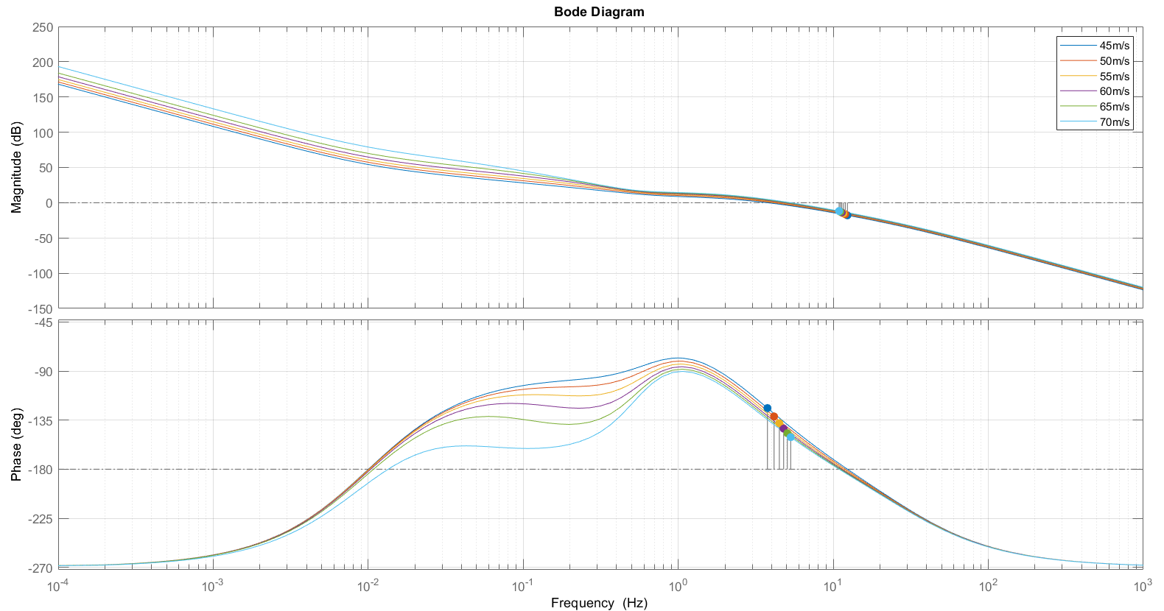
Bode diagram of L(s) at different velocity speeds
31
Alessio Russo, Carmelo Valore
Notes:
Senza lookahead con il regolatore di mori con gain cambiato a 0.01, le funzioni sono stabili ma ci sono oscillazioni forti già in partenza, senza feed-forward

Slide 32
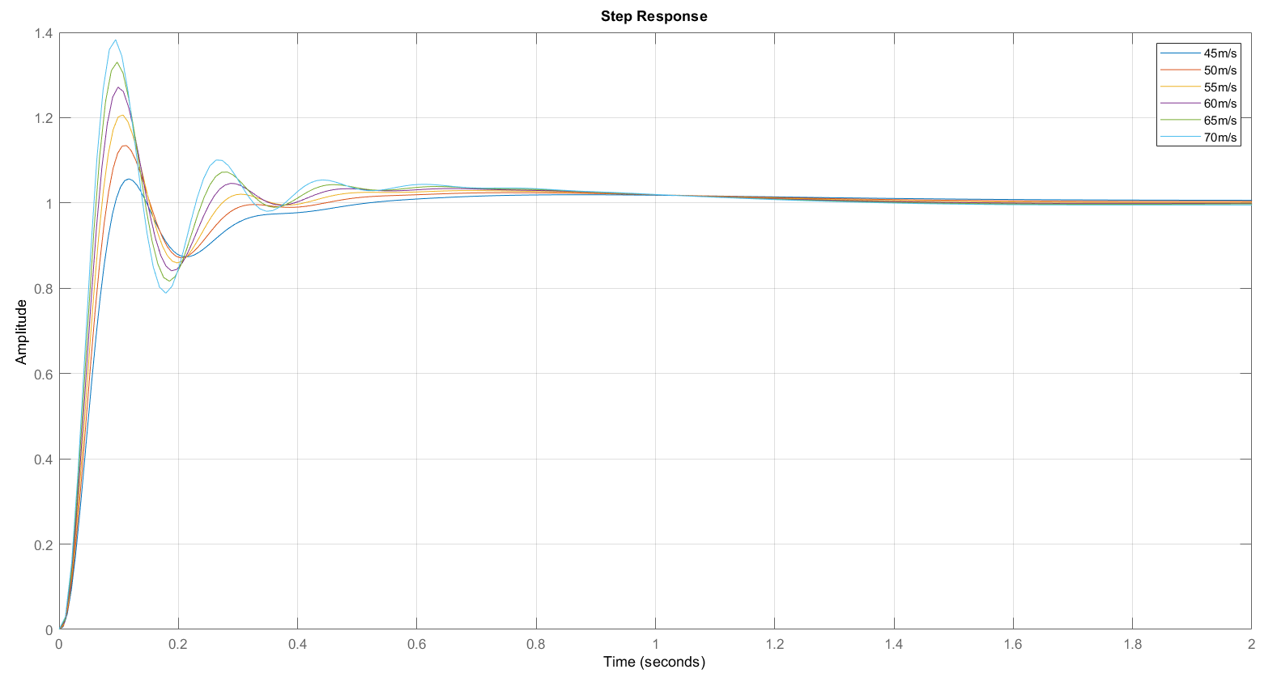
Step response of the system at different velocity speeds
32
Alessio Russo, Carmelo Valore
Notes:
Senza lookahead con il regolatore di mori con gain cambiato a 0.01, le funzioni sono stabili ma ci sono oscillazioni forti già in partenza, senza feed-forward

Slide 33
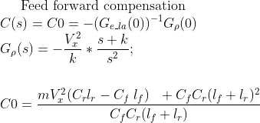
Lateral controller with Lookahead (first version)
Lookahead varies instantly according to the velocity Vx scaled by a factor 1/k with k = 3
We implemented the feed-forward mechanism: the value of the curvature referred to the current position of the vehicle is multiplied by the value C_0
33
Alessio Russo, Carmelo Valore

Slide 34
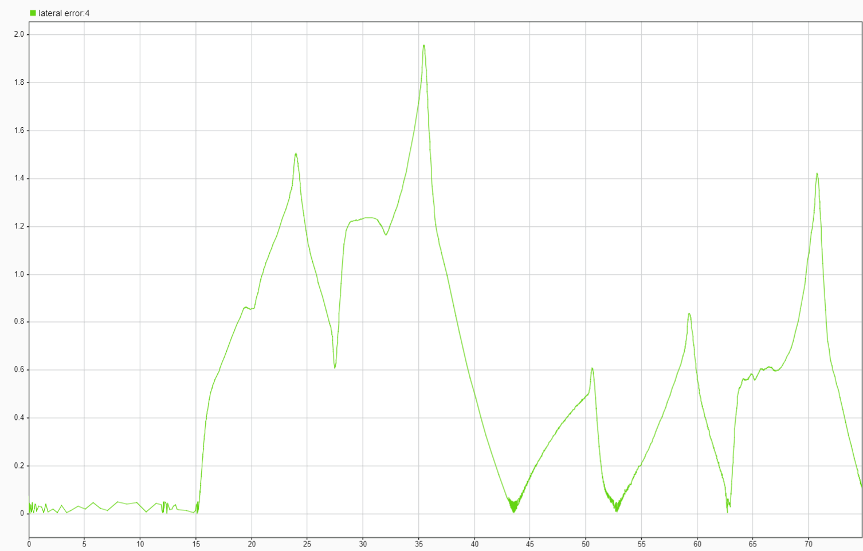
Lateral error of simulation (first version with lookahead)
34
Alessio Russo, Carmelo Valore

Slide 35
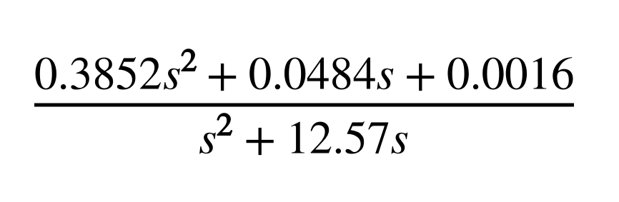

Lateral controller with Lookahead (second version)
Starting from the function G(s) obtained with the addition of the error of lookahead we also defined the following regulator R(s):
That can also be seen showing that:
Gain 1.3*10^-4
Integrator
One pole in 2 Hz
Two zero in 0.01 Hz
Combining the results we define the function L(s) = R(s)*G(s)
L(s) is stable with each considered velocity
The bandwidth is around 7 Hz
The phase margin is around 35 deg
35
Alessio Russo, Carmelo Valore

Slide 36
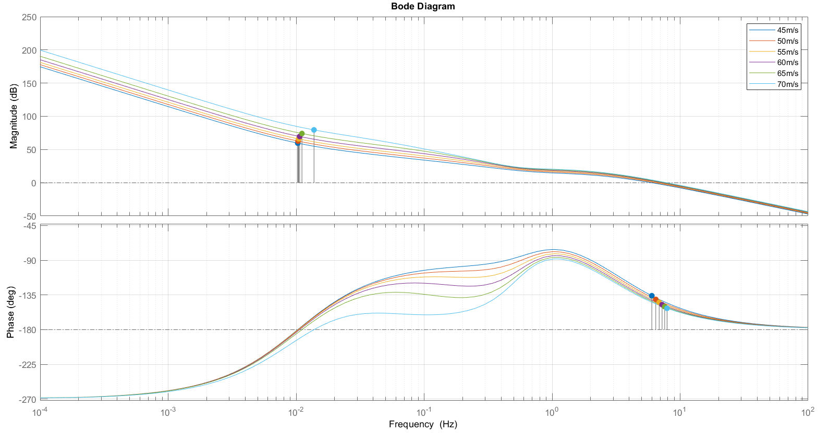
Bode diagram of L(s) at different velocity speeds
36
Alessio Russo, Carmelo Valore
Notes:
Senza lookahead con il regolatore di mori con gain cambiato a 0.01, le funzioni sono stabili ma ci sono oscillazioni forti già in partenza, senza feed-forward

Slide 37
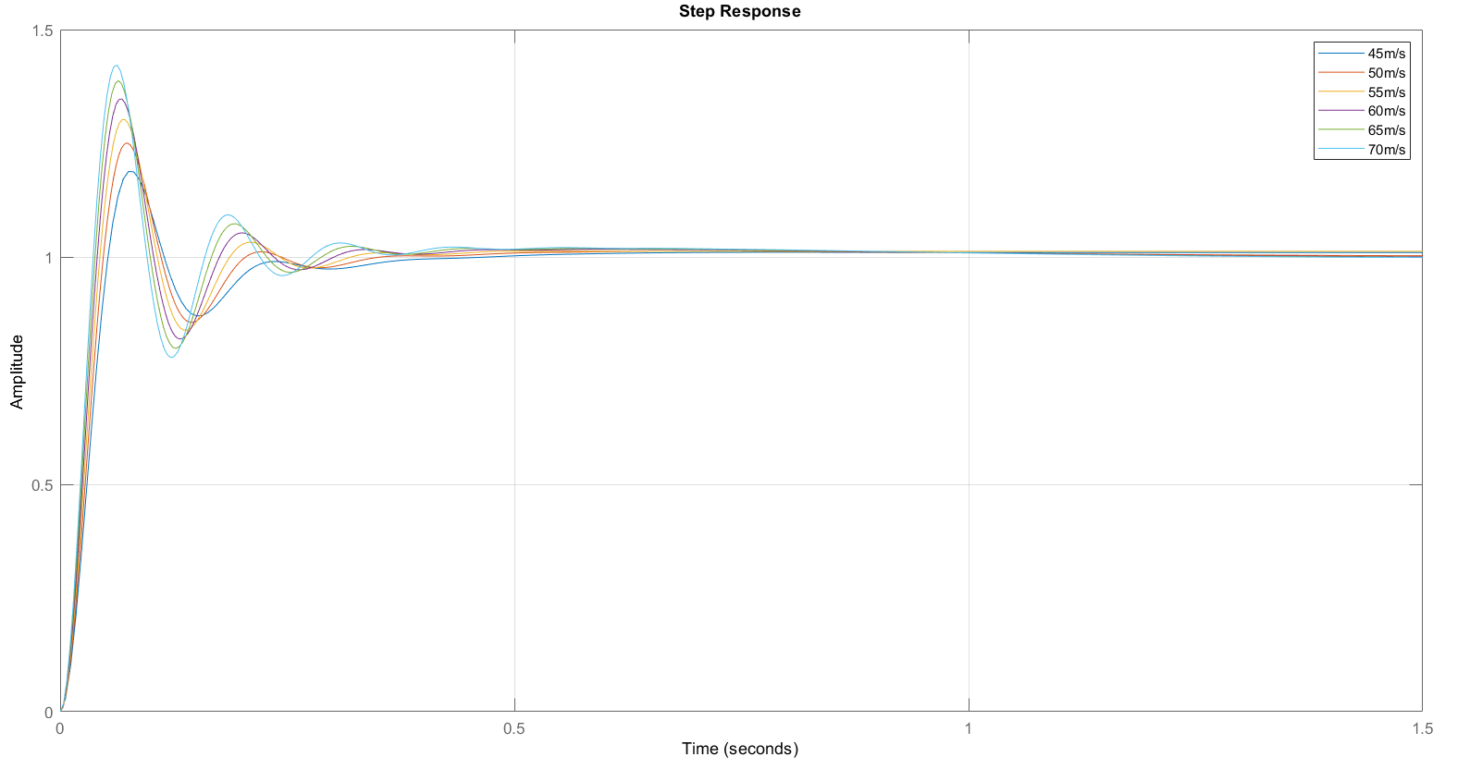
Step response of the system at different velocity speeds
37
Alessio Russo, Carmelo Valore
Notes:
Senza lookahead con il regolatore di mori con gain cambiato a 0.01, le funzioni sono stabili ma ci sono oscillazioni forti già in partenza, senza feed-forward

Slide 38
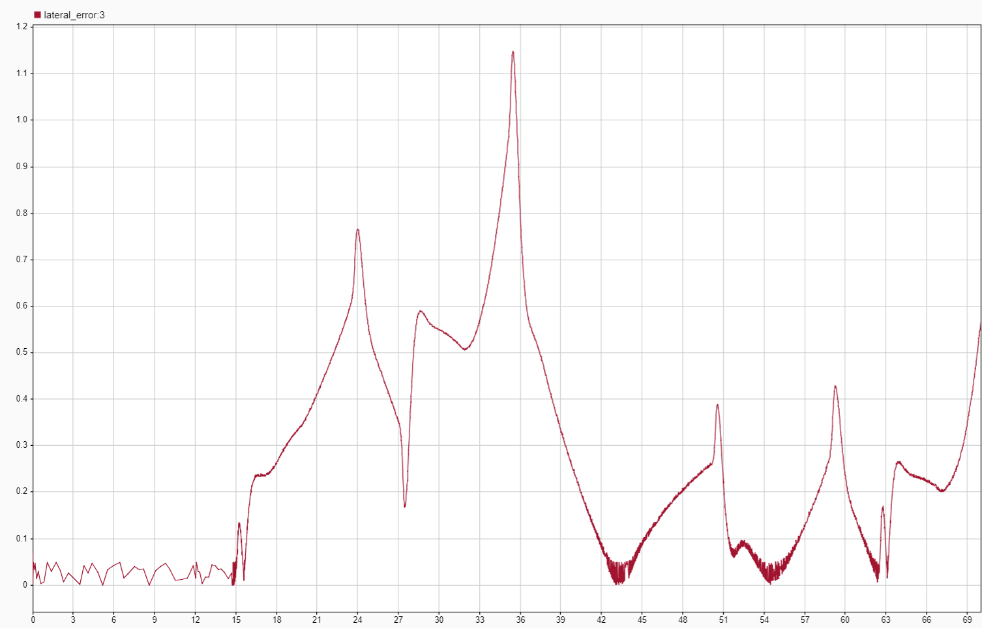
Lateral error with lookahead (second version)
38
Alessio Russo, Carmelo Valore
Notes:
Senza lookahead con il regolatore di mori con gain cambiato a 0.01, le funzioni sono stabili ma ci sono oscillazioni forti già in partenza, senza feed-forward

Slide 39
Meeting 7: Lateral Control
39

