Slide 1
Meeting 6: Control
02/09/2020, Milano
Alessio Russo
Carmelo Valore

Slide 2
Overview
Longitudinal control
Lateral control
2
Alessio Russo, Carmelo Valore

Slide 3
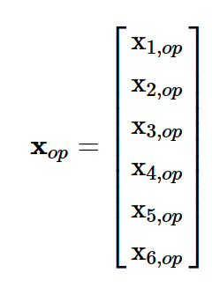
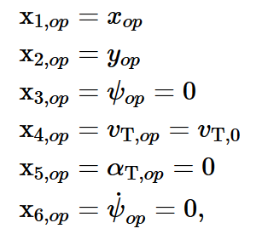
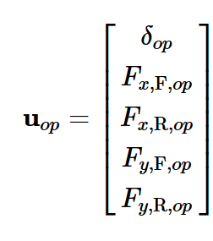
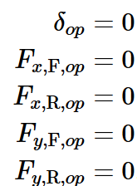
Longitudinal control
Linearize model:
@ operating point
3
Alessio Russo, Carmelo Valore

Slide 4
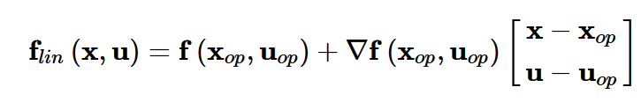
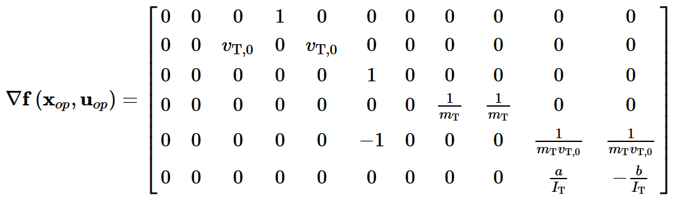
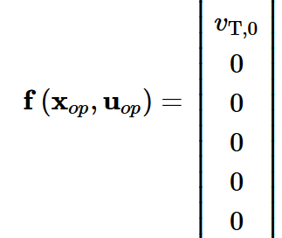
Longitudinal control
Linearize model:
4
Alessio Russo, Carmelo Valore

Slide 5
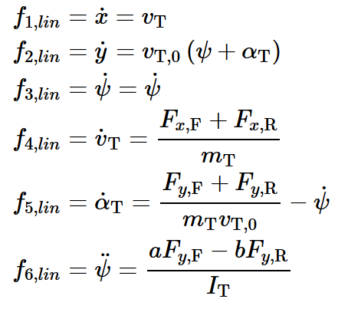
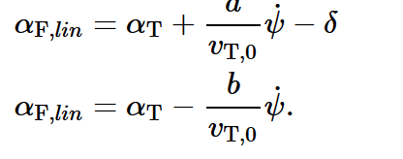
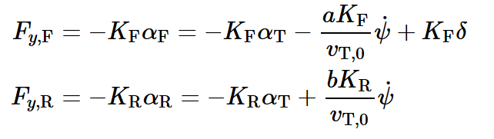
Longitudinal control
Linearized model:
Linear slips:
Linear tyre model:
5
Alessio Russo, Carmelo Valore

Slide 6
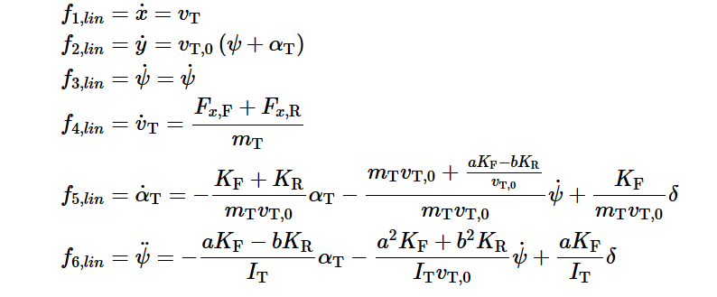
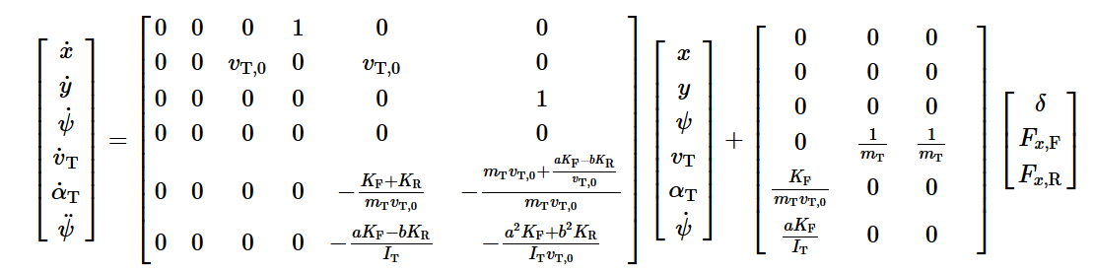
Longitudinal control
Linearized model:
6
Alessio Russo, Carmelo Valore

Slide 7
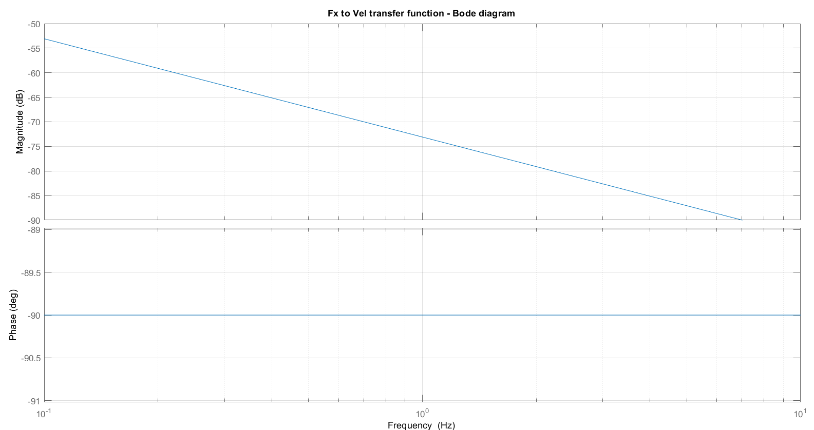
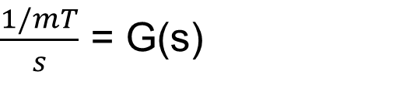
Longitudinal control
Transfer function Fx -> vT:
$\frac{1/mT}{s}$ = G(s)
7
Alessio Russo, Carmelo Valore

Slide 8
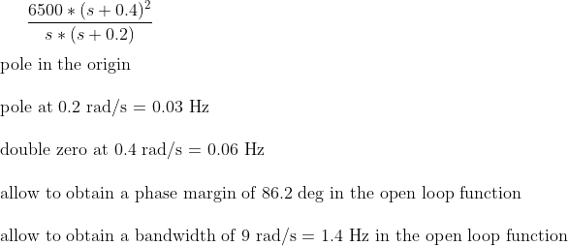

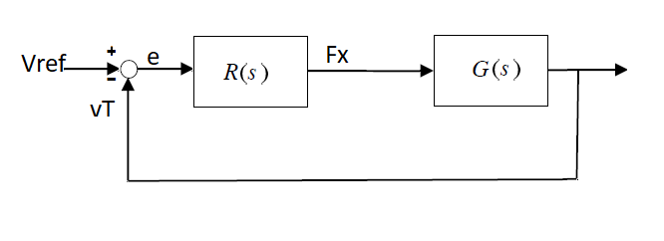
Longitudinal control
Regulator projected in order to:
- have a L(s) = R(s) * G(s) with a bandwidth of at least 1.4 Hz
- have an integrator to reject step disturbances
- stable closed loop system
8
Alessio Russo, Carmelo Valore

Slide 9
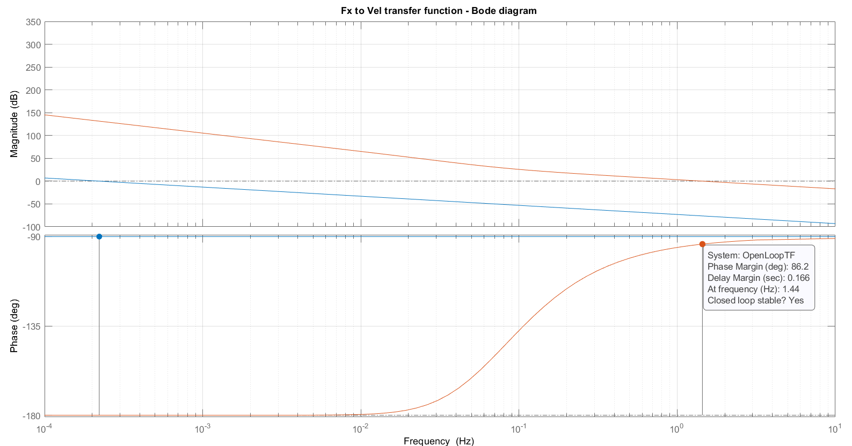
Longitudinal control
Results – Open loop L(s) function bode plot:
9
Alessio Russo, Carmelo Valore

Slide 10
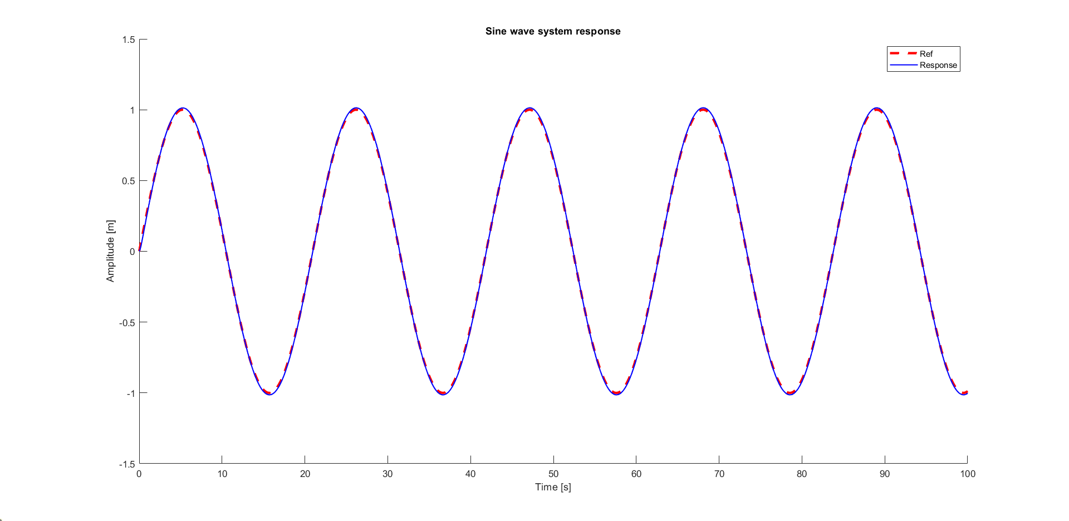
Longitudinal control
Results – Tracking of a sinusoidal wave:
10
Alessio Russo, Carmelo Valore

Slide 11
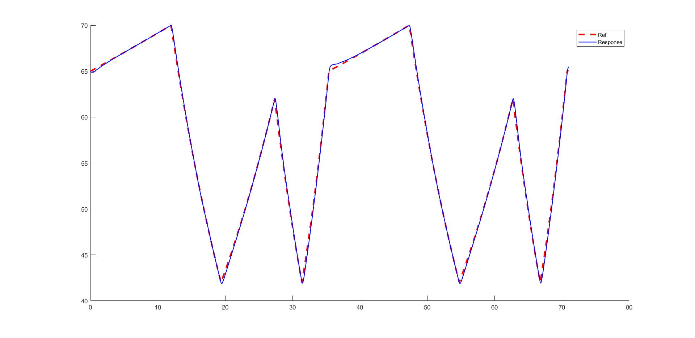
Longitudinal control
Results – Tracking of the reference speed:
11
Alessio Russo, Carmelo Valore

Slide 12

Questions
12
Alessio Russo, Carmelo Valore

Slide 13
Questions
Lateral controller
We tried our best but probably do not get the point:
We do not undersand, in Mori’s thesis (and some literature papers too), how error’s dynamic is actually related to the the distance to the path
How to choose our requirements of the regulator? (e.g. bandwidth of the open-loop function)
Should we include the dynamic of the error in the complete model, or it’s just used to project the regulator, and then our «search for minimum distance reference point» algorithm have to be used?
High speed problem(?)
We also tested other controllers, such as «pure pursuit» controller and «dynamic stanley controller» but for our high speeds (> 45m/s) they do not works well
13
Alessio Russo, Carmelo Valore

Slide 14
Meeting 6: Control
14

