Slide 1
Meeting 3: Review of our steps towards race car simulation
21/05/2020, Milano
Alessio Russo
Carmelo Valore

Slide 2
Introduction
Our steps
Generate the track (trajectories to be followed)
Add vehicle based on dynamic bicycle model (ego vehicle)
Add other “static” opponents following a predefined trajectory
Make ego vehicle to follow the track (path following*)
Create a fuel tank model to account for time-varying mass of the ego
Take into account air flow effects when moving behind an opponent
2
Alessio Russo, Carmelo Valore

Slide 3
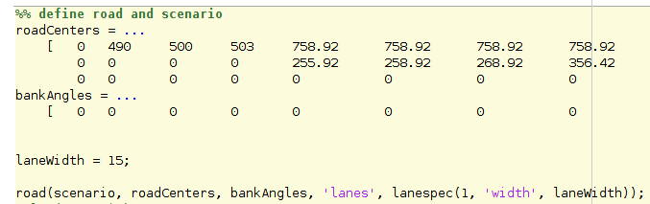
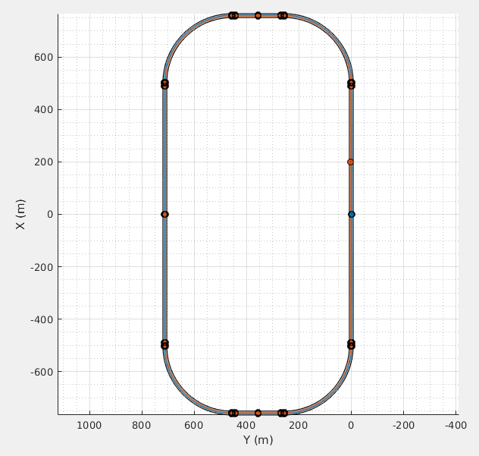
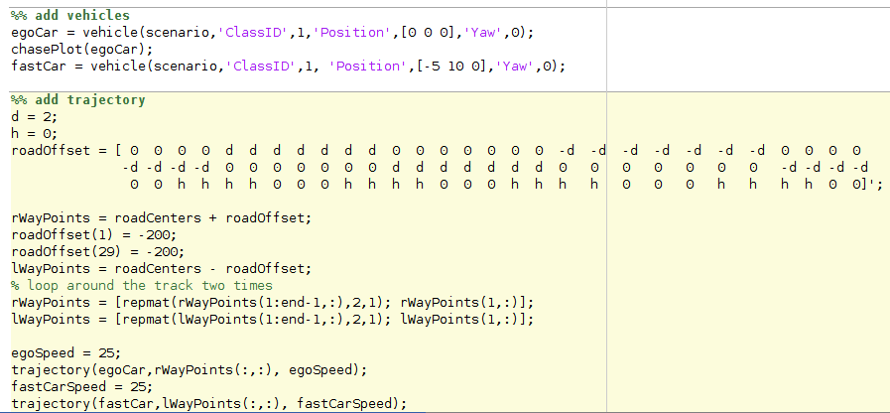
1. Generate the track (trajectories to be followed)
3
Alessio Russo, Carmelo Valore

Slide 4
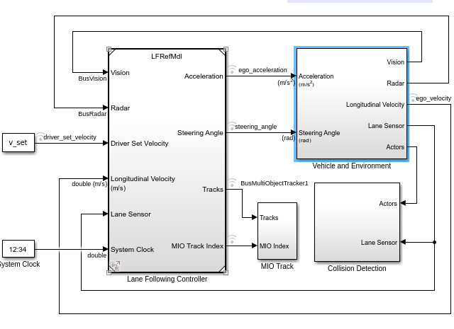
2. Add vehicle based on dynamic bicycle model
4
Alessio Russo, Carmelo Valore

Slide 5
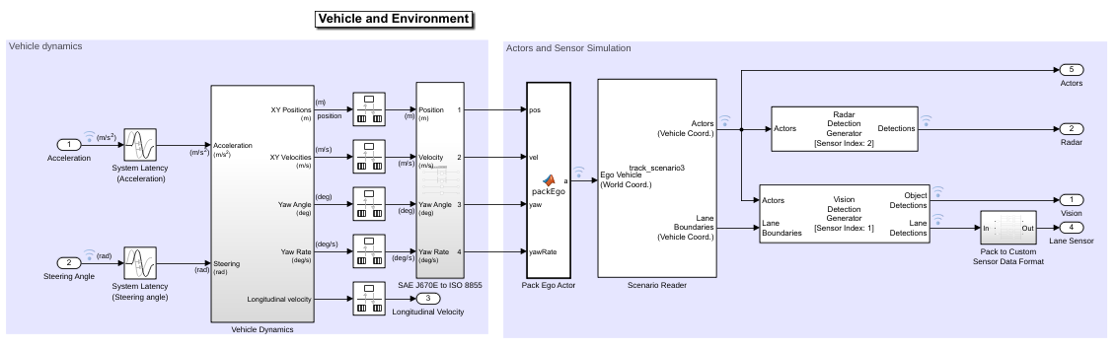
2. Add vehicle based on dynamic bicycle model
5
Alessio Russo, Carmelo Valore

Slide 6
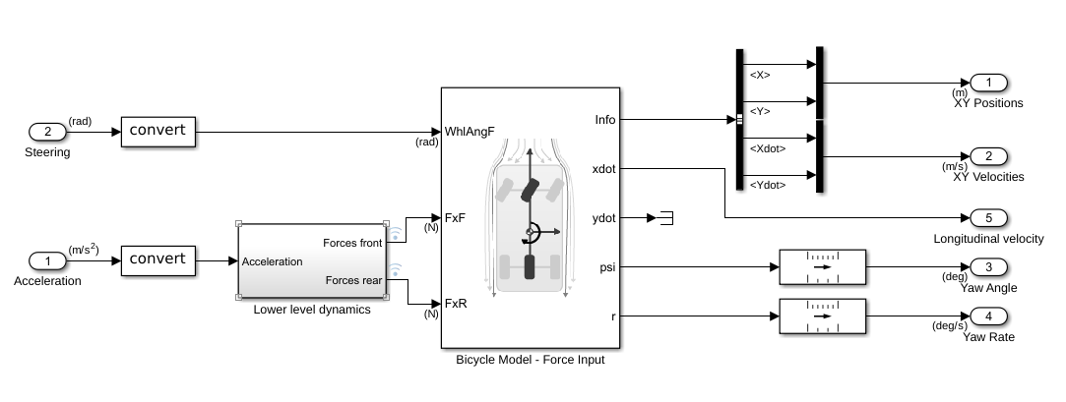
2. Add vehicle based on dynamic bicycle model
6
Alessio Russo, Carmelo Valore

Slide 7
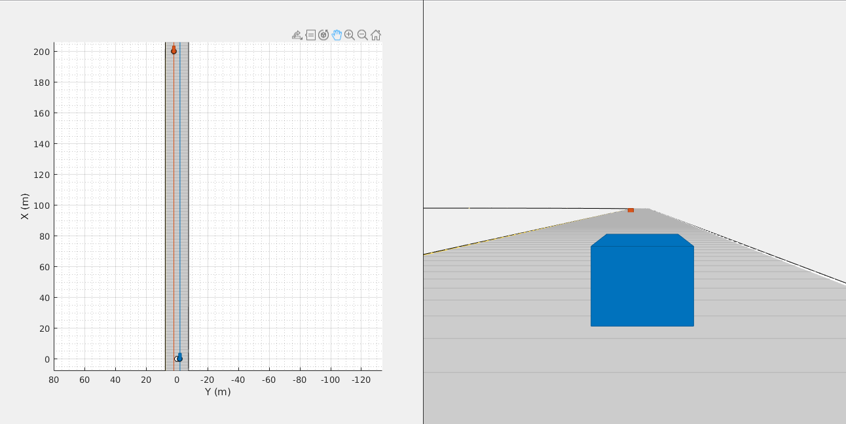
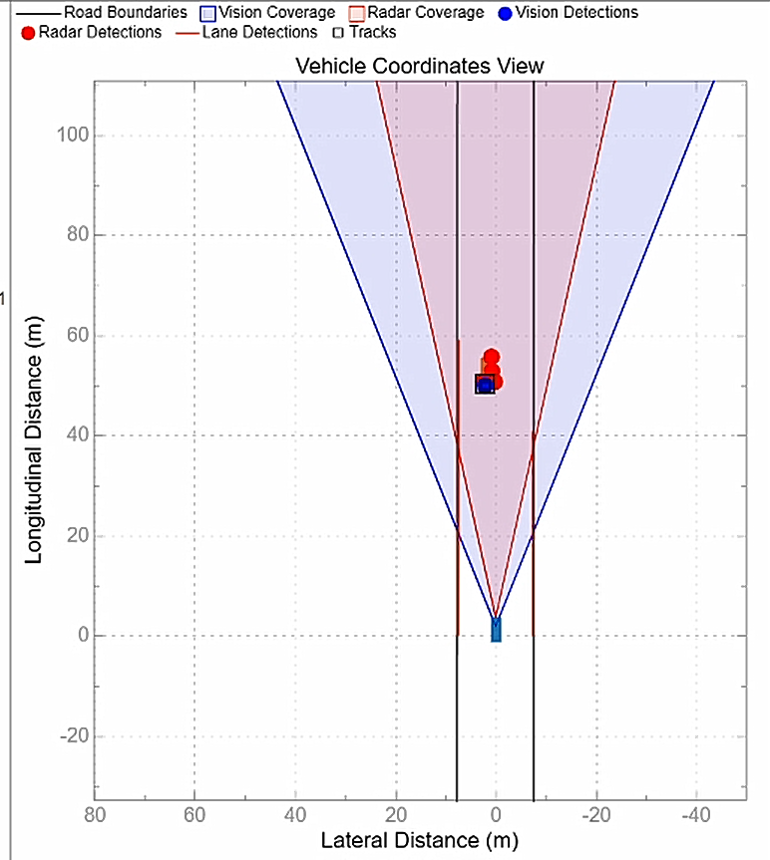
3. Add other “static” opponents following a predefined trajectory
7
Alessio Russo, Carmelo Valore

Slide 8
4. Make ego vehicle to follow the track (path following)
8
Alessio Russo, Carmelo Valore

Slide 9
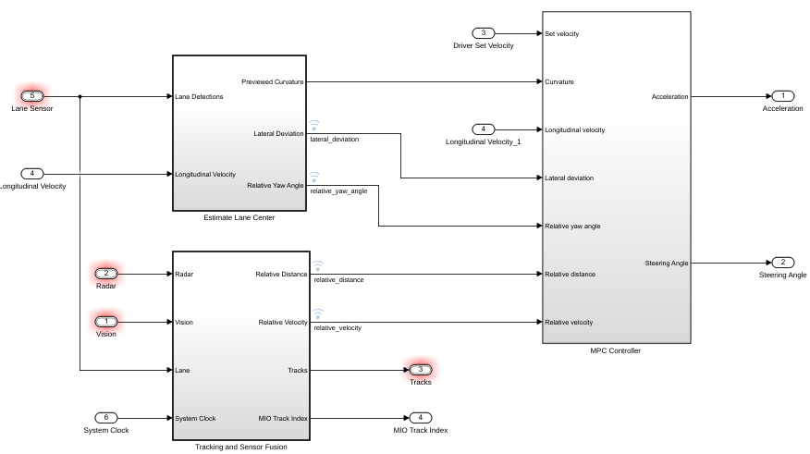
4. Make ego vehicle to follow the track (path following)
9
Alessio Russo, Carmelo Valore

Slide 10
4. Make ego vehicle to follow the track (path following)
10
Alessio Russo, Carmelo Valore

Slide 11
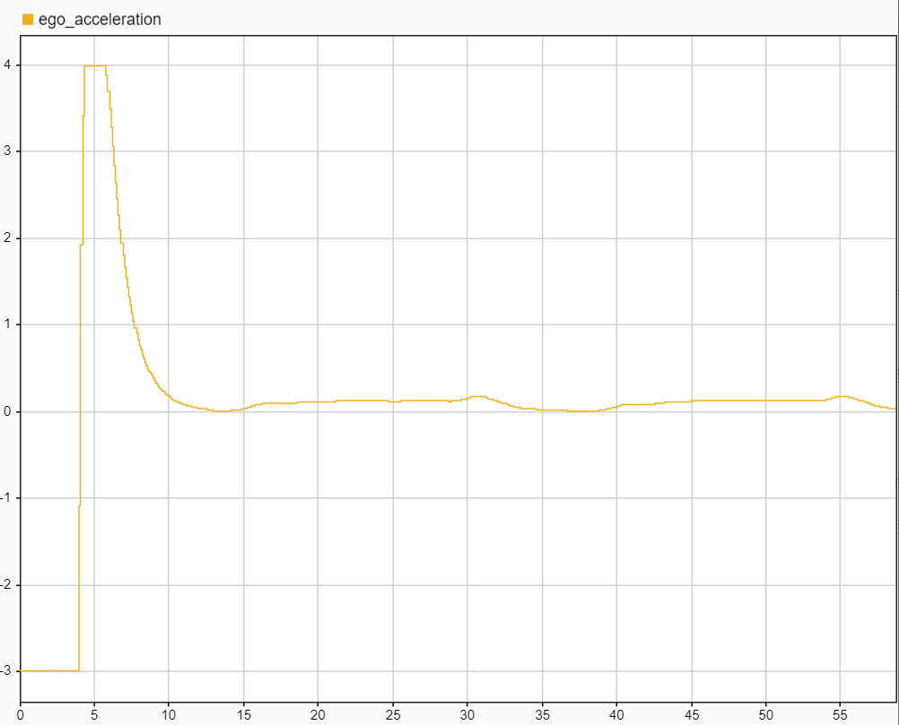
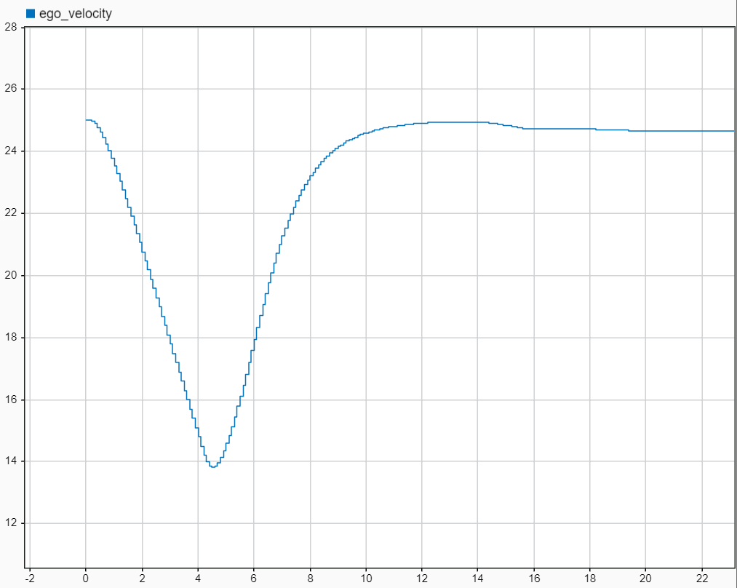
4. Make ego vehicle to follow the track (path following)
11
Alessio Russo, Carmelo Valore

Slide 12
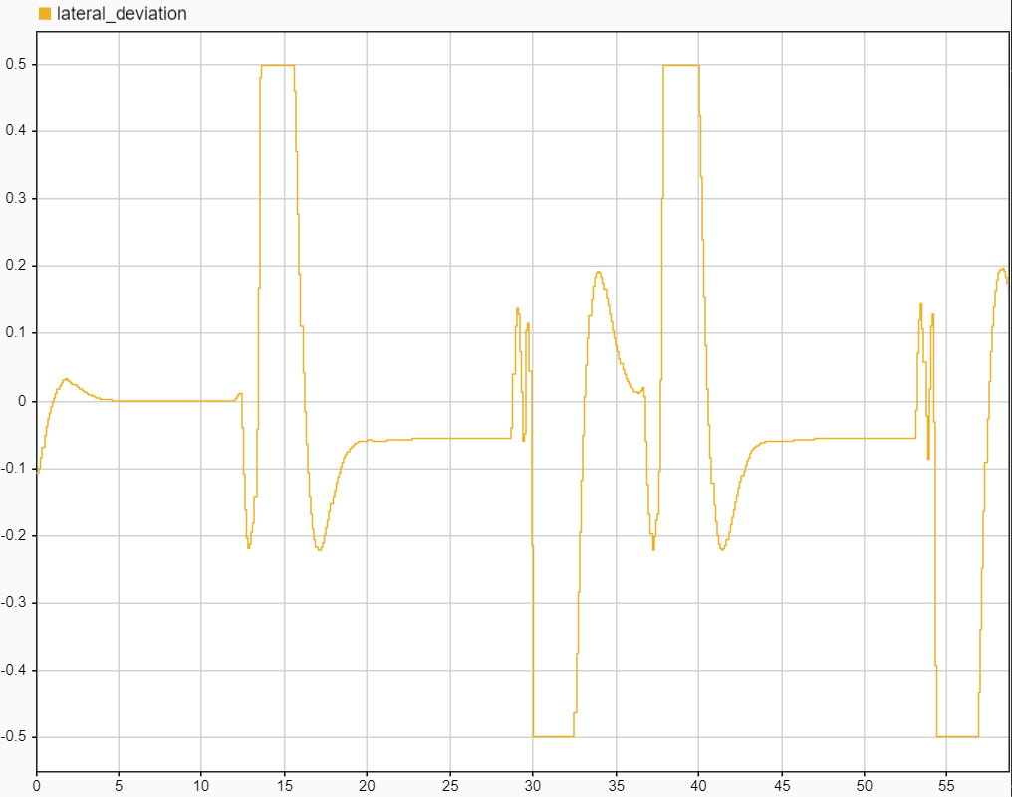
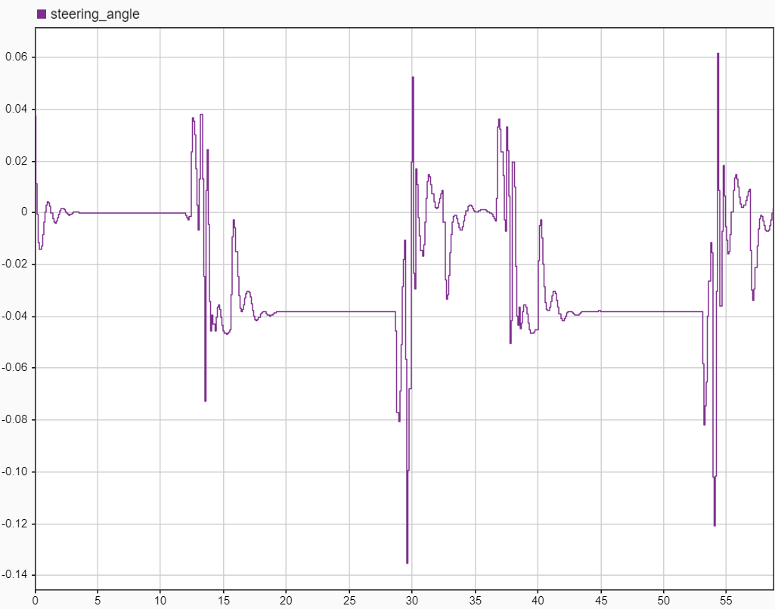
4. Make ego vehicle to follow the track (path following)
12
Alessio Russo, Carmelo Valore

Slide 13

Questions
13
Alessio Russo, Carmelo Valore

Slide 14
Questions
Considerations about what we have done so far
Lane following + sensors?
Predefined blocks?
MPC and vehicles parameters for high speed?
..
Technical issues
Fuel tank model - time varying mass ?
..
14
Alessio Russo, Carmelo Valore

Slide 15
Meeting 3: Review of our steps towards race car simulation
15

