Slide 1
Final presentation:
02/09/2020, Milano
Alessio Russo
Carmelo Valore

Slide 2
Dynamic bicycle model
Introduction /objectives
2
Alessio Russo, Carmelo Valore
Notes:
Inserire qui gli slip

Slide 3
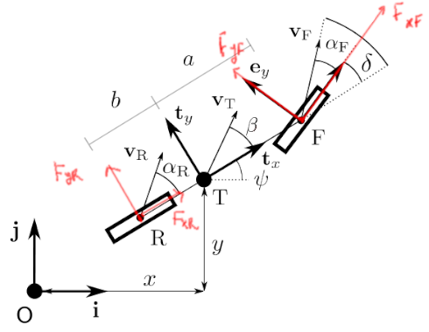
Dynamic bicycle model
Dynamic bicycle model
Pacejka tyre model
Aerodynamic forces
Fuel consumption model
Tyre wear model
Banking
3
Alessio Russo, Carmelo Valore
Notes:
Inserire qui gli slip

Slide 4
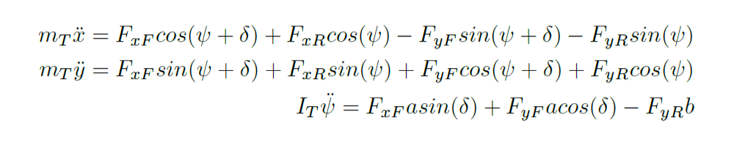
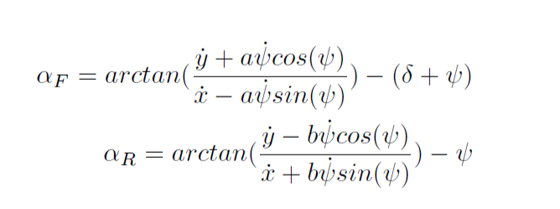
Dynamic bicycle model
4
Alessio Russo, Carmelo Valore
Notes:
Inserire qui gli slip

Slide 5
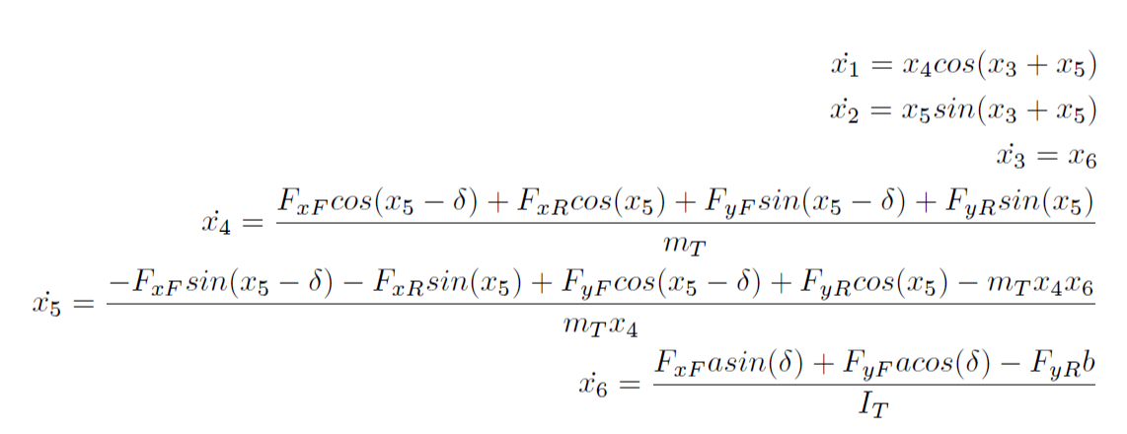
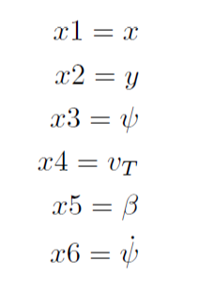
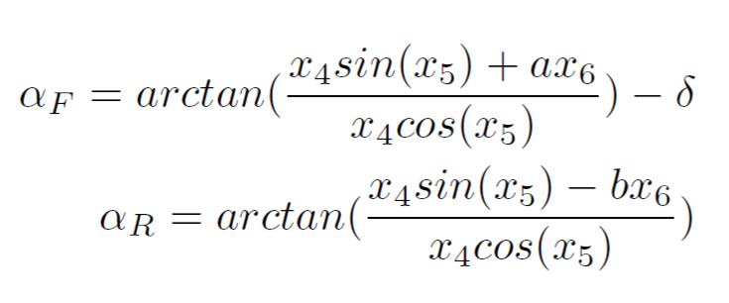
Dynamic bicycle model
We set the followings as the states of the model:
5
Alessio Russo, Carmelo Valore
Notes:
Inserire qui gli slip

Slide 6
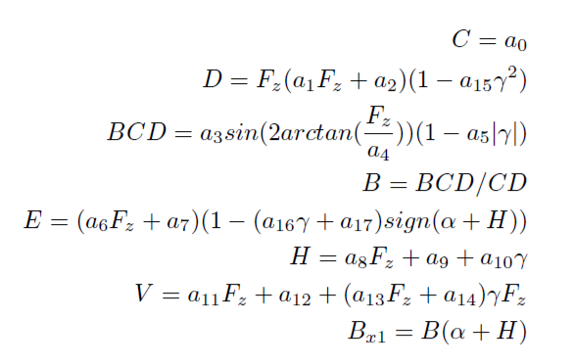
Pacejka tyre model
Pacejka formula derived
from experimental data
Takes as input:
the slip angle α
vertical load on the tyre F_{z}
The amplitude D
6
Alessio Russo, Carmelo Valore
Notes:
Inserire qui gli slip

Slide 7

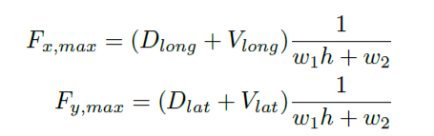
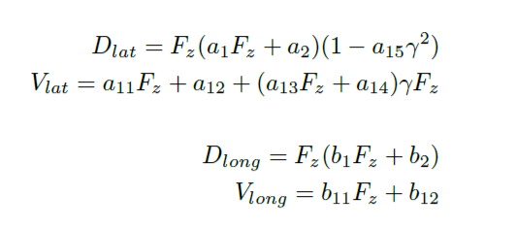
Friction ellipse (slide 1)
The physics of the tyre model is represented
through the friction ellipse
The ellipse dimension depends on:
The wear of the tyre h
The vertical load F_{z}
7
Alessio Russo, Carmelo Valore
Notes:
Inserire qui gli slip

Slide 8
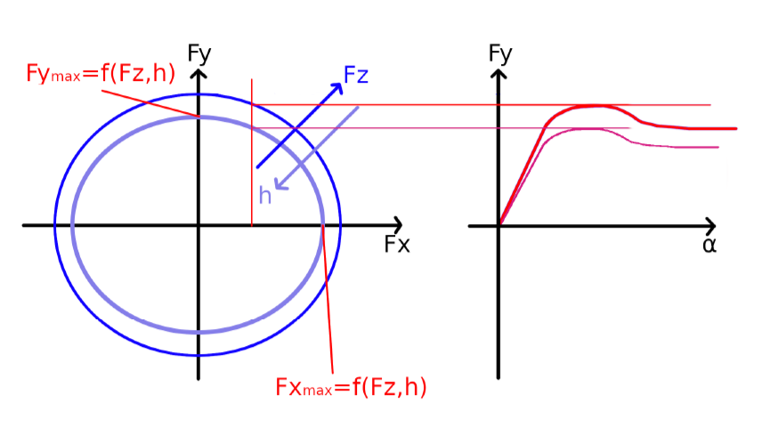
Friction ellipse (slide 2)
The control variable F_{x} determines F_{y} on the ellipse
The output of the Pacejka will be scaled according to F_{y}
We set the peak of the Pacejka (Dlat + Vlat) = F_{y}
8
Alessio Russo, Carmelo Valore
Notes:
Inserire qui gli slip

Slide 9

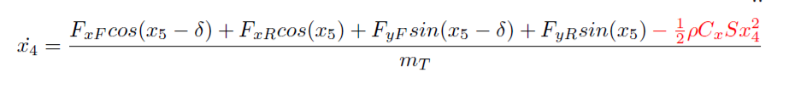
Aerodynamic forces
The contribution of the drag force is considered inside body acceleration equation:
The contribution of the lift force increases the vertical load:
9
Alessio Russo, Carmelo Valore
Notes:
Inserire qui gli slip

Slide 10
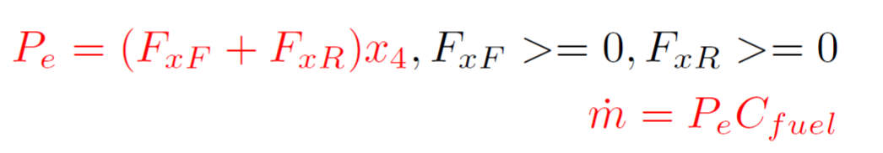
Fuel consumption model and
Fuel consumption has been modelled by taking into account the power output
P ≠ 0 only while accelerating
P is multiplied by a C_{fuel} coefficient to express fuel consumption
10
Alessio Russo, Carmelo Valore
Notes:
Inserire qui gli slip

Slide 11
Tyre wear
Based on the Archard model for tyre wear
The model has been converted in order to take into account, instead of the sliding velocity, the forces acting on the wheels
So it depends on:
The vertical load pressure F_{z} / Tyre_contact_area
Forces F_{x} and F_{y} acting on the wheel
K_{wear} coefficient opportunely chosen
MISSING IMAGE OF FORMULA
11
Alessio Russo, Carmelo Valore
Notes:
Inserire qui gli slip

Slide 12
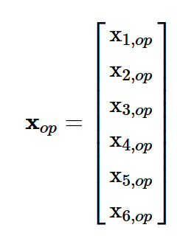
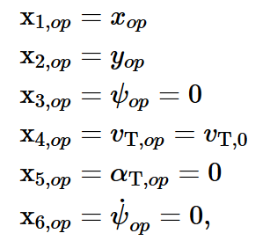
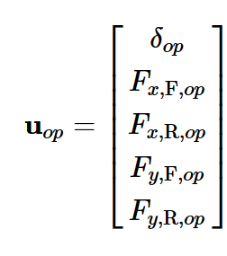
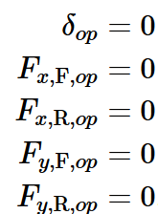
Linearized model
Linearize model:
@ operating point
12
Alessio Russo, Carmelo Valore

Slide 13
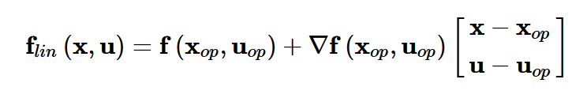
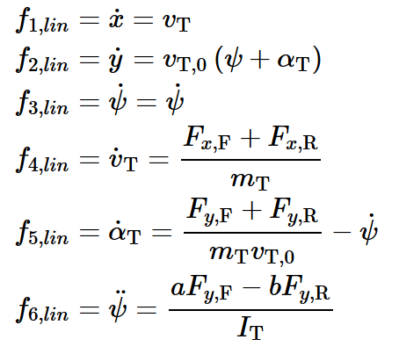
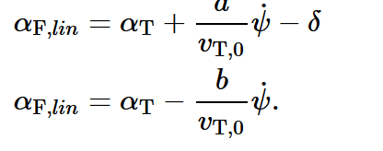
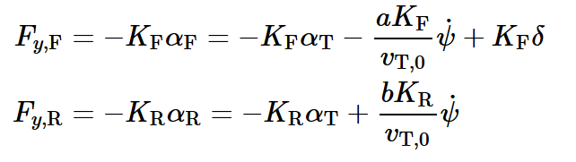
Linearized model
Linearized model:
Linear slips:
Linear tyre model:
13
Alessio Russo, Carmelo Valore

Slide 14
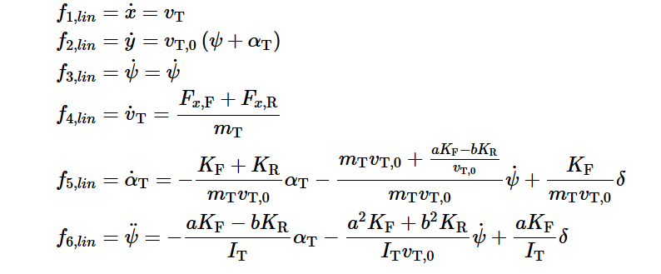
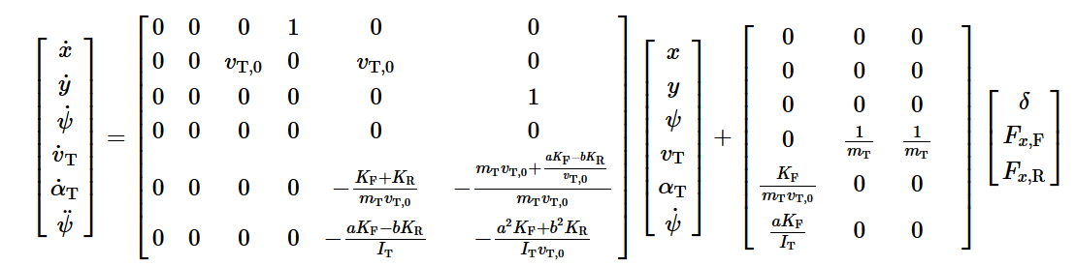
Linearized model
Linearized model:
14
Alessio Russo, Carmelo Valore

Slide 15
Lateral controller
We implemented 3 main versions:
Controller based on the model without lookahead
2 different controllers based on the model with lookahead
15
Alessio Russo, Carmelo Valore

Slide 16
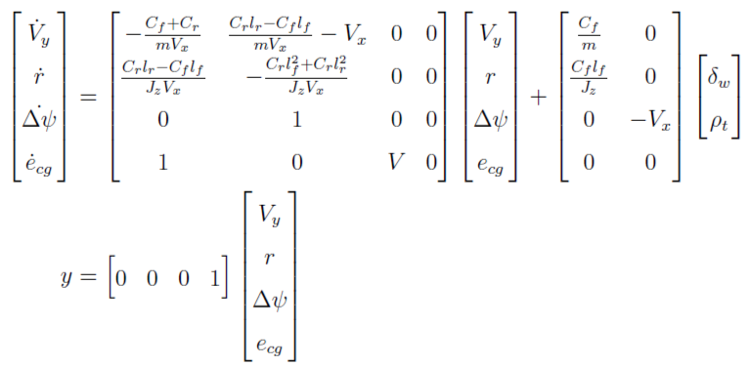
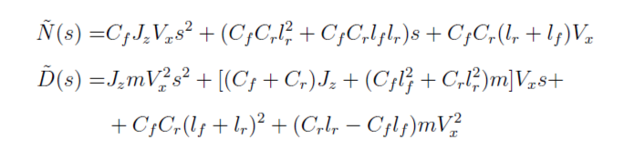

Lateral controller without Lookahead
- The linearized model seen so far can also be
represented in this way.
Here we added two more states:
The heading angle error
The lateral error
Considering different velocity speeds for the value Vx we defined the following transfer function G(s) from the steering angle
to the output
16
Alessio Russo, Carmelo Valore

Slide 17
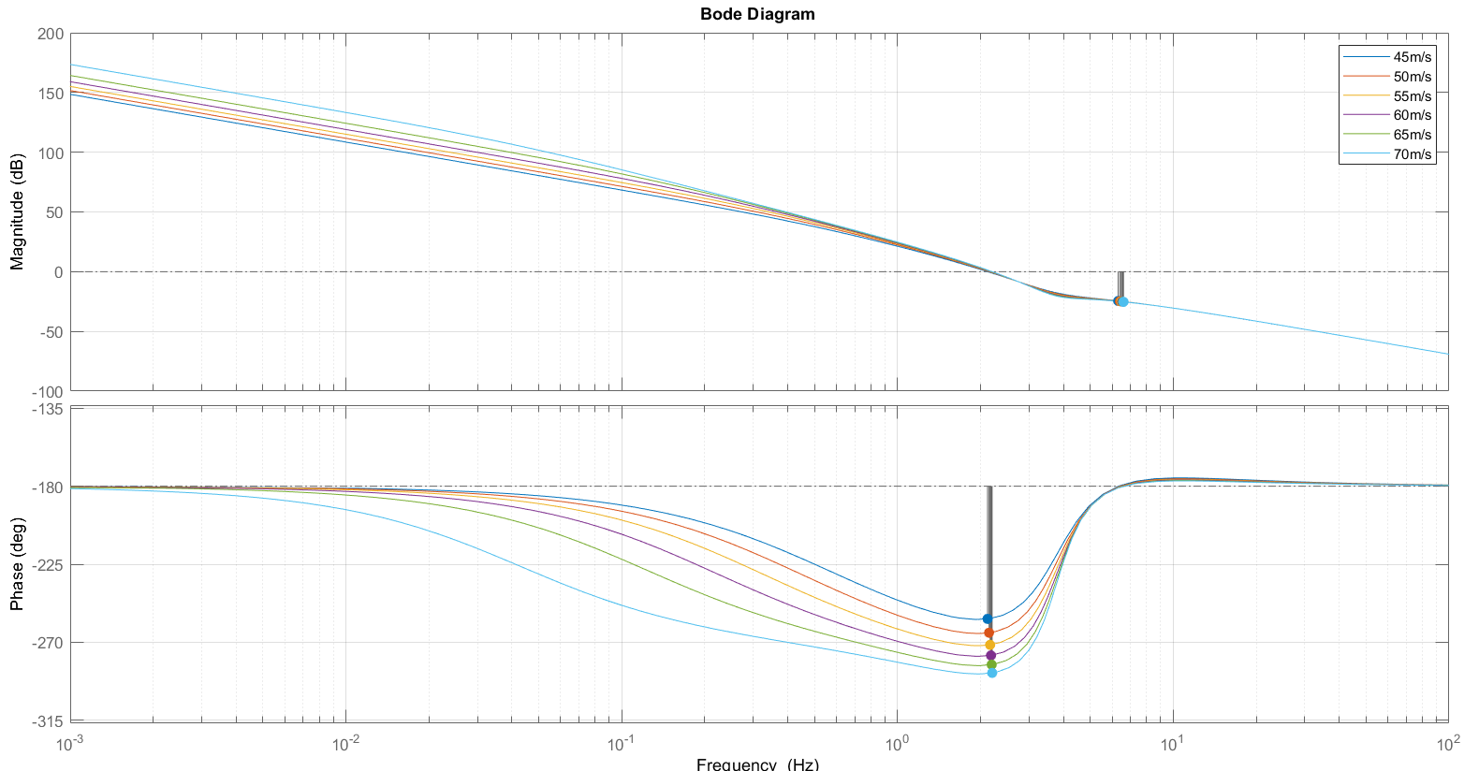
Bode diagram of G(s) at different velocity speeds
17
Alessio Russo, Carmelo Valore
Notes:
Senza lookahead con il regolatore di mori con gain cambiato a 0.01, le funzioni sono stabili ma ci sono oscillazioni forti già in partenza, senza feed-forward

Slide 18
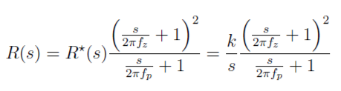
Lateral controller without Lookahead
From that transfer function we obtain the following regulator R(s) with structure:
Pole in 2 Hz
Zero in 0.01 Hz
Gain 0.01
Combining the results we define the function L(s) = R(s)*G(s)
L(s) is stable with each considered velocity
The bandwidth is around 9.5 Hz
The phase margin is around 15 deg
Despite of the stability of the obtained Bode diagram, the simulation results are not satisfactory. The error oscillates too much even along the straight path and this makes the simulation run very slow.
18
Alessio Russo, Carmelo Valore
Notes:
Senza lookahead con il regolatore di mori con gain cambiato a 0.01, le funzioni sono stabili ma ci sono oscillazioni forti già in partenza, senza feed-forward

Slide 19
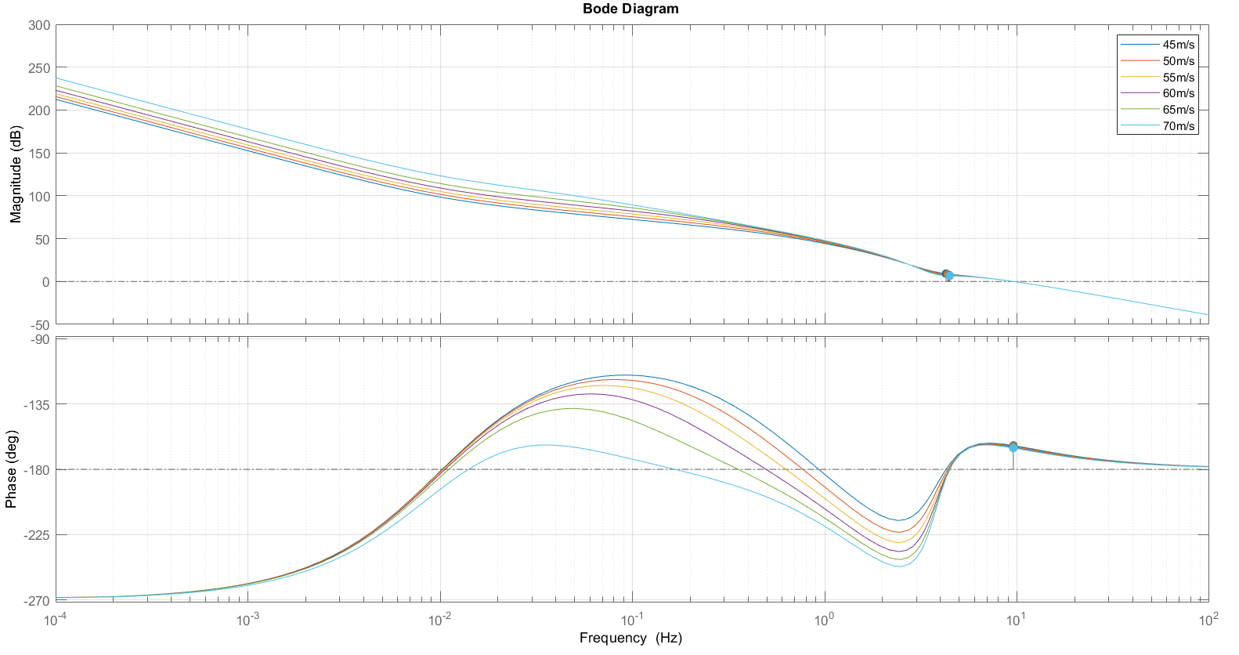
Bode diagram of L(s) at different velocity speeds
19
Alessio Russo, Carmelo Valore
Notes:
Senza lookahead con il regolatore di mori con gain cambiato a 0.01, le funzioni sono stabili ma ci sono oscillazioni forti già in partenza, senza feed-forward

Slide 20
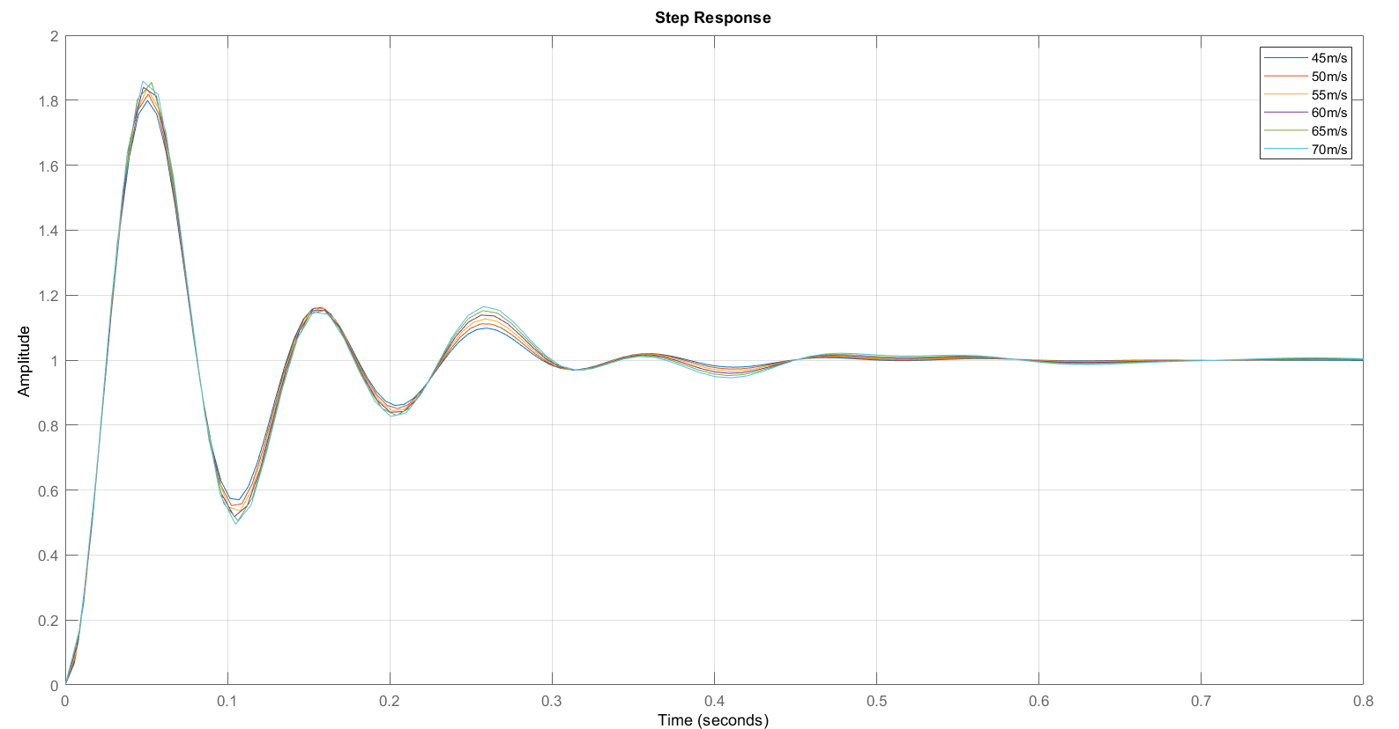
Step response of the system at different velocity speeds
20
Alessio Russo, Carmelo Valore
Notes:
Senza lookahead con il regolatore di mori con gain cambiato a 0.01, le funzioni sono stabili ma ci sono oscillazioni forti già in partenza, senza feed-forward

Slide 21
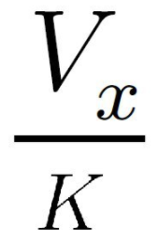
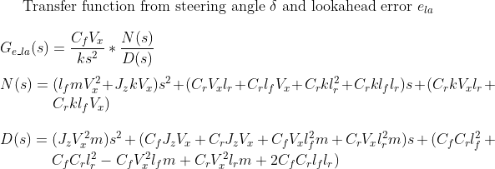
Lateral controller with Lookahead (first version)
This model is the same as the one before but we considered a Lookahead distance with value
La = V_x/k where k = 3.
The lookahead distance defines an additional
error e_La = La*delta(psi).
This error sums up to the original output
e = e_La + e_cg
Considering different velocity speeds for the value Vx we defined the following transfer function G(s) from the steering angle to the output
21
Alessio Russo, Carmelo Valore

Slide 22
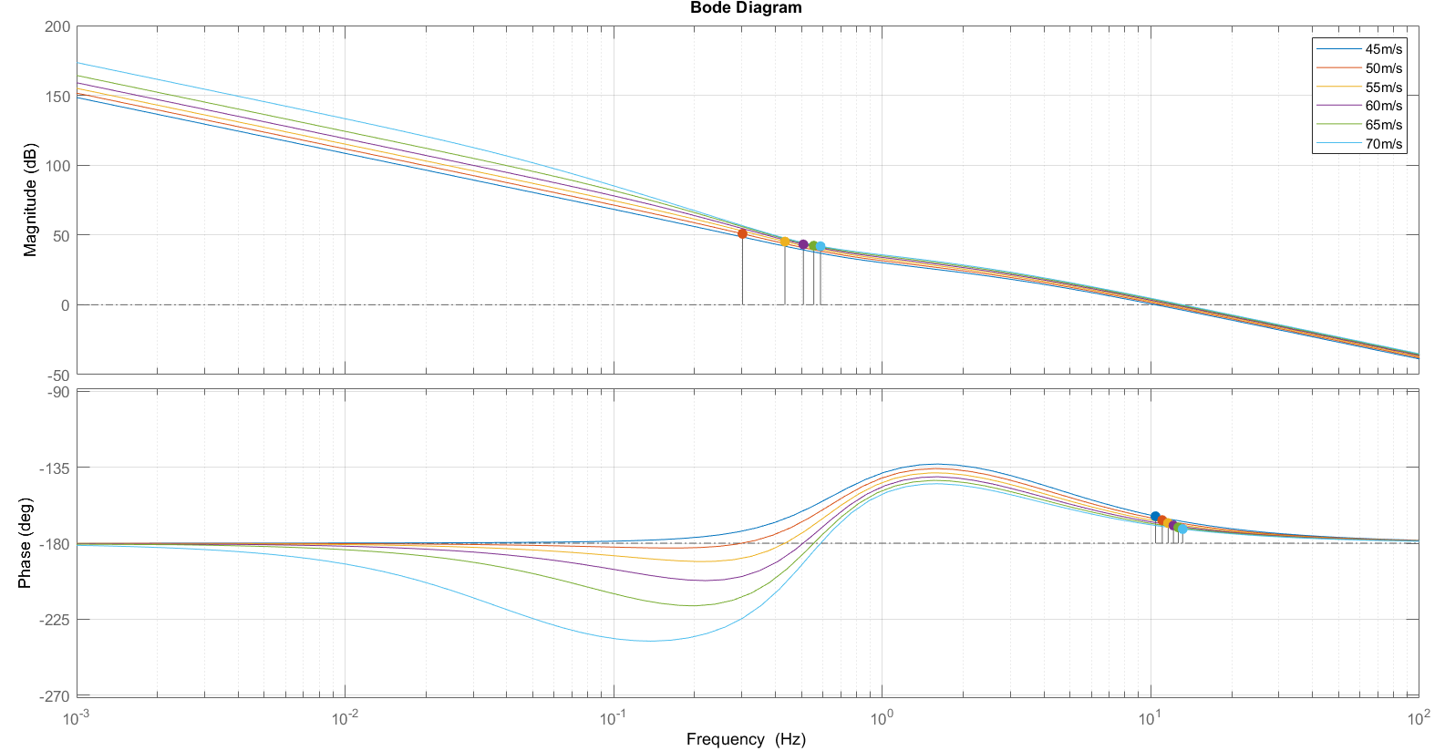
Bode diagram of G(s) at different velocity speeds
22
Alessio Russo, Carmelo Valore

Slide 23
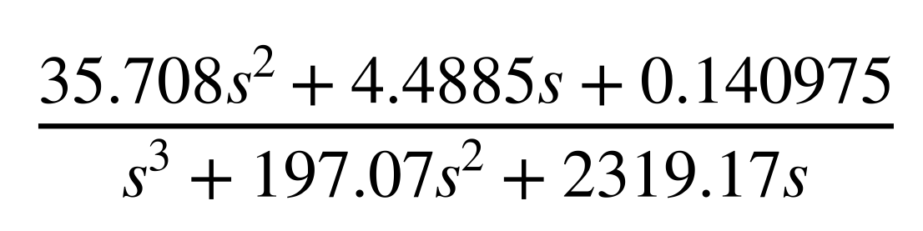

Lateral controller with Lookahead (first version)
From that transfer function we obtain the following regulator R(s) with the structure:
That can also be seen showing that:
Gain 6*10^-5
Integrator
One pole in 2 Hz
One pole in 29.4
Two zero in 0.01 Hz
Combining the results we define the function L(s) = R(s)*G(s)
L(s) is stable with each considered velocity
The bandwidth is around 4 Hz
The phase margin is around 45 deg
23
Alessio Russo, Carmelo Valore

Slide 24
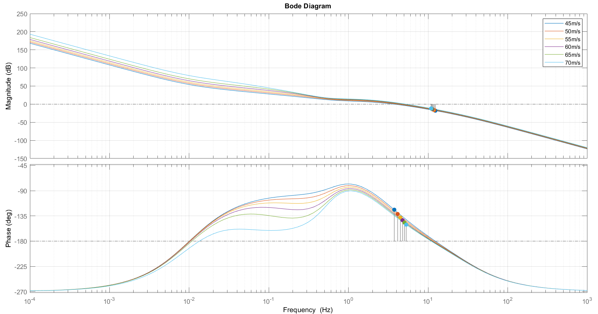
Bode diagram of L(s) at different velocity speeds
24
Alessio Russo, Carmelo Valore
Notes:
Senza lookahead con il regolatore di mori con gain cambiato a 0.01, le funzioni sono stabili ma ci sono oscillazioni forti già in partenza, senza feed-forward

Slide 25
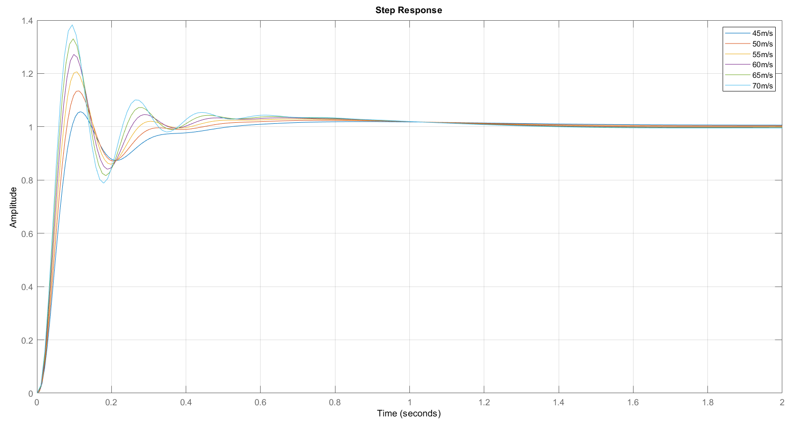
Step response of the system at different velocity speeds
25
Alessio Russo, Carmelo Valore
Notes:
Senza lookahead con il regolatore di mori con gain cambiato a 0.01, le funzioni sono stabili ma ci sono oscillazioni forti già in partenza, senza feed-forward

Slide 26
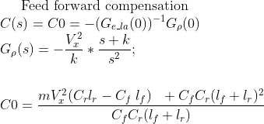
Lateral controller with Lookahead (first version)
Lookahead varies instantly according to the velocity Vx scaled by a factor 1/k with k = 3
We implemented the feed-forward mechanism: the value of the curvature referred to the current position of the vehicle is multiplied by the value C_0
26
Alessio Russo, Carmelo Valore

Slide 27
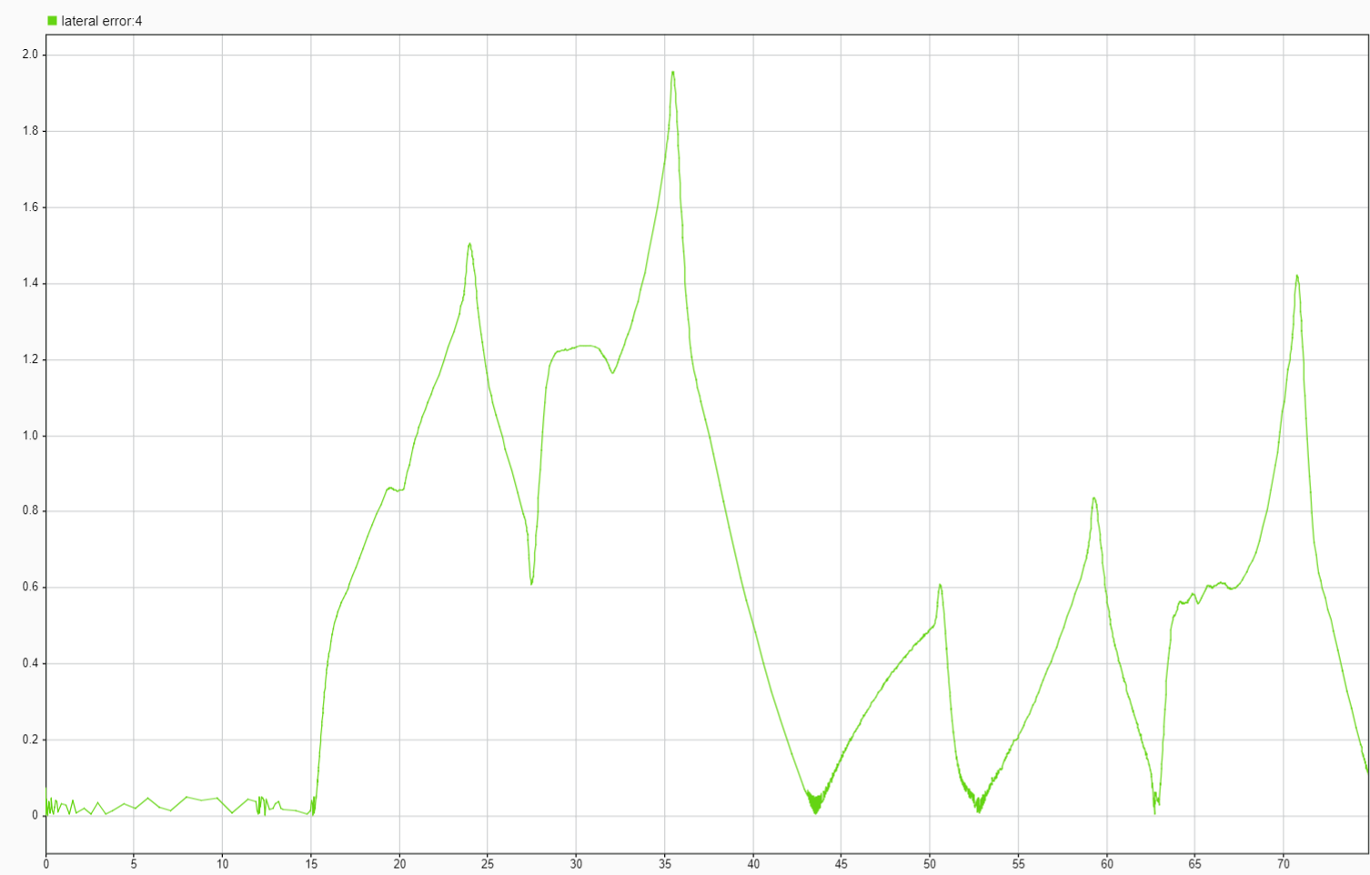
Lateral error of simulation (first version with lookahead)
27
Alessio Russo, Carmelo Valore

Slide 28
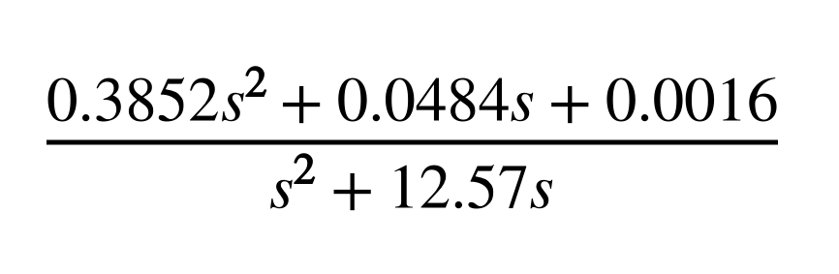

Lateral controller with Lookahead (second version)
Starting from the function G(s) obtained with the addition of the error of lookahead we also defined the following regulator R(s):
That can also be seen showing that:
Gain 1.3*10^-4
Integrator
One pole in 2 Hz
Two zero in 0.01 Hz
Combining the results we define the function L(s) = R(s)*G(s)
L(s) is stable with each considered velocity
The bandwidth is around 7 Hz
The phase margin is around 35 deg
28
Alessio Russo, Carmelo Valore

Slide 29
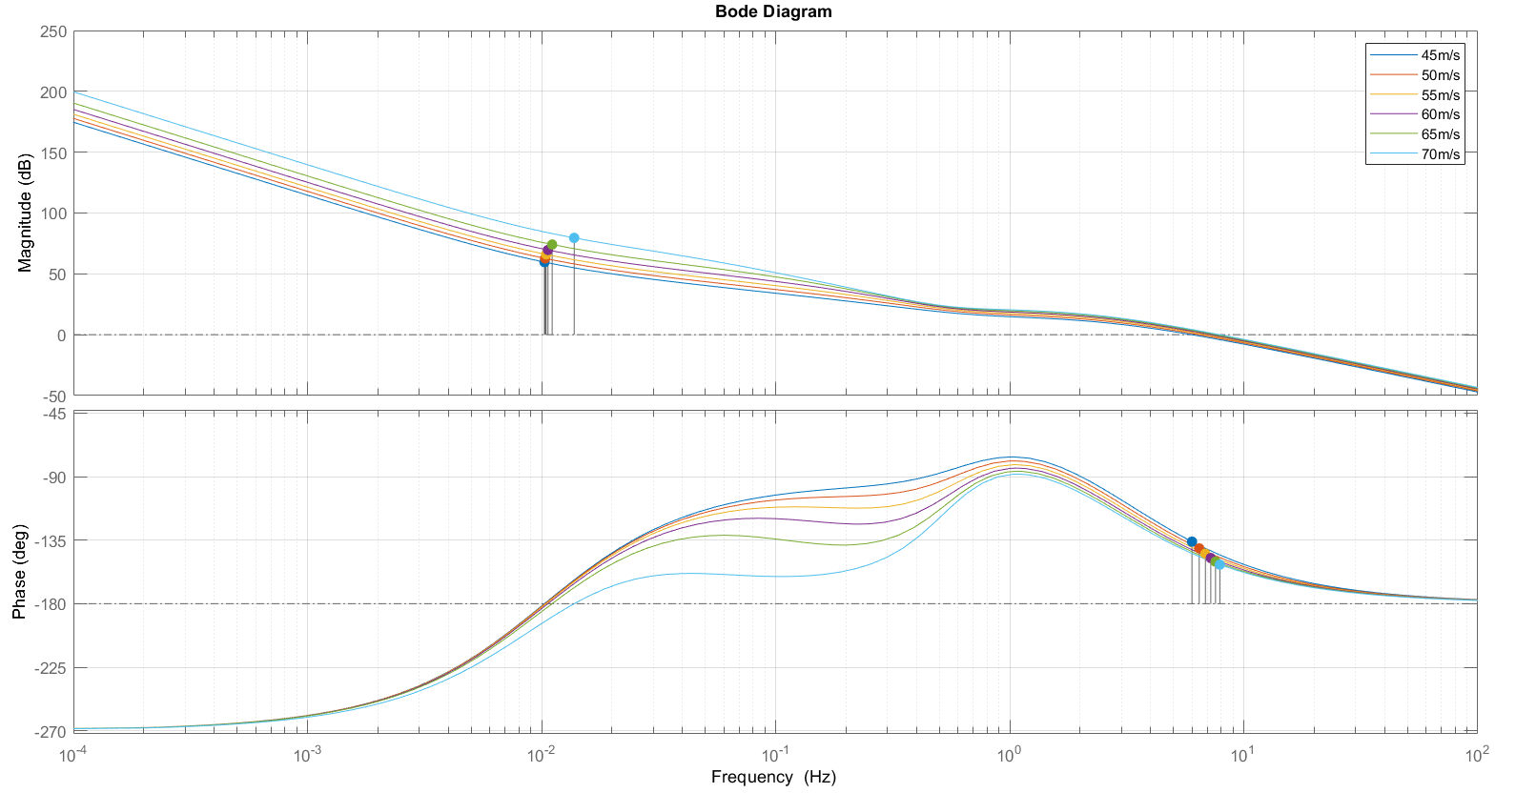
Bode diagram of L(s) at different velocity speeds
29
Alessio Russo, Carmelo Valore
Notes:
Senza lookahead con il regolatore di mori con gain cambiato a 0.01, le funzioni sono stabili ma ci sono oscillazioni forti già in partenza, senza feed-forward

Slide 30
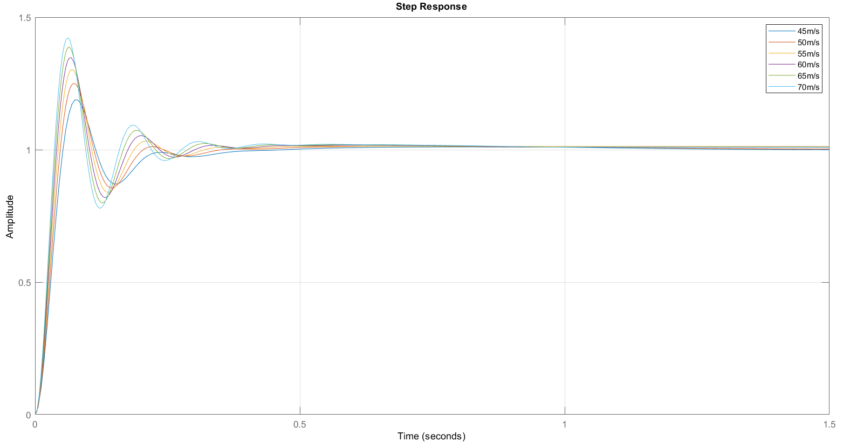
Step response of the system at different velocity speeds
30
Alessio Russo, Carmelo Valore
Notes:
Senza lookahead con il regolatore di mori con gain cambiato a 0.01, le funzioni sono stabili ma ci sono oscillazioni forti già in partenza, senza feed-forward

Slide 31
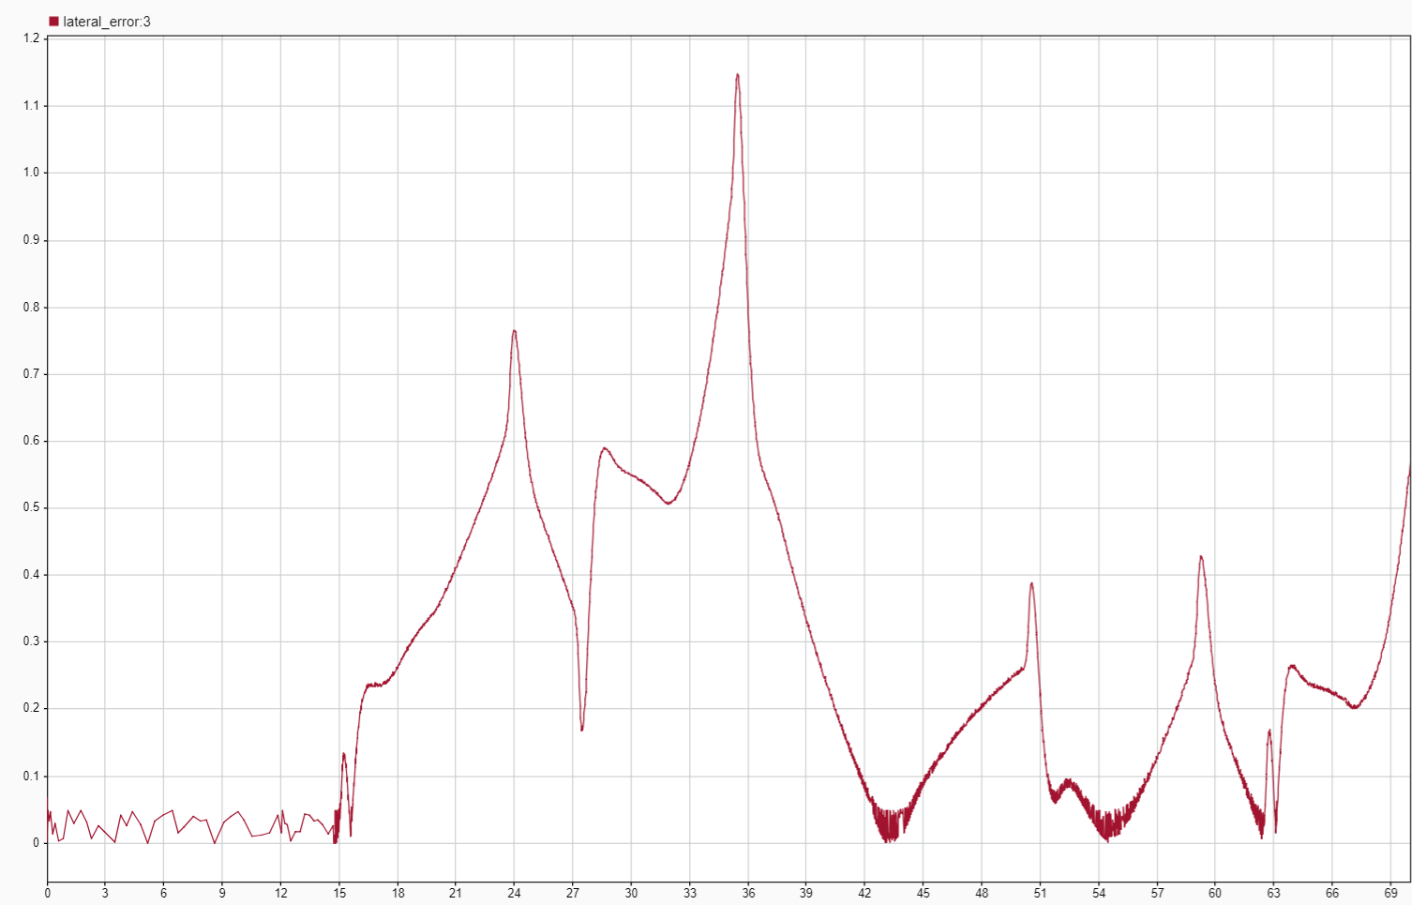
Lateral error with lookahead (second version)
31
Alessio Russo, Carmelo Valore
Notes:
Senza lookahead con il regolatore di mori con gain cambiato a 0.01, le funzioni sono stabili ma ci sono oscillazioni forti già in partenza, senza feed-forward

Slide 32
Meeting 7: Lateral Control
32

