Slide 1
Meeting 4: Review of our model
03/07/2020, Milano
Alessio Russo
Carmelo Valore

Slide 2
Introduction
Dynamic bicycle model
Pacejka tyre model
Aerodynamic force (F_A + F_Lift)
Fuel consumption model (simplified version)
Tyre wear model
Modeled a 3D track with different lanes and different banking angles
Introduce banking in the dynamic model ??

Slide 3
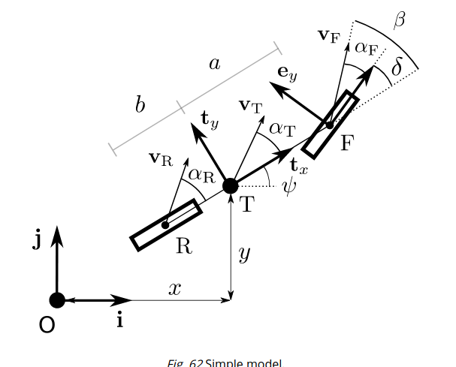
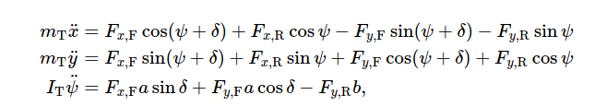

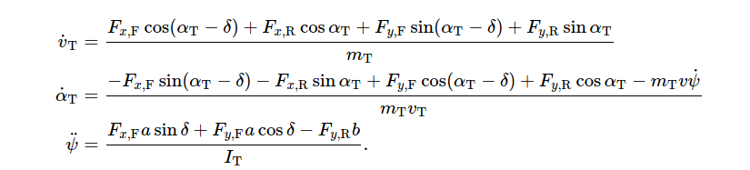
Dynamic bicycle model

Slide 4
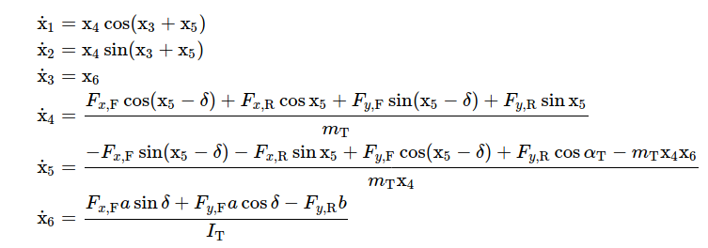
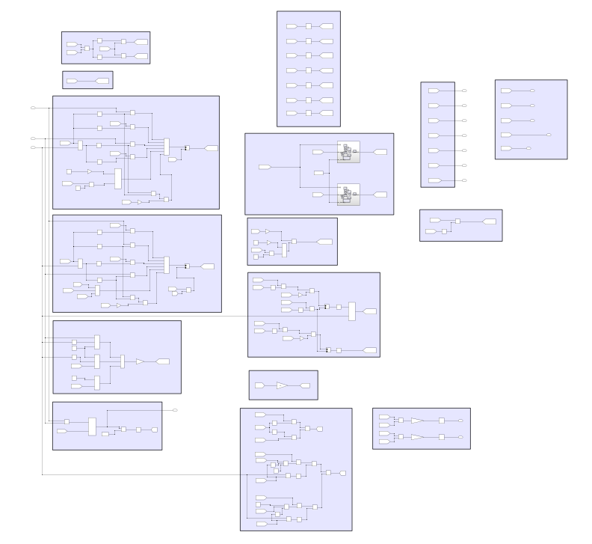
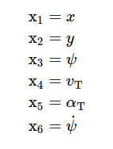
Dynamic bicycle model

Slide 5
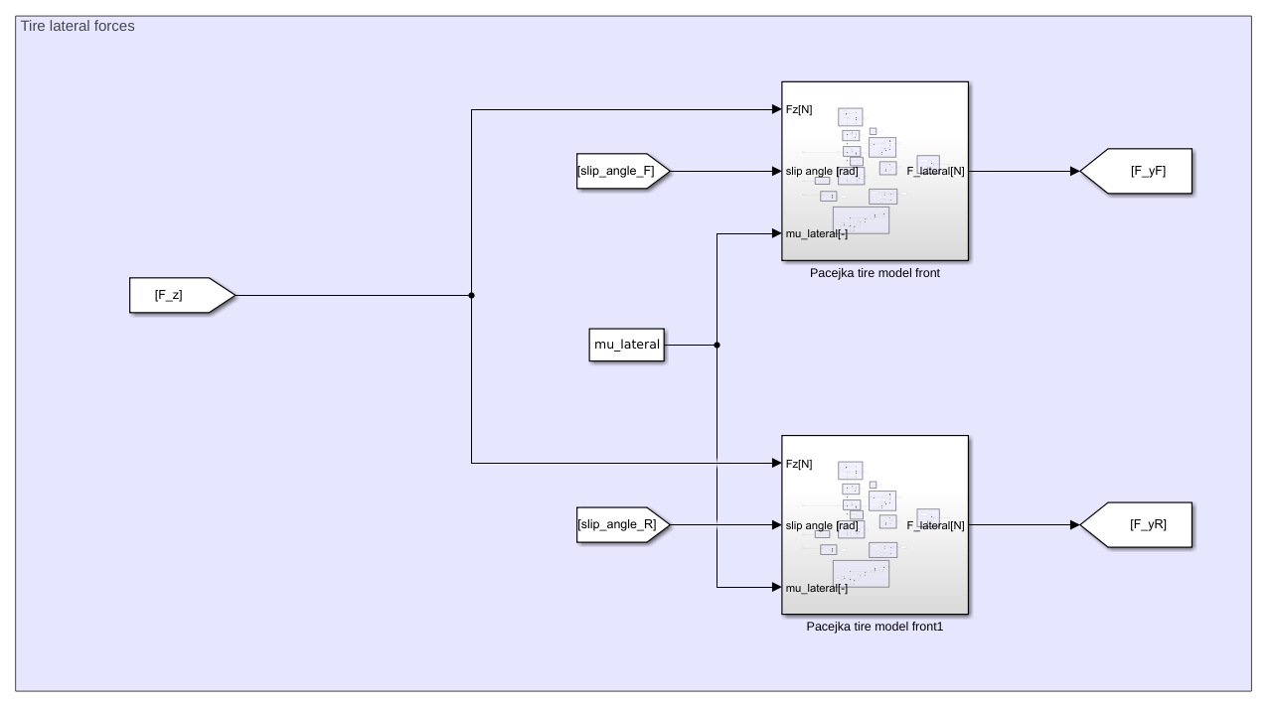



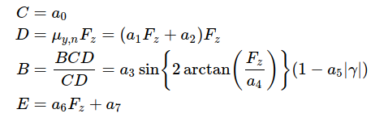
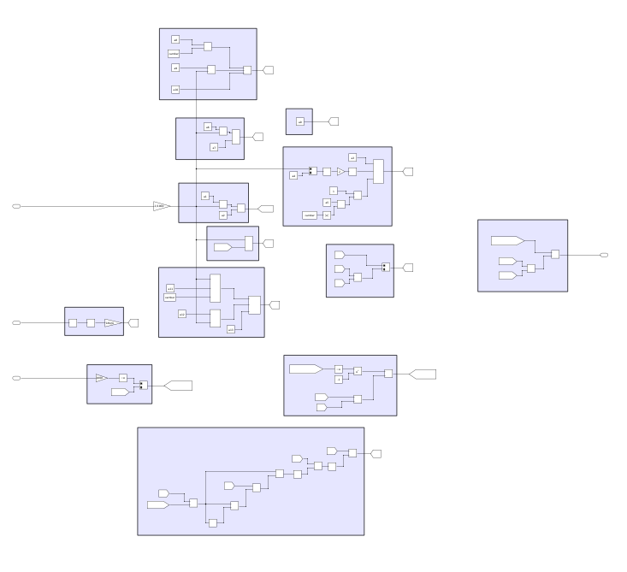

Pacejka tyre model

Slide 6
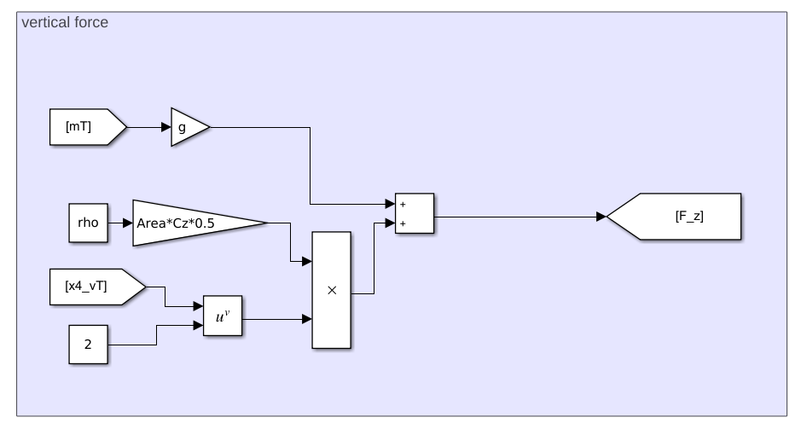
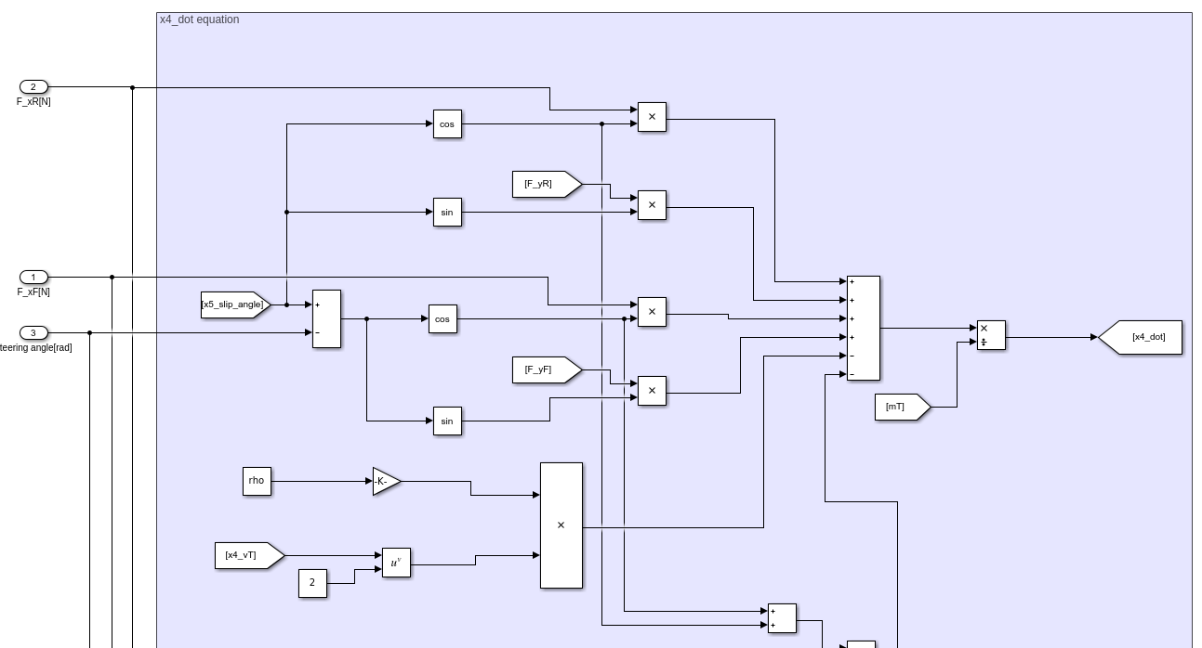
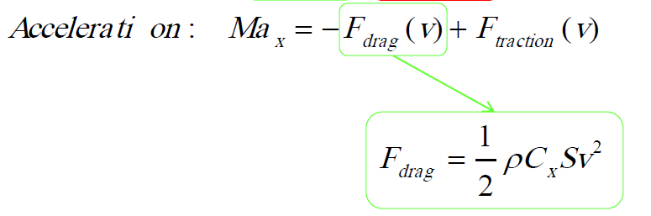
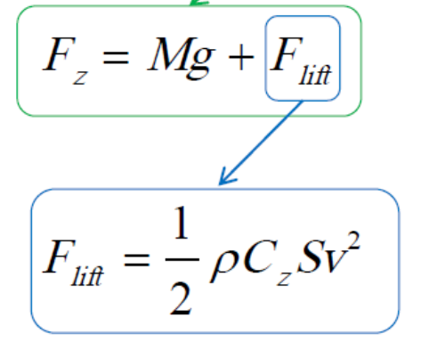
Aerodynamic force

Slide 7
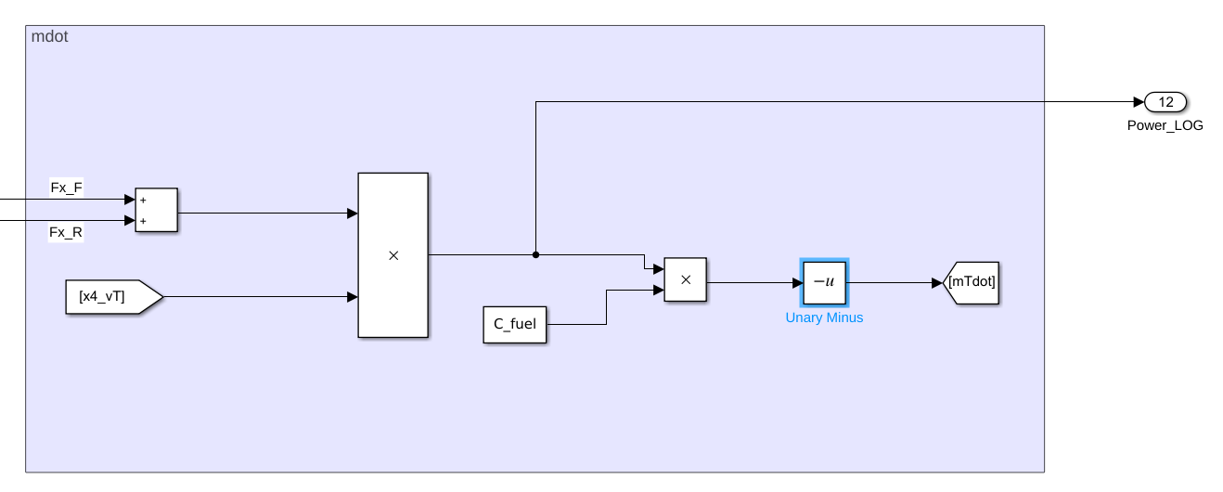
Fuel consumption model (simplified version)

Slide 8
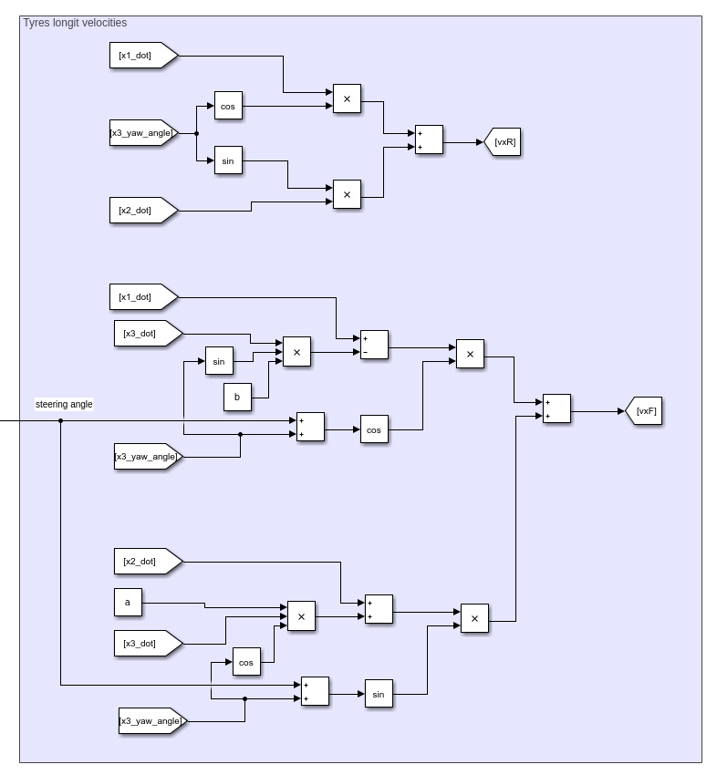
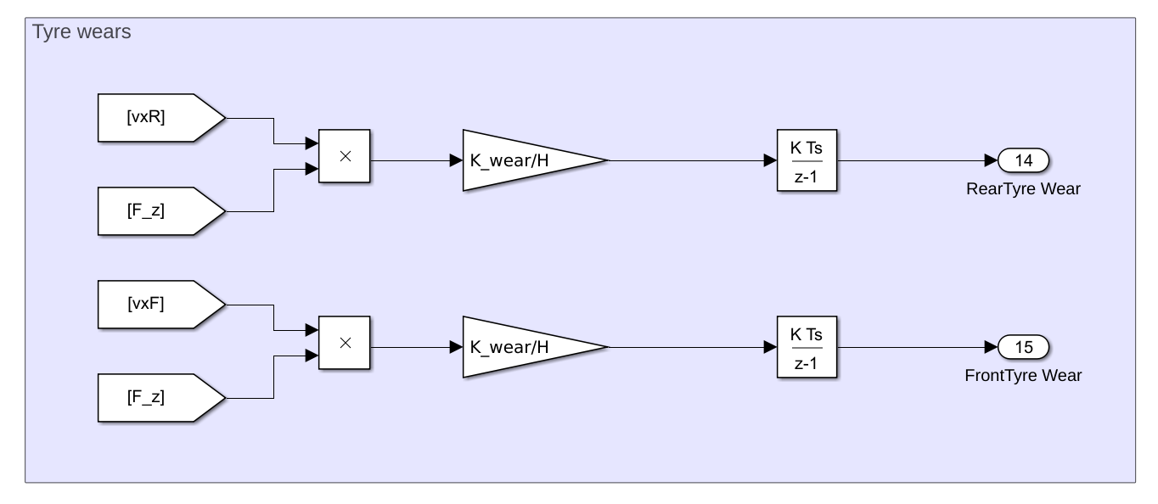
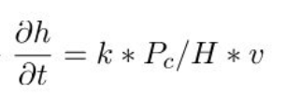
Tyre wear model – Archard model

Slide 9
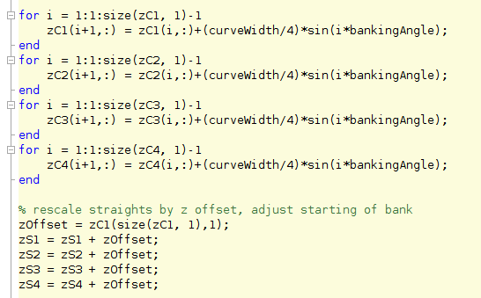
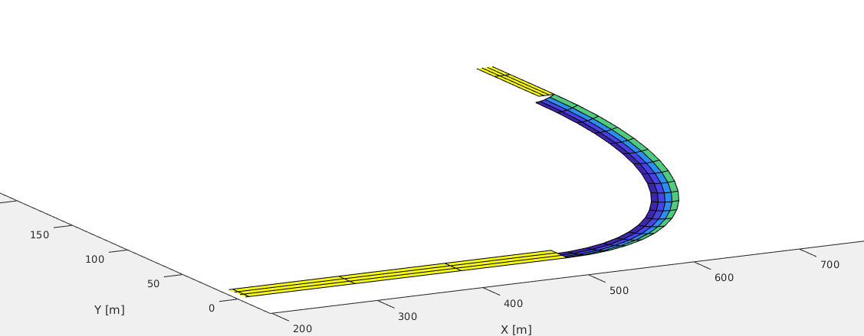
3D track and banking
    …
    ...

Slide 10
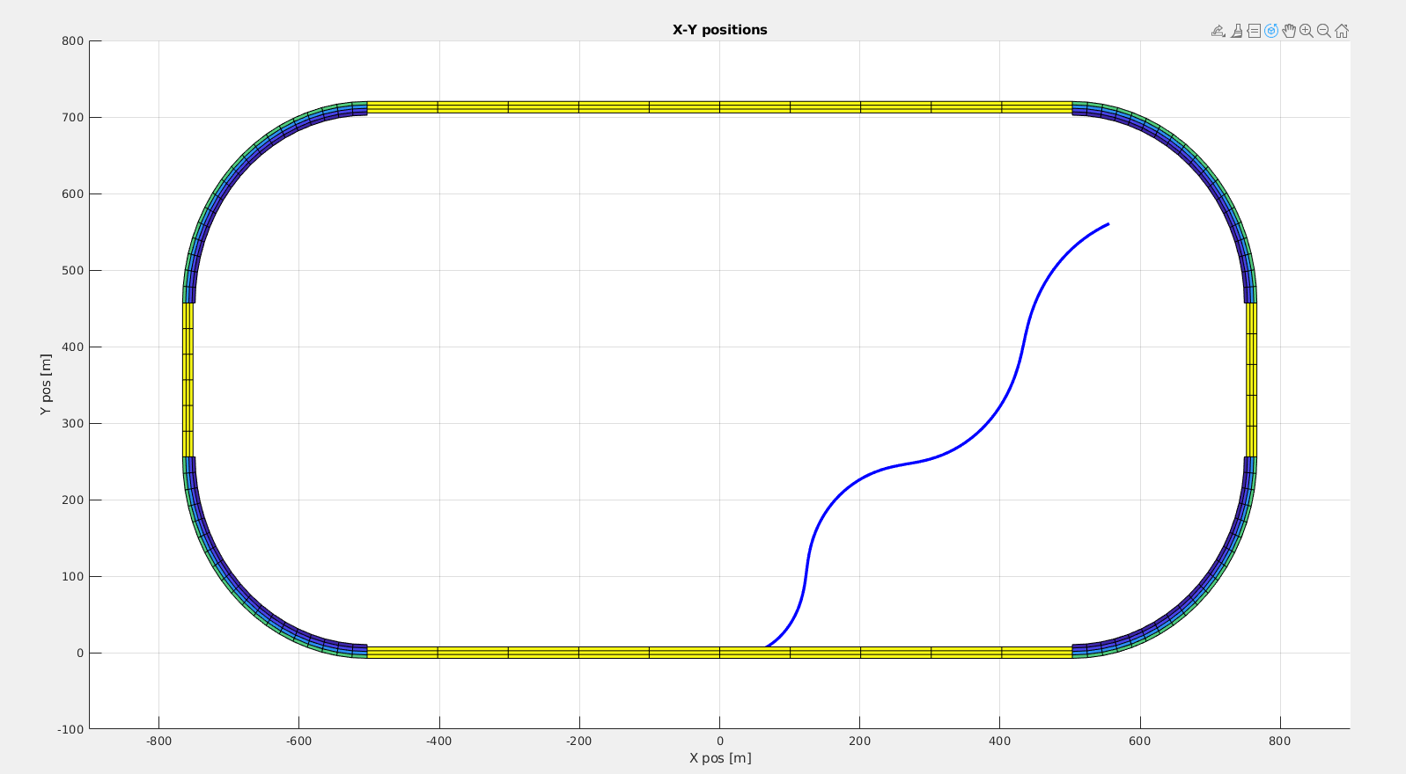
First simulation results

Slide 11
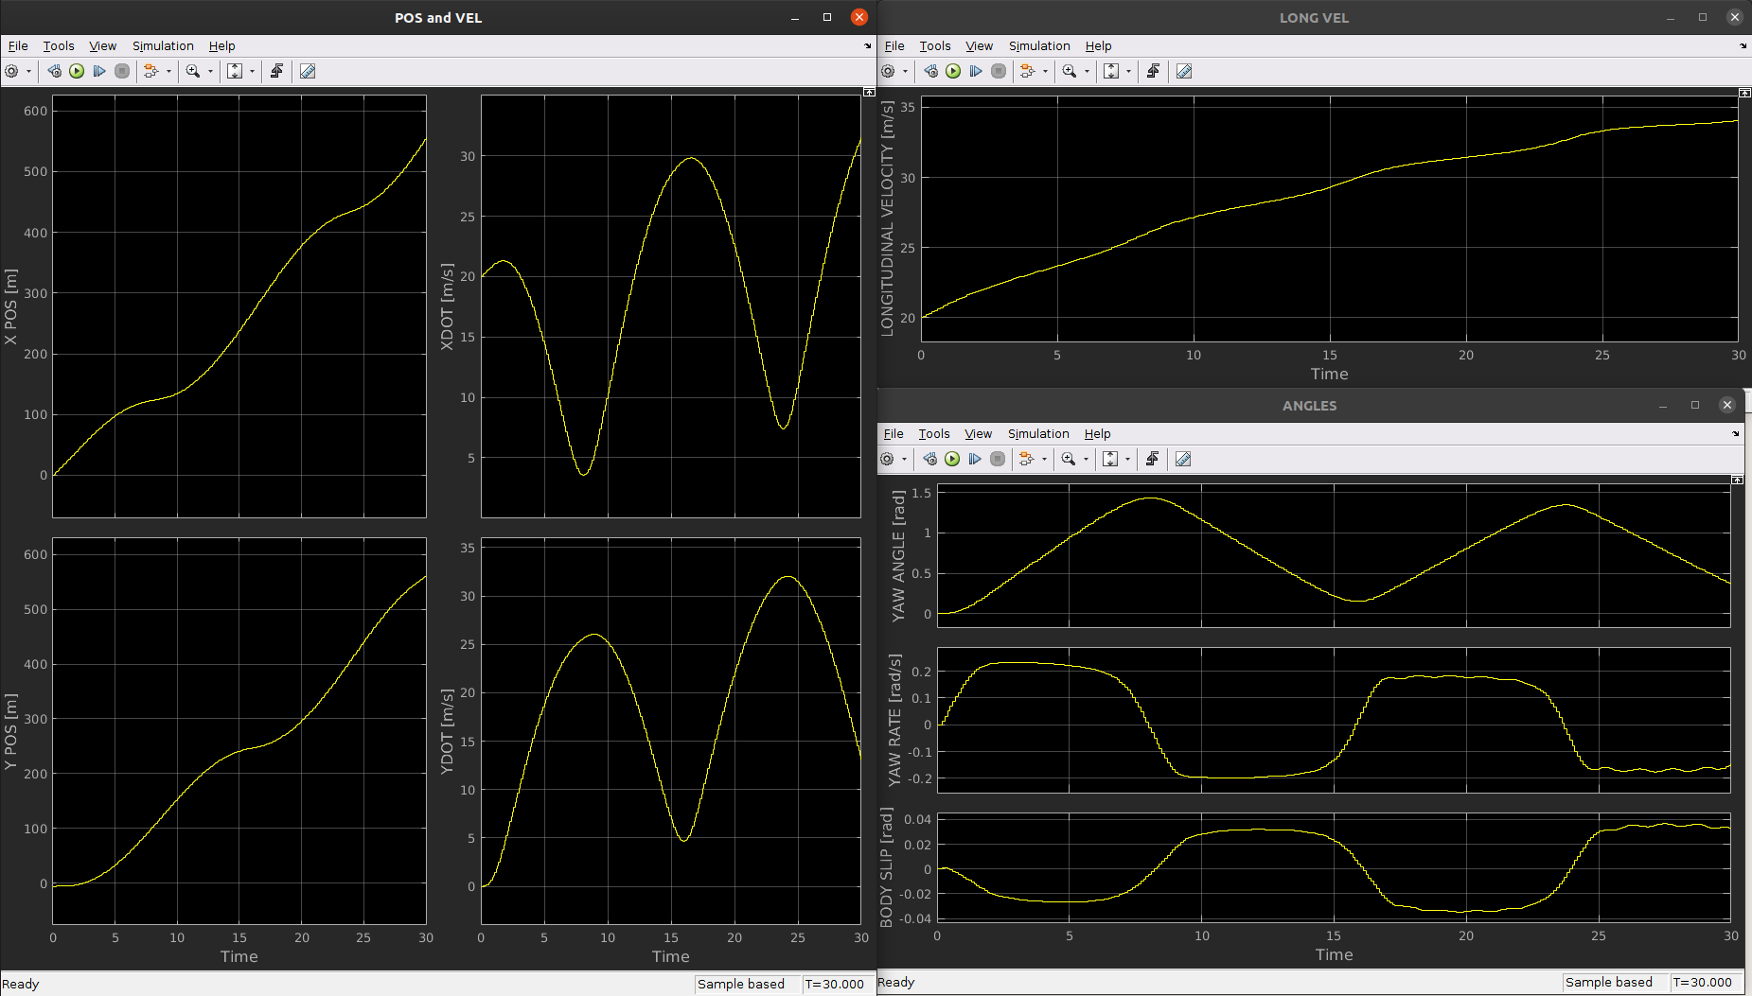
First simulation results

Slide 12
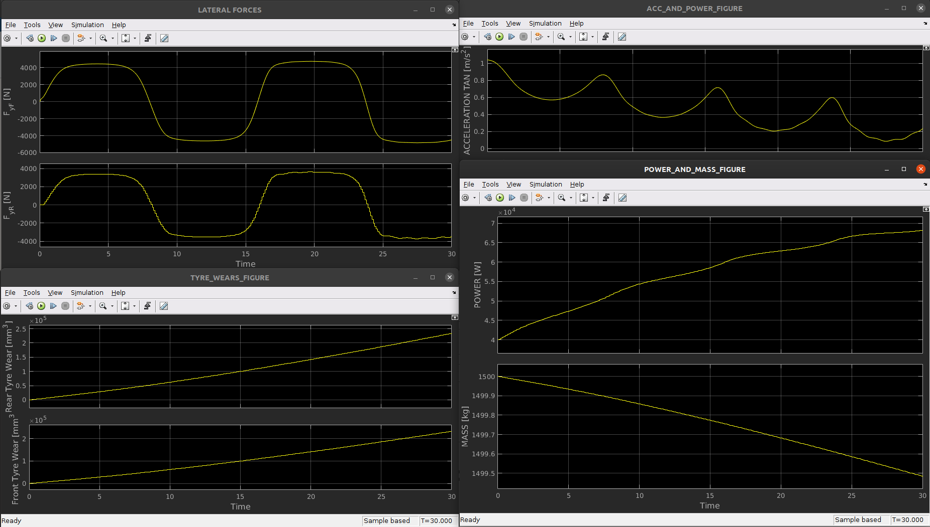
First simulation results

Slide 13

Questions

Slide 14
Questions
Consider banking in the dynamic model (see pdf..)
Fuel consumption (simplified)
How tyre wear model affects the dynamic model
For future.. Advices for control..

Slide 15
Meeting 4: Review of our model

