Slide 1
Meeting 2 - Overview of autonomous racing strategies
06/05/2020, Milano
Alessio Russo
Carmelo Valore

Slide 2
Introduction
General understanding of autonomous vehicles race competiotions
Global vs Local path planning
Different approaches
Graph-based ←
Game theoretic ←
Probabilstic
Learning-based
…
Our particular case-study
Strategy of autonomous vehicles path planning in a competitive scenario
2
Alessio Russo, Carmelo Valore

Slide 3
Motion planning techniques
Graph search-based ←
Sampling-based
Random sampling of state space looking for connectivity
Interpolating curve planners
Numerical optimization approaches ←
3
Alessio Russo, Carmelo Valore

Slide 4
Main challanges..
Real-time feasibility
Solving time
Computational complexity
HW constraints
Handling of vehicle at limits
4
Alessio Russo, Carmelo Valore

Slide 5
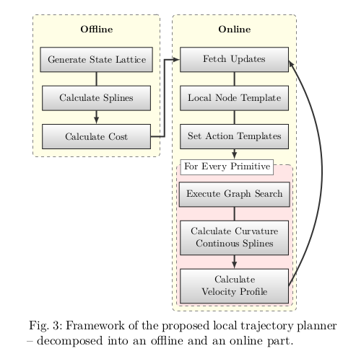
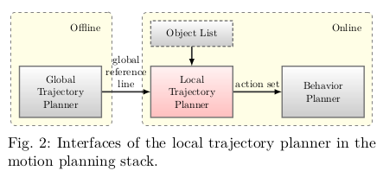
Some techniques
Multi-layer graph-based trajectory planning
Ref: [tim-stahl]_multilayer-graph-based-trajectory-planning-for-race-vehicles-in-dynamic-scenarios
5
Alessio Russo, Carmelo Valore

Slide 6
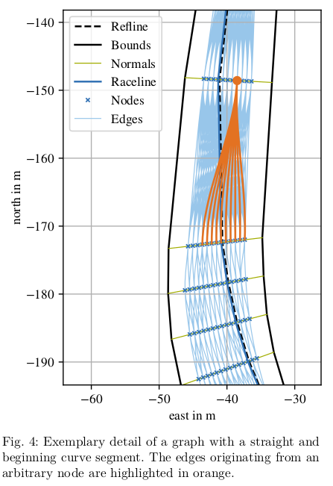
Some techniques
Multi-layer graph-based trajectory planning
Ref: [tim-stahl]_multilayer-graph-based-trajectory-planning-for-race-vehicles-in-dynamic-scenarios
6
Alessio Russo, Carmelo Valore

Slide 7
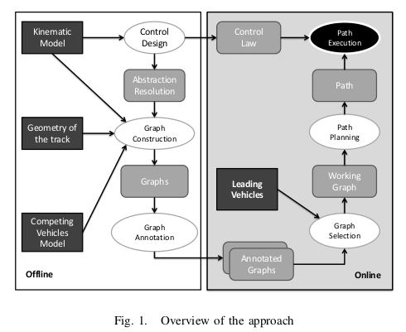
Some techniques
Global/Local path planning for competitive robotic cars
Ref: [tizar-rizano]_global-path-planning-for-competitive-robotic-cars Ref: [tizar-rizano]_local-motion-planning-for-robotic-race-cars
Discrete abstraction → real-time feasibility → quantising the possible positions and velocities of the car when intersects the way line
Overtaking → graph manipulation
Local path planning solves the problem of finding
a sequence of maneuvres to move from a node to
another
7
Alessio Russo, Carmelo Valore

Slide 8
Some techniques
Global/Local path planning for competitive robotic cars
Ref: [tizar-rizano]_global-path-planning-for-competitive-robotic-cars Ref: [tizar-rizano]_local-motion-planning-for-robotic-race-cars
Global
Mutliple vehicles → one graph for each vechicle → when a slower vehicle is in leading position, the algorithm considers pairs of arcs, one for each vehicle’s graph, and annotates pairs of arcs intersecting each other with the min-arrival-time that prevents accidents. If it’s not possible to follow that path in the given time, the path is pruned from the graph
Local
Pontryagin-minimum principle to find the best possible control for taking a dynamical system from one state to another, especially in the presence of constraints for the state or input controls → define set of extremals
Heuristic (otherwise not real-time feasible) to find a sub-optimal sequence of extremals
Each extremals have a set of parameters that are either bounded to themselves (e.g. the final velocity of a straight sector and the inital velocity of the following curve sector) or be “open” and used as decision variables for a min-optimizazion problem
8
Alessio Russo, Carmelo Valore

Slide 9
Meeting 2 - Overview of autonomous racing strategies
9

