Slide 1
Meeting 4: Review of our model
03/07/2020, Milano
Alessio Russo
Carmelo Valore

Slide 2
Introduction
Dynamic bicycle model
Pacejka tyre model
Aerodynamic force (F_A + F_Lift)
Fuel consumption model (simplified version)
Tyre wear model
Modeled a 3D track with different lanes and different banking angles
Introduce banking in the dynamic model ??
<number>
Alessio Russo, Carmelo Valore

Slide 3
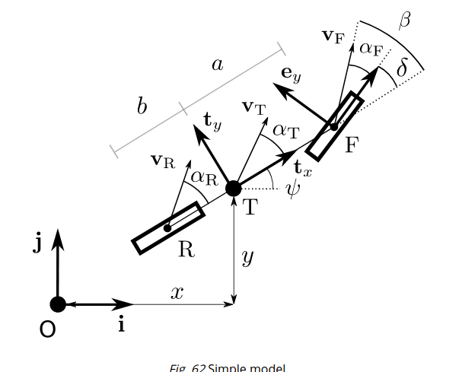
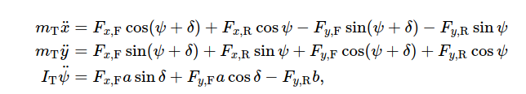

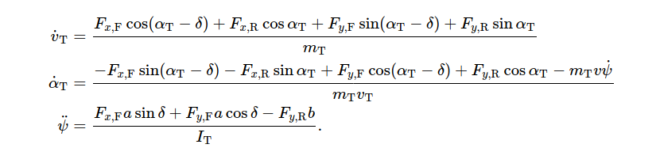
Dynamic bicycle model
<number>
Alessio Russo, Carmelo Valore

Slide 4
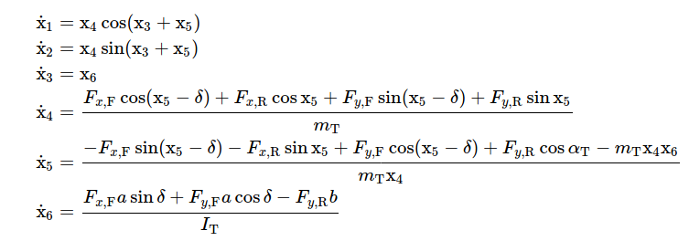
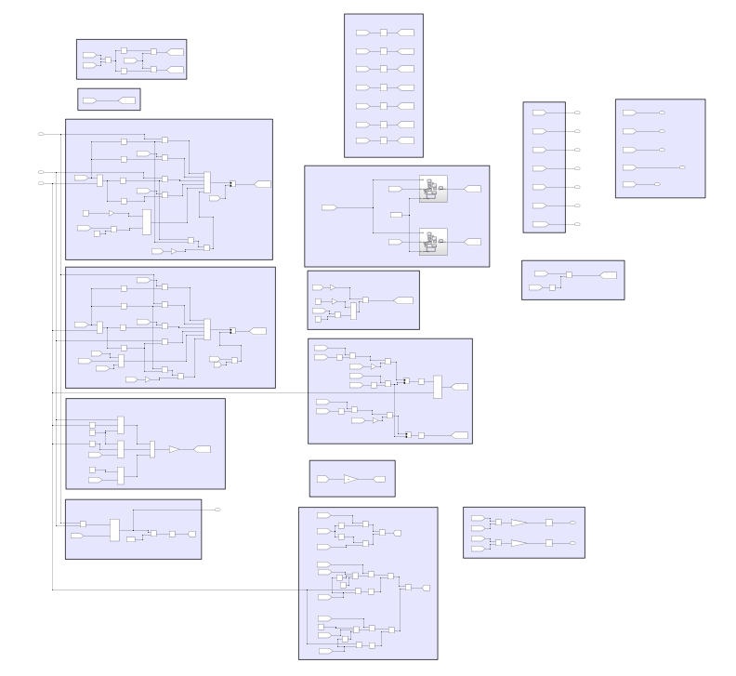
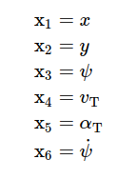
Dynamic bicycle model
<number>
Alessio Russo, Carmelo Valore

Slide 5
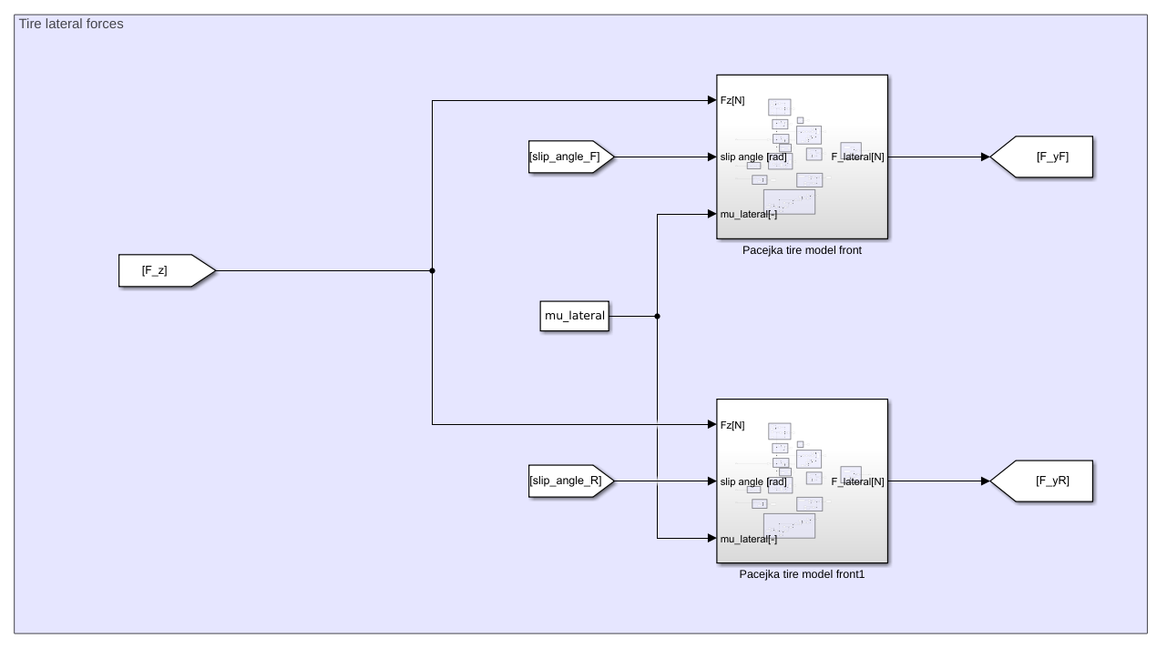



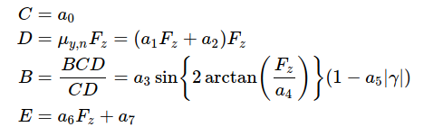
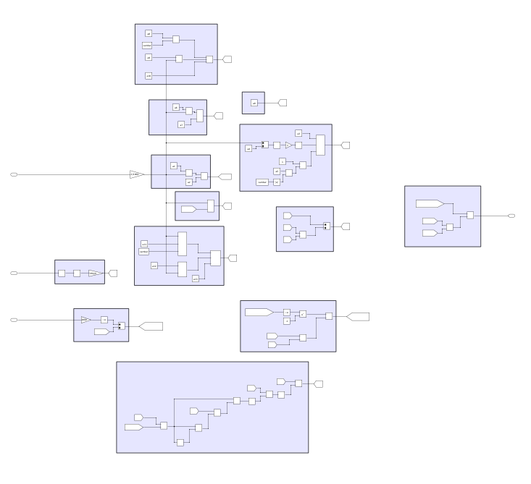

Pacejka tyre model
<number>
Alessio Russo, Carmelo Valore

Slide 6
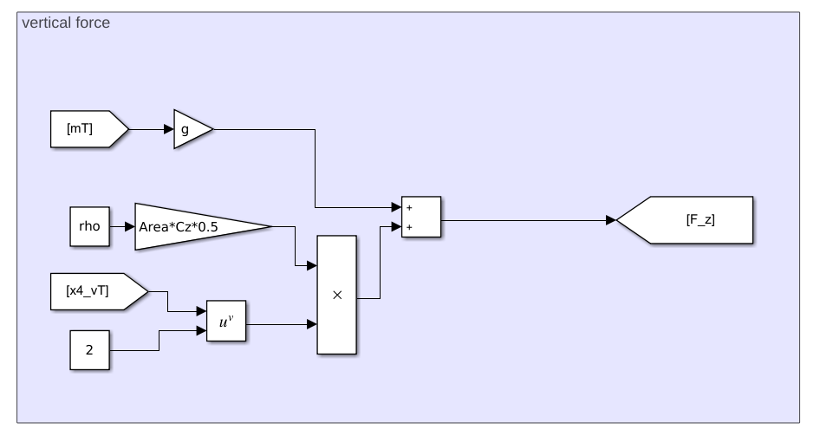
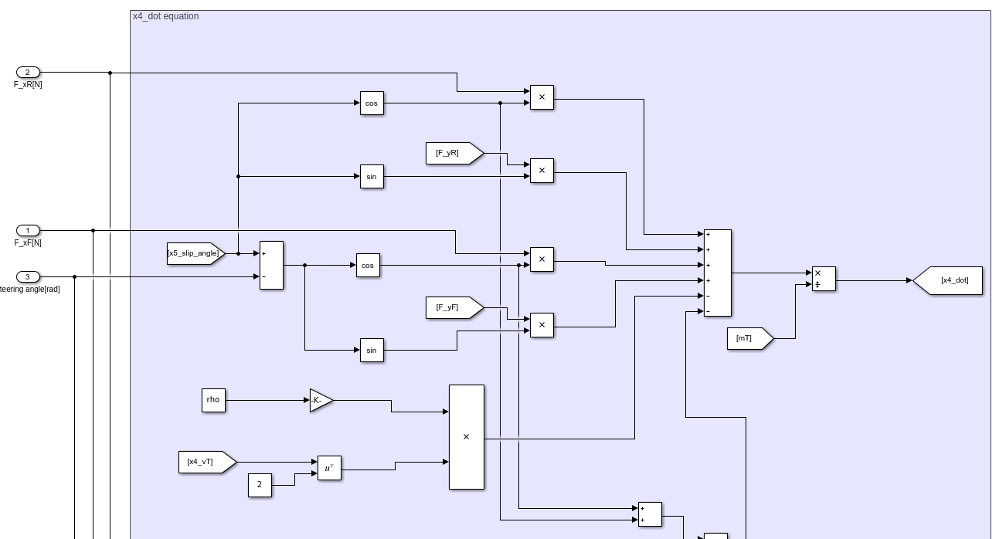
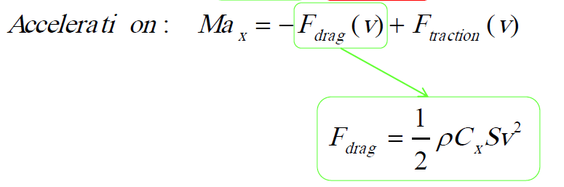
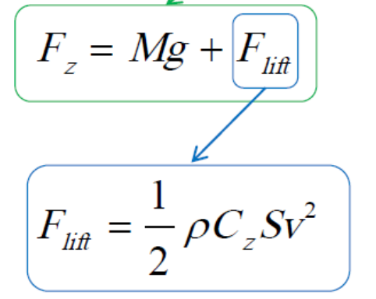
Aerodynamic force
<number>
Alessio Russo, Carmelo Valore

Slide 7
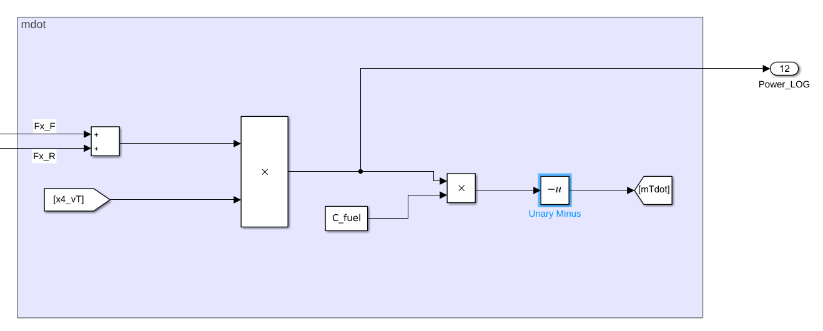
Fuel consumption model (simplified version)
<number>
Alessio Russo, Carmelo Valore

Slide 8
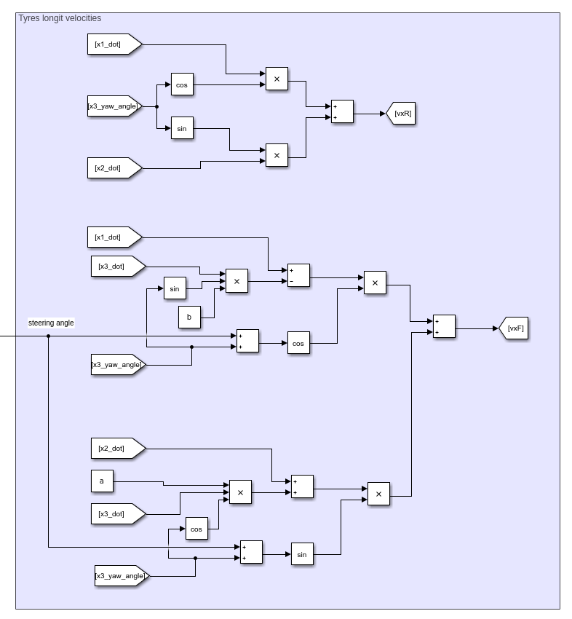
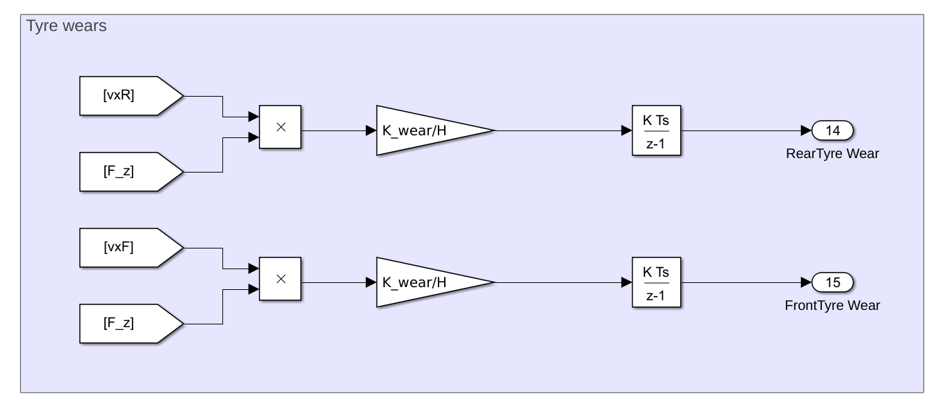
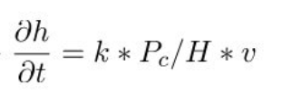
Tyre wear model – Archard model
<number>
Alessio Russo, Carmelo Valore

Slide 9
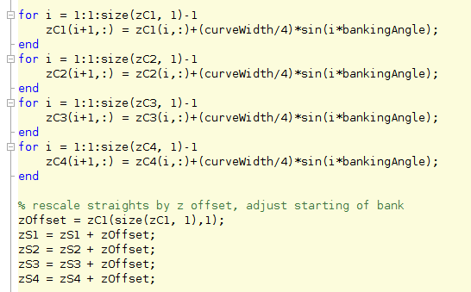
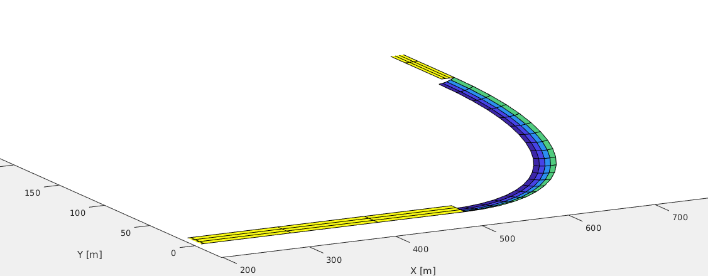
3D track and banking
…
...
<number>
Alessio Russo, Carmelo Valore

Slide 10
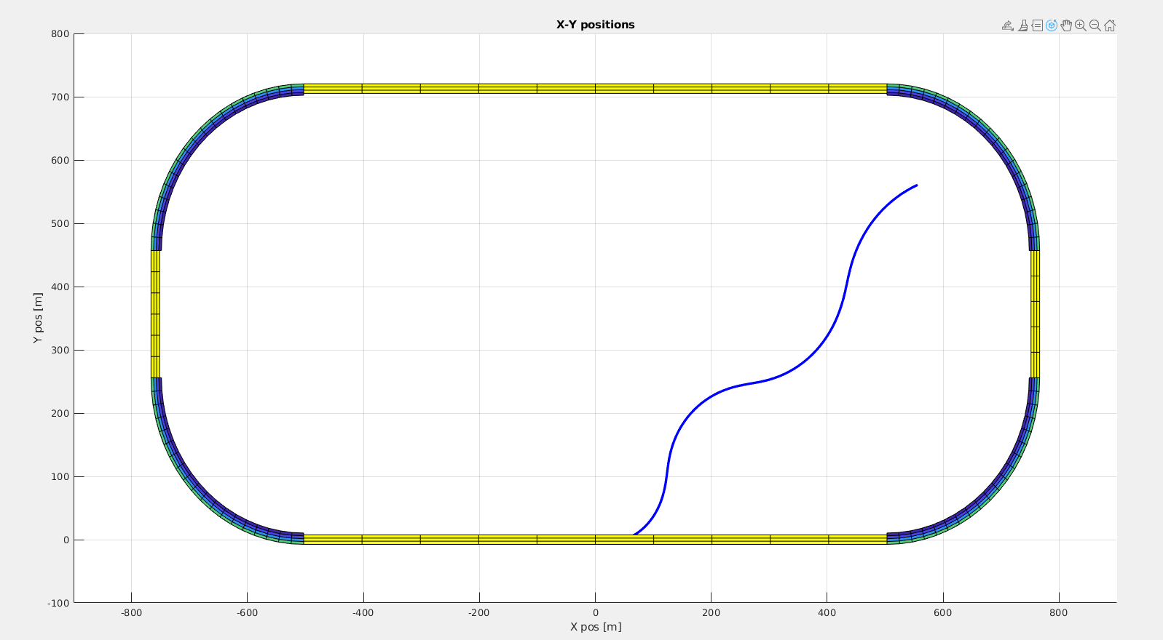
First simulation results
<number>
Alessio Russo, Carmelo Valore

Slide 11
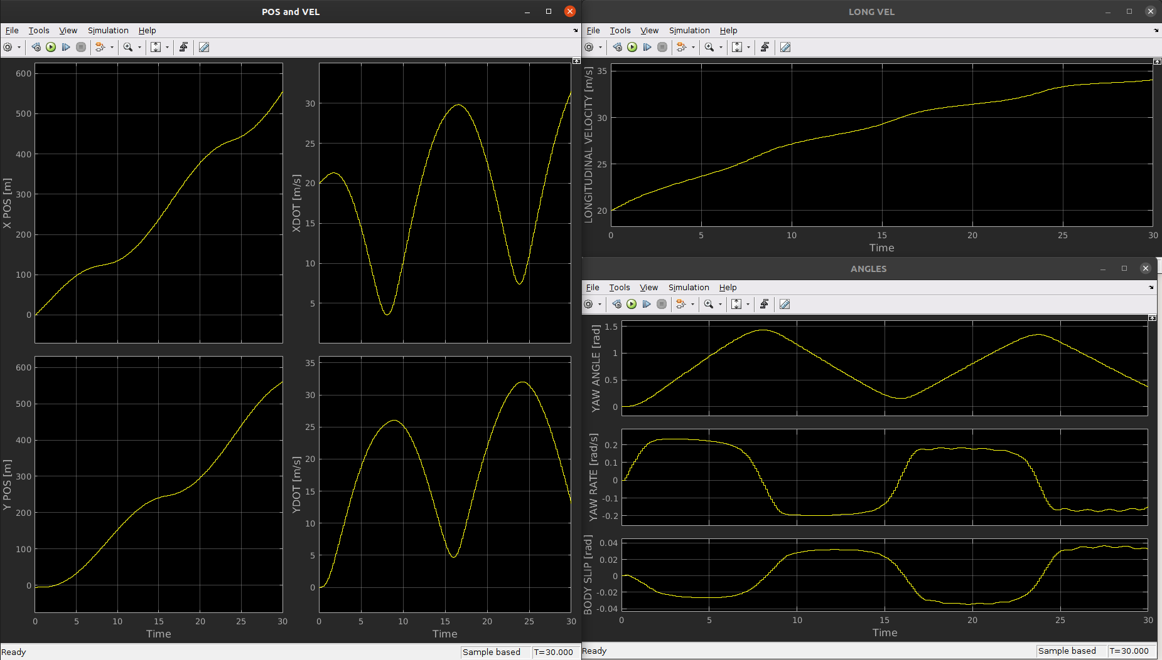
First simulation results
<number>
Alessio Russo, Carmelo Valore

Slide 12
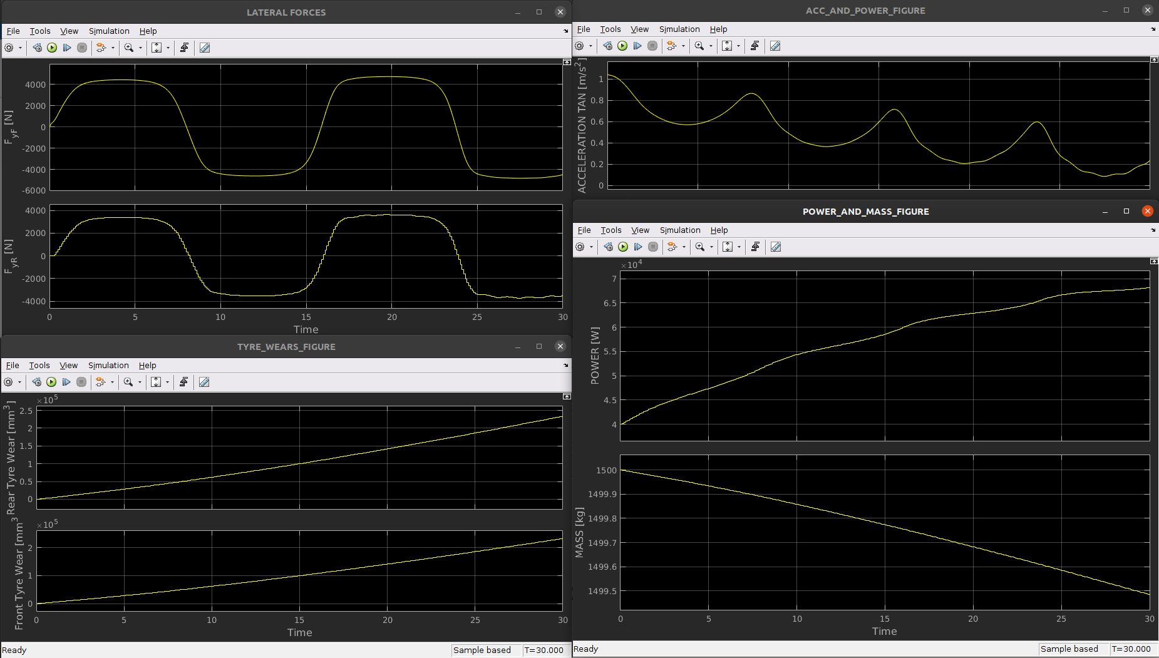
First simulation results
<number>
Alessio Russo, Carmelo Valore

Slide 13

Questions
<number>
Alessio Russo, Carmelo Valore

Slide 14
Questions
Consider banking in the dynamic model (see pdf..)
Fuel consumption (simplified)
How tyre wear model affects the dynamic model
For future.. Advices for control..
<number>
Alessio Russo, Carmelo Valore

Slide 15
Meeting 4: Review of our model
<number>

