Slide 1
Intellect Design Arena (Formerly Known as Polaris Software Labs) :
A Product based Fintech which offers various B2B products like Core Banking Platform, Loan Management system, Trade Finance System, Supply Chain, Cash Management System (CMS).
Revenue Channels:
Public Listed Company
Private Investments
Product Services to clients
Pricing Mechanism for Products being serviced:
Fixed cost of the product + Per Change request Costing (required by banks) + Per Product Feature enhancement (R&D and opted by bank)
Main things for Intellect to be executed for it to run well:
Continuous Product Feature Enhancement in such a way that the product offered to banks is inline with latest technology and features at par with the market .
Lethargic approach to identify new ,useful and effective features leads to impact on revenue

Slide 2
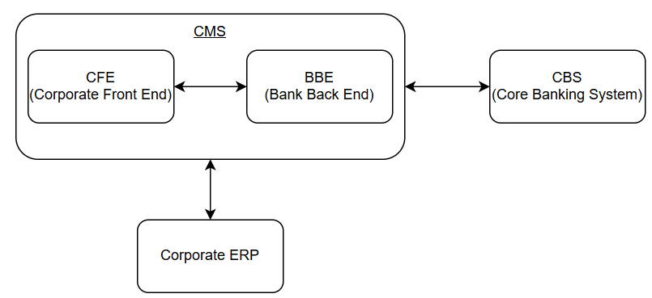
Context:
Product : Cash Management System
Cash Management System is a product/platform which is provided to the banks across countries as a service. The primary purpose of this platform is to help corporate customers of the bank to manage their cash effectively.
High Level workflow of Cash Management System:
Bank users onboard corporates into cash management system using BBE portal.
All the mandatory setups and masters are configured as per corporate’s requirement in BBE porta.
Once all the setups are done, Corporates can login to CFE portals for various activities
Corporates can also integrate their respective ERPs like SAP, MS Dynamics etc with CMS for better insights and automations.

Slide 3
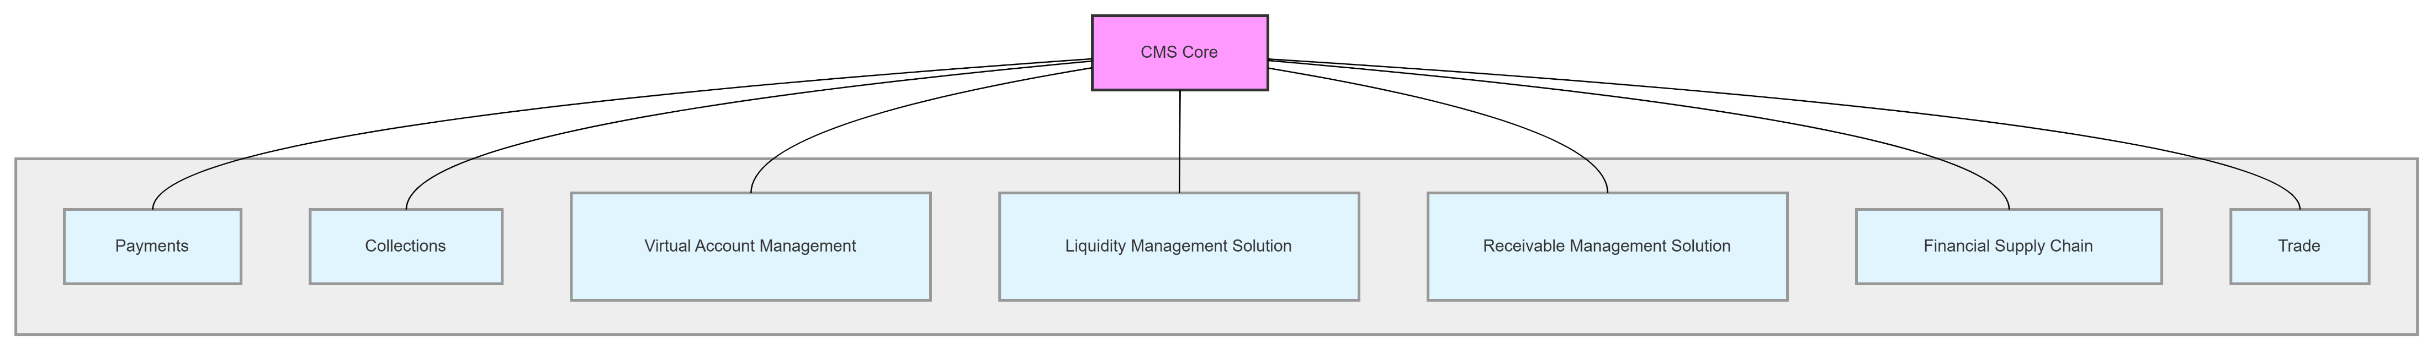
Modules in CMS:
Focus Area: Payments - CFE
For the current scope , the focus will be on Identifying AI features in Payments module for Corporate user.
Some Key features of Payment module offered to corporates include –
  Helps corporate initiate and track payments
  Generate reports
  Manage Fixed Deposits, Loans and other products offered by banks
Current Challenge
Currently, the platform is built on traditional method and does not have an intelligence layer. As a result of there is no assistance to corporate users in providing insights, anomalies and recommendations for any intended actions.

Slide 4
Suggested AI Features:
Feature | Problem it solves | Type of AI | Data needed | What it improves | Metrics it will impact
Cashflow Forecasting | Currently, corporates do not have feature to check what can be the probable cash which will be required for engagements like purchase of goods, deciding on investments etc. Using this feature, system’s intelligence layer can predict and display the net cashflow (Outflow-Inflow) of the corporate’s account for the future defined number of months, which will help the corporates plan cash liquidity in a better way | Prediction AI (ML- Linear/Polynomial Regression) | Data Source – Database Data points – Transaction Details (Inflows/Outflows) | Improved Decision Making | Operating Cash Flow

Slide 5
Feature | Problem it solves | Type of AI | Data needed | What it improves | Metrics it will impact
Payment Initiation using Invoice document upload | Currently, corporate user has to fill the payment initiation form containing various fields like, debit account number, beneficiary account number, amount, confirmed exchange rate, Attach support documents and review it and submit the requests. Instead a bot can be introduced in which corporate user can drop an invoice. When the invoice will be dropped, the intelligence layer can detect the invoice , extract key fields from the invoice like amount, ccy, beneficiary name etc. For the fields which cannot be derived from the invoice like debit account number, beneficiary account number etc can be derived by the intelligence layer using historical transaction data. Once the key fields are derived, the same can be displayed to corporate user for confirmation before final submission. | Image AI + Predictive AI | Sample Invoices Transaction DB table for understanding historical transactions of corporate user (for deriving the values of fields which are not present in the invoice) | This reduces the effort and time of corporate user for initiating a transaction | Transaction Initiation Time, Number of clicks before submitting a transaction.

Slide 6
Feature | Problem it solves | Type of AI | Data needed | What it improves | Metrics it will impact
Product Recommendation | Currently , the corporate user has to decide on things like investing in FD or pre-closure of loan based on the probably amount of funds with high uncertainty derived outside the system. With this new feature, using the intelligence layer: The system predicts incoming cash flows and identifies optimal pre closure dates before the planned loan maturity. It proactively suggests pre closure opportunities on specific dates when sufficient funds are expected ,helping reduce interest burden. The system analyzes predicted cash outflows across various timelines and automatically suggests suitable investment options (short term , medium term, long term) based on available balance and liquidity needs, enabling informed decisions with minimal effort. | Recommendation AI | Data source – DB: Transaction Details table Product details table (Loan/FD) | Better usage of cash available/ lying with corporate | Cash Optimization, Interest Optimization

Slide 7
Feature | Problem it solves | Type of AI | Data needed | What it improves | Metrics it will impact
Widget Analysis | Widgets are graphical representation of key data points. These provide a basic summary various business related aspects happening in the system. For example, Volume of transactions in different status widget can display count of transactions lying in different status like pending , completed, failed . Looking at this widget, corporate can get an estimate of how transactions are being processed in the system. Currently, the widgets in most of the systems are static i.e., corporate cannot get detailed insights, anomalies or recommendations out of these widgets. Widgets are generally generated by referring to limited columns of tables in DB. As a part of this feature enhancement, for a particular widget, corporate should be able derive meaningful insights, anomalies and recommendations from all the associated columns of a widgets instead of only limited columns. For example : In Volume of transactions in different status widget, corporate user only views the count of transactions in different status. He/she wont see the most common reasons for transactions to fail, if there is a suspicious transaction , why and with whom the transactions have been pending for authorization, and corresponding recommendations. | Generative AI + Predictive AI | Data Source – DB 1. Table related to Transaction table | Better Insights to corporate users for informed decision making | TAT for Authorization of Time, Reduction in anomalies etc

