Slide 1

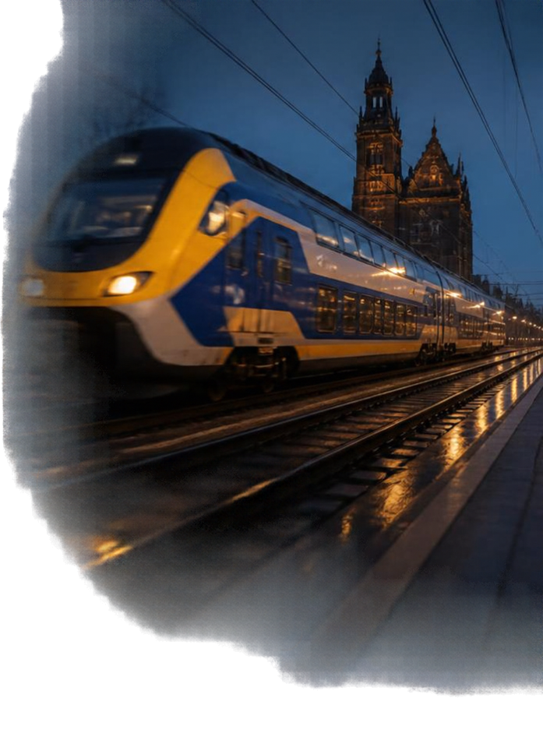






THE CHALLENGE
King’s Day: Can the railway network handle the demand?
27 April 2024 — The Netherlands
?
Large-scale event
Passenger demand
Railway performance

Slide 2


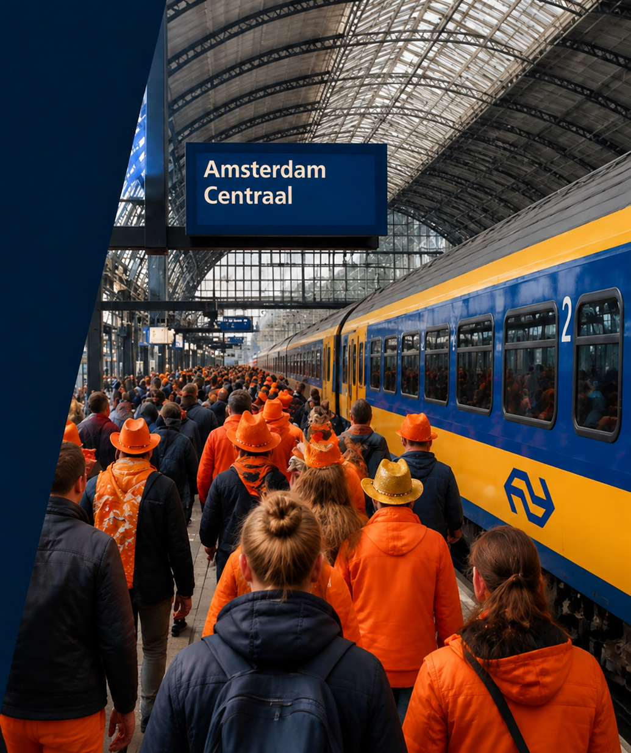




RESEARCH QUESTION
How resilient is the railway network during King’s Day?
How does the Dutch railway network respond to increased passenger demand during King’s Day, in terms of passenger volumes, train services and punctuality?
Passenger volume: How much does demand increase?
Train services: How do frequency and the timetable change?
Punctuality: Do delays increase?
Location: Which stations around Amsterdam are most affected?

Slide 3


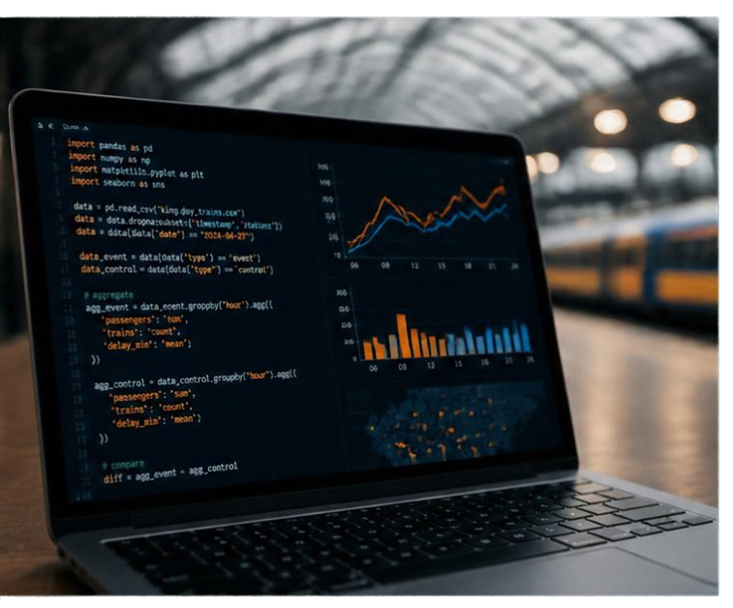











PYTHON ANALYSIS
ANALYSIS WORKFLOW
KEY OUTPUTS
Data
Passenger volume
Clean & filter
Train frequency
Compare event vs. control
Delay / punctuality
Visualise differences
Station differences

