Slide 1
Project 1
Caleb VanDong

Slide 2
Purpose
Parse different data types including json, yaml, & xml
Run unit tests to check if the methods are working correctly

Slide 3
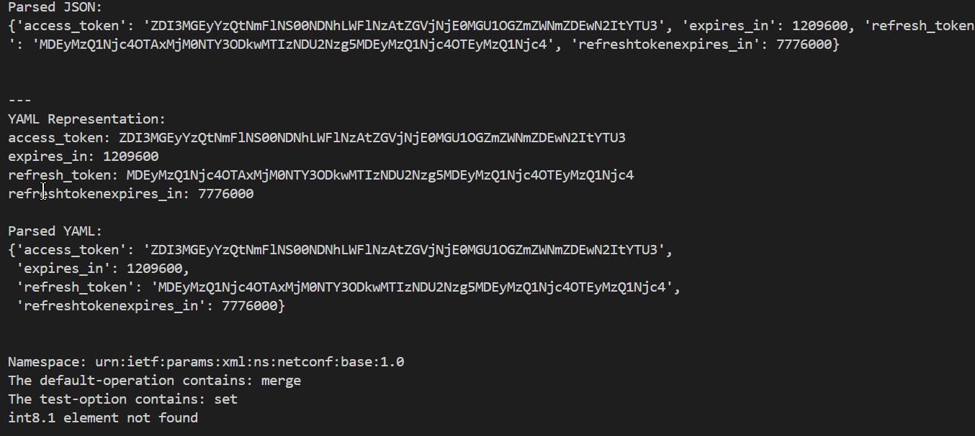
Functionality

