Slide 1

De history van javascript
1996 tot 2021
gemaakt door: Maarten, constantijn, Antony, Latif
hoe haal ik een slechte achtergrond weg?

Slide 2
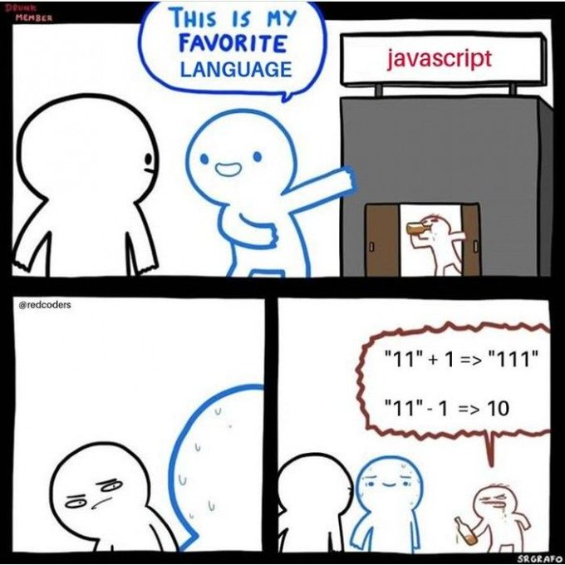
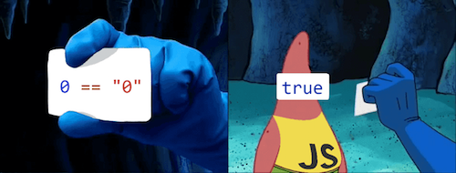
Waar gaan we het over hebben
Over de geschiedenis van js
1996-2003
2003-2012
2012-2021
toekomst in js

Slide 3
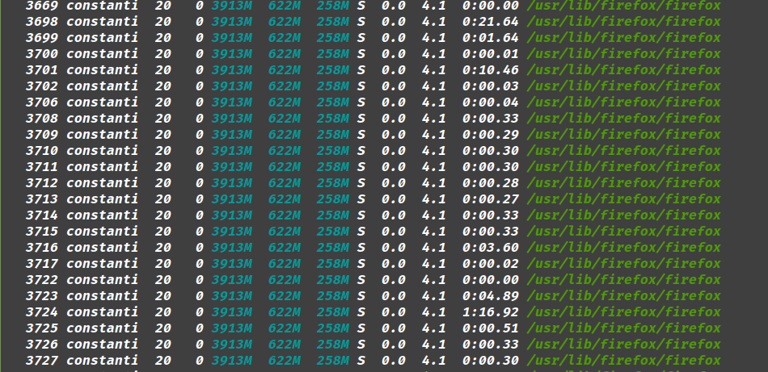
hoe werkt javascript
sandboxed
single threaded
JIT compiler
interpreted
Notes:
sandbox
zie foto voor iedere site wordt een aparte procces aan gemaakt
single treaded
kan maar op 1 core maak per script een worker
JIT
normaal alles is 1 keer compiled
bij JIT wordt het Just In Time gecompiled
interpreted dit is javascript het wordt niet gecompiled
V8 is Google’s implementation of the engine for its Chrome browser.
SpiderMonkey was the first engine built for Netscape Navigator and now powers FireFox.
JavaScriptCore is what Apple uses for the Safari browser

Slide 4
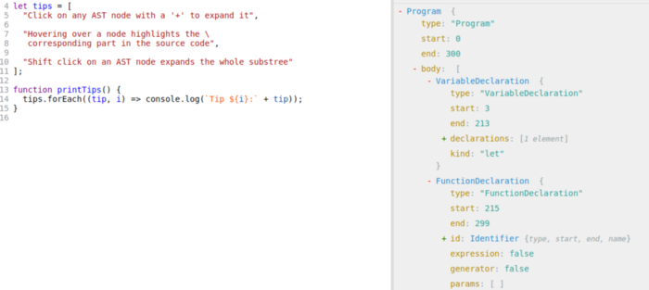
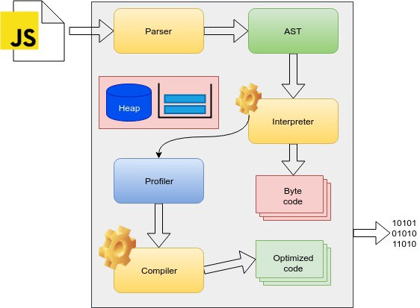
Notes:
parser
leest mensen code en hakt dit op in :
keyword(if)
bracket(})
identifier(const dit)
operator(>)
number(3.1)
dit is de AST(Abstract Syntax Tree).
interpreter
bij v8 is dit igniton
profiler
dit optimaliseerd de code en vervangt de on op gematiseerde code on the fly
compiler
dit is bij v8 turbofan
op basis van de data van de AST kan er niet geoptimaliseerde code gecompiled worden
optimized code
bytecode4

Slide 5

1996-2003
constantijn
Notes:
1995 wordt javascript uitgevonden Brendan Eich
het is een:
glue language
in 10 dagen geschreven
door een programeur bij netscape
1997 ecmascript 1 uitgebracht
1998 ecmascript 2 uitgebracht
kleine updates om iso standaard te volgen
1999 ecmascript 3 uitgebracht
vol met:
Added regular expressions(regex)
Added try/catch
Added switch
Added do-while
V8 is Google’s implementation of the engine for its Chrome browser.
SpiderMonkey was the first engine built for Netscape Navigator and now powers FireFox.
JavaScriptCore is what Apple uses for the Safari browser

Slide 6
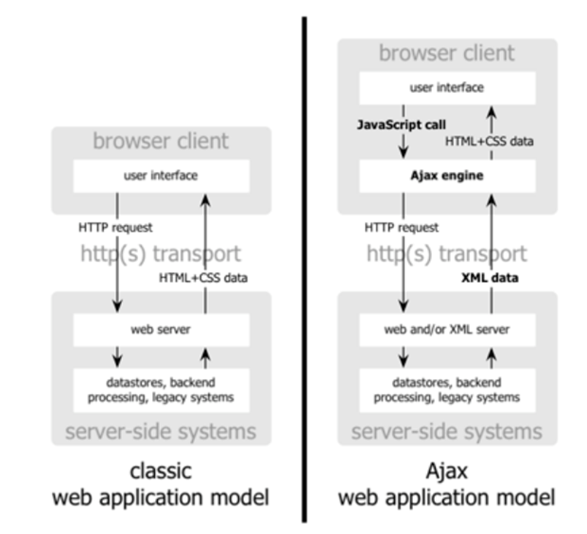
2003 - 2012
libraries
Prototype (2005)
Dojo Toolkit (2005)
jQuery (2006)
YUI Library (2006)
Ext JS (2007)
MooTools (2007)
node js (2009)
frameworks
Backbone (2010)
Knockout (2010)
AngularJS (2010)
Ember (2011)
Notes:
v8 is gemaakt door google omdat ze zagen dat het internet veel bloat ging hebben dus een snelle engine nodig was, in 2008 werdt v1.0 openbaar gemaakt -conto

Slide 7

2012 - 2021
ES6 Release
Promises
Let/Const Syntax
Babel/TypeScript
React & Meer.

Slide 8



















Het heden & de toekomst
Frameworks
ReactJS
VueJS

Slide 9



slot
doei
Notes:
INDUSTRIAL SOCIETY AND ITS FUTURE
Introduction
The Industrial Revolution and its consequences have been a disaster for the human race. They have greatly increased the life-expectancy of those of us who live in “advanced” countries, but they have destabilized society, have made life unfulfilling, have subjected human beings to indignities, have led to widespread psychological suffering (in the Third World to physical suffering as well) and have inflicted severe damage on the natural world. The continued development of technology will worsen the situation. It will certainly subject human beings to greater indignities and inflict greater damage on the natural world, it will probably lead to greater social disruption and psychological suffering, and it may lead to increased physical suffering even in “advanced” countries.
The industrial-technological system may survive or it may break down. If it survives, it MAY eventually achieve a low level of physical and psychological suffering, but only after passing through a long and very painful period of adjustment and only at the cost of permanently reducing human beings and many other living organisms to engineered products and mere cogs in the social machine. Furthermore, if the system survives, the consequences will be inevitable: There is no way of reforming or modifying the system so as to prevent it from depriving people of dignity and autonomy.
If the system breaks down the consequences will still be very painful. But the bigger the system grows the more disastrous the results of its breakdown will be, so if it is to break down it had best break down sooner rather than later.
We therefore advocate a revolution against the industrial system. This revolution may or may not make use of violence; it may be sudden or it may be a relatively gradual process spanning a few decades. We can’t predict any of that. But we do outline in a very general way the measures that those who hate the industrial system should take in order to prepare the way for a revolution against that form of society. This is not to be a POLITICAL revolution. Its object will be to overthrow not governments but the economic and technological basis of the present society.
In this article we give attention to only some of the negative developments that have grown out of the industrial-technological system. Other such developments we mention only briefly or ignore altogether. This does not mean that we regard these other developments as unimportant. For practical reasons we have to confine our discussion to areas that have received insufficient public attention or in which we have something new to say. For example, since there are well-developed environmental and wilderness movements, we have written very little about environmental degradation or the destruction of wild nature, even though we consider these to be highly important.

