Slide 1
CSS3 Cascading Style Sheets
Adding Style to your Pages

Slide 2
Browser Default Styling
The same html file may look different when viewed on different browsers.
Some tags are supported, some aren’t
Browsers may have different default styles
In general, default looks are plain.

Slide 3

Adding Style
As styling tags were phased out of html, styling was done with style attribute
Violated separation of content/style

Slide 4
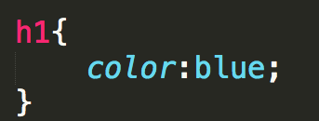
Cascading Style Sheet
CSS defined generic rules that can apply to multiple elements
selector {
property: value;
}

Slide 5
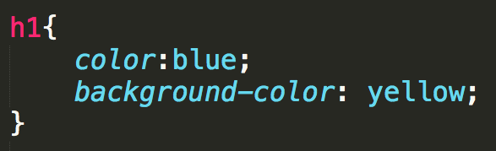

Multiple Properties

Slide 6
External Style Sheet
You can put rules in an external file (don’t use the style tag!!)
A link to the style sheet is put in the head section.
Styles are applied to all elements in all files that links to the style sheet

Slide 7
The “Cascading” part of CSS
Browser default
External style sheets
Internal style (in the head section)
Inline style (inside an HTML element)

Slide 8
Designing for Accessibility
POUR

Slide 9
Overview
The content of your page should be in the HTML.
It is tempting to add content via colors, images, etc.
Follow the POUR guidelines
Perceivable, Operable, Understandable, Robust

Slide 10
Perceivable
Provide text alternatives for images
Provide captions and transcripts for video and audio
Use correct semantic markup so content can be presented in different ways
Make it easier for users to see content by using good color contrast

Slide 11
Operable
All functionality available from the keyboard!
Users have control over timing and limits
Do not cause seizures (don’t flash content)
Provide ways to help users navigate, find content, and determine where they are

Slide 12






Slide 13
Understandable
Economical and plain use of language
Text supplemented with illustrations, videos, and other formats where appropriate (i.e., use good Universal Design)
Navigation, information structure are discernable and consistent
Make pages operate in predictable ways
Help users avoid and correct mistakes
Notes:
Chunking appropriately, avoiding jargon or institutional language, avoid URL descriptors
Different learning modalities, visual versus verbal
Don’t change nav and layout structure
Careful with AJAX-y elements, pop-ups
Considerate form validation and error correction

Slide 14
Robust
Is your site functional across various technologies (smart phone, screen reader, laptop, pensticks, etc..)?
Syntax errors that don’t affect visual presentation may hamper assistive technology and accessibility tools
Adhering to W3C standards ensures future compatibility
Validate your code at validator.w3c.org and wave.webaim.org

Slide 15
Meaningful link text
Screen readers can find and list links
Descriptions for the links must be meaningful out of context, via tabbing or presented in a list
Don’t use “here”, “click here”, “read this”, and “more”
Don’t use URL as a link description—will sound like gibberish, unless very short and intuitive

Slide 16
Review
Accessibility starts with proper HTML tags
Styling can actually make it HARDER for some people to access the information
Get into the early habit of utilizing accessibility tools
“Cool” new style should not be at the cost of accessibility

Slide 17
Assess
How easy is it to navigate your page?
What would happen if the colors weren’t there?
What would happen if you couldn’t use a mouse?
Plan for everyone

Slide 18
The Good News
You can use style sheets from others to style your code, just by adding class!!
You can override style sheets from others just by rewriting the class, or making your own version of it and linking it last.

Slide 19
Colors
Using the best colors for your site

Slide 20
Color Conventions
Color names (blue, red, yellow, etc.) work, but should be avoided
Hexadecimal is common convention
#0000FF, #FF0000, #FFFF00
rgb
(0, 0, 1), (1, 0, 0), (1, 1, 0)
rgba
(0, 0, 1, .5)
#0000FF
#FF0000
#FFFF00
rgb(0,0,1)
rgba(0, 0, 1, .5)

Slide 21
Accessibility
Appropriate use of color is critical to web accessibility
Many more people are visually impaired or color blind than are legally blind

Slide 22
What is color contrast?
You intuitively know when something has poor contrast
There are tools that quantify the contrast between text and its background
http://wave.webaim.org/
http://webaim.org/resources/contrastchecker/

Slide 23
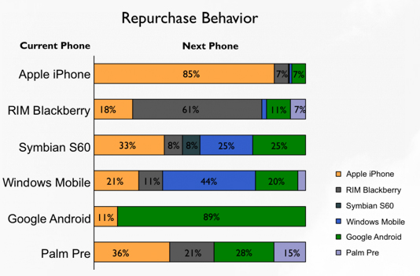
Don’t use color alone to convey meaning

Slide 24
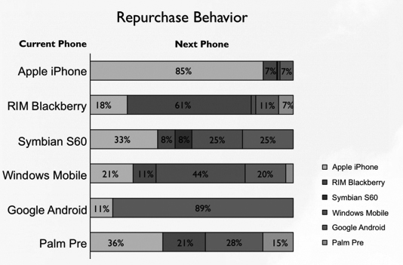
Test in gray scale …

Slide 25
The Big Picture
http://www.csszengarden.com/214/

Slide 26
Review
Use web safe colors and use an accepted convention
Test your site using a contrast checker
Avoid using color to convey meaning

