Slide 1
The Request/Response Cycle
Or, what happens when you type something into the address bar

Slide 2
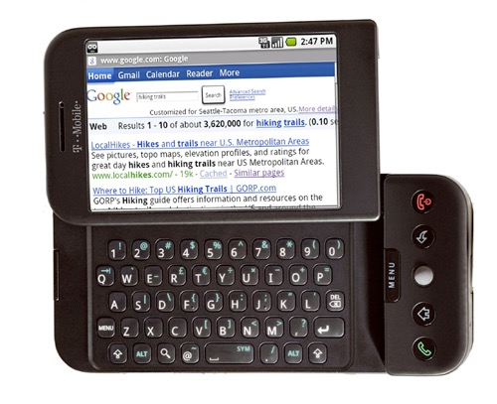

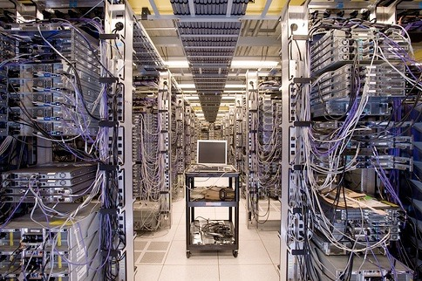
Internet
HTTP
Request
Python
HTML
JavaScript
Response
GET
Data Store
AJAX
Templates
memcache
CSS
POST
Cookies
MVC

Slide 3
How Does This All Work?
When you type an address into the URL bar, what happens?

Slide 4
Client/Server Relationship
Servers
Machines that hold shared resources
Always connected to the network
Clients
Machines for personal use (laptops, phones, etc.)

Slide 5
Request/Response Cycle
This is what happens when your computer (the client) requests a page and a server responds with the appropriate files.

Slide 6
Uniform Resource Locator
URL – three parts:
protocol – how to connect
domain – where to find the document you want
document – what specific file is needed*
Most pages are made up of multiple files

Slide 7
Protocols
HTTP – Hypertext Transfer Protocol
HTTPS – Secure Hypertext Transfer Protocol
FTP – File Transfer Protocol

Slide 8
Domain Names
Identifies the entity you want to connect to
umich.edu, google.com, wikipedia.org
Each has different top-level domain
Determined by Internet Corporation for Assigned Names and Numbers (ICAAN)
https://www.icann.org/resources/pages/tlds-2012-02-25-en

Slide 9
Document
URLs can specify a specific document
http://www.intro-webdesign/contact.html
http://www.intro-webdesign/Ashtabula/harbor.html
Wikipedia
Do a pictures
If no document is specified, the default document is returned.
Convention is index.html

Slide 10
The Request
Once the IP address is determined, the browser creates an HTTP request.
Lots of hidden information in this request
header, cookies, form data, etc

Slide 11
The Response
The server returns files/output, not “web pages”
It is up to the browser to decide what to do with that info
If the server can’t fulfill the request it will send back error codes: 404, 500, etc.

Slide 12
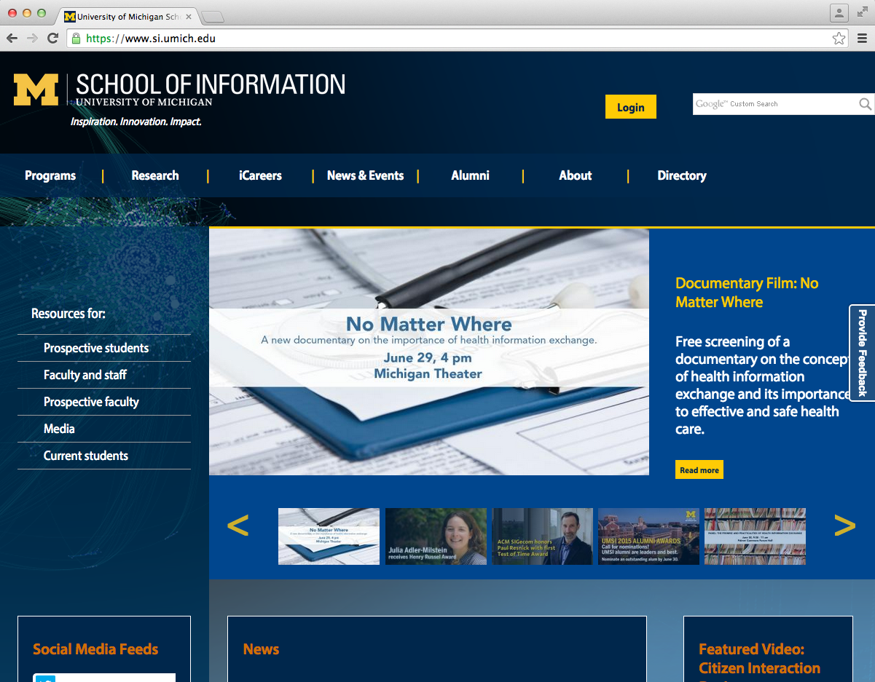
What happens when you type “http://si.umich.edu/” into the address bar.
1. The browser look up the domain in the DNS
The Request/Response Cycle is initiated
2. The DNS returns the IP address:54.88.175.189
3. The browser sends an HTTP request to the server located at that address.
4. The server finds the requested and sends it back as a response.
5. The browser takes the response and renders the HTML code as a nice graphical presentation, often repeating steps 3 – 5 as needed to request images and other supporting files.

Slide 13
Review
A URL typically requires multiple rounds of the Request/Response cycle.
The browser must request the main file but any supporting files and images are also returned

